Slide 1
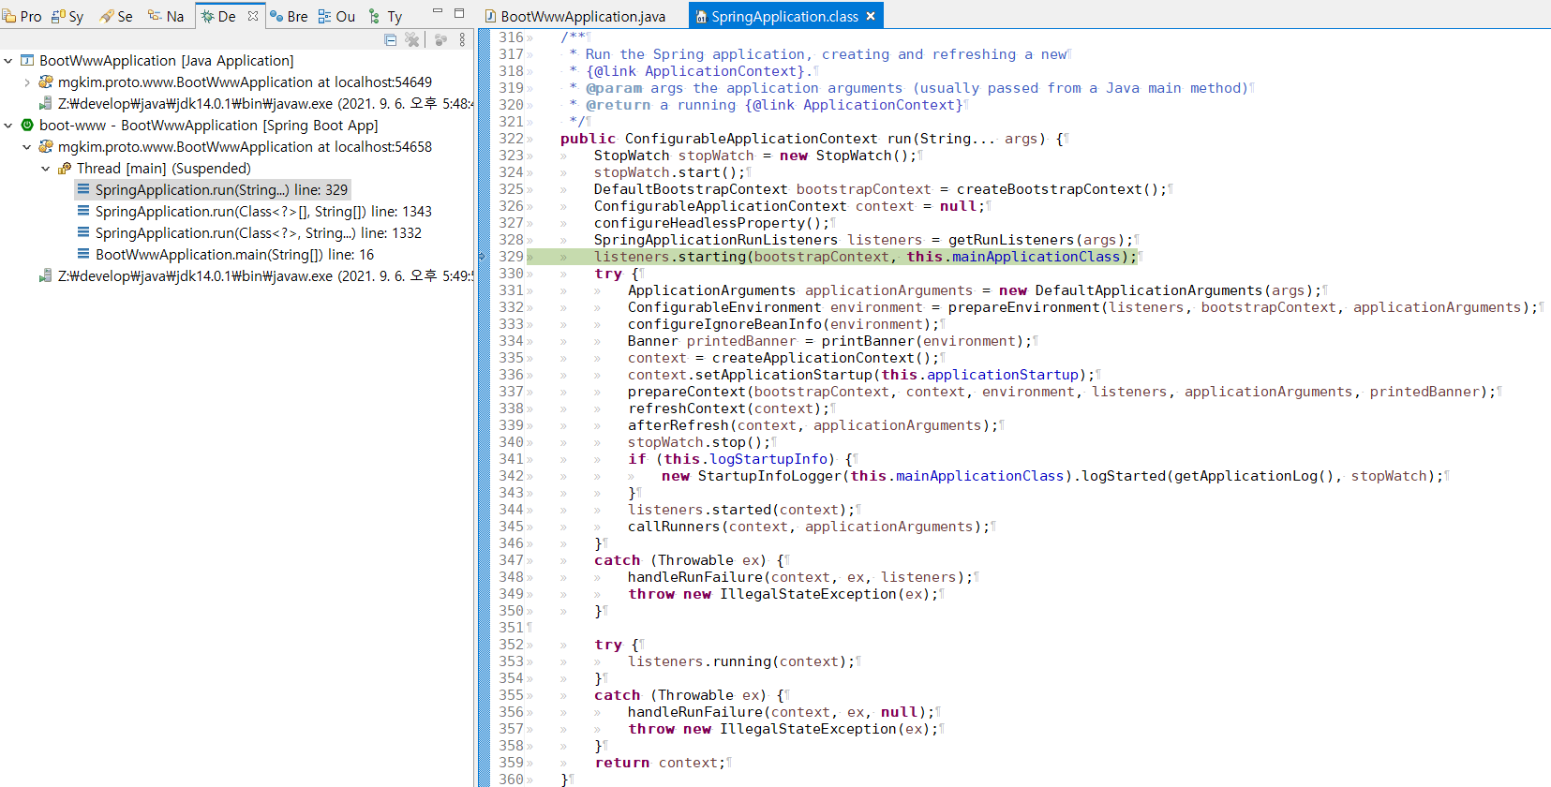
`org.springframework.boot.SpringApplication` 에서 부트스트랩을 하기 위해 아래의 과정을 거칩니다.
•Create an appropriate ApplicationContext instance (depending on yourclasspath)
•Register a CommandLinePropertySource to expose command line arguments asSpring properties
•Refresh the application context, loading all singleton beans
•Trigger any CommandLineRunner beans

Slide 2
