Slide 1

Hamilton go
By the bit busters

Slide 2
Roles
Zolile Sibanda
Provided the base code for the GUI and back-end code
Kick started the implementation process
Acquired background and Pokémon player images
Nkululeko Ntakana
Assisted in improving the back and front-end code
Tested and debugged the fighting mechanics and code
Implemented the appropriate code for music and sound effects
Pranay Patel
Lead the process of improving the base front and back-end code
Also implemented appropriate music and sound effects
Improved the fight mechanics (attacked inflicted and energy gained)
Adjusted special attacks to be unique to character

Slide 3
Roles
Liso Mafu (Our Team Leader)
Improved both documentation (created and updated our UML diagram)
Ntsika Mduba
Created the rough drafts for both documentation
Designed the character class, responsible for making new characters and other useful methods

Slide 4
Hamilton go (the game)

Slide 5
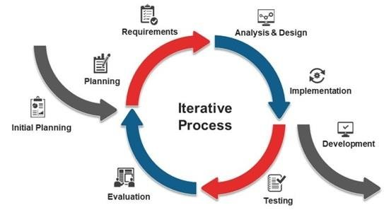
ITERATIVE SDLC
Due to the complexity of a game similar to Pokémon, we choose and iterative as version control was imperative. Getting a working version then being able to continuously update and evaluate made the most sense for this project.

Slide 6

Description
A Player vs Player turn-based game. Battle until all characters in the other team are dead (health of zero or less). Select from few attacks (punches, kicks and special attacks when you have enough energy) to inflict damage onto opponent.

Slide 7
Design
A fully Java code predominantly using the Visual Studio IDE
One main class that does heavy loading (PokemonGame), with a mini Character class, where characters (pokémons) are made
Used javax.swing, java.awt and java.sound libraries
To direct yourself and fight, you will need a mouse / mousepad / touchpad

Slide 8
Implementation

Slide 9
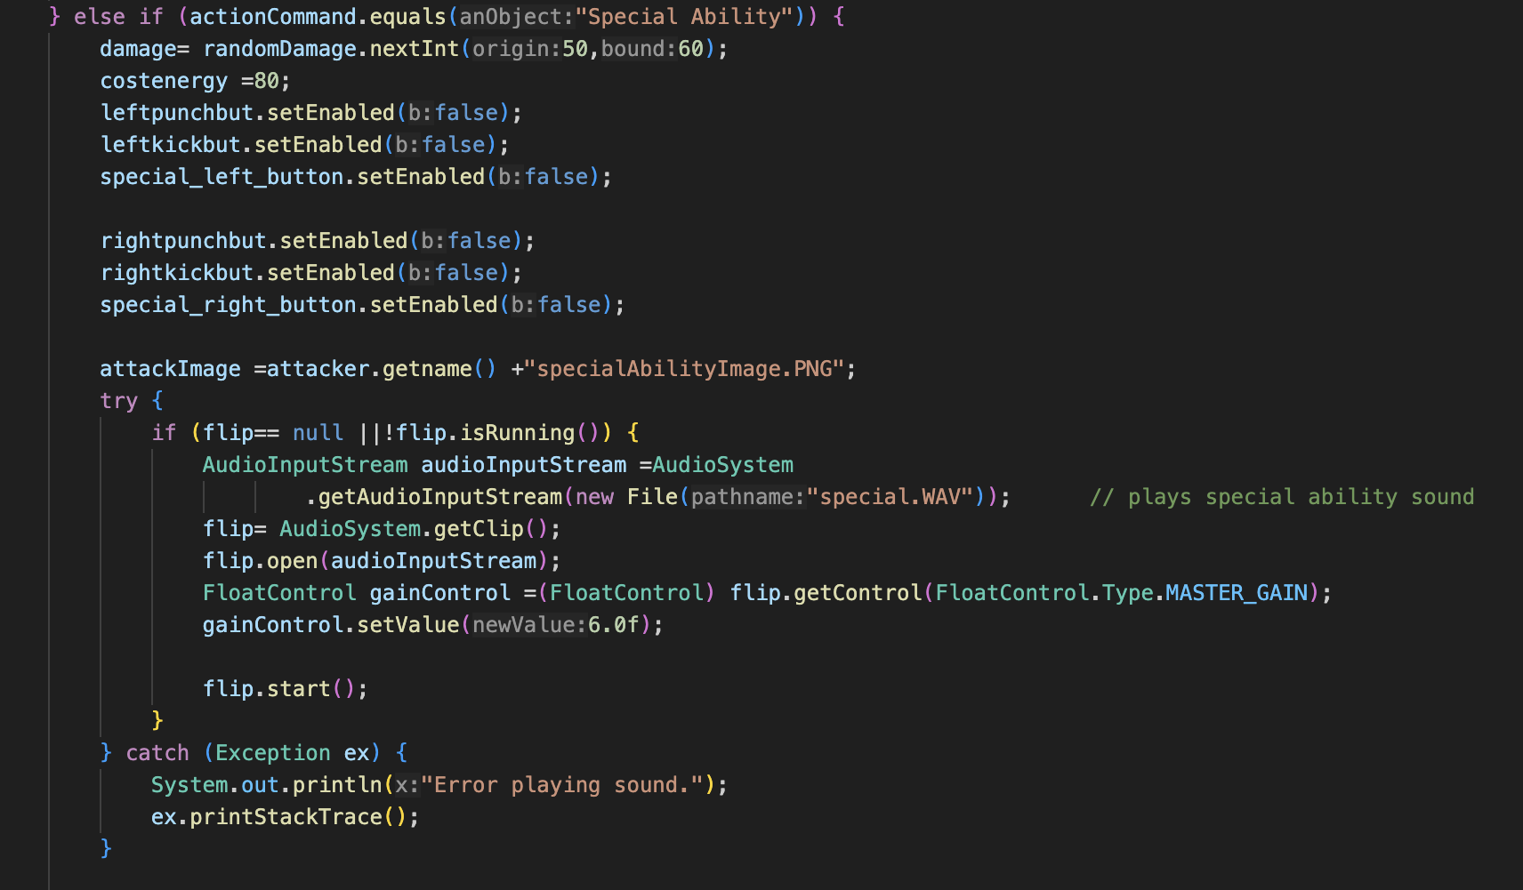
Special attack mechanics
Get a random amount of damage between 50 & 60 (the highest amount of damage)
Decrease the attacker’s energy so that you don’t repeat the Special Attack multiple times
attackImage shows how the uniqueness of each special attack was implemented
When Special Attack chosen synchronise with sound effect of special attack

Slide 10
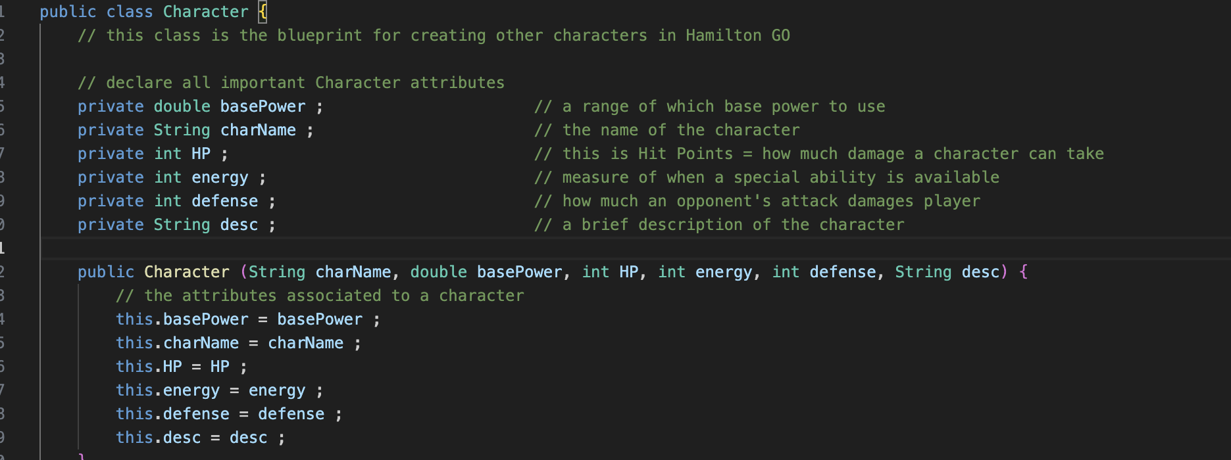
Character class
Declare the character traits with short description on the character
The constructor method after declaring character traits

Slide 11
New feature
Somewhat like a Pokèmon package as we specialised the original game into the Computer Science faculty. With the heavily investigated pictures of our lecturers.
Wanted to have tournament and ladder modes, where CPU player would need to be used. To give players ability to create and save their own characters for later.

Slide 12
Challenges lessons
Soft-skills:
Project Management (meeting deadlines)
Teamwork and Collaboration
Project Requirement Research
Technical skills:
Implementing sound library with sound effects
Cement course knowledge of objects and classes by using them here
Create multiple classes to handle different events of the code from main menu display to arena fight mechanics
Programming will humble you. To achieve your initial ambition, you will need consistent and intentional effort to learn and implemented the learned content
Making a successful project Is fulfilling. Enjoying your hard-work by finally playing the game without any bugs (or at a satisfactory state) makes the obstacles worth it
To manage time better and have effective communication in the group

Slide 13
references
Chen, R., Levy, R. and Eisape, T., 2021. On factors influencing typing time: Insights from a viral online typing game. In Proceedings of the Annual Meeting of the Cognitive Science Society (Vol. 43, No. 43).

