Slide 1

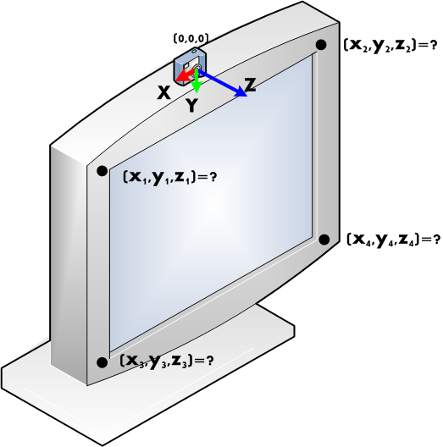
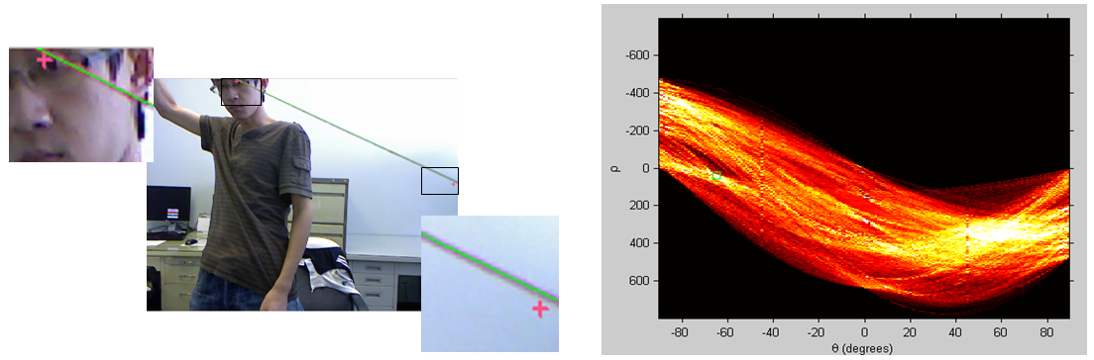
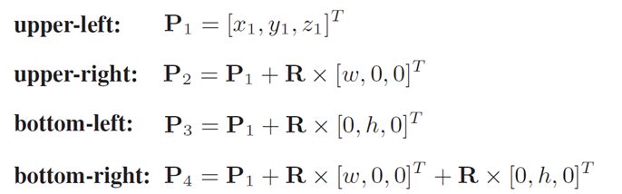
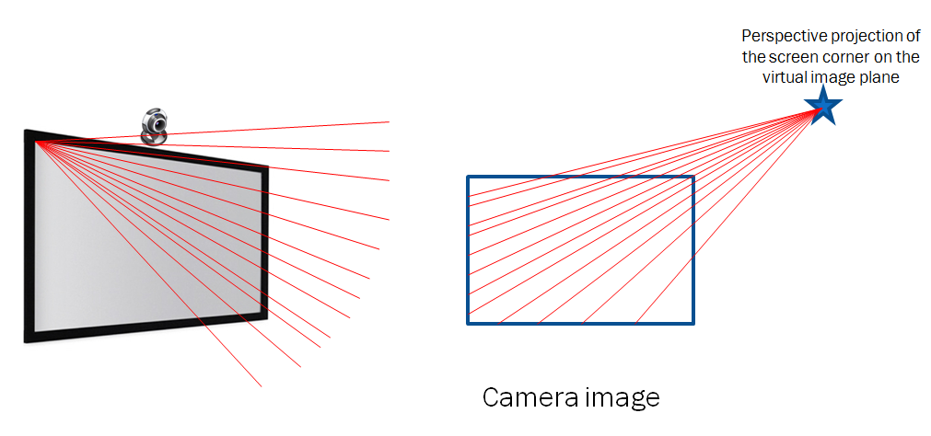
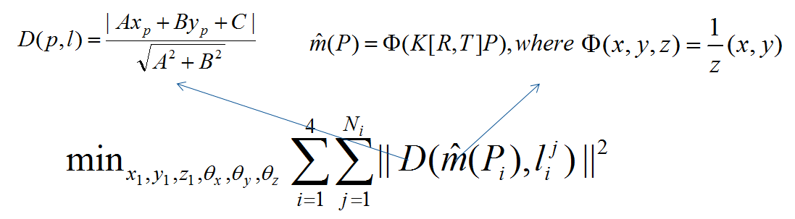
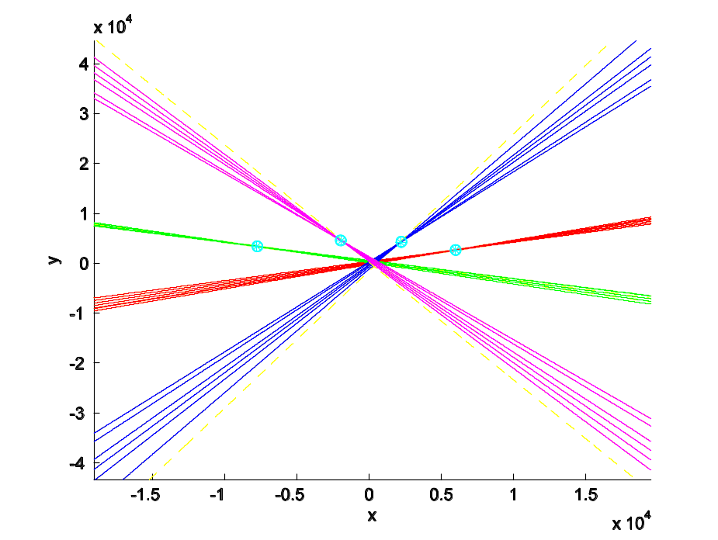
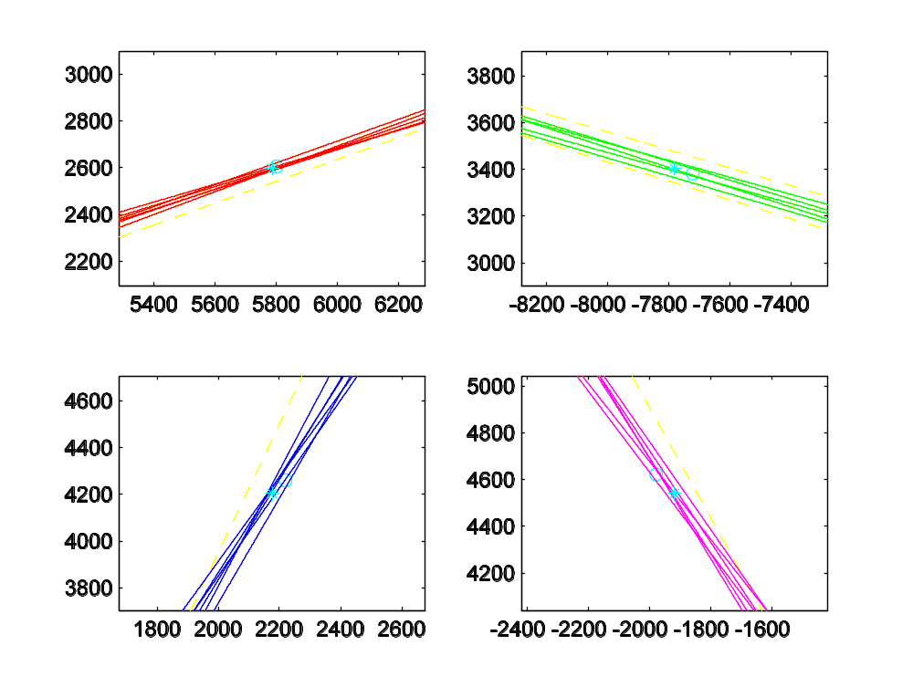
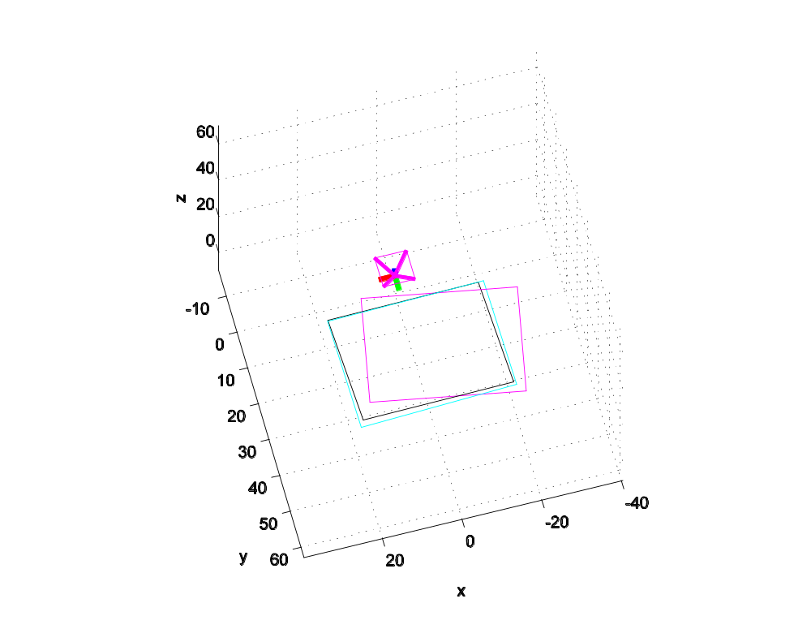
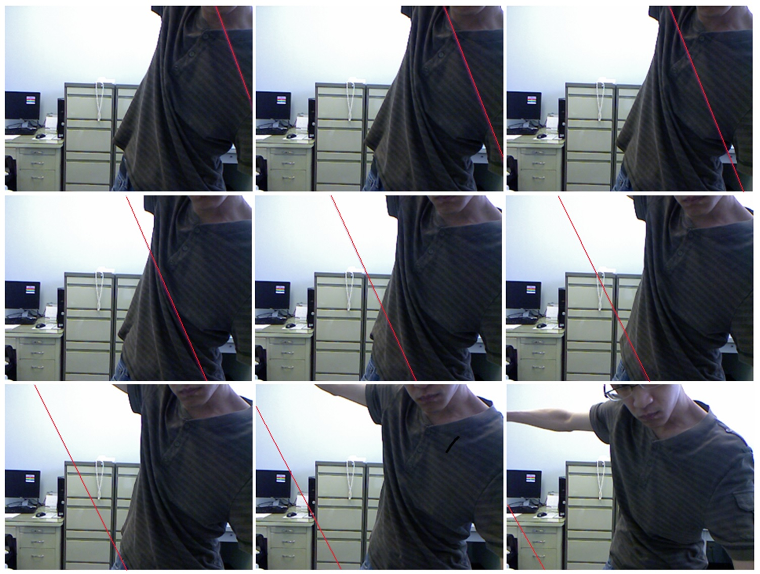
香港中文大學
The Chinese University of Hong Kong
SCREEN-CAMERA CALIBRATION USING A THREAD
Songnan Li, King Ngi Ngan, Lu Sheng
Department of Electronic Engineering, The Chinese University of Hong Kong, N.T., Hong Kong SAR
{snli, knngan, lsheng}@ee.cuhk.edu.hk
1. Abstract – In this paper, we propose a novel screen-camera calibration algorithm which aims to locate the position of the screen in the camera coordinate system. The difficulty comes from the fact that the screen is not directly visible to the camera. Rather than using an external camera or a portable mirror like in previous studies, we propose to use a more accessible and cheaper calibrating object, i.e., a thread. The thread is manipulated so that our algorithm can infer the perspective projections of the four screen corners on the image plane. The 3-dimentional (3D) position of each screen corner is then determined by minimizing the sum of squared projection errors.
2. Purpose To locate the 3D position of the screen in the camera coordinate system 3. Application Holographic-like displaying Using the screen as a controllable planar light source for shape recovery and reflectance measure Enabling the user's interaction with a specific region of the screen 4. Motivation The main difficulty of our problem is that the screen is not visible to the camera. Rather than using an external camera or a mirror, the proposed method uses a more common and cheaper calibrating object, a thread, to infer the screen position.
5. Line detection Manually mark a rough line position Edge detection in CIELAB color space Use Hough transform and search the optimal line position Use RANSAC algorithm to reject outliers 6. Optimization The positions of the four screen corners in the camera coordinate system, i.e., P₁,P₂,P₃,P₄, can be defined as: where P₁ is the 3D position of the upper-left corner; R is a 3×3 rotation matrix which has three degrees of freedom, i.e.,θ_{x},θ_{y},θ_{z}. Therefore, the positions of the four screen corners can be determined by 6 parameters, i.e., x₁, y₁, z₁, θ_{x}, θ_{y}, θ_{z}, which can be obtained by minimization: The initial parameters can be calculated using [1] [1] Z. Zhang, “A flexible new technique for camera calibration", TPAMI, 2000. 7. Experiment Left: The red, green, blue, and magenta colored lines are associated with the upper-left, upper-right, bottom-left, and bottom-right corners, respectively. Middle: Zoom-in images around the intersection point for each screen corner. Right: calibration result of the initial parameters from [1] (purple), result from [2] (blue), and ours (black). [2] C. Zhang, et al., “Viewport: A Fully Distributed Immersive Teleconferencing System with Infrared Dot Pattern”, TMM, 2013.

