Slide 1
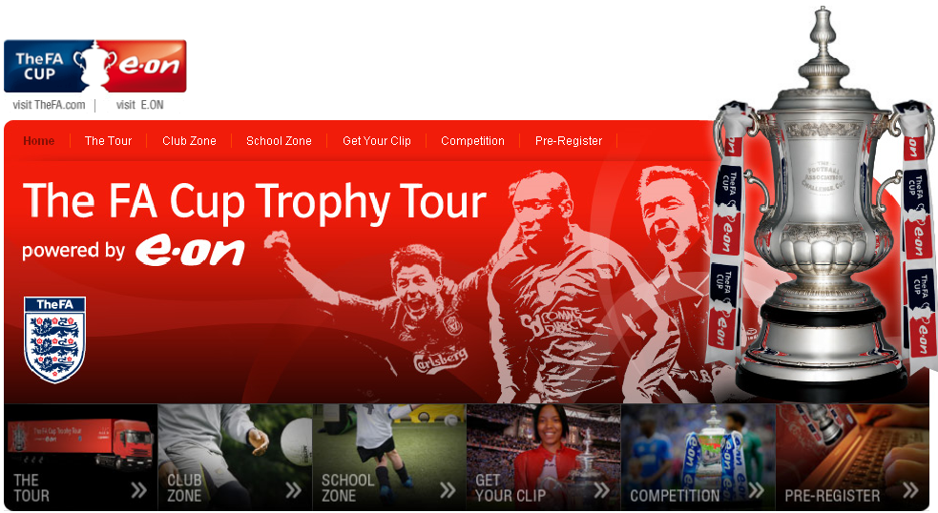
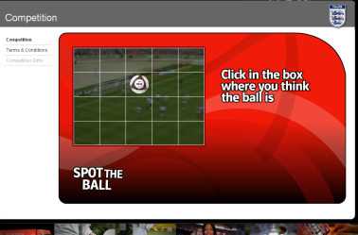
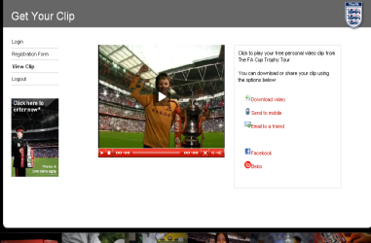
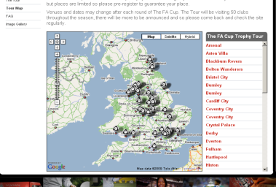
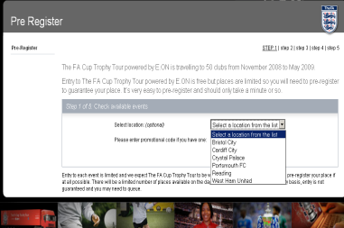
THE FA
The FA Cup Trophy Tour Online Platform
www.facuptrophytour.co.uk
------------------------------------------------------
THE BRIEF
To provide an online platform to support The FA Cup Trophy Tour activations (x50) and to facilitate consumer data capture through interactive assets, including a simple navigation for a target audience aged 7 to 11yrs.
------------------------------------------------------
THE EXPERIENCE
Six ‘zones’ including an i-Frame for visitors to download their unique FA Cup video clip; a pre-registration system for each of the 50 events; a dynamic video ‘spot the ball’ competition with data capture form.
------------------------------------------------------
THE RESULT (after 4 months)
60,000 unique visits; 11,000 clips viewed over 55,000 times; over 8,000 competition entries.
Tour Map and Photo Gallery
Pre-registration for each event
Dynamic ‘Spot the Ball’ Competition
View/download your personalised clip

