Slide 1
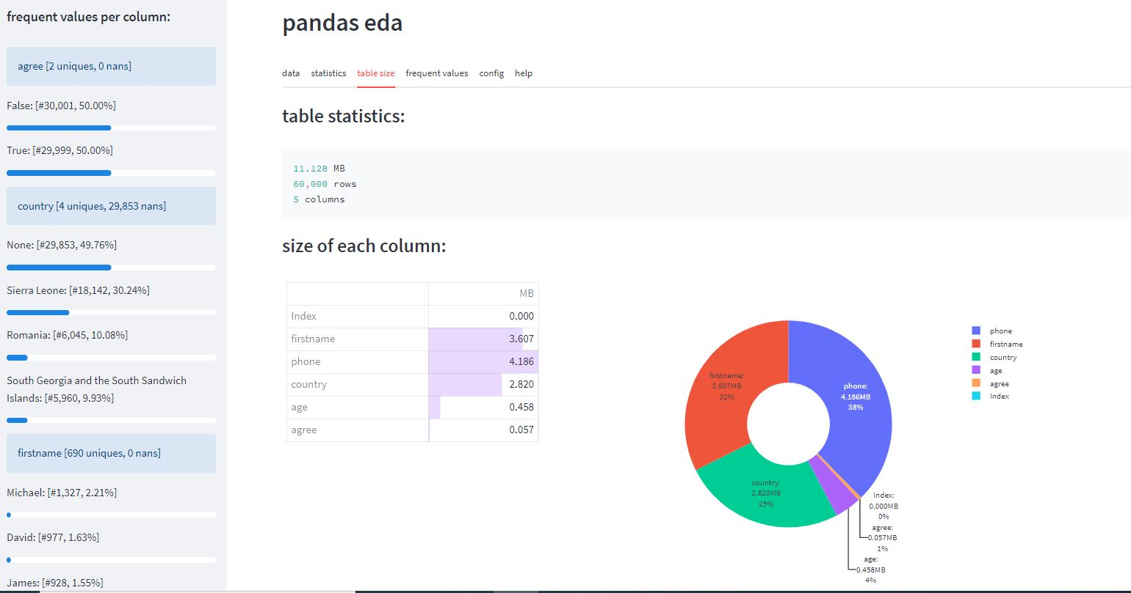
EDA tool
for exploring
pandas table

