Slide 1
plotly without pandas

Slide 2
motivation
demo… sine, eye, folded pulse, DC
interactive:
zoom in
choose legends to show
working offline
controls

Slide 3
disadvantages and alternative
build for pandas. if you want stand alone it’s complicated, but you can use cufflinks to generate initial plotly dictionary
alternatives:
bokeh
dash (next plotly generation)
interactive matplotlib
pygal
ggplot
seaborn – for extra plot types

Slide 4
install plotly and cufflinks
please install before meeting and run the next slide code!!!

Slide 5
basic example
import plotly as py
import numpy as np
import cufflinks
x = np.linspace(0, 1, 10000)
sines=30
amp=np.random.normal(0.2,0.01,sines)
offset=np.random.normal(0,0.05,sines)
phase=np.random.normal(0,3,sines)
freq=np.random.normal(200,100,sines)
y=[amp[i]*np.sin(2*np.pi*x*freq[i]+phase[i])+offset[i] for i in range(sines)]
data = [dict(x=x, y=y[i], name='sine %d'%i, type='scatter',mode='lines') for i in range(sines)]
layout=cufflinks.getLayout(title='hello world',xTitle="my x",yTitle='my y')
py.offline.plot(dict(data=data,layout=layout))

Slide 6
let’s play
https://plot.ly/python/reference/
if you choose type='bar' you don’t have mode=
so at this link you can look at bar and see all the options that it has underneath it
you can see attributes per type by:
help(py.graph_objs.Bar)
type='scatter',mode='lines'
type='scatter',mode='markers+lines'
type='scatter',mode='markers'
type='bar' # you can add to cufflinks.getLayout-> barmode='stack'

Slide 7
plot types

Slide 8
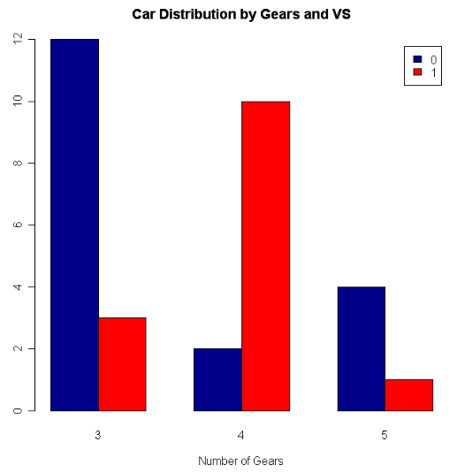
exercise

Slide 9
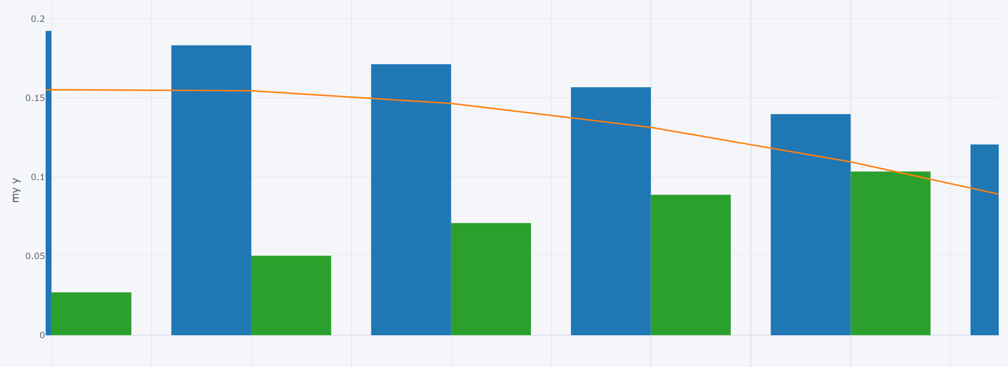
exercise

Slide 10
dots types

Slide 11
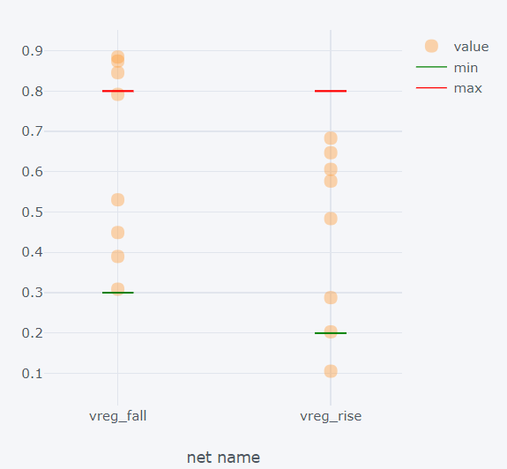
exercise

Slide 12
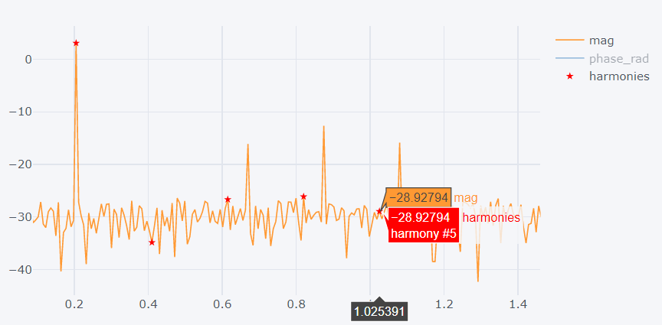
exercise

Slide 13
max min example
import plotly as py import numpy as np import cufflinks x=['first','sedonc','end'] y1=[4,3,5] y2=[4.5,3.5,4] bar_max=[6,7,6] bar_min=[1,1,2] # data = [dict(x=x, y=y[i], name='sine %d'%i, type='scatter',mode='lines') for i in range(sines)] data=[dict(x=x,y=y1,name='data1',type='scatter',mode='markers')] data+=[dict(x=x,y=y2,name='data1',type='scatter',mode='markers')] data+=[dict(x=x,y=bar_max,name='max',type='scatter',mode='markers',marker=dict(symbol='line-ew-open',color='red',size=20))] data+=[dict(x=x,y=bar_min,name='min',type='scatter',mode='markers',marker=dict(symbol='line-ew-open',color='green',size=20))] # data = [dict(x=x, y=y[i], name='sine %d'%i, type='bar') for i in range(sines)] layout=cufflinks.getLayout(title='hello world',xTitle="my x",yTitle='my y') py.offline.plot(dict(data=data,layout=layout),config={'editable':True})

Slide 14
layout colors
print(cufflinks.getLayout())
{'legend': {'bgcolor': '#F5F6F9', 'font': {'color': '#4D5663'}},
'paper_bgcolor': '#F5F6F9',
'plot_bgcolor': '#F5F6F9',
'titlefont': {'color': '#4D5663'},
'xaxis1': {'gridcolor': '#E1E5ED',
'showgrid': True,
'tickfont': {'color': '#4D5663'},
'title': '',
'titlefont': {'color': '#4D5663'},
'zerolinecolor': '#E1E5ED'},
'yaxis1': {'gridcolor': '#E1E5ED',
'showgrid': True,
'tickfont': {'color': '#4D5663'},
'title': '',

Slide 15
lines spaces and annotations
layout['shapes']=[cufflinks.tools.get_shape(kind='rect',y0=70,y1=80,fill=1,opacity=0.4)]
help(cufflinks.tools.get_shape)

Slide 16
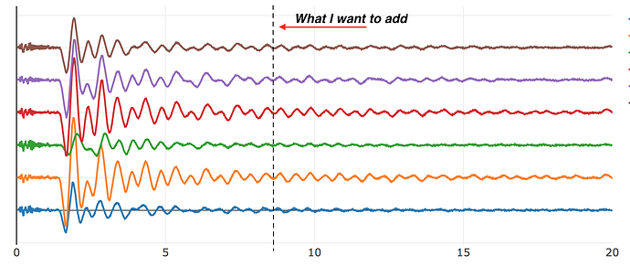
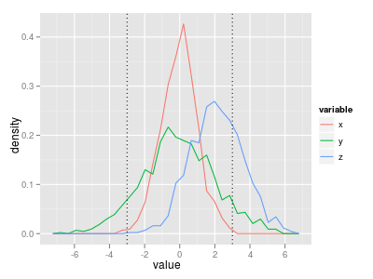
exercise

Slide 17
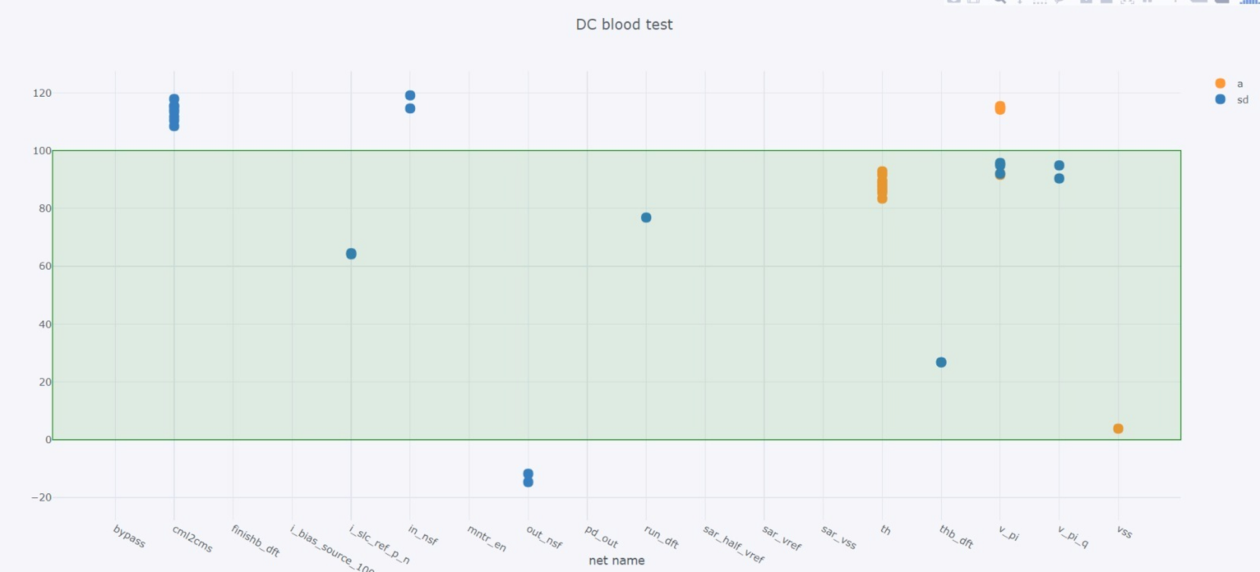
exercise

Slide 18
controls

