Slide 1
Evaluation
Evaluation of the Extended Pylint Tool
-Improvements in usability, data visualization, and user interaction.
Challenges encountered during development.
Solutions implemented and system evaluation.
Innovations compared to the original Pylint tool.

Slide 2
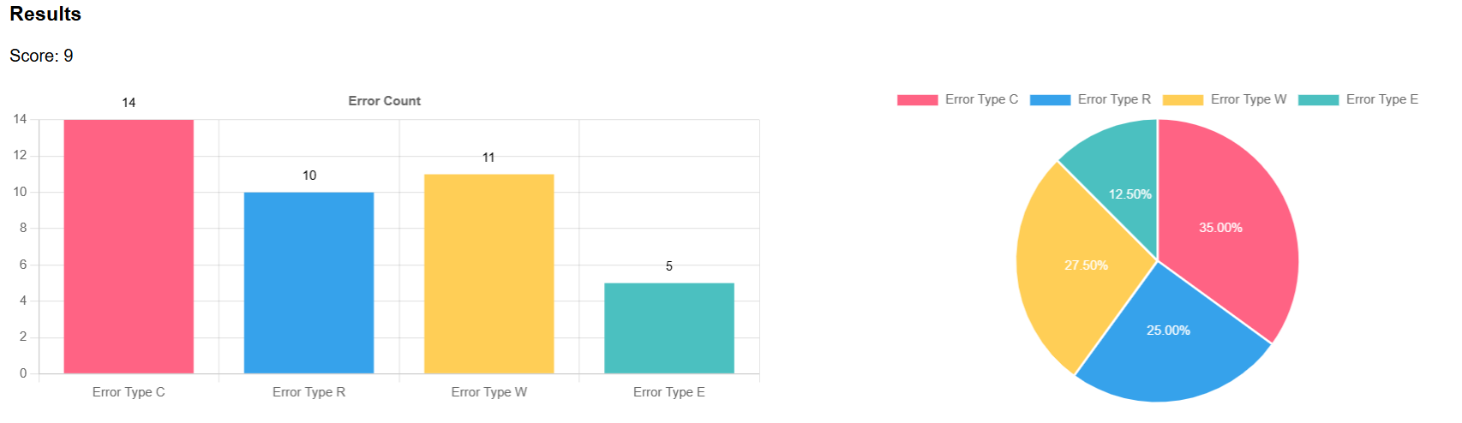
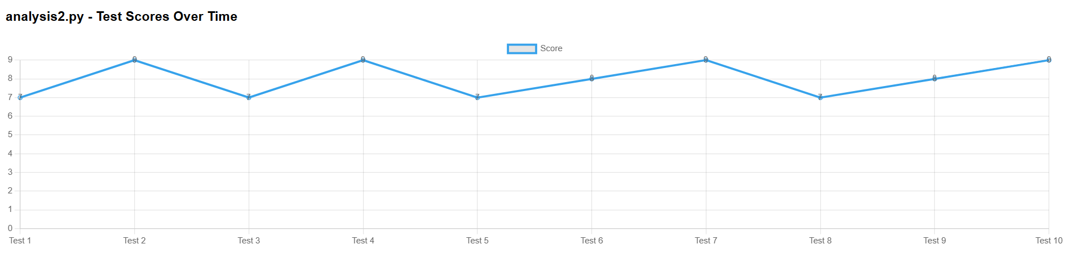
Data Visualization Interface Design
Features
Added charts like bar graphs and pie charts for presenting CWE issues and code quality scores.
Introduced interactive features for dynamic data exploration.

Slide 3
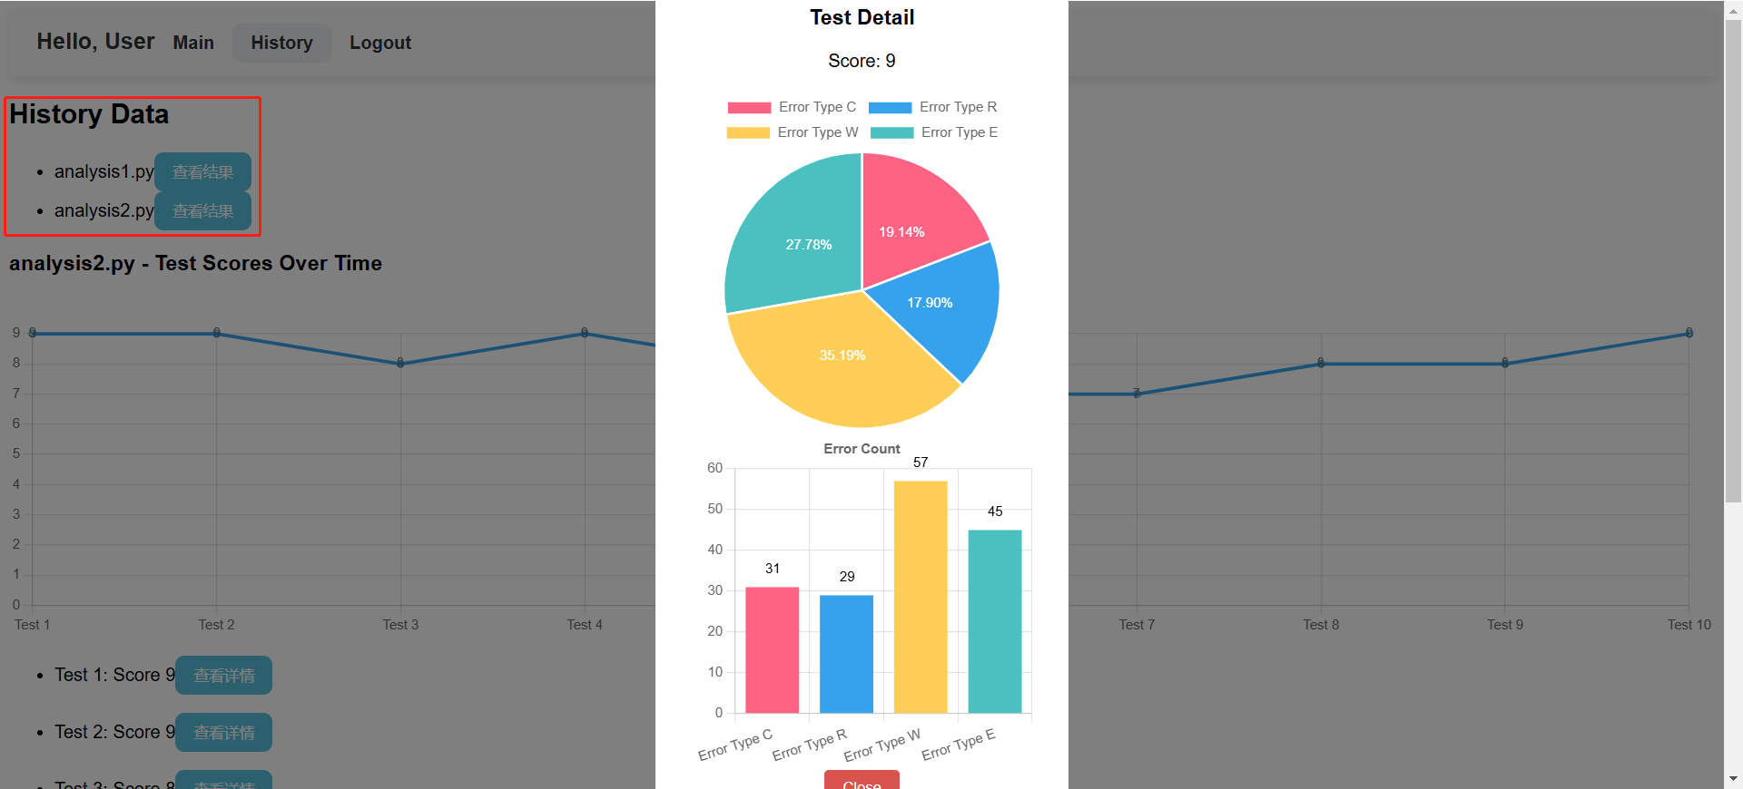
Data Management
Historical Data Access
Provides quick access to historical data for users to view previous analysis results, with file names and scores displayed.
Database Enhancements
Normalized structure to reduce redundancy and improve efficiency.
Added consistency tests to ensure reliable data operations.

Slide 4
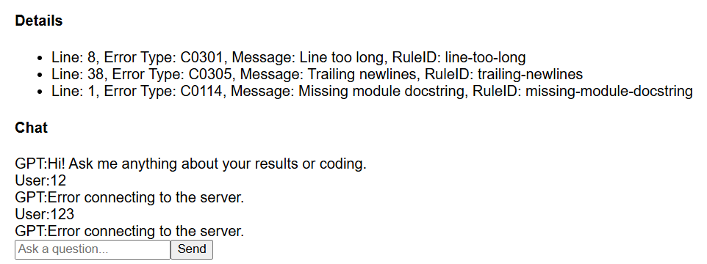
ChatGPT Interaction
User Feedback
Interface was difficult to use, difficult to track which code suggestions belong to which part of the code.
Enhancements
Visual links between suggestions and corresponding code sections .
Step-by-step annotations to guide users in applying recommendations.

Slide 5
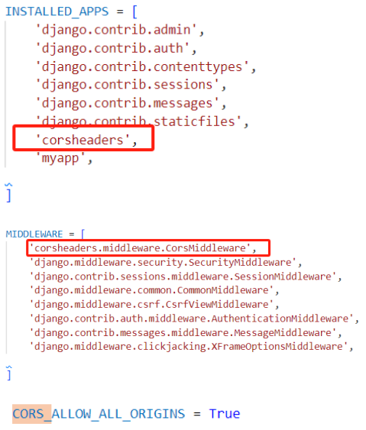
Frontend and Backend Interaction
Key Changes:
Configured Vue proxy server and enabled CORS headers in Django to resolve cross-origin issues.
Standardized JSON data format for smooth transmission.
User Experience:
Enhanced reliability with error feedback systems and loading indicators.

Slide 6
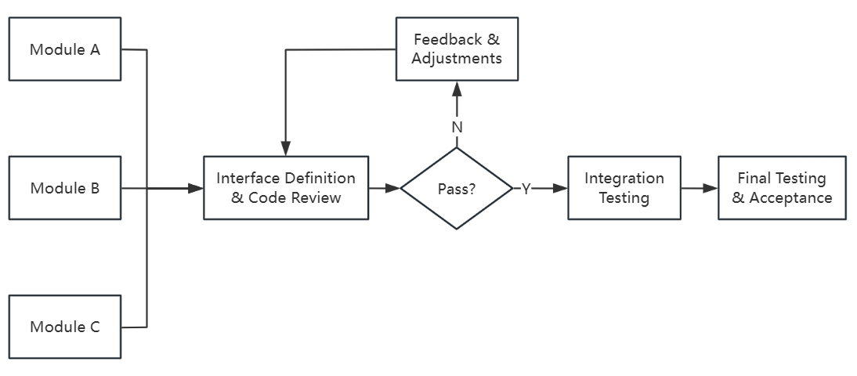
Cross-Module Coordination and Integration
Problem
Inconsistent module integration and dependencies.
Process Improvements:
Conducted regular team meetings to align module requirements.
Introduced code reviews for better compatibility before integration.

Slide 7
Evaluation-Conclusion
Highlights
Enhanced visualization, smart suggestions, and user experience.
Significant improvements over the original Pylint tool.
Future Work
Further updates and feature demonstrations to increase competitiveness.

