Slide 1
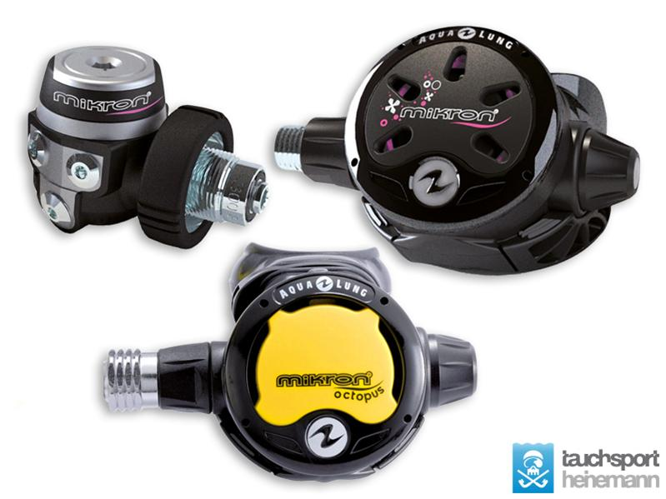
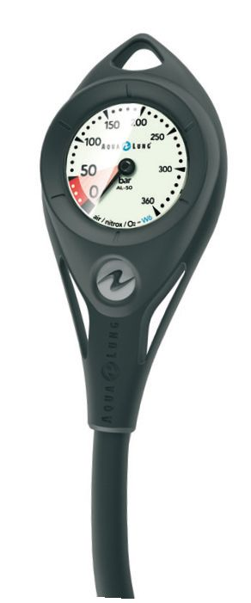
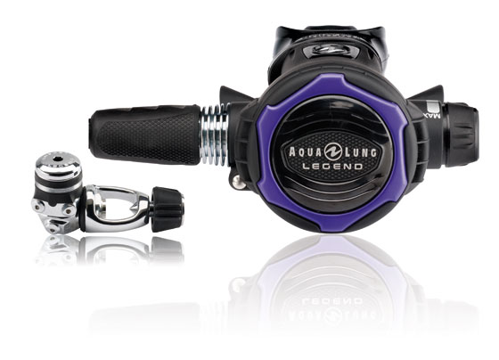
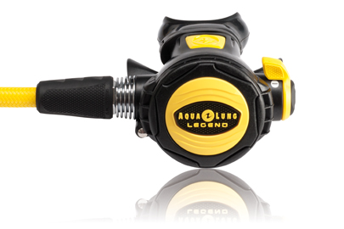
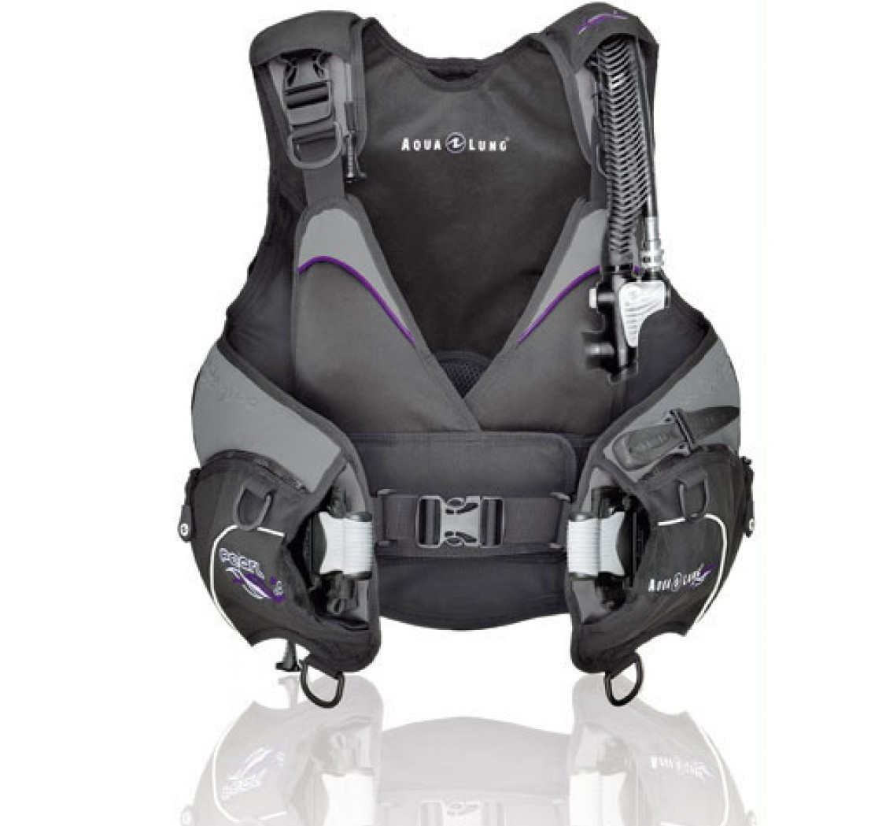
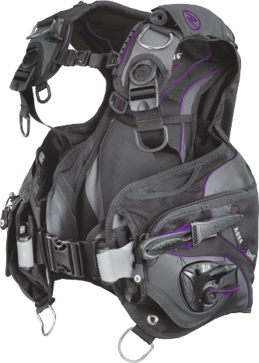
Aqualung LX Lady Package offer
Aqualung Lady Package offer
Regulator Mikron Lady + Octo + Pressure Guage
Regulator Legend LX twilight + Octo Legend + Pressure Guage
+
+
BCD Pearl
BCD Soul I3
=
=
840€ instead of 970€
1200€ instead of 1360€

