Slide 1
Bank Marketing Insights and Prototype classification models
Listia Rini
Purwadhika JCDS-07 Final Project
April 2020

Slide 2
Context
Portuguese Bank Marketing Data Set obtained from University of California, Irvine (UCI) Machine Learning Repository (https://archive.ics.uci.edu/ml/datasets/Bank+Marketing) [Moro et al., 2014].
The data was collected from a direct marketing campaign conducted by Portuguese banking institution to offer term deposits. The data collection was made by phone calls to potential customer from May 2008 to November 2010.
There are 41,188 total observations (89% negative, 11% positive)

Slide 3
Output and Features
Output variable, divided into 2: Target Yes and Target No
Total of 20 features, divided into 4 categories:
7 Bank client data (socio-demographic e.g age, job, and education, etc)
4 Contact made during this campaign (e.g month, day of week, etc)
5 Social and economic context ( e.g euribor3m, consumer index, etc)
4 Other attributes (e.g contact made during previous campaign)

Slide 4
Objectives
Gain insight of bank customers:
Helping bank, such as advising:
Who are more likely to accept the marketing offer ?
When is the best time to do the calling during campaign ?, etc
Using machine learning to possibly help identifying positive customers
Training models for classification case (using significant features)
Helping bank, such as to determine whether this customer is worth pursuing

Slide 5
Dataset Preparations
Bank Marketing
Dropping some features based on the correlation to the target or other features
Picking only significant features (after dummies) with statistical measures
Focus is in aggressive strategy (getting more True Positives / acquiring customers)

Slide 6
Jupyter and Dash Sessions
Exploratory Data Analysis
Dataset preparation – shortlisting features
Supervised 1 – Initial models comparison (log_reg, xgb, rfc)
Supervised 2 – Hyperparameter tuning (log_reg, xgb)
Supervised 3 – Trials to improve the model (log_reg)
Model deployment
Dash session

Slide 7
Suggestions to consider
More due diligence
Modify the dataset (e.g binning numerical features)
Checking other models (e.g AdaBoost, RFC, Decision Tree)
Using GridSearchCV and include other hyperparameters to better tune the models
Feature engineering
Training the models using different processed datasets
SMOTE oversampling
Oversampling method with different ratio
Using other pre-processing methods:
E.g Logarithmic scaling, MinMaxScaler()
Dimension reduction (PCA)

Slide 8
Acknowledgement
Dataset was taken from: https://archive.ics.uci.edu/ml/datasets/Bank%2BMarketing : bank-additional-full.csv
S. Moro, P. Cortez and P. Rita. A Data-Driven Approach to Predict the Success of Bank Telemarketing. Decision Support Systems, Elsevier, 62:22-31, June 2014

Slide 9
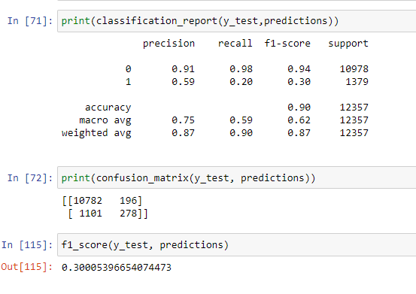
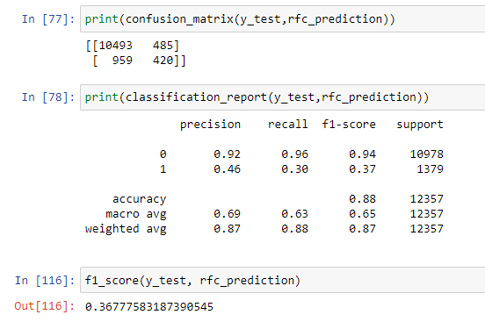
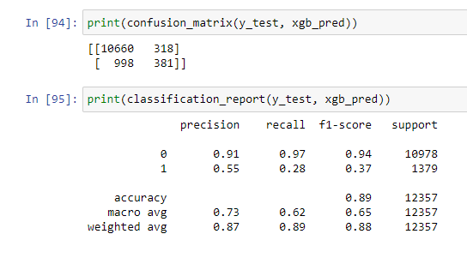
Appendices v1 original dataset models comparison

Slide 10
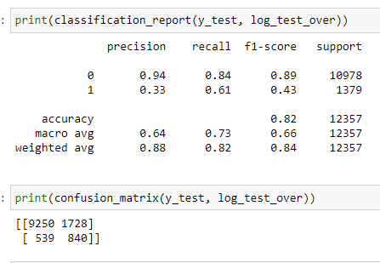
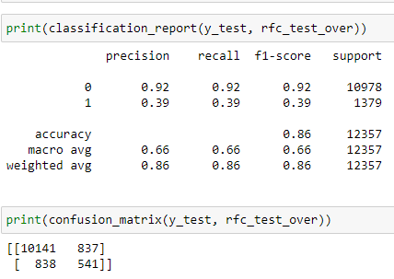
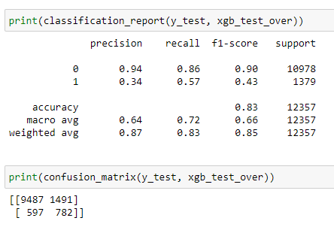
Appendices v1 oversampled dataset models comparison

Slide 11
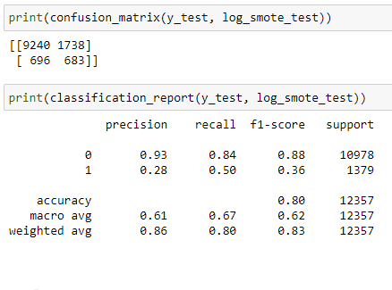
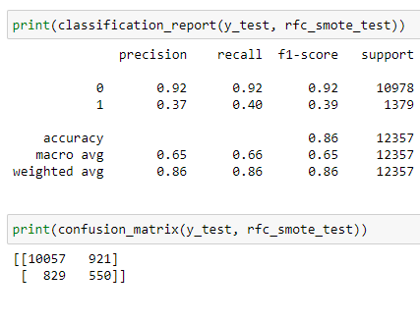
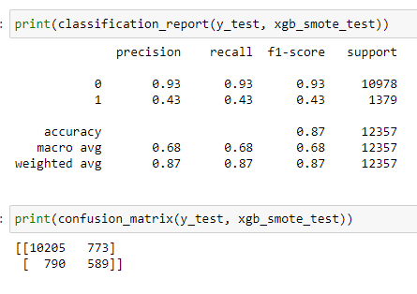
Appendices v1 SMOTE dataset models comparison

Slide 12
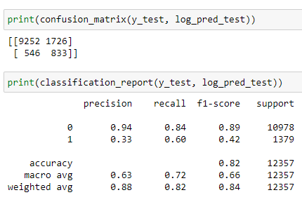
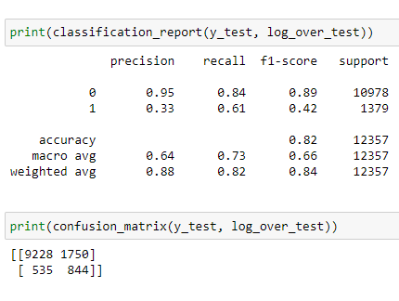
Appendices v1 tuned log_reg comparison

Slide 13
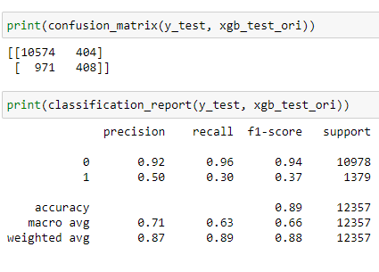
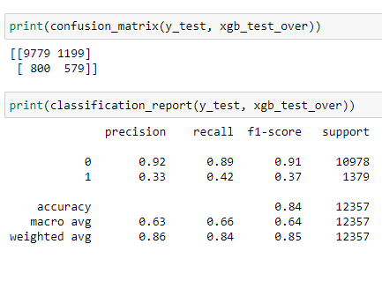
Appendices v1 tuned xgb comparison

Slide 14
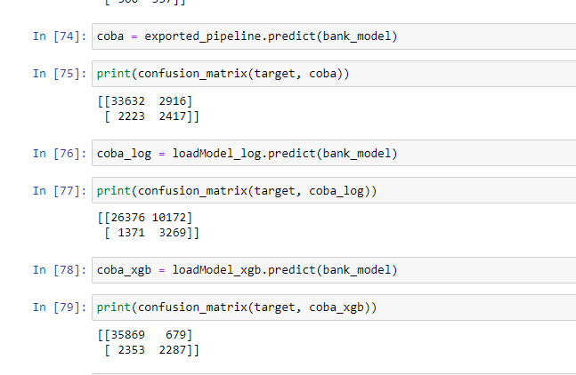
Appendices v1 Dash models comparison

