Slide 1

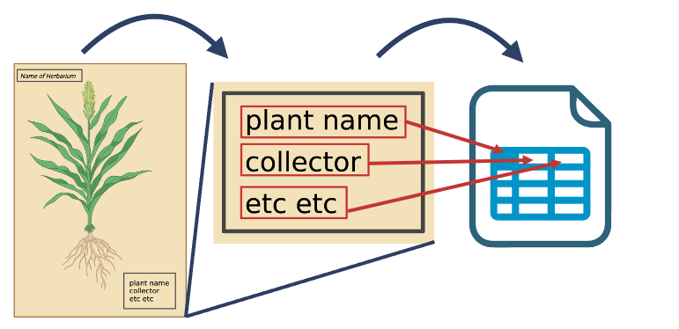



Slide 2
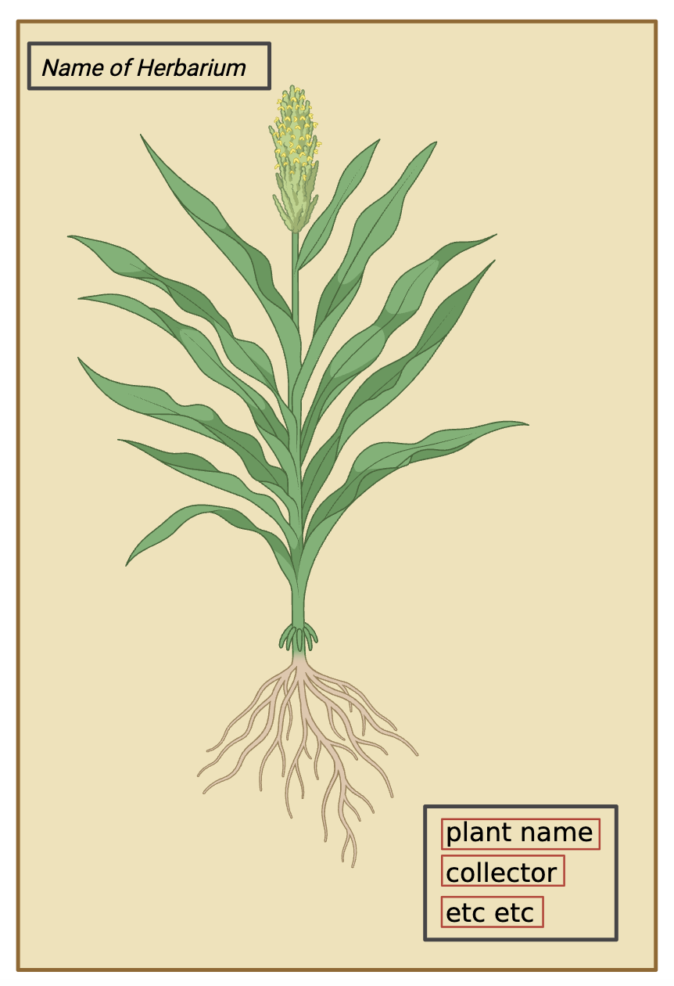

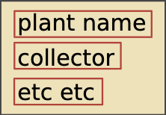
Step 1: Take photo of specimen and process image
Step 2: Use OCR to identify text
Step 3: Run AI model to parse text into fields
Step 4: Human verifies and edits output

