Slide 1
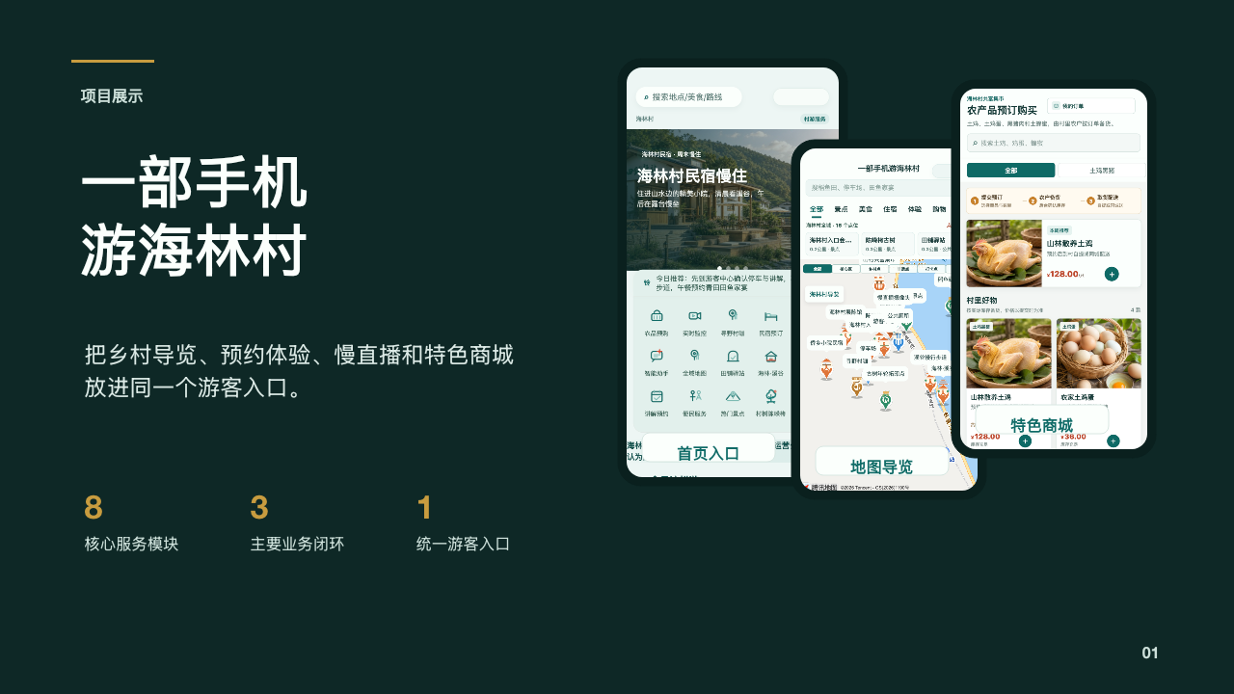
Notes:
[Sources]
整页来源：/Users/zz/Desktop/projects/hailin-miniprogram/tmp-ppt-build-final/combined-rendered/main-01.png

Slide 2
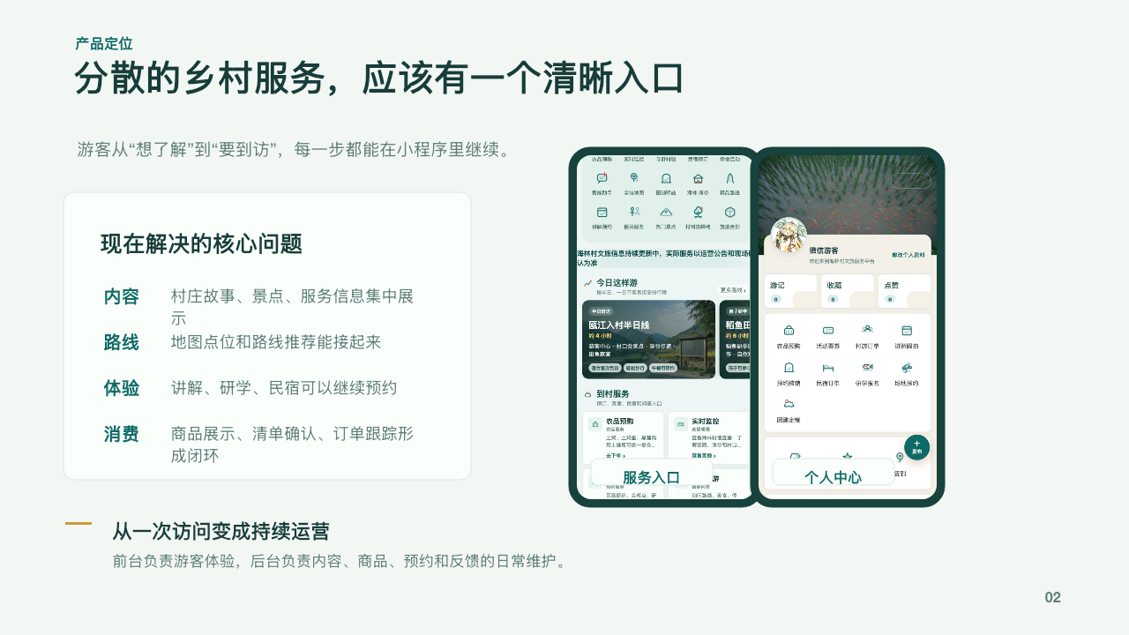
Notes:
[Sources]
整页来源：/Users/zz/Desktop/projects/hailin-miniprogram/tmp-ppt-build-final/combined-rendered/main-02.png

Slide 3
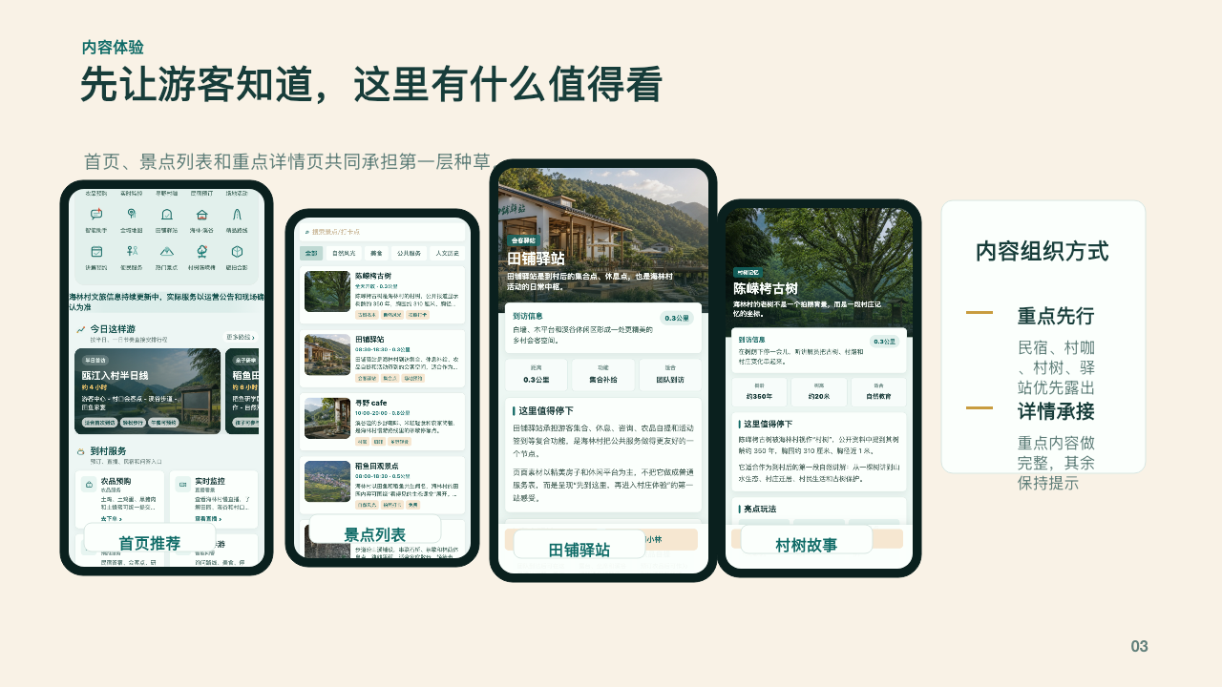
Notes:
[Sources]
整页来源：/Users/zz/Desktop/projects/hailin-miniprogram/tmp-ppt-build-final/combined-rendered/main-03.png

Slide 4
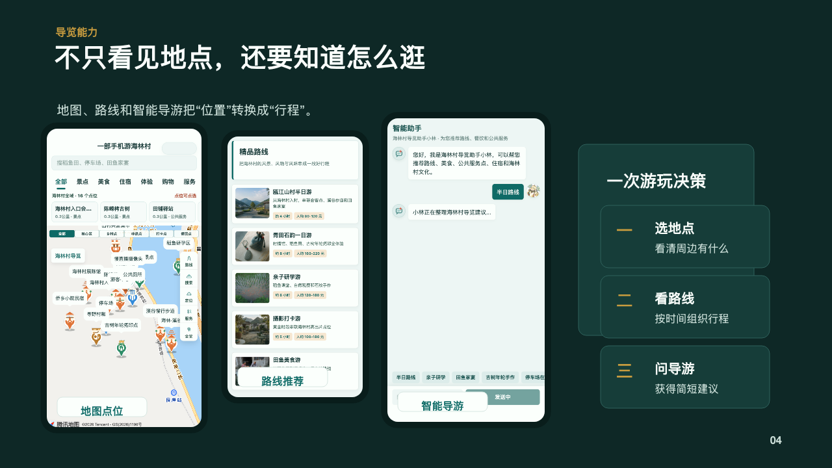
Notes:
[Sources]
整页来源：/Users/zz/Desktop/projects/hailin-miniprogram/tmp-ppt-build-final/combined-rendered/main-04.png

Slide 5

Notes:
[Sources]
整页来源：/Users/zz/Desktop/projects/hailin-miniprogram/tmp-ppt-build-final/combined-rendered/main-05.png

Slide 6

Notes:
[Sources]
整页来源：/Users/zz/Desktop/projects/hailin-miniprogram/tmp-ppt-build-final/combined-rendered/main-06.png

Slide 7
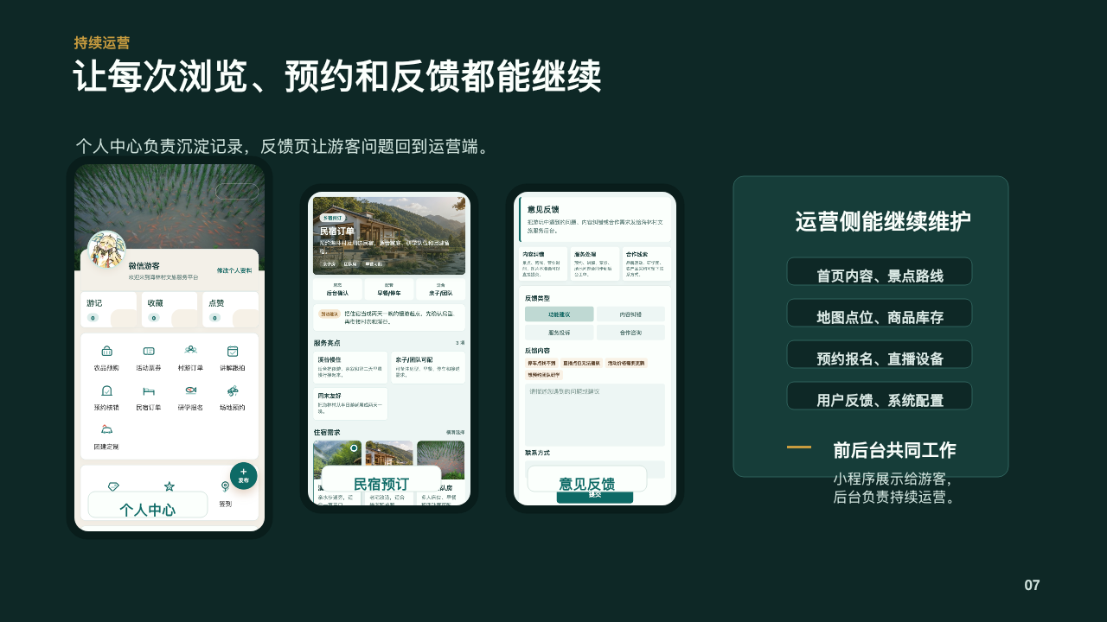
Notes:
[Sources]
整页来源：/Users/zz/Desktop/projects/hailin-miniprogram/tmp-ppt-build-final/combined-rendered/main-07.png

Slide 8
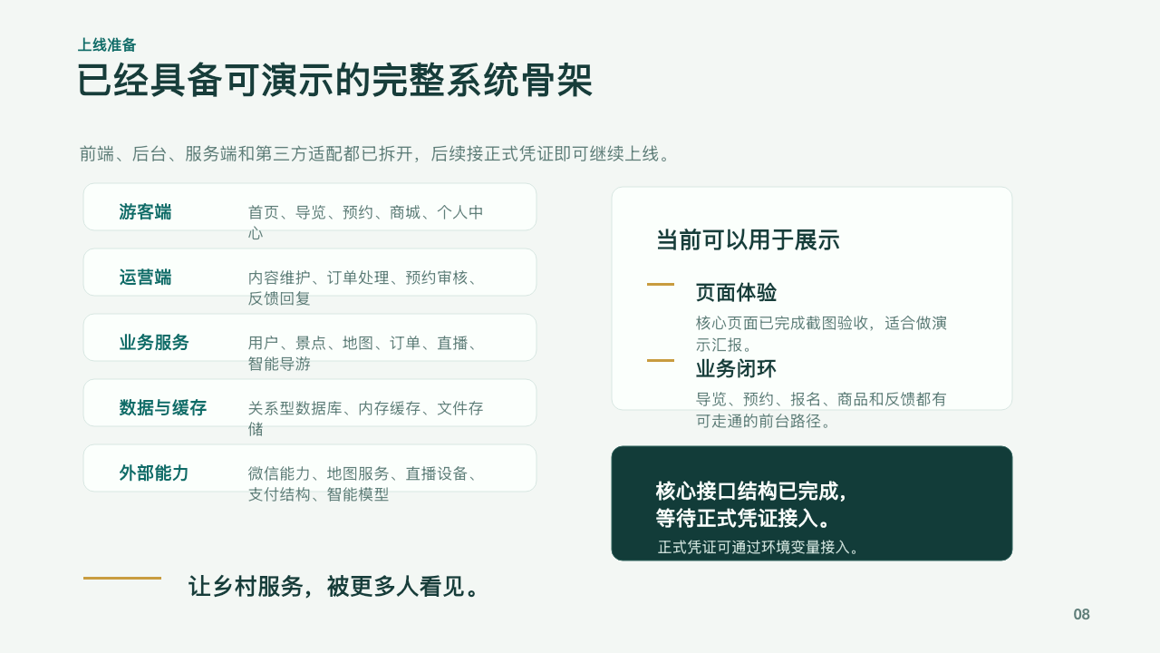
Notes:
[Sources]
整页来源：/Users/zz/Desktop/projects/hailin-miniprogram/tmp-ppt-build-final/combined-rendered/main-08.png

Slide 9
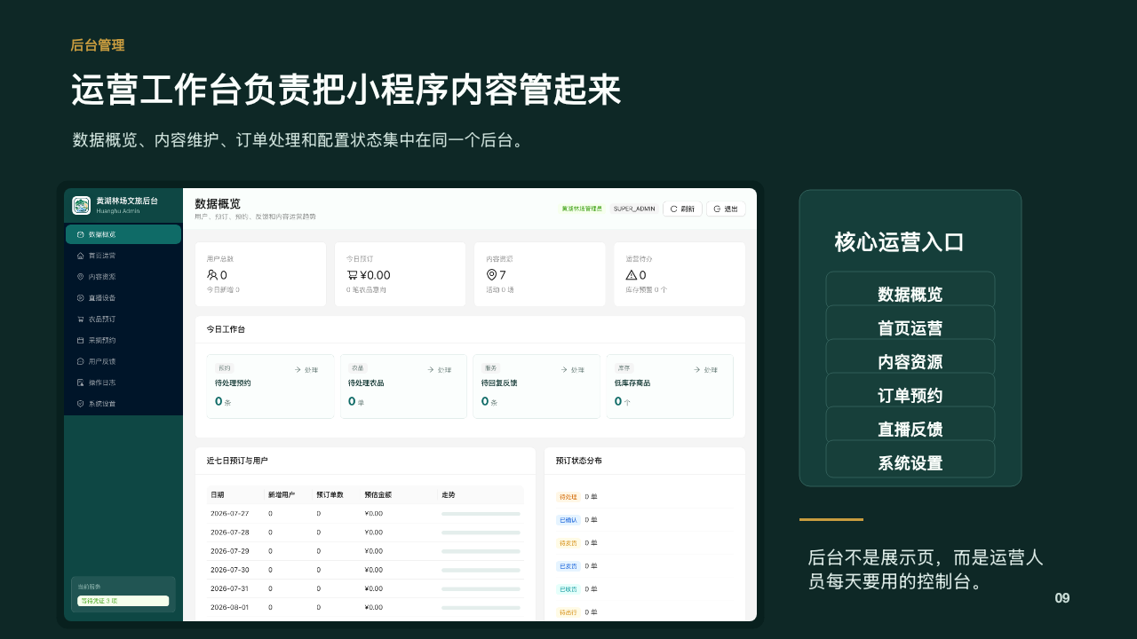
Notes:
[Sources]
整页来源：/Users/zz/Desktop/projects/hailin-miniprogram/tmp-ppt-build-final/combined-rendered/admin-01.png

Slide 10
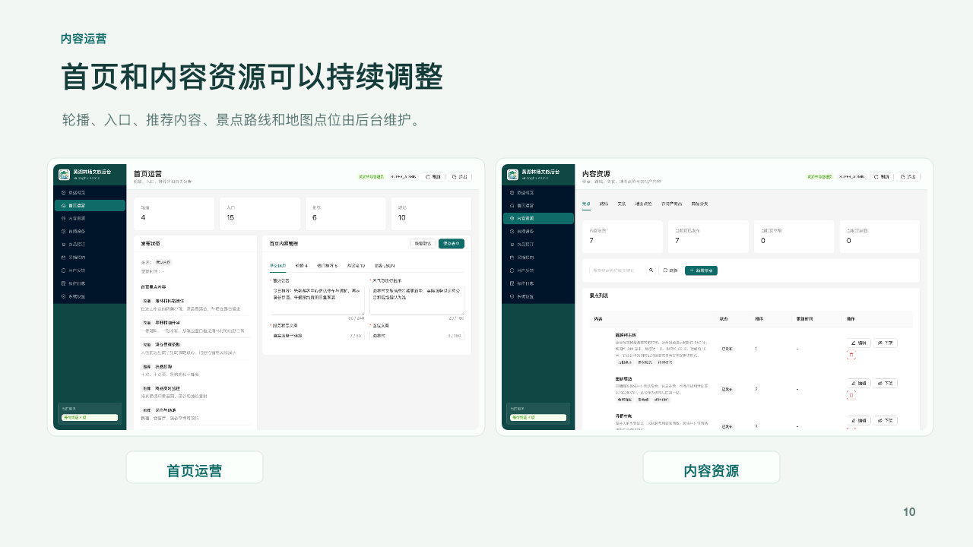
Notes:
[Sources]
整页来源：/Users/zz/Desktop/projects/hailin-miniprogram/tmp-ppt-build-final/combined-rendered/admin-02.png

Slide 11

Notes:
[Sources]
整页来源：/Users/zz/Desktop/projects/hailin-miniprogram/tmp-ppt-build-final/combined-rendered/admin-03.png

Slide 12

Notes:
[Sources]
整页来源：/Users/zz/Desktop/projects/hailin-miniprogram/tmp-ppt-build-final/combined-rendered/admin-04.png

Slide 13
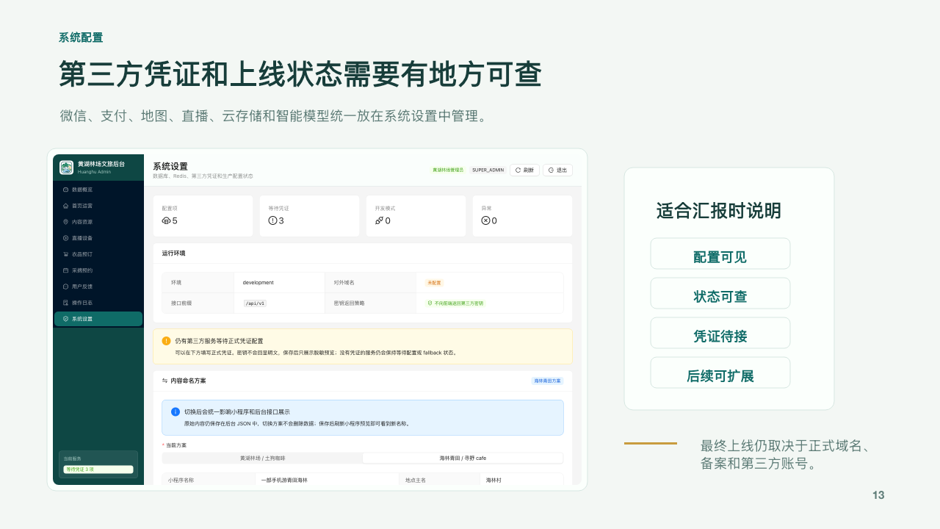
Notes:
[Sources]
整页来源：/Users/zz/Desktop/projects/hailin-miniprogram/tmp-ppt-build-final/combined-rendered/admin-05.png

