Slide 1
FINAL PROJECT
House Pricing Prediction
Prepared by
Aydin Gokcen
Buck Matt
Channer Timothy
Le Phuong
Russo Estel

Slide 2
Overview of the Project
Creating a machine learning model that can predict the prices of the houses in Ames City, Iowa, USA for the sellers, and create an interactive website for the users, where they can filter for multiple search criteria at the same time by entering all or some of the variables in the Dataset as an input.

Slide 3
Introduction
1
Strategy
2
Challenges Forward
3
History
4

Slide 4
Data Description
The origin Data was composed of 81 columns and 1460 rows
Our filtered data contains 20 columns and 1236 rows

Slide 5
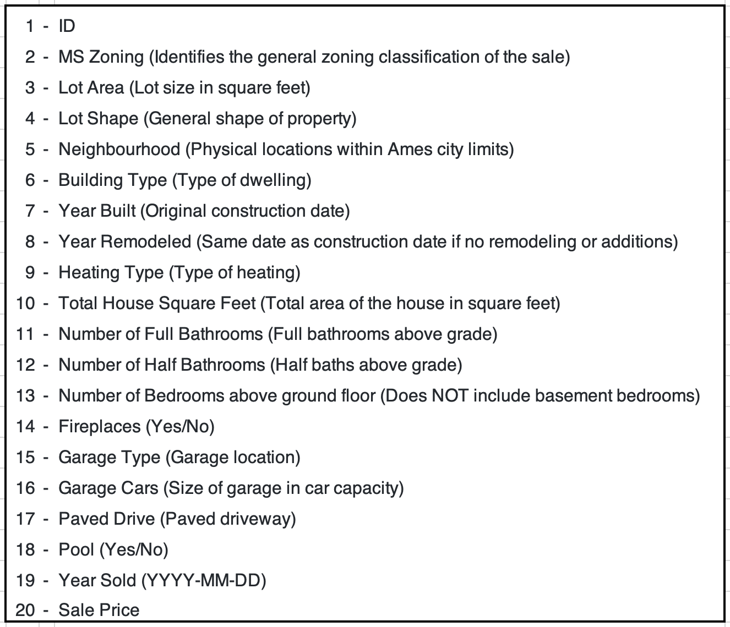

Slide 6
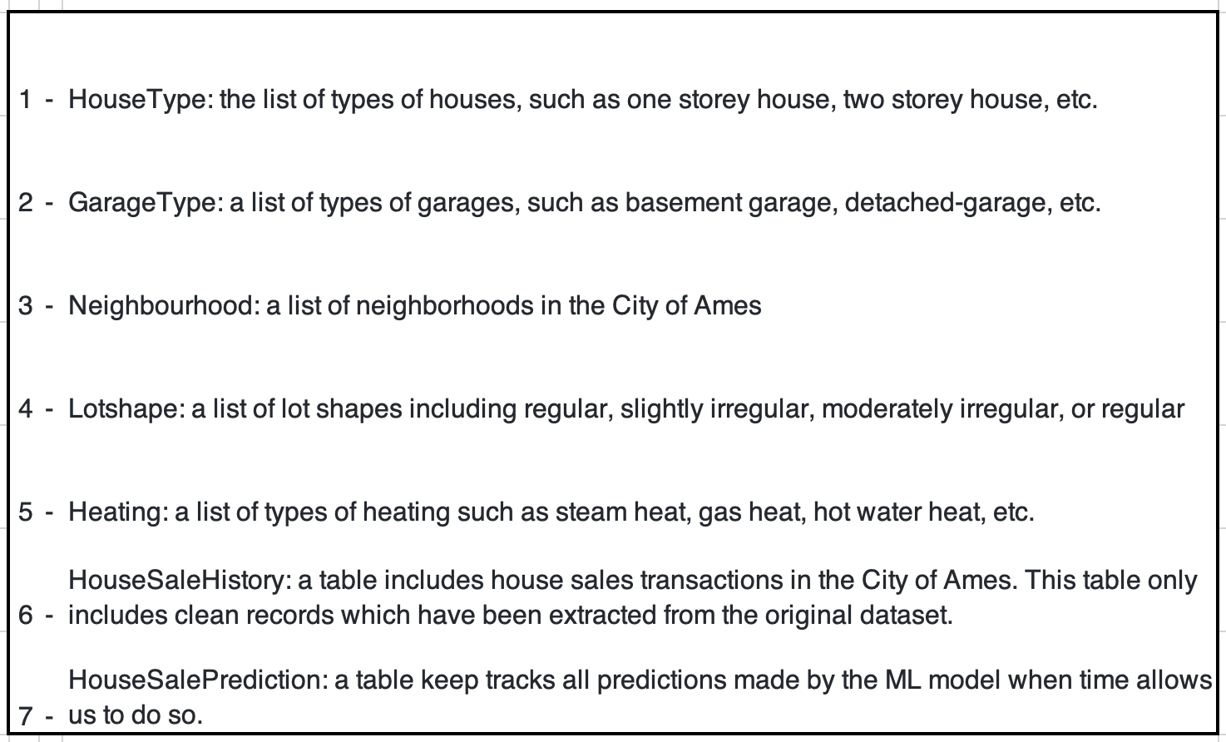
Database (7 Tables)

Slide 7
Technologies Used in the Project
Cleaning, Preparing and Exploring
_{the Data}
_{Creating Tables}
_{Geocoding}
_{Visualizing Database}
Jupyter Notebook
Pandas
Numpy
Matplotlib
Tableau
ERD
PostgreSQL

Slide 8
Technologies Used in the Project
_{Training}
_{and Executing Machine Learning}
_{Model}
Calling a Model
Presentation of Data Visualization
AWS
Machine Learning
HTML
Javascript
CSS
Flask

Slide 9
Why did we choose this project?
There is significant need for such a service
The model can be adapted to service other areas
Creating an easy way to estimate which feature(s) impact house value
Practical implications:
You can estimate the value of the house if you were to remodel
You can find an appropriate price for your house so you know what you can afford in a new house

Slide 10
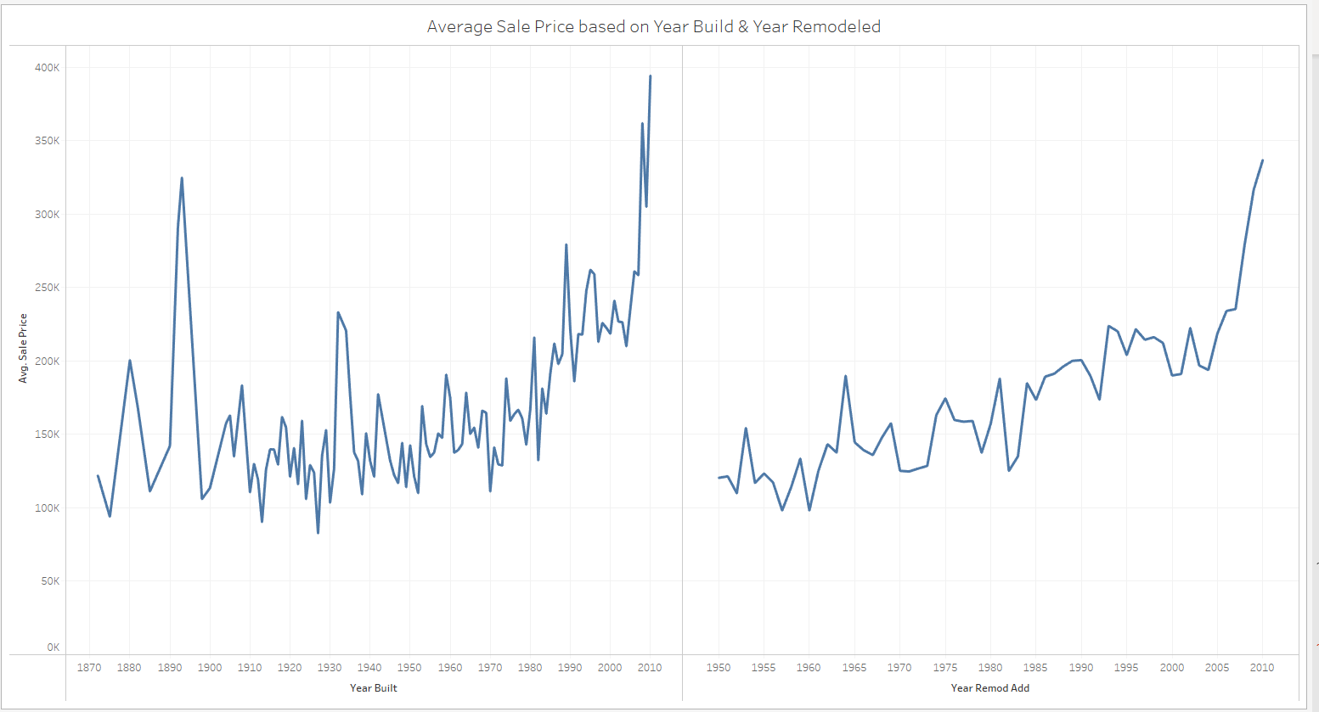
Static Statistical Analysis (Pt. 1)

Slide 11
Static Statistical Analysis (Pt.2)

Slide 12
Thank You!

