Slide 1
FINAL PROJECT
House Pricing Prediction
Prepared by
Aydin Gokcen
Buck Matt
Channer Timothy
Le Phuong
Russo Estel

Slide 2
Overview of the Project
Create a machine learning model that can predict house prices in Ames City, IA, USA, for sellers and provide an interactive display for the users, where users can filter for various search criteria simultaneously.
Notes:
Create a machine learning model that can predict house prices in Ames City, IA, USA, for sellers and provide an interactive display for the users, where users can filter for various search criteria simultaneously.

Slide 3

Why was This Topic Chosen?
1- Many homeowners look to sell their homes. Using our display, users will be able to pinpoint what key factors need to be taken into consideration to maximize the sale of their home.
2- This model can be adapted to any country, and city, in the world.

Slide 4
Introduction
1
Strategy
2
Challenges Forward
3
History
4

Slide 5

Data Description
The original data was composed of 81 columns and 1460 rows and was filtered down to 18 columns and 1150 rows.
This Photo by Unknown Author is licensed under CC BY-SA-NC

Slide 6
Data Description The Fields
Lot Area (Lot size in square feet)
Lot Shape (General shape of property)
Neighbourhood (Physical locations within Ames city limits)
Building Type (Type of dwelling)
Year Built (Original construction date)
Year Remodeled (Same date as construction date if no remodeling or additions)
Heating Type (Type of heating)
Total House Square Feet (Total area of the house in square feet)
Number of Full Bathrooms (Full bathrooms above grade)
Number of Half Bathrooms (Half baths above grade)
Number of Bedrooms above ground floor (Does NOT include basement bedrooms)
Fireplaces (Yes/No)
Garage Type (Garage location)
Garage Cars (Size of garage in car capacity)
Paved Drive (Paved driveway)
Pool (Yes/No)
Year Sold (YYYY-MM-DD)
Sale Price

Slide 7
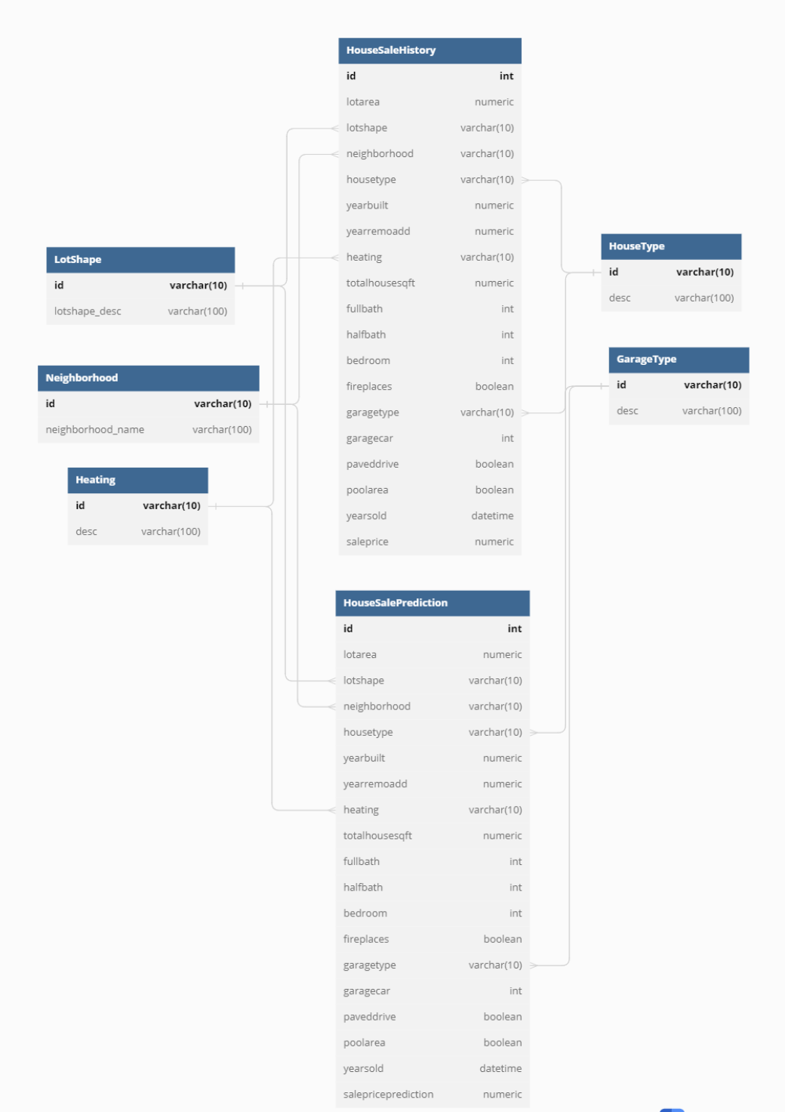
Database (6 Tables)
House Type: The list of types of houses
Garage Type: A list of types of garages
Neighbourhood: A list of neighborhoods in the City of Ames
Lot shape: A list of lot
Heating: A list of types of heating such as steam heat
House Sale History: A table includes house sales transactions in the City of Ames.

Slide 8
Technologies Used in the Project
Cleaning, Preparing and Exploring
_{the Data}
DataBase
_{Static Visualizations}
_{Visualizing Database}
Excel
Jupyter Notebook
Pandas
Numpy
Matplotlib
Tableau
ERD
PostgreSQL

Slide 9
Technologies Used in the Project
Calling
a Model
_{Training}
_{and Executing Machine Learning}
_{Model}
Presentation of Data Visualization
AWS
Machine Learning
One Hot Encoder, Rare Label Encode,
Random Forest Regressor, joblib
HTML
Javascript
CSS
Flask

Slide 10
Thank You!

