Slide 1
schema:givenName
eg:Person1
Bob
Identifier
Key=Value Pair
Person 1 givenName=’Bob’
“ Person1 has given name ‘Bob’ ”

Slide 2
schema:givenName
eg:Person1
Bob
STRING
eg:age
32
INT

Slide 3


1.
eg:participatesIn rdf:type owl:ObjectProperty ;
rdfs:domain eg:HumanStudySubject ;
rdfs:range ncit:Study .
Reasoner sees relation:
eg:participatesIn
2.
Reasoner Infers:
This is a HumanStudySubject
This is a Study
3.
Therefore:
eg:participatesIn
eg:Study6
eg:Person63

Slide 4
1.
eg:HumanStudySubject rdf:type owl:Class ;
rdfs:subClassOf schema:Person .
Reasoner sees Ontology
has classes and subclasses
2.
Thing
Person
HumanStudySubject
3.
This is a HumanStudySubject, Person, and Thing
Therefore:
eg:participatesIn
eg:Study6
eg:Person63

Slide 5
ncit:study
eg:Drug1
eg:Study1
Identifier
Key=Value Pair
Drug 1 study=Study1
“ Drug1 has study Study 1”

Slide 6
http://www.example.org/LDW#Drug1
http://www.example.org/LDW#Study1
http://ncicb.nci.nih.gov/xml/owl/EVS/Thesaurus.owl#study

Slide 7
ncit:study
eg:Drug1
eg:Study1

Slide 8
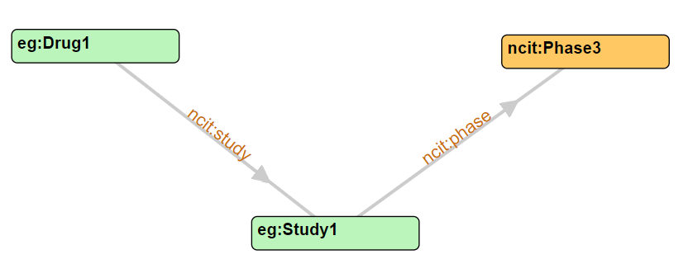
1
2

Slide 9
Study1
Study2
Study20
Study3
Study19
Study4
Study18
Drug1Pool
Study5
Study17
Study6
Study16
Study7
Study15
Study8
Study14
Study9
Study13
Study10
Study12
Study11

Slide 10
eg:participatesIn
eg:Person1
eg:Study1
Identifier
Key=Value Pair
Person 1 participatesIn=Study1
“ Person1 participates in Study 1”

Slide 11
GRAPH QC Checks
ncit:study
eg:Drug1
eg:Study(n)
Links
Nodes
eg:Person(n)(n2)
eg:TrtArm(n)-<1,2>

Slide 12
NODES
eg:Study<n>
eg:TrtArm<n>-<x>
eg:Person<n><y>
eg:PlaceboArm
eg:LDExpert
ncit:Phase<z>
ncit:Male
ncit:Female
LINKS
eg:age
eg:LDExpert
eg:participatesIn
eg:randomizedTo
eg:trtArm
eg:trtArmType
ncit:gender
ncit:phase
ncit:study
schema:givenName

Slide 13
<n> = Study number. Same for Study, TrtArm, Person
NODES
eg:Study<n>
eg:TrtArm<n>-<x>
eg:Person<n><y>
ncit:Phase<z>
<x> = Number: 1, or 2
<y> Number: 1, 2 or 3
<z> = Number: 2, 3 or 4

