Slide 1
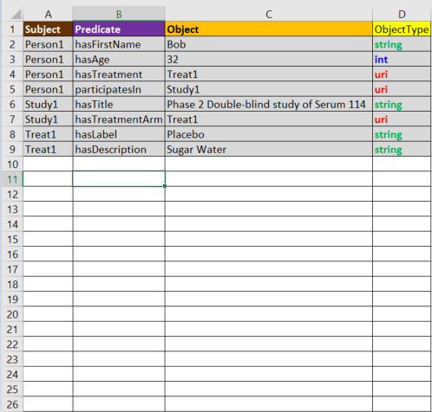
Pre-filled for base model
Add your values here

Slide 2




Diagram
Real World Model
Machine Readable
Spreadsheet
Neo4j
Linked Data
Query, Vis

Slide 3
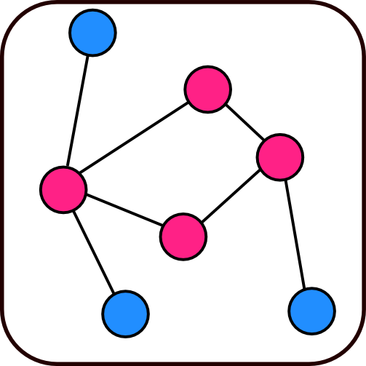
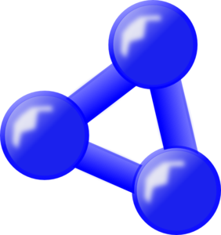
Neo4j
Spreadsheet
RDF Spreadsheet
RDF Spreadsheet
Query, Vis
Diagram
RDF
Real World Model
Linked Data

