Slide 1
Information Sharing
The Redesign

Slide 2
Summary of ACTM Presentation
ACTM – Automated Cash and Ticket Management System
Used to organize and automate process flow (cash and ticket) of the Cash Assistant (CA)
Previous design was functional but left room for streamlining

Slide 3
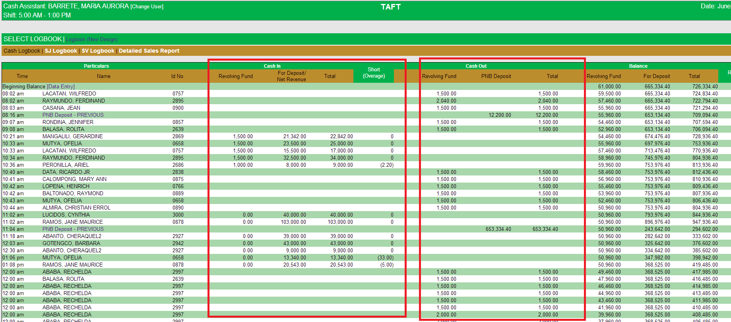
Old Design

Slide 4
Old Design
Colors were cool to the eyes, but seemed loud
Columns were squeezed in
Forms opened new windows, resulting in opened multiple windows at a time

Slide 5
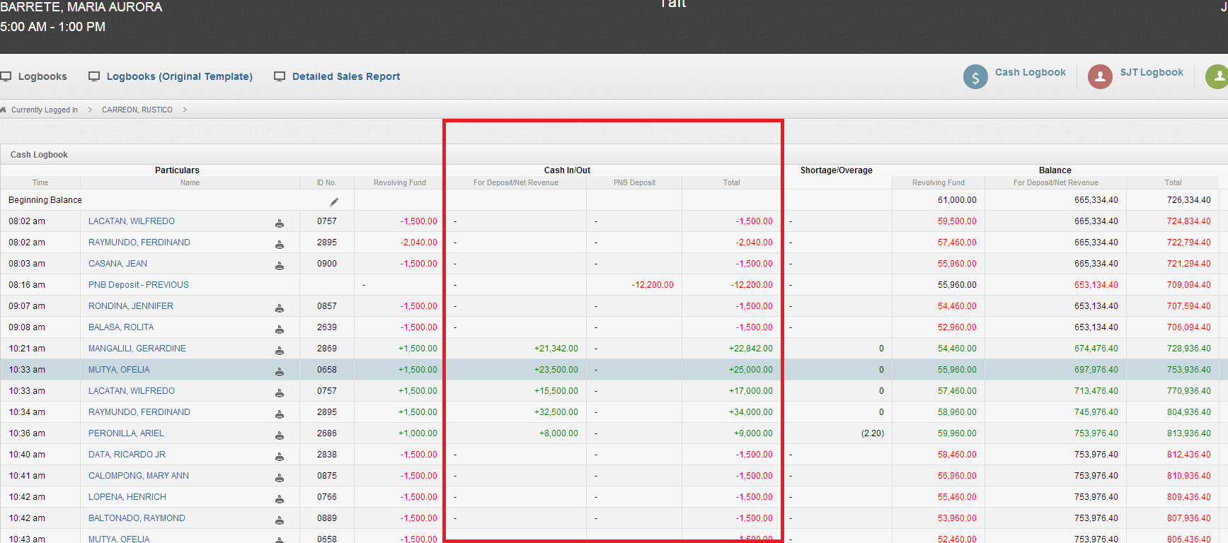
New Design

Slide 6
New Design
Colors are more muted, neutral
Columns have been compressed, merged
Forms are now opened in dialog boxes within the page

Slide 7
Logbook
Control Slip
Transaction
Cash Transfer
Ticket Order
Ticket Seller
Unit
Station
Discrepancy
Old Structure

Slide 8
Old Structure
CTF, Ticket Order was connected to a Control Slip only through a common set of Fields: Ticket Seller, Unit, Station which was inaccurate
Discrepancy was attached to CTF and manually calculated

Slide 9
Logbook
Control Slip
CTF
Ticket Order
Discrepancy
New Structure

Slide 10
New Structure
Identity of Ticket Seller is now based on Control Slip
CTF and Ticket Order are now directly connected to Control Slip
Discrepancy is automatically calculated based on Control Slip Remittance and CTF Remittance

Slide 11
Requested (and Applied) Changes
Cash Advance is now automatically based on Allocation of CTF on Remittance
Remittance is now divided between Partial and Full Remittance; the CTF for Final is created within the Control Slip
Discrepancy is immediately calculated based on Initial Remittance of Control Slip and Cash Remittance

Slide 12
Requested (and Applied) Changes
Unpaid Shortage is automatically calculated when Shortage discrepancy appears, and is automatically deducted after CTF Payment Shortage
Ticket Discrepancy now has Amount and is calculated with Overage to check for possible Unreg Sale

Slide 13
Specs
Browser: Preferably Google Chrome
URL: http://localhost/actm
Login account is now through username ID than drop down of names for increased security

