Slide 1

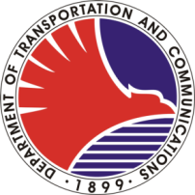
REPUBLIC OF THE PHILIPPINES
Department of Transportation and Communications
Metro Rail Transit 3 (DOTC – MRT3)
This certificate is issued to
for having completed the training on
CASH CLERK III
conducted by the Support Staff/Computer Section/AFC Center
on April 27 – 29, 2011
Given this 29th day of April 2011
at the MRT3 Training Hall, MRT3 Depot, North Avenue corner EDSA,
North Triangle Area, Quezon City
MARICEL O. IDOS
OFELIA D. ASTRERA
Chief Transportation Development Officer
RENATO Z. SAN JOSE
Officer-in-Charge, DOTC – MRT3

