Slide 1




Lesson 3: Python Basic (2)
Haihua Chen, Ph.D.
9402200057
Haihua.chen@unt.edu

Slide 2

Agenda
1
Python Dates
2
Python Arrays
3
Functions
4
Module and Package
5
Python JSON
6
Python Try Except
7
Classes and Objects
8
Demo
9
In-class Exercise 1

Slide 3
1
Python Dates

Slide 4
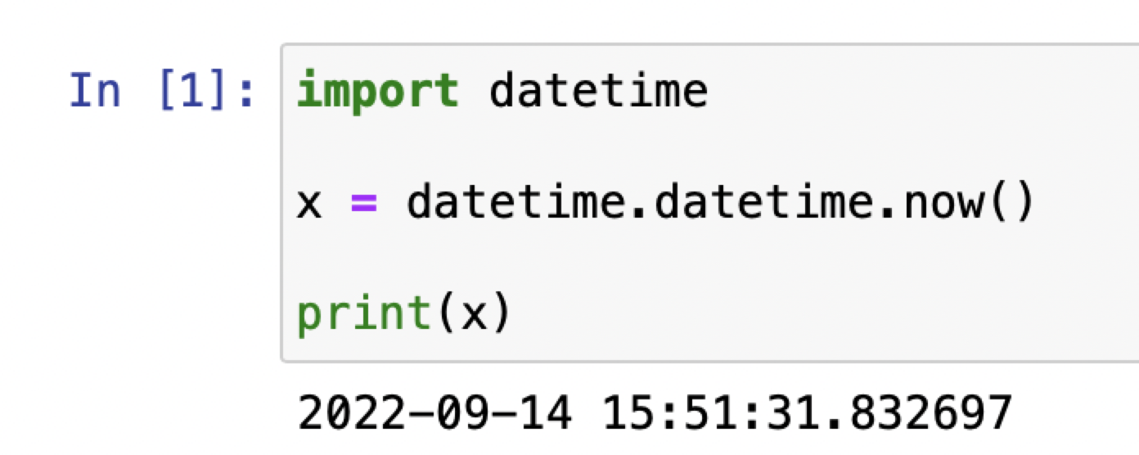


Python Dates
we can import a module named datetime to work with dates as date objects.
Return the current local date and time.
Notes:
A date in Python is not a data type of its own, but we can import a module named datetime to work with dates as date objects.
Output: The date contains year, month, day, hour, minute, second, and microsecond.

Slide 5
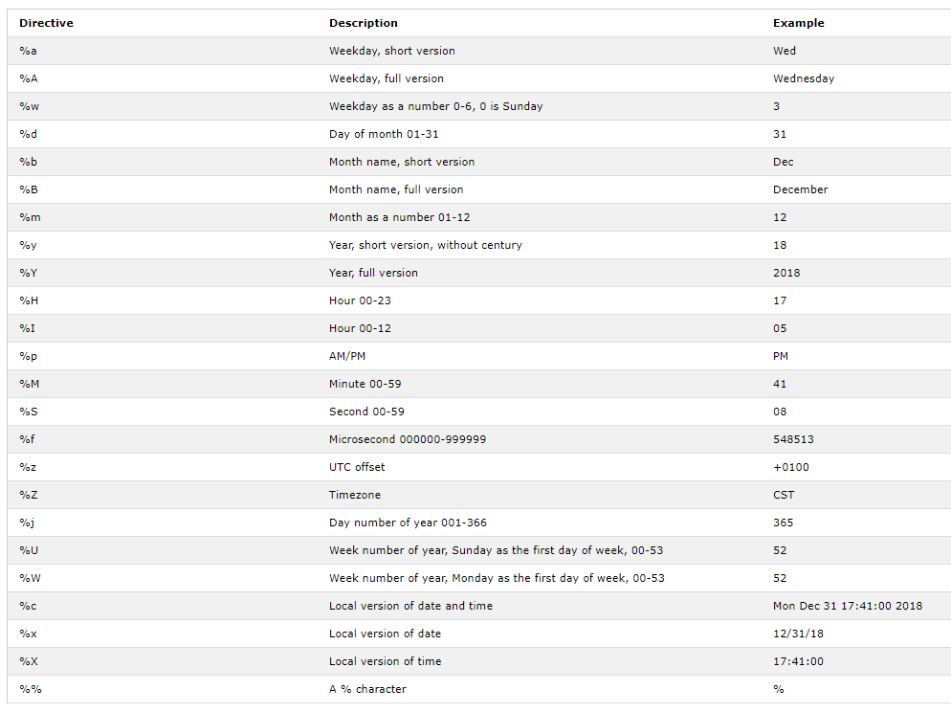
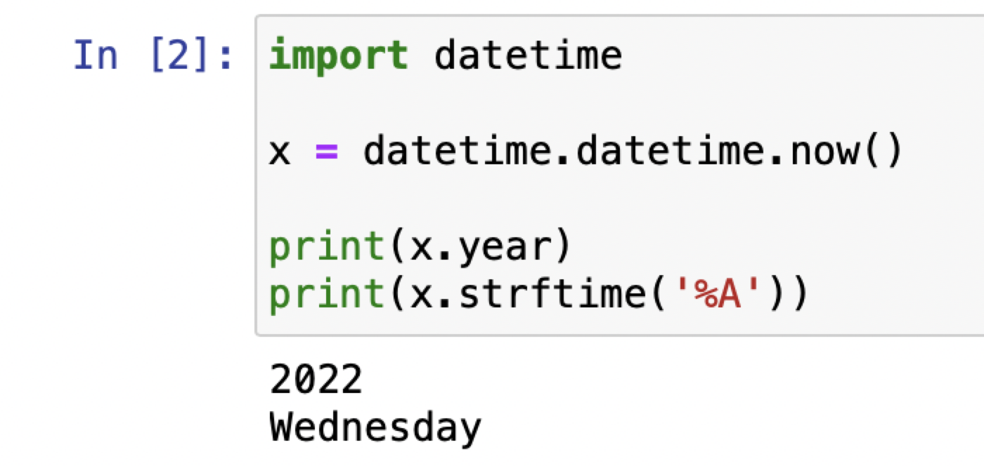
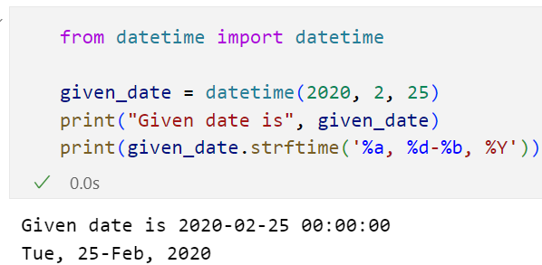
Date Output
The datetime module has many methods to return information about the date object.
Notes:
To create a date object, we can use the datetime() class (constructor) of the datetime module.
The datetime() class requires three parameters to create a date: year, month, day.

Slide 6
More about Date
https://docs.python.org/3/library/datetime.html#module-datetime

Slide 7
2
Python Arrays

Slide 8
Arrays
a = [1, 3.5, "Hello"]
b = [1.1, 3.5, 4.5]
We can treat lists as arrays.
we cannot constrain the type of elements stored in a list.
If you create arrays using the array module, all elements of the array must be of the same numeric type.
Notes:
Python does not have built-in support for Arrays, but Python Lists can be used instead.
You can treat lists as arrays, but to to work with arrays in Python you will have to import a library, like the NumPy library.
If you create arrays using the array module, all elements of the array must be of the same numeric type.

Slide 9
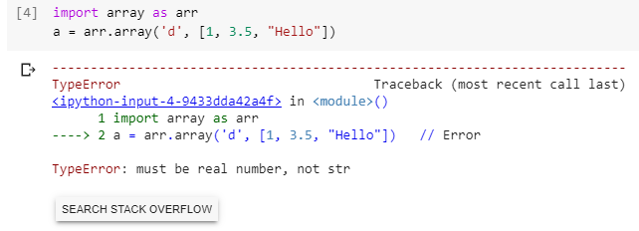
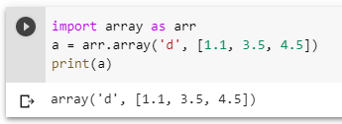
Arrays
array of numeric values are supported in Python by the array module.
Notes:
This module defines an object type which can compactly represent an array of basic values: characters, integers, floating point numbers. It behaves very much like lists, except that the type of objects stored in them is constrained.
- array.array(type_code, single_type_array)
- type_code: ‘c’: character; ‘u’: Unicode character; ‘I’: int, ‘d’: double float

Slide 10
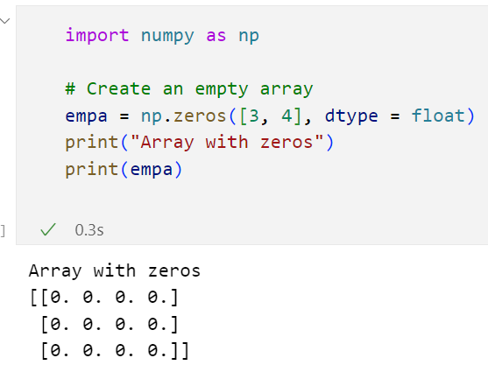
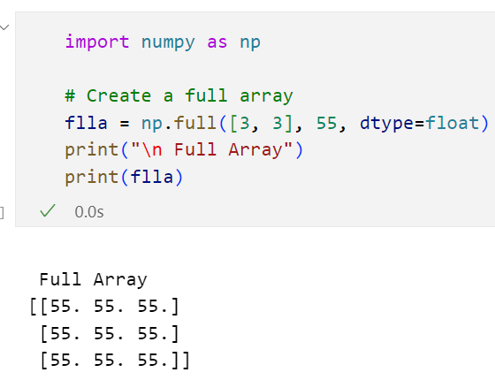
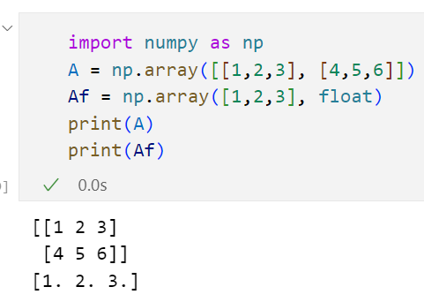
Arrays
array of numeric values are supported in Python by the Numpy library.
Notes:
For more examples, check the lecture 1 colab file.

Slide 11
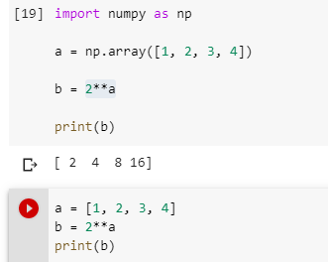
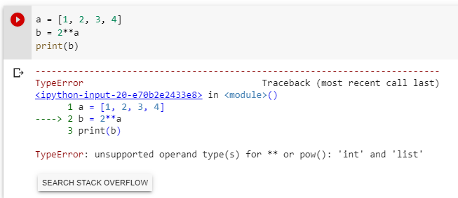
Differences between List and Arrays
If you're going to perform arithmetic functions to your lists, you should really be using arrays instead
Arrays will store your data more compactly and efficiently, so if you're storing a large amount of data, you may consider using arrays as well

Slide 12
3
Functions

Slide 13
Definition of a function
A function is a named sequence of statements that belong together
Help us organize programs into chunks that match how we think about the problem
def <name>(<parameters>):
<statements>

Slide 14
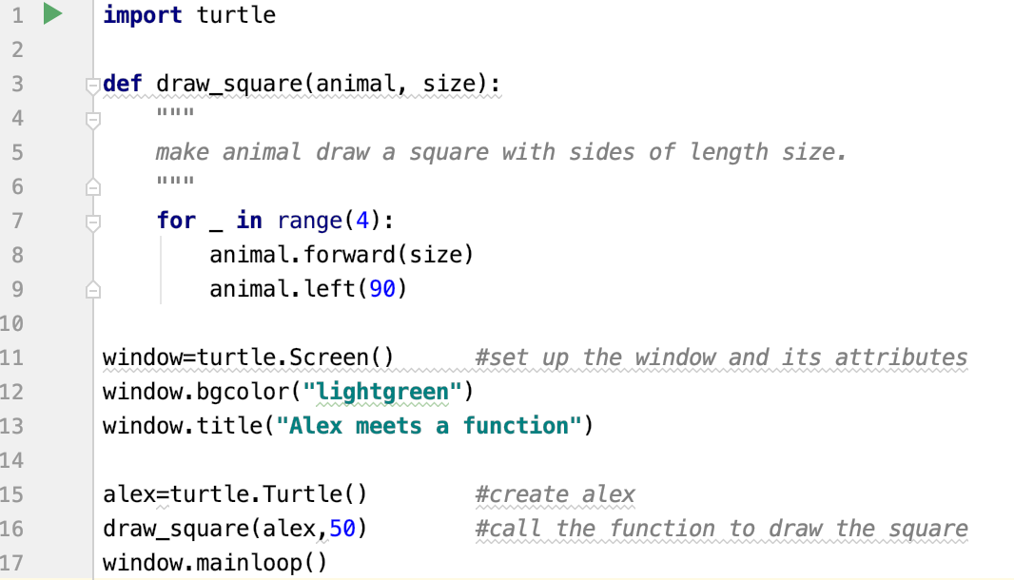
An example
A header line which begins with a keyword and ends with a colon.
A body consisting of one or more Python statements, each indented the same amount (4 spaces recommended ) from the header line.
Call the function with the right parameters

Slide 15
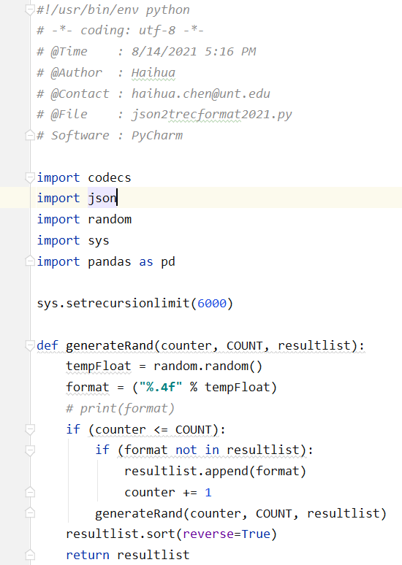
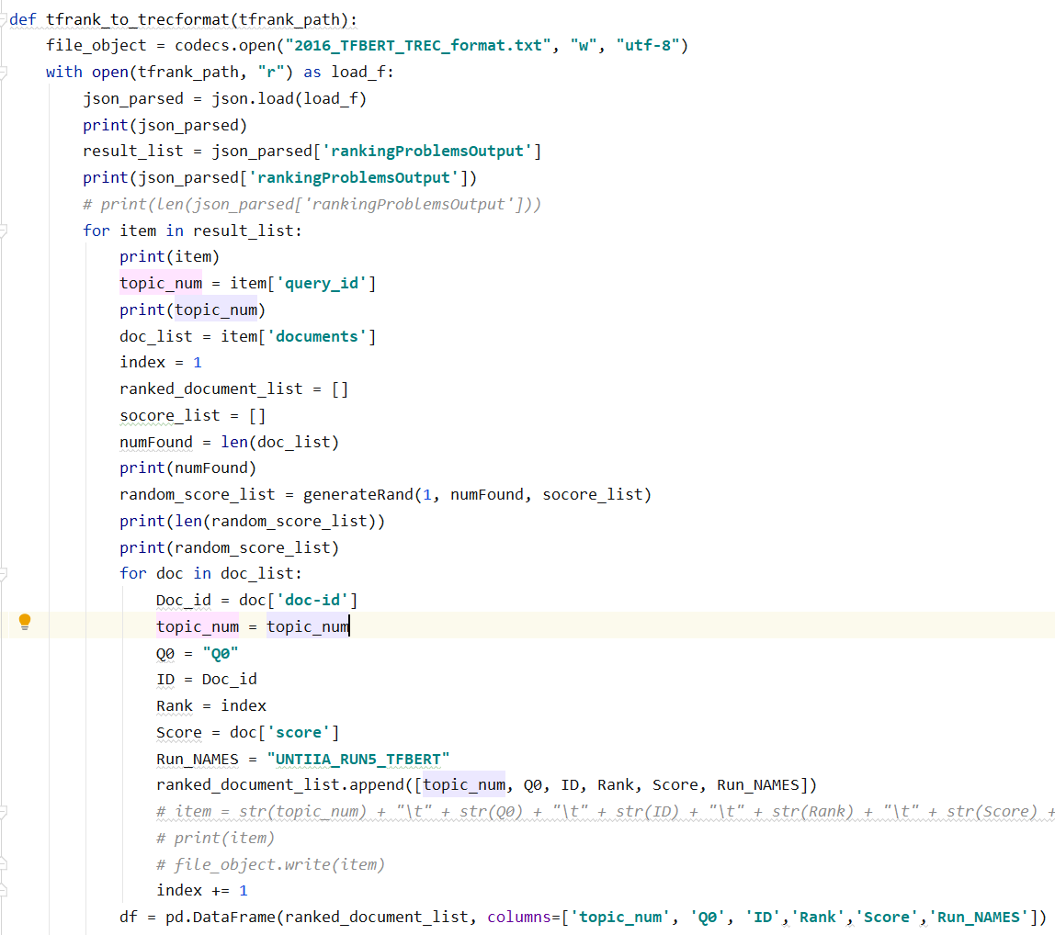
A further example

Slide 16
Functions can call other functions
Write a function which can draw a rectangle
Call the function with different arguments for width and height
We cannot repeat the same things 4 times, as the four sides are not equal

Slide 17
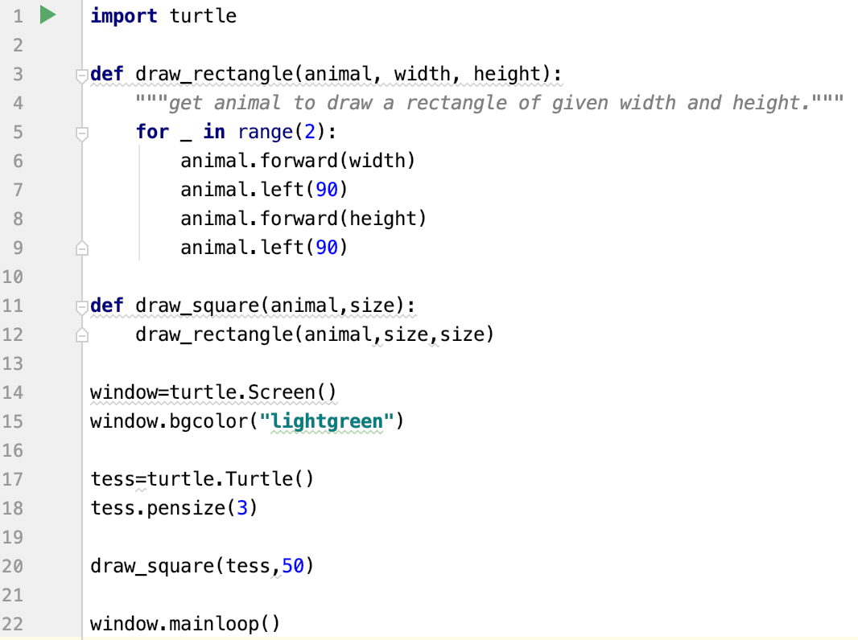
Functions can call other functions
Functions can call other functions.
draw_square(tess,50), animal and size are assigned the values of the tess object, and the int 50 respectively.
They are just like any other variable.
Draw_rectangle(animal,size,size), animal is assigned tess, the two sizes are assigned the value of 50.

Slide 18
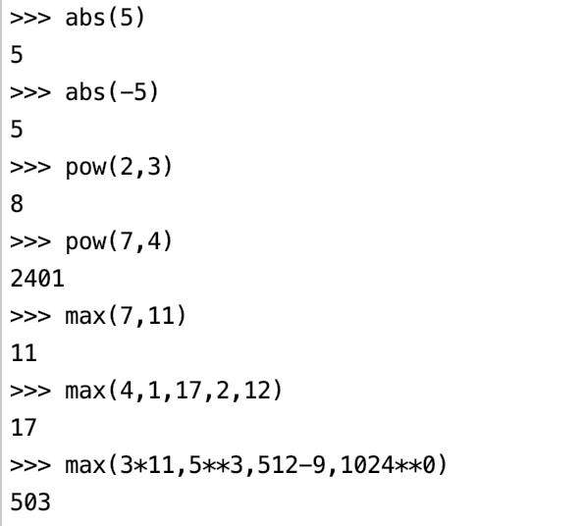
Functions that require arguments
The function abs require one argument
The function pow require two arguments
The function max could accept at least 2 arguments.

Slide 19
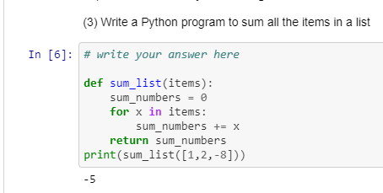
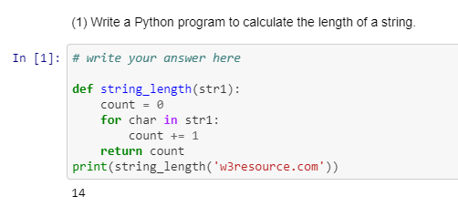
Functions can return values
Return the sum
Return the length

Slide 20
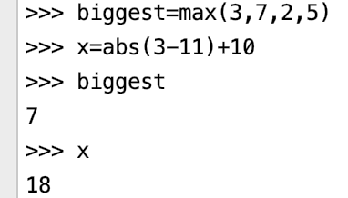
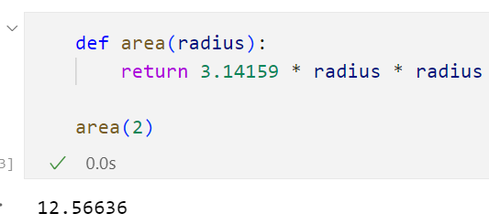
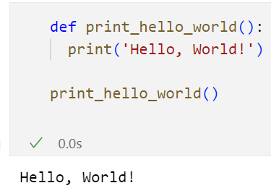
fruitful function
A function that returns a value is called a fruitful function
The opposite of a fruitful function is void function.
Notes:
Fruitful function: Some of the functions we are using, such as the math functions, yield results
Void function: like print_twice, perform an action but don't return a value.

Slide 21
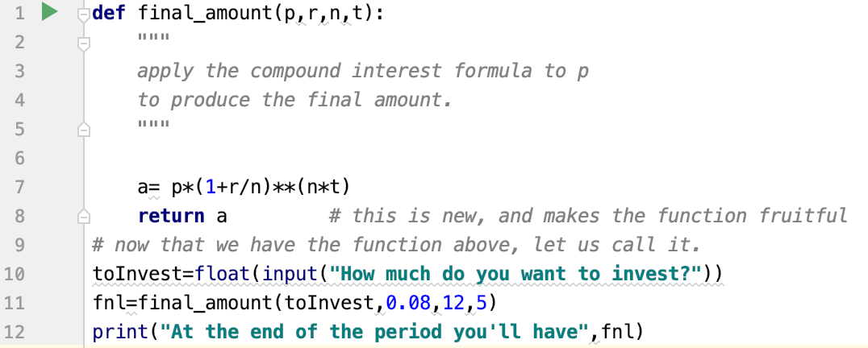
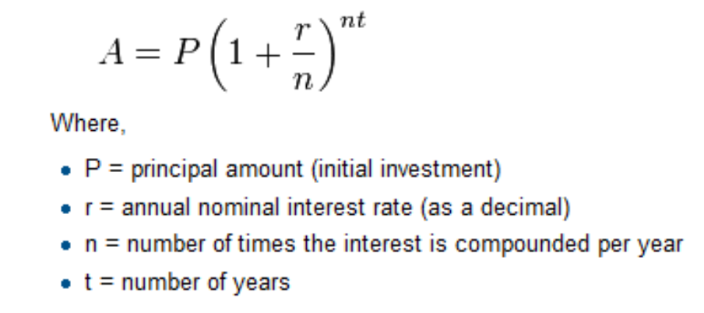
An example of fruitful function

Slide 22
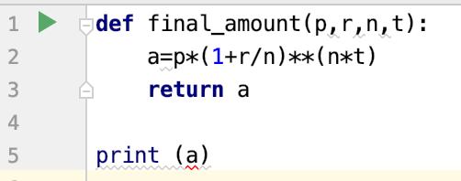
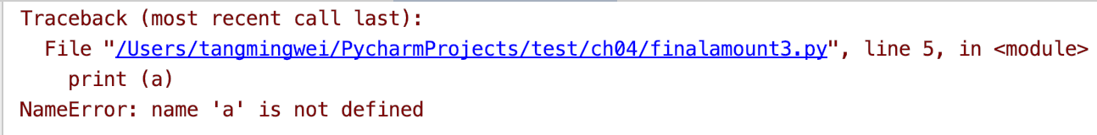
Variables and parameters are local
a is local variable
we can’t use outside the function of final_amount
p,r,n,t are all local variables

Slide 23
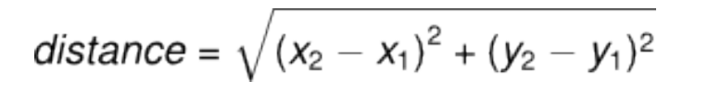
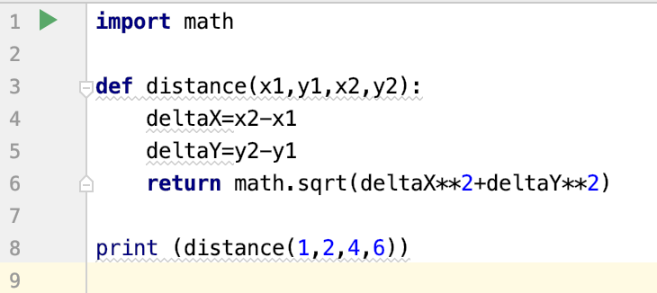
A further example
Calculate the distance between two points in two-dimensional space
Notes:
Squared Euclidean distance between 2 points

Slide 24
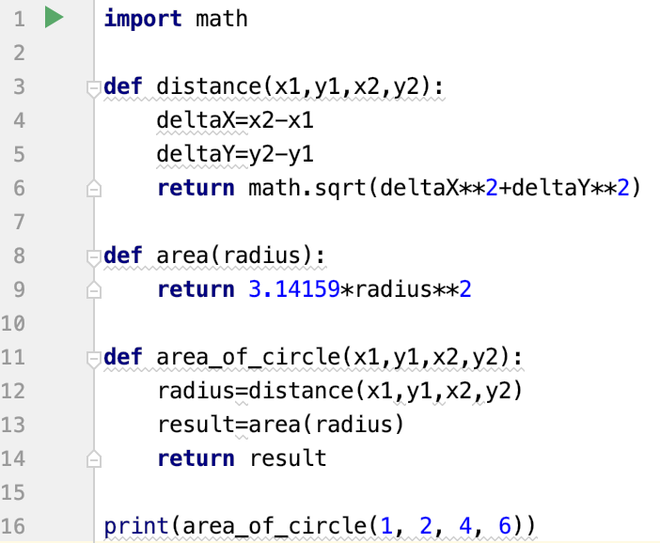
Composition – A good way to reuse your code
You can call one function from within another, it is called composition
Calculate the area according to the coordinate axis of two points

Slide 25
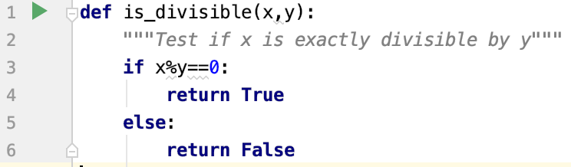
Boolean functions
Functions can return Boolean values.

Slide 26
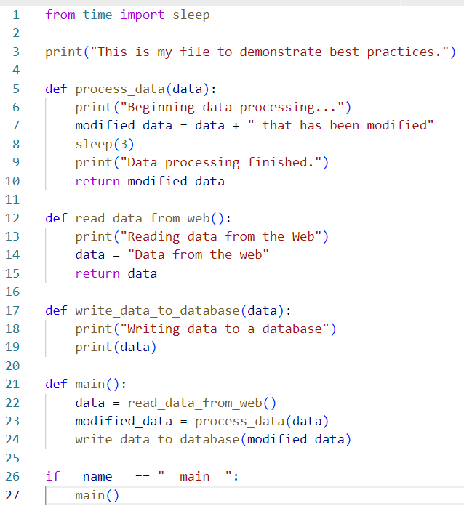
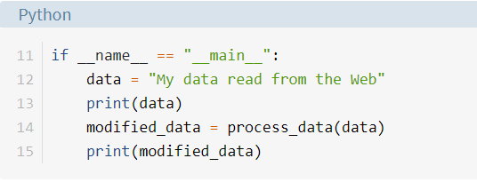
main functions
Use if __name__ == "__main__" to Control the Execution of Your Code.

Slide 27
4
Module and Package

Slide 28
Python Module
A module is a file containing Python definitions and statements.
A module can define functions, classes and variables.
A module can also include runnable code.
Grouping related code into a module makes the code easier to understand and use.
https://www.w3schools.com/python/python_modules.asp

Slide 29
Python Package
Packages are namespaces which contain multiple packages and modules themselves.
They are simply directories, but with a twist.
Each package in Python is a directory which MUST contain a special file called init.py. This file can be empty, and it indicates that the directory it contains is a Python package, so it can be imported the same way a module can be imported.
Grouping related code into a module makes the code easier to understand and use.
https://docs.python.org/3/tutorial/modules.html#package

Slide 30
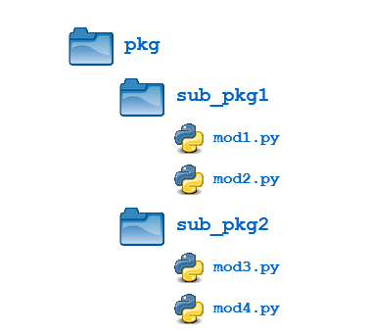
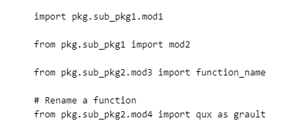
Python Package Structure

Slide 31
What is difference between a Python module and package?
A module is a single file (or files) that are imported under one import and used. E.g., import my_module
A package is a collection of modules in directories that give a package hierarchy.
E.g., from my_package.timing.danger.internets import function_of_love

Slide 32
Where to find Python packages?
https://pypi.org/

Slide 33
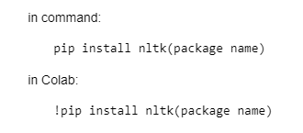
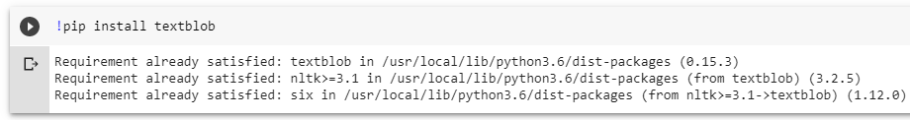
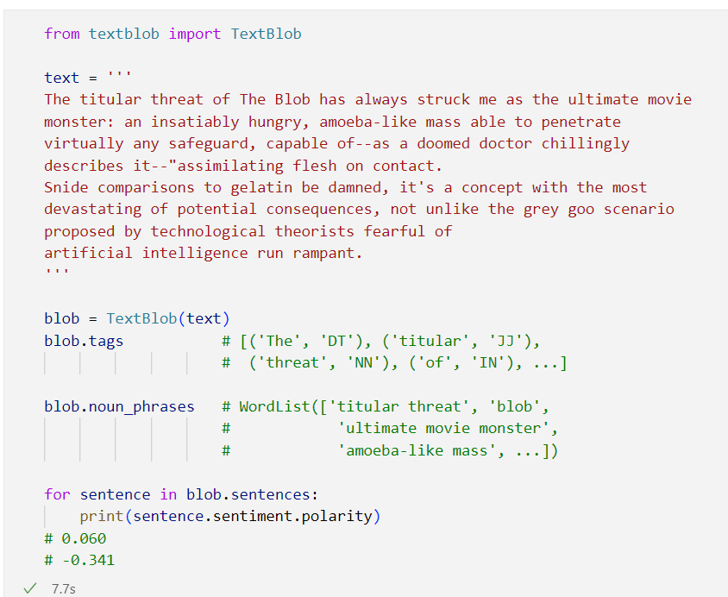
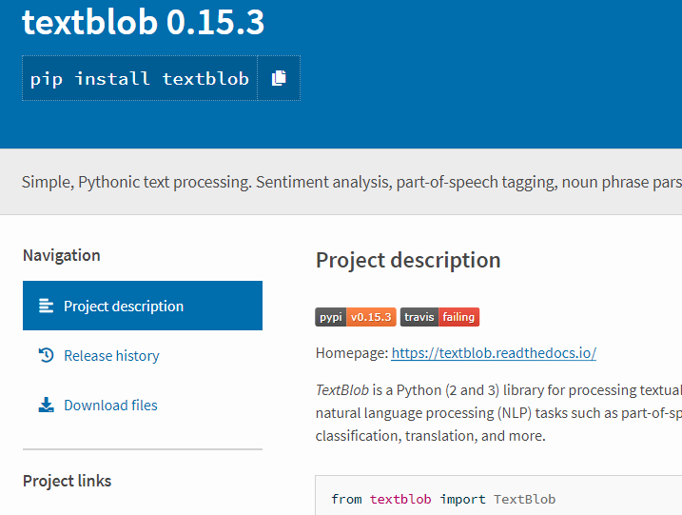
How to install and use a python package?
E.g., install textblob, a useful nlp package
https://pypi.org/
Notes:
https://textblob.readthedocs.io/en/dev/

Slide 34
5
Python JSON

Slide 35
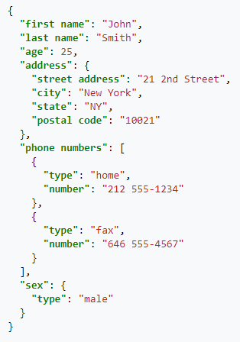
Python JSON
JavaScript Object Notation (JSON) is an open-standard file format or data interchange format that uses human-readable text to transmit data objects consisting of attribute–value pairs.
https://www.w3schools.com/js/js_json_intro.asp

Slide 36
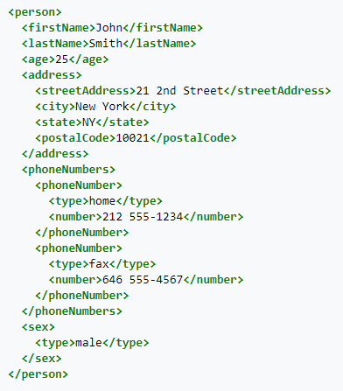
Python XML
Extensible Markup Language (XML) is a markup language that defines a set of rules for encoding documents in a format that is both human-readable and machine-readable.
https://www.w3schools.com/xml/xml_whatis.asp

Slide 37
What is difference between a Python JSON and Dictionary?
JSON stands for JavaScript Object notation and is an open standard human readable data format.
A python dictionary is a list that is indexed by key values.
It is apples vs. oranges comparison: JSON is a data format (a string), Python dictionary is a data structure (in-memory object).
If you need to exchange data between different (perhaps even non-Python) processes then you could use JSON format to serialize your Python dictionary.
https://www.w3schools.com/python/python_json.asp
Notes:
Json file example: https://support.oneskyapp.com/hc/en-us/articles/208047697-JSON-sample-files

Slide 38
6
Python Try Except

Slide 39
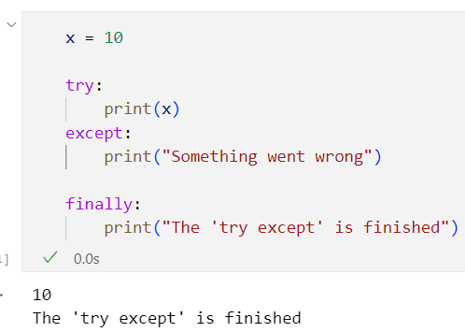
Python Try Except
The try block lets you test a block of code for errors.
The except block lets you handle the error.
The finally block lets you execute code, regardless of the result of the try- and except blocks.

Slide 40
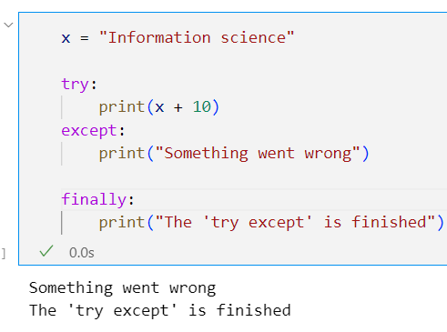
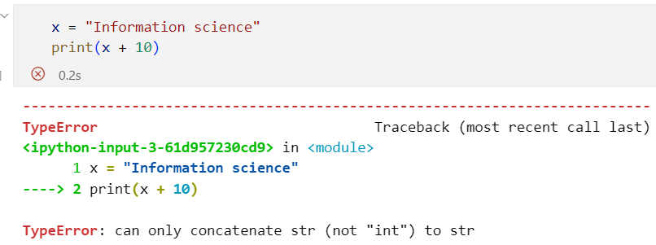
Why we need Try Except in our code
Since the try block raises an error, the except block will be executed.
Without the try block, the program will crash and raise an error:

Slide 41
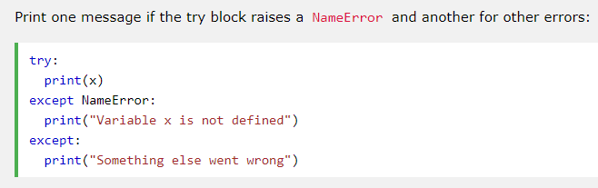
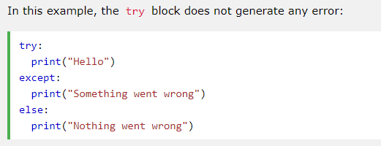
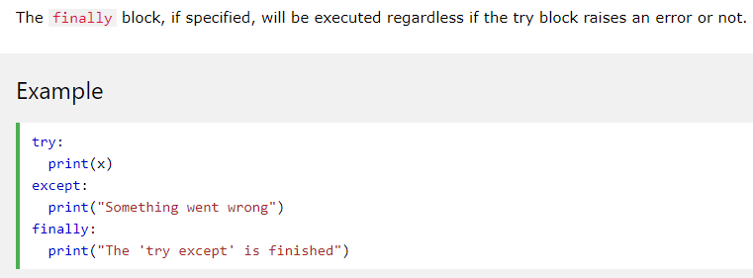
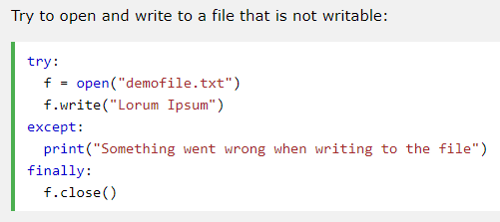
How to use Try Except
finally can be useful to close objects and clean up resources
The program can continue, without leaving the file object open

Slide 42

7
Classes and Objects

Slide 43

Python Object Oriented Programming (OOP)
Python is a multi-paradigm programming language, it supports different programming approach
One of the popular approach to solve a programming problem is by creating objects. This is known as Object-Oriented Programming (OOP).
The concept of OOP in Python focuses on creating reusable code.
An object has two characteristics: attributes and behavior

Slide 44
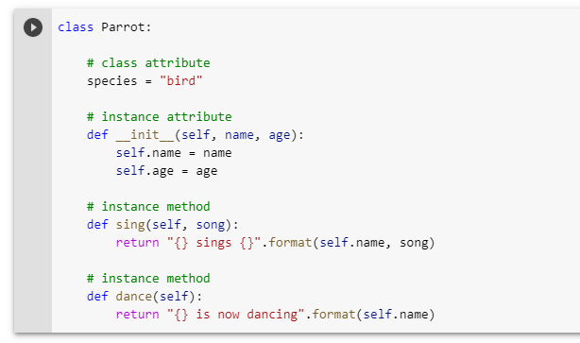
An example

Slide 45
What are classes and objects in Python?
Object is simply a collection of data (variables) and methods (functions) that act on those data. Class is a blueprint for the object.
We can think of class as a sketch (prototype) of a house. It contains all the details about the floors, doors, windows etc. Based on these descriptions we build the house. House is the object.
As, many houses can be made from a description, we can create many objects from a class. An object is also called an instance of a class and the process of creating this object is called instantiation.

Slide 46
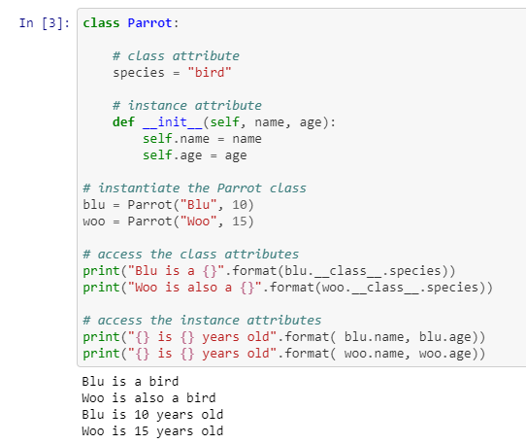
An example

Slide 47
Principles of OOP
Principles | Description
Inheritance | A process of using details from a new class without modifying existing class.
Encapsulation | Hiding the private details of a class from other objects.
Polymorphism | A concept of using common operation in different ways for different data input.

Slide 48

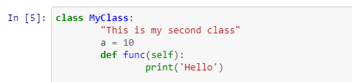
Defining a Class in Python
We define a class using the keyword class

Slide 49

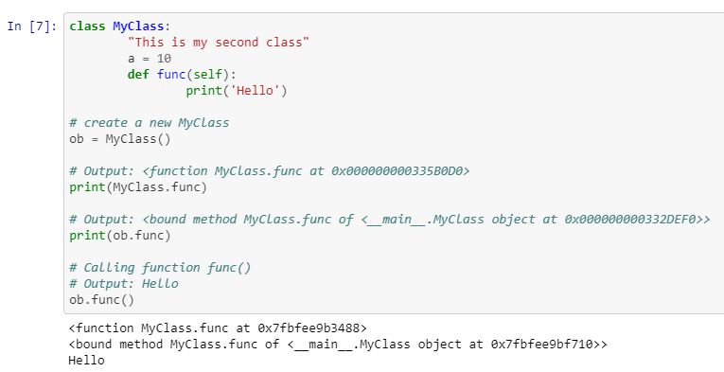
Creating an Object in Python
This will create a new instance object named ob. We can access attributes of objects using the object name prefix.
Attributes may be data or method. Method of an object are corresponding functions of that class.
This means to say, since MyClass.func is a function object (attribute of class), ob.func will be a method object.

Slide 50


Methods and Constructors in a Class
Methods are functions defined inside the body of a class. They are used to define the behaviors of an object.
Class functions that begin with double underscore (__) are called constructors, which get called whenever a new object of that class is instantiated

Slide 51

Inheritance
Inheritance is a way of creating a new class for using details of an existing class without modifying it. The newly formed class is a derived class (or child class). Similarly, the existing class is a base class (or parent class).

Slide 52

Encapsulation
Using OOP in Python, we can restrict access to methods and variables. This prevents data from direct modification, which is called encapsulation. In Python, we denote private attribute using underscore as prefix i.e., single “ _ “ or double “ __“.

Slide 53

Polymorphism
Polymorphism is an ability (in OOP) to use common interface for multiple form (data types).
Suppose, we need to color a shape, there are multiple shape option (rectangle, square, circle). However, we could use same method to color any shape. This concept is called Polymorphism.
Notes:
In the above program, we defined two classes Parrot and Penguin. Each of them have common method fly() method. However, their functions are different. To allow polymorphism, we created common interface i.e flying_test() function that can take any object. Then, we passed the objects blu and peggy in the flying_test() function, it ran effectively.

Slide 54
Advantages of Object Oriented Programming (OOP)
The programming gets easy and efficient.
The class is sharable, so codes can be reused.
The productivity of programmers increases.
Data is safe and secure with data abstraction.

Slide 55
Learn Python with ChatGPT
https://thedeveloperspace.com/learn-python-with-chatgpt/

Slide 56

Prepare Python for Interview

Slide 57
Thank you

