Slide 1
Backpropagation Observations on XOR 2-2-1
Litha Thampan

Slide 2
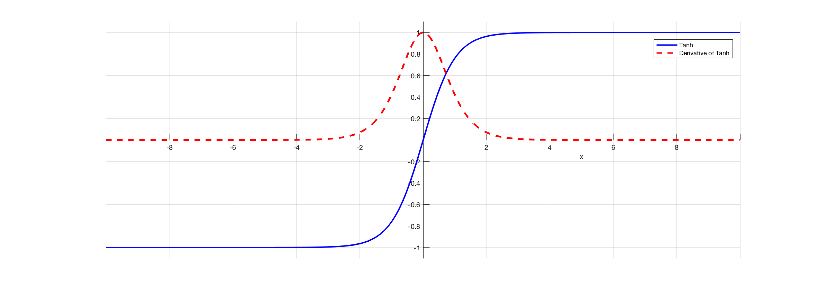
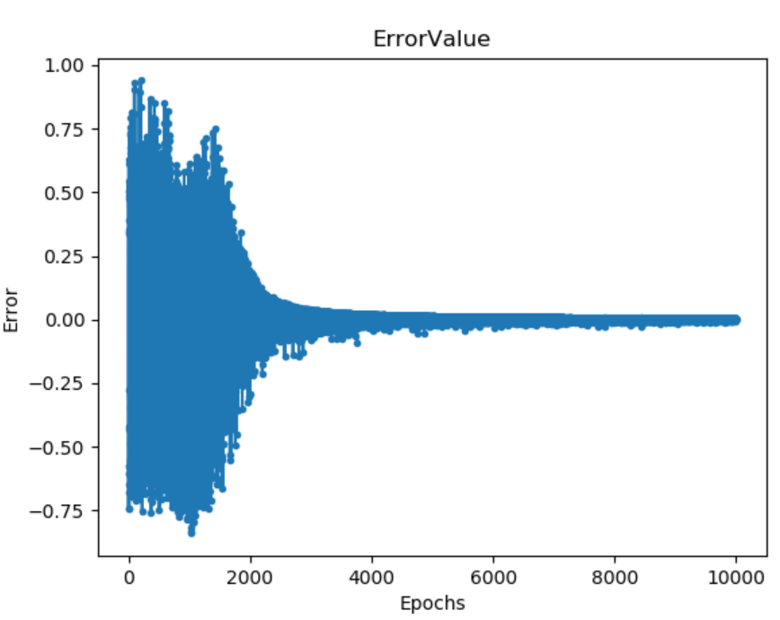
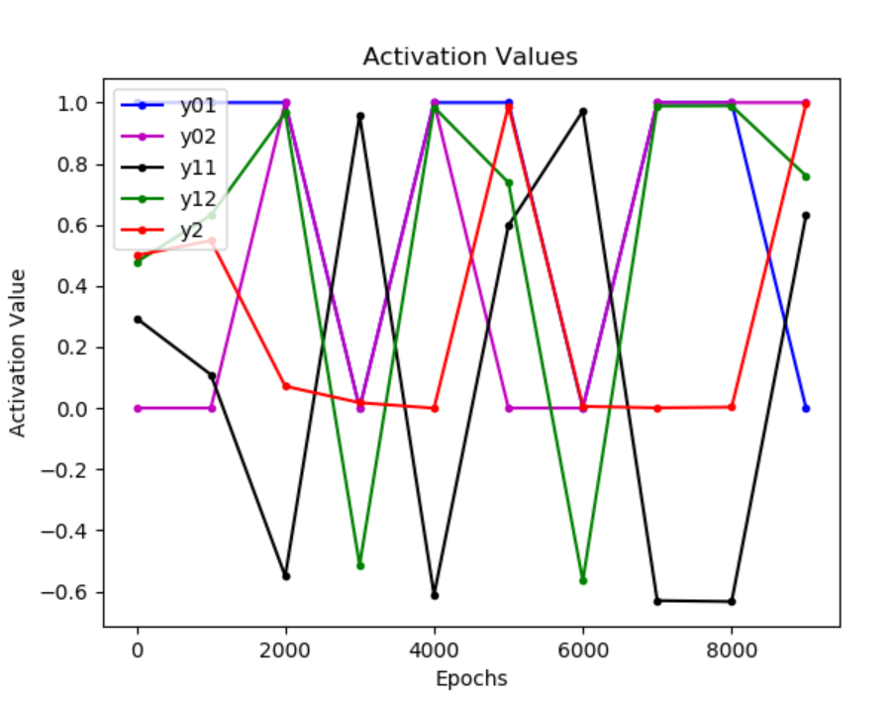
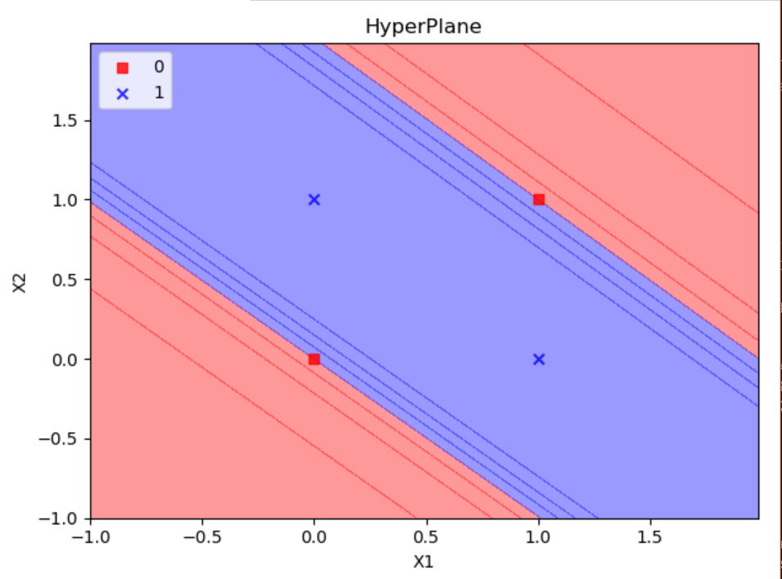
Algorithm Observations
TanH function is used in the algorithm as the sigmoid function.
HyperPlane become parallel area between tangent 0,0 and 1,1
Errors mostly resolved after 2000 epochs due to gradient descent
One of the first layer activations becomes negative when both inputs are same (0,0 and 1,1).

Slide 3
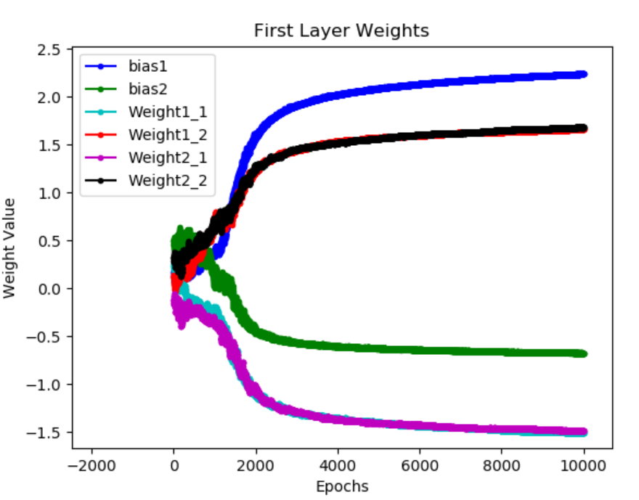
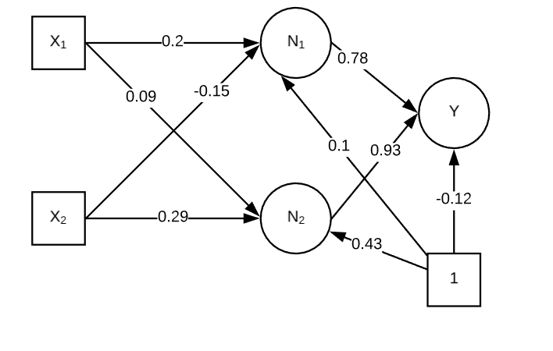
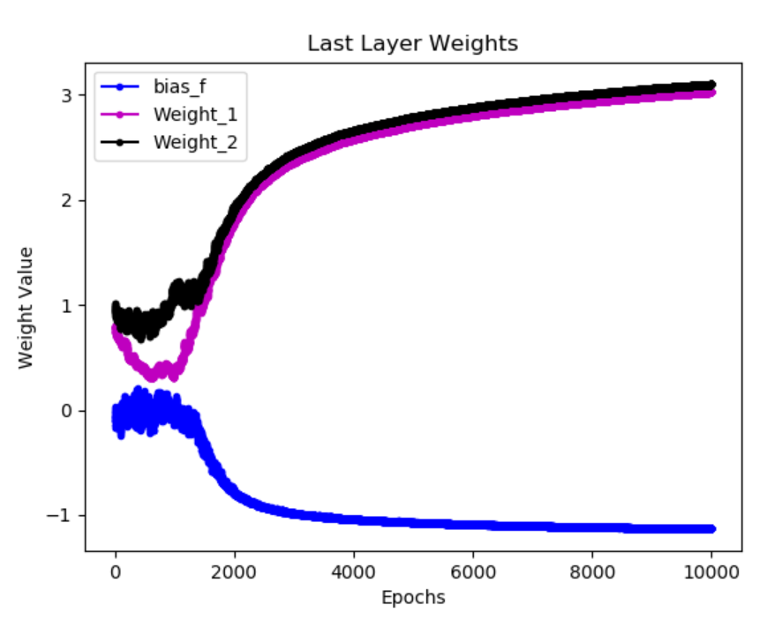
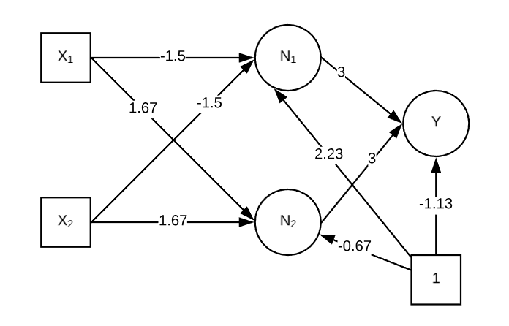
Weights and Bias Observations
First Layer Weights and Bias tended to
W₁₁ : -1.5 W₁₂ : 1.67 b₁ : 2.23
W₂₁ : -1.5 W₂₂ : 1.67 b₂ : -0.67
Last Layer Weights and Bias tended to
W₁ : 3 W₂ : 3 b : -1.13

Slide 4
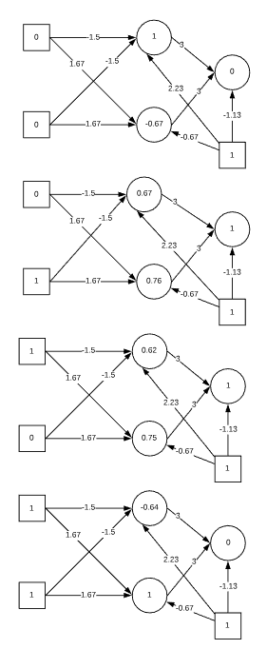
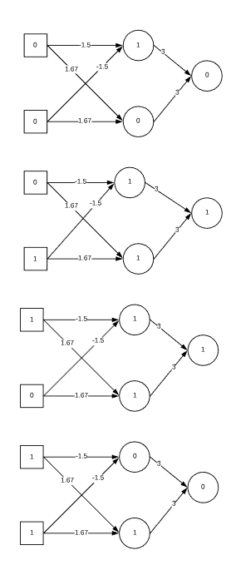
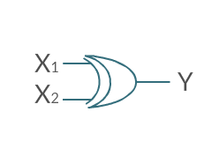
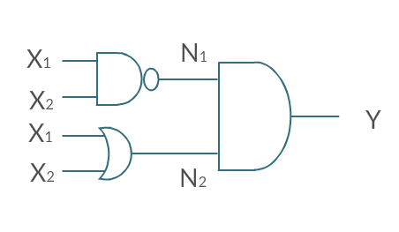
Middle Layer Observations
If there is no middle layer, the weights and biases cannot reach a correct value as the function would be symmetric and will not get a proper bias to overshoot the product.
Middle Layer solves that problem and deciphers problem into Logical layers.
Observing the behaviour of the Middle Layer, one of them acts as a NAND gate and other as an OR gate. The last layer acts as an AND gate.
Thus XOR(X₁,X₂)
= AND(NAND(X₁,X₂),OR(X₁,X₂) )

