Slide 1
Observations about Bagging Ensemble method on Iris Data
Litha Thampan

Slide 2
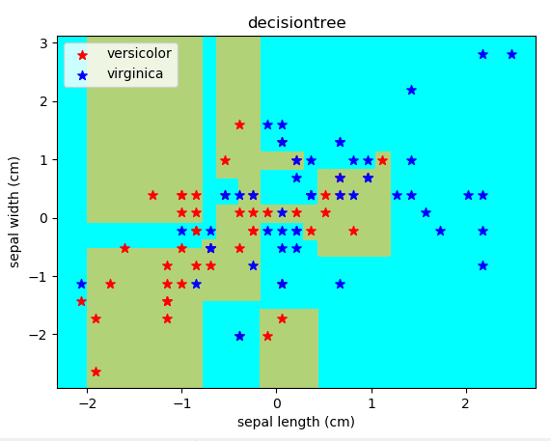
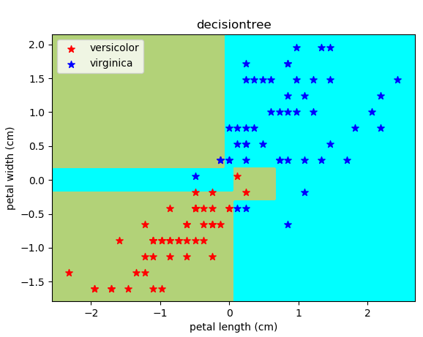
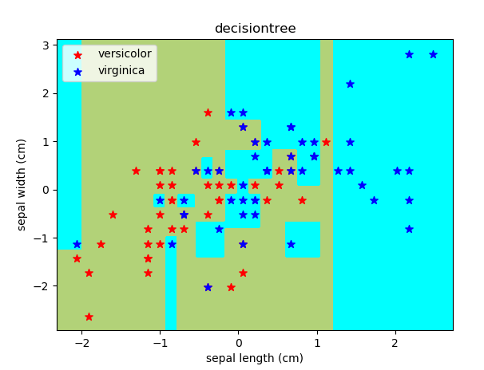
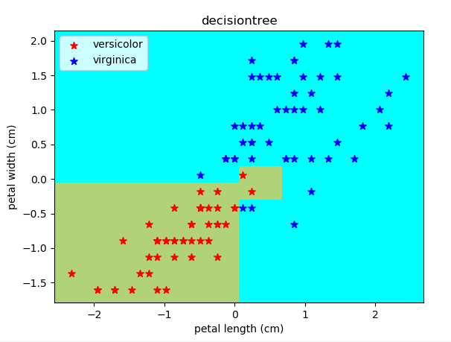
Base Estimator (Decision Tree)
Decision Tree Classifier was used on Iris Data on Sepal features and Petal features using 70/30 train-test split
Sepal features tree had 55 nodes and score of 0.8
Petal features tree had 13 nodes and score of 0.98
Max accuracy (100% training set) creates 81 node tree(score 0.89) and 13 node tree (score 0.99) respectively.

Slide 3
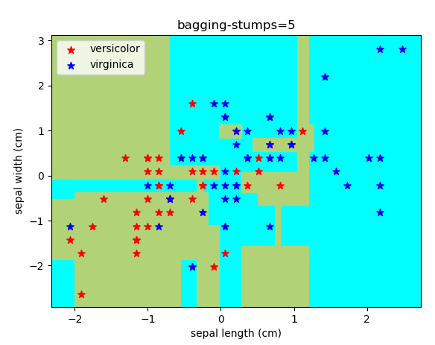
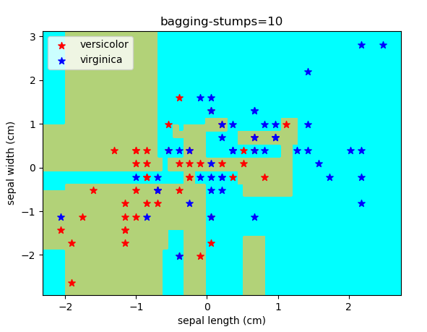
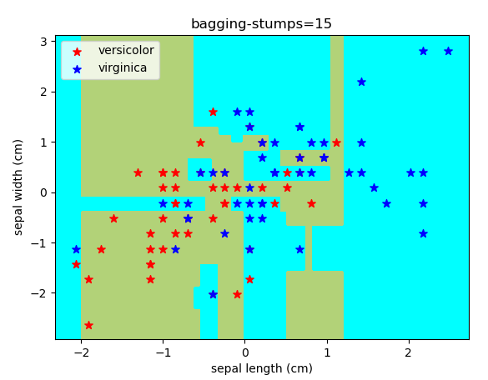
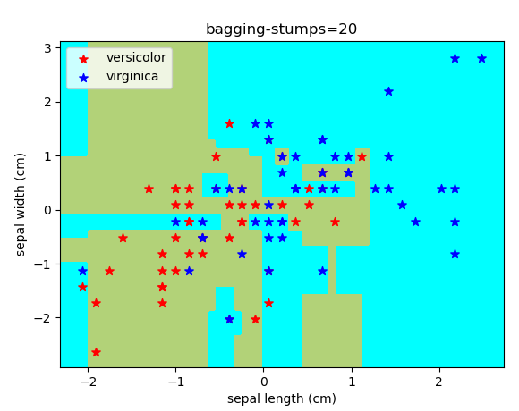
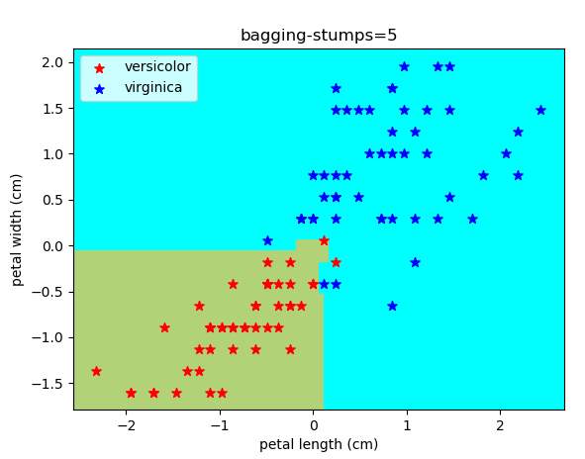
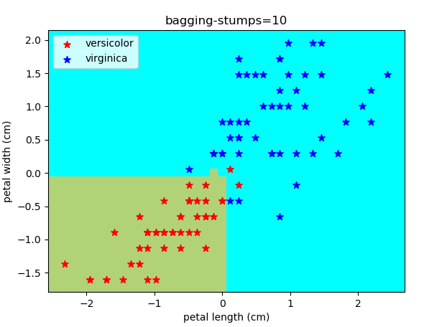
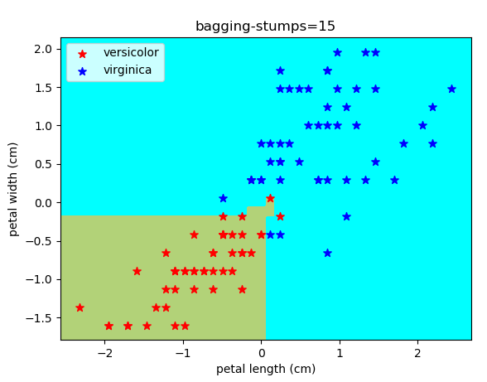
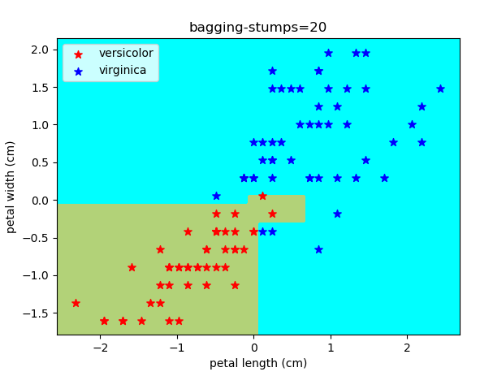
Bagging Classifier
Base estimator was used with bagging with 5 trees to 20 trees.

Slide 4
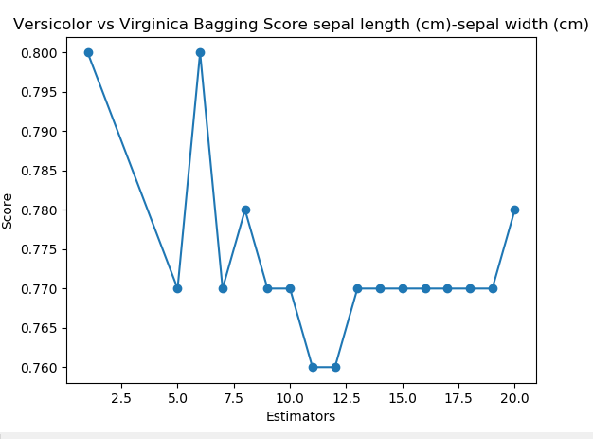
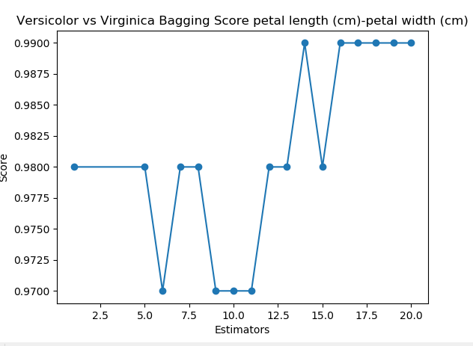
Bagging Classifier
Score started showing less variance with increased number of trees bagged.
Score stabilized around 0.77 for sepal features and around 0.99 for petal features.
Decision Tree
Decision Tree

