Slide 1
Observations about Lasso and Ridge Regressions on Iris Data
Litha Thampan

Slide 2
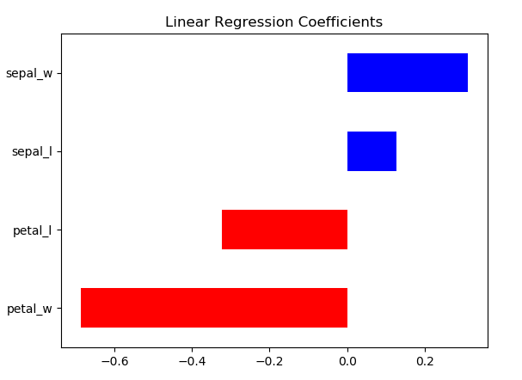
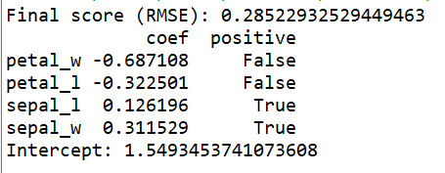
Linear Regression
Linear Regression was applied for Versicolor and Virginica with all 4 features.
RMSE Score = 0.2852 with Y intercept at 1.5493
Regression coefficients plotted for all 4 features.

Slide 3
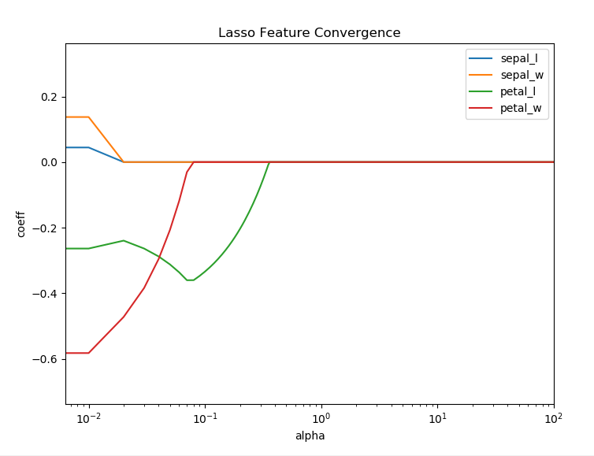
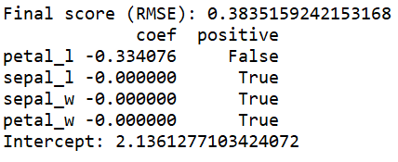
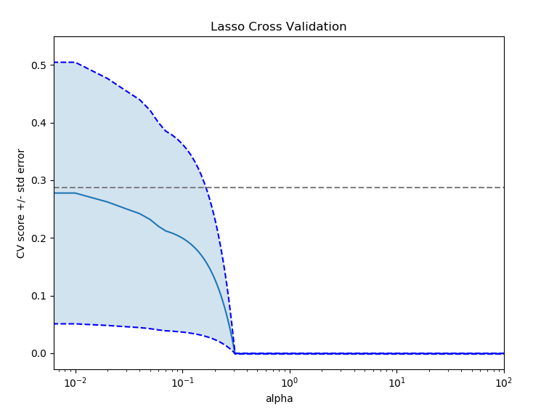
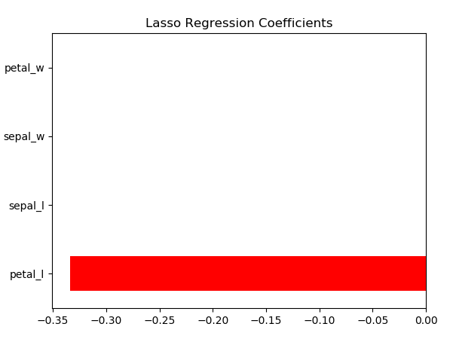
Lasso Regression
Lasso Regression (L1) applied with alpha 0.1
RMSE Score = 0.3835 with Y intercept at 2.1361
Increasing the alpha converges more features to Zero.
Feature coeffeicient and Cross validation score was plotted in a logarithmic scale for alpha ranging from 0 - 100 (with 0.01 increments)
Petal length converges last and has the least effect on penalisations .
Feature coefficients converges to Zero value at one point.
Alpha 0.1

Slide 4
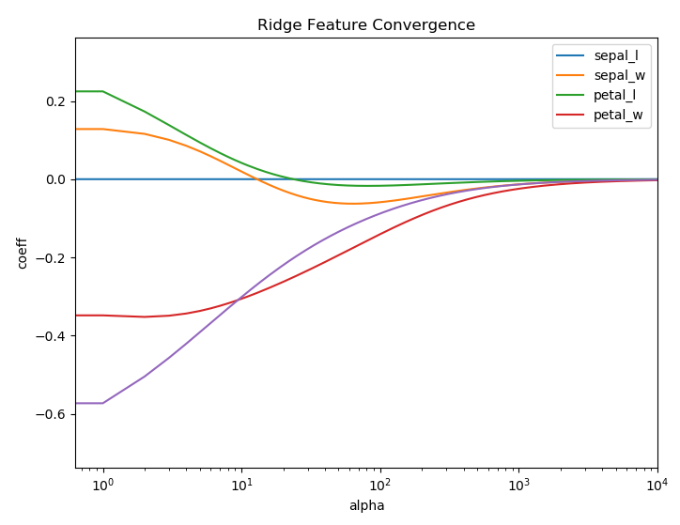
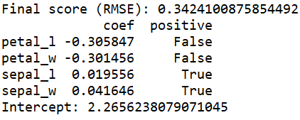
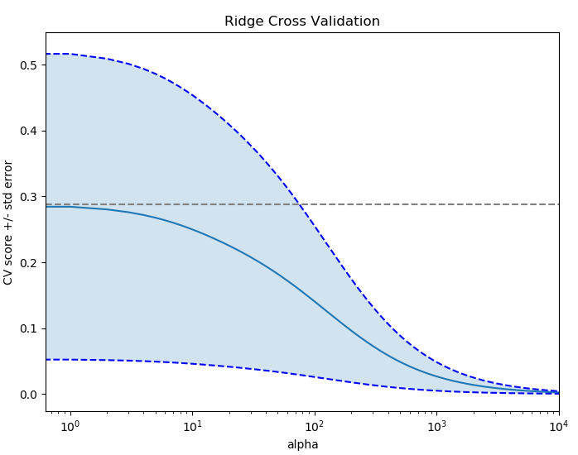
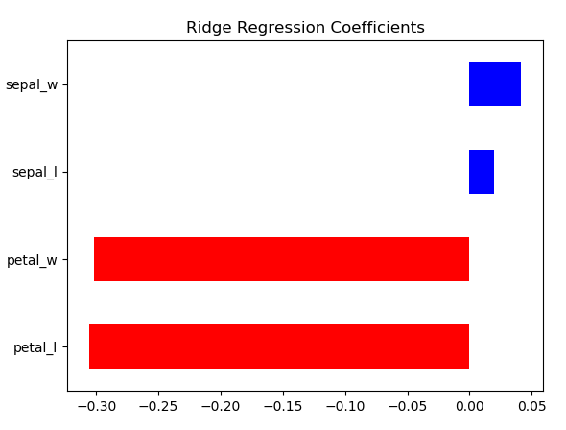
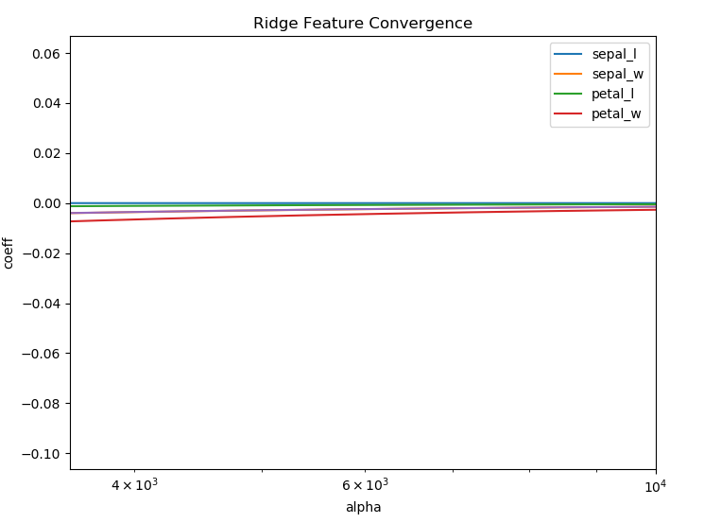
Ridge Regression
Ridge Regression (L2) applied with alpha 10
RMSE Score = 0.3424 with Y intercept at 2.2656
Increasing alpha causes features to tend to Zero
Feature coeffeicient and Cross validation score was plotted in a logarithmic scale for alpha ranging from 0 - 10,000 with increments of 1
Petal length and Petal width are the least penalised coefficients at alpha = 10
Feature coefficients never really reach Zero value.
Alpha 10

Slide 5
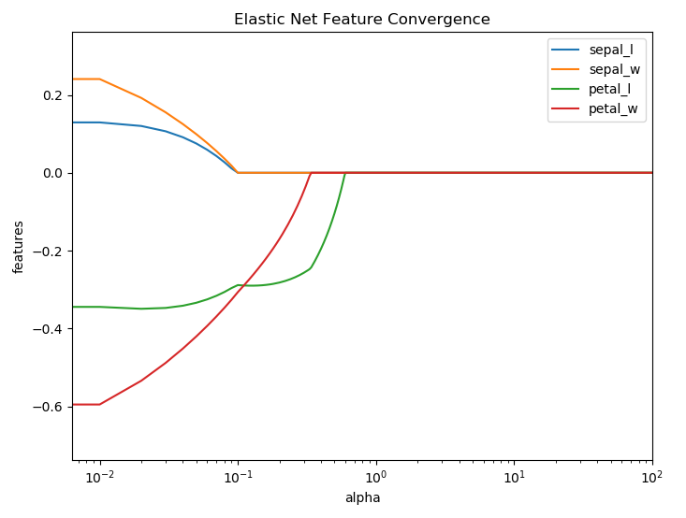
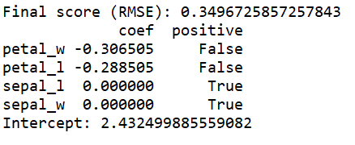
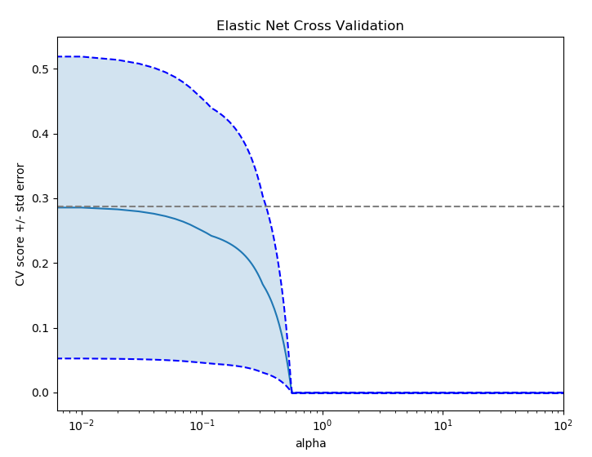
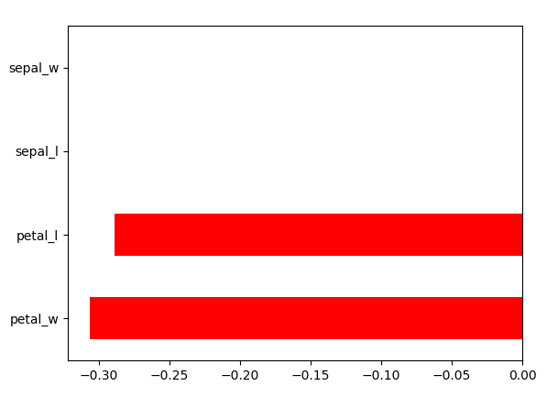
Elastic Net Regression
Elastic Net Regression applied with alpha 0.1 and l1_ratio of 0.1
Hybrid between Lasso and Ridge behavior
RMSE Score = 0.3497 with Y intercept at 2.4324
Increasing alpha causes features to converge to Zero
Feature coeffeicient and Cross validation score was plotted in a logarithmic scale for alpha and l1_ration ranging from 0 - 100 (with 0.01 increments)
Petal length and Petal Width converges last and has the least effect on penalisations .
Feature coefficients converges to Zero value at one point.
alpha 0.1 l1_ratio 0.1

