Slide 1
Observations on Linear SVM and SVD on Iris Data
Litha Thampan

Slide 2
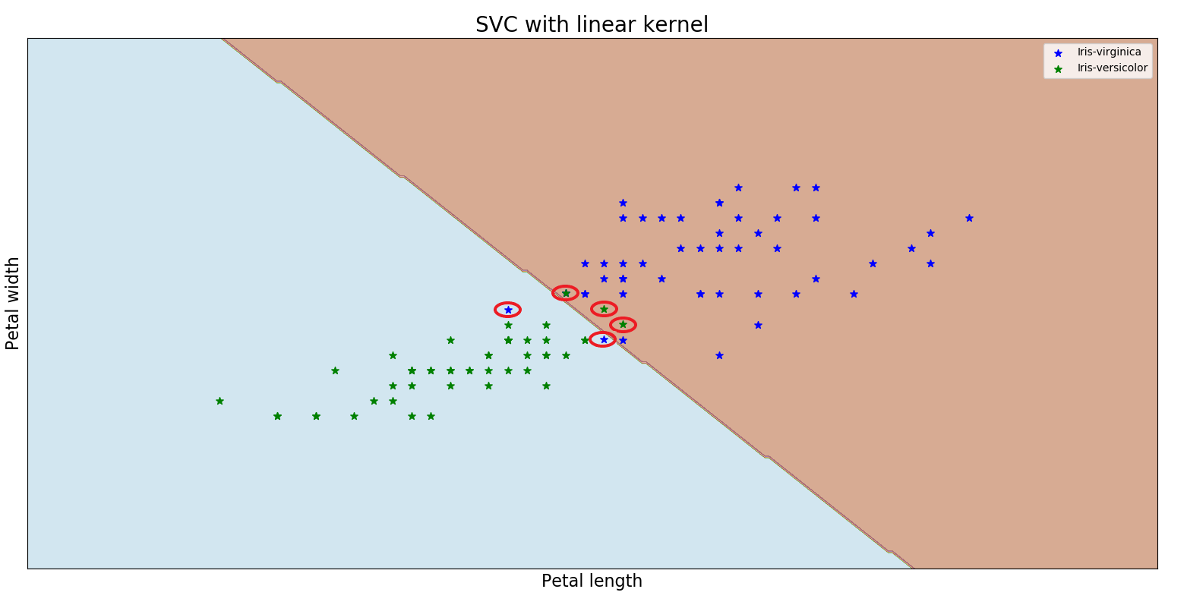
Linear Support Vector Classification
Linear SVC was applied on the Petal Length and Petal Width for Versicolor and Virginica
Since they are not linearly seperable, the decision boundary was drawn for the least error value as shown in the below plot.
Mean Accuracy Score from SVC = 95% , Error 5 %

Slide 3
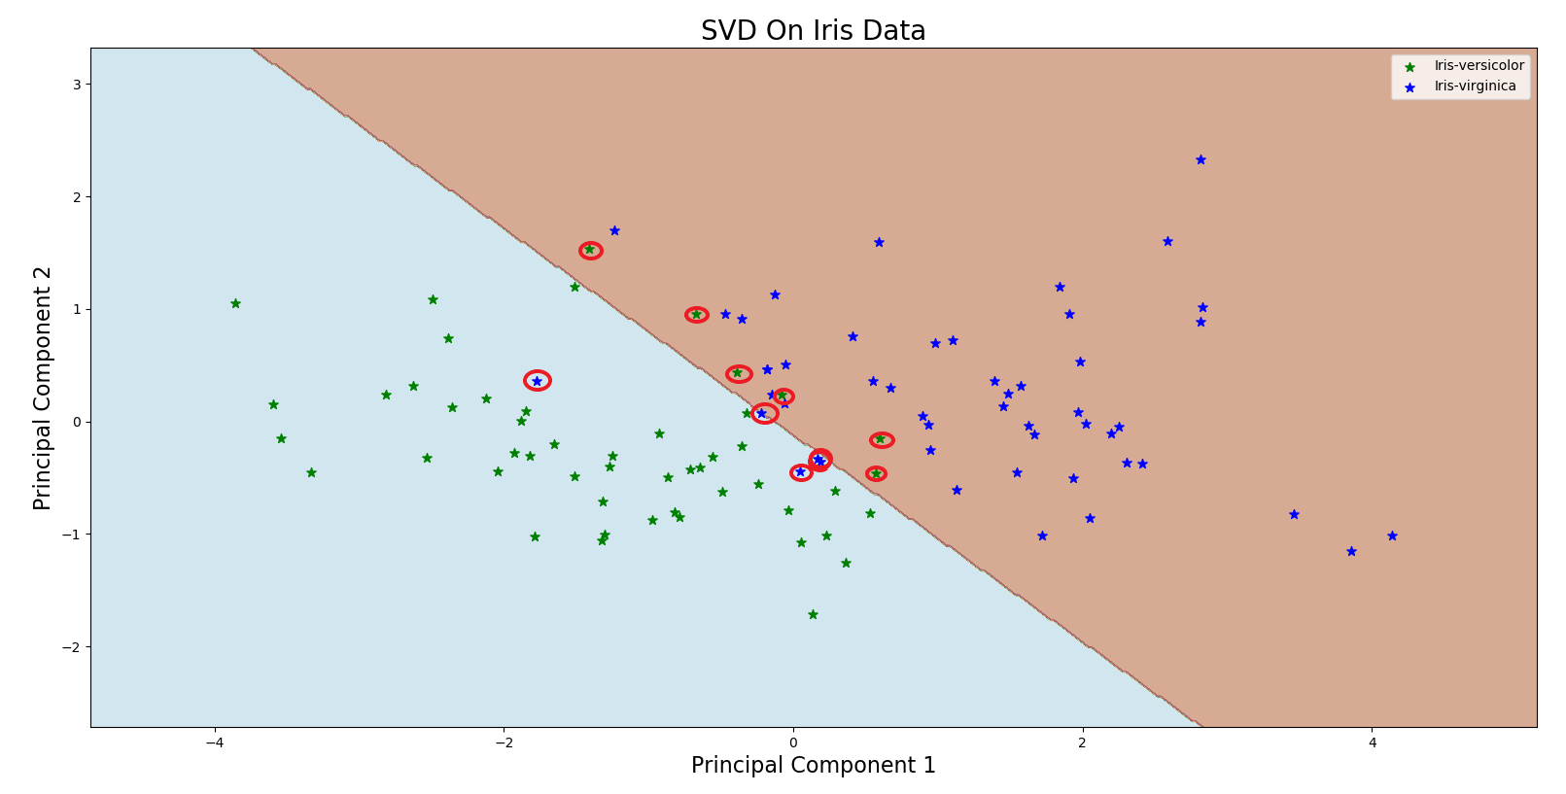
Singular Value Decomposition
For Versicolor and Virginica, all 4 features were used for singular value decomposition.
First eigenvector (principal component) calculated has 73.95% accuracy. Second eigenvector added additional 13.88 , making an overall 87.83% accuracy.
Both eigenvectors were plotted against each other as shown below
Mean Accuracy score from SVC = 89% Error = 11 %
This reduces the complexity of visualizing the classification to two dimension from original 4 dimensions without compromizing much of the accuracy.

