Slide 1
PR Project
Wine Classification and correlation
Course Instructor: Dr. Anish Chand Turlapaty
Group - 6
Kakarla V S S Pavan Teja {S20190020216}
K Sreenivasulu Reddy {S20190020217}
K Litheesh Kumar {S20190020218}

Slide 2
Introduction
Here we will classify the wine on the basis of given features. We used the wine quality dataset downloaded from Kaggle and UCI.
This dataset has the fundamental features which are responsible for affecting the quality of the wine.
By the use of several Machine learning models, we will classify the wine.

Slide 3
Introduction
We use classification techniques to check further the correlation of fundamental features like
fixed acidity
volatile acidity
citric acid
residual sugars
chlorides
free sulphur dioxide
Density
pH
sulphates
alcohol
total sulphur dioxide
quality

Slide 4
Implementation - Matlab
Combined both white wine and red wine datasets
White wine -1
Red wine - 0
Normalized the features so that equal distribution of variance will be there for all features
Trained these features to Logistic Regression, Gaussian SVM, Neural Network Classifiers and Linear Discriminant, obtained confusion matrices, accuracy, ROC Curves
Tested the data using above trained models, result is the test accuracy

Slide 5
Implementation (Contd.)
Applied Principal Component Analysis or PCA
PCA is keeping enough components to explain 95% variance. After training, 9 components were kept.
Explained variance per component (in order): 27.5%, 22.3%, 14.4%, 8.8%, 6.6%, 5.6%, 4.8%, 4.6%, 3.1%, 2.1% (variances of least important components hidden)

Slide 6
Classifiers used
Logistic Regression
Gaussian SVM
Linear Discriminant
Neural networks

Slide 7
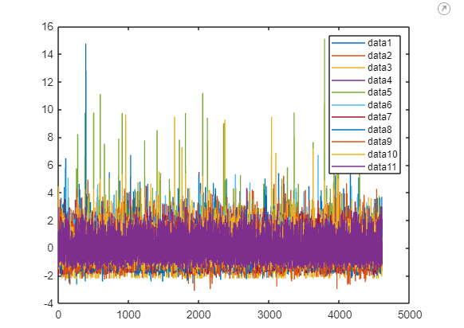
Results

Slide 8
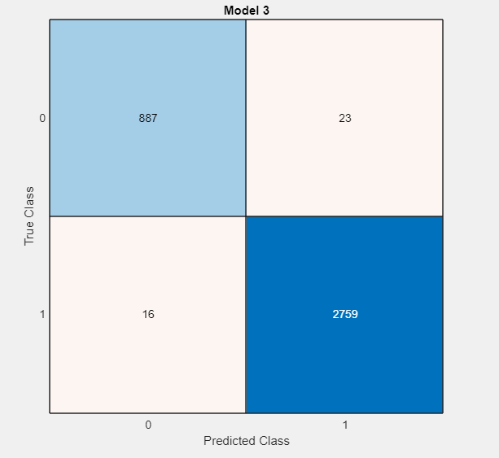
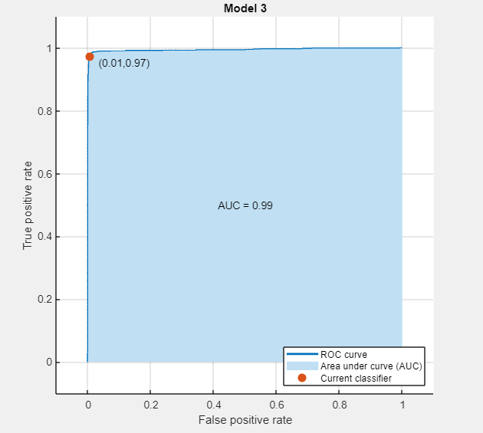
Results (Contd.) - Logistic Regression (Training)
Confusion Matrix
ROC Curve

Slide 9
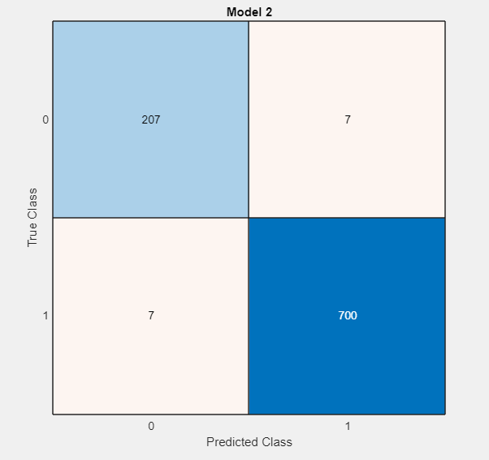
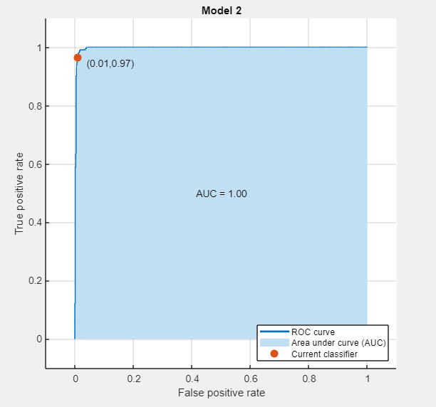
Results (Contd.) - Logistic Regression (Tested)
Confusion Matrix
ROC Curve

Slide 10
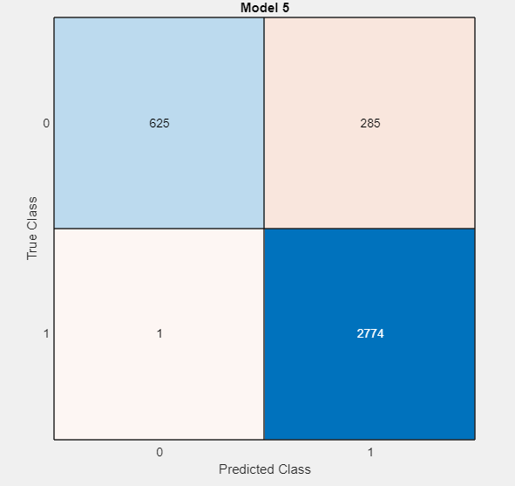
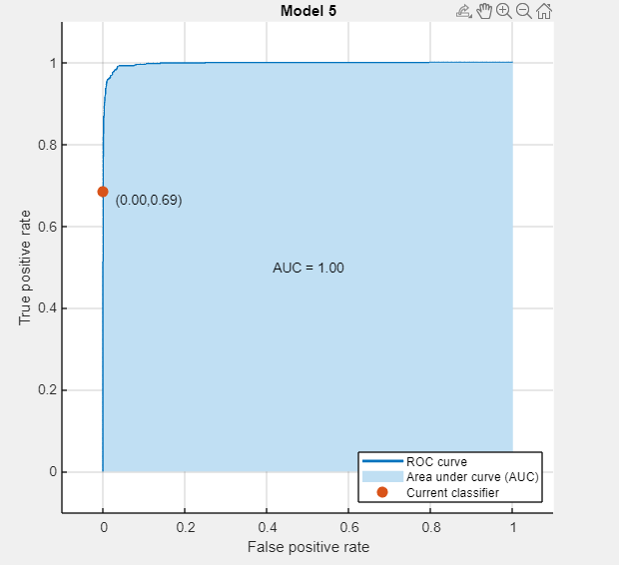
Results (Contd.) - Gaussian SVM (Training)
Confusion Matrix
ROC Curve

Slide 11
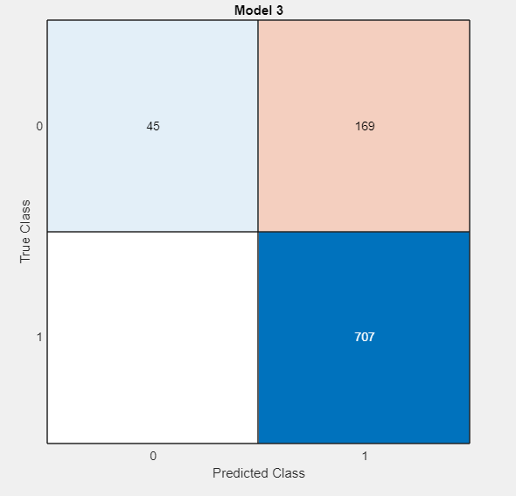
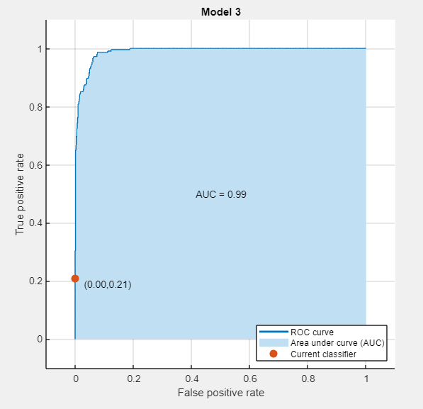
Results (Contd.) - Gaussian SVM (Tested)
Confusion Matrix
ROC Curve

Slide 12
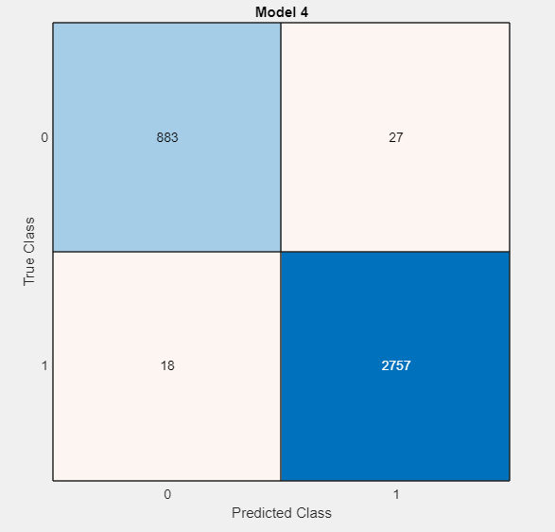
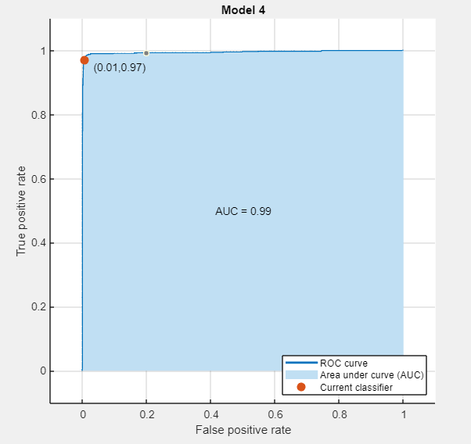
Results (Contd.) - Linear Discriminant (Training)
Confusion Matrix
ROC Curve

Slide 13

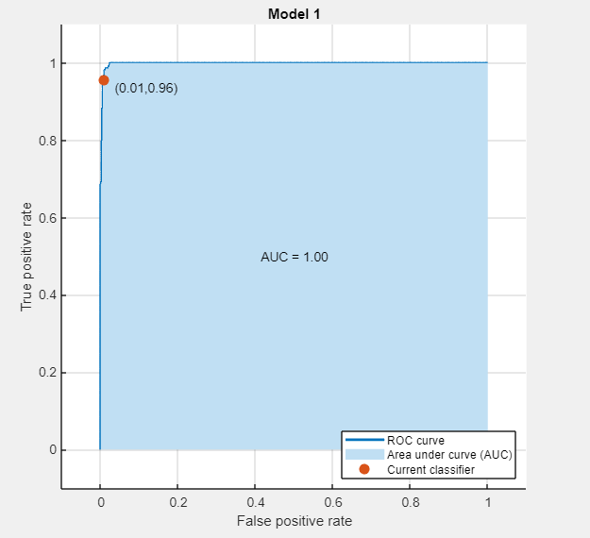
Results (Contd.) - Linear Discriminant (Tested)
Confusion Matrix
ROC Curve

Slide 14
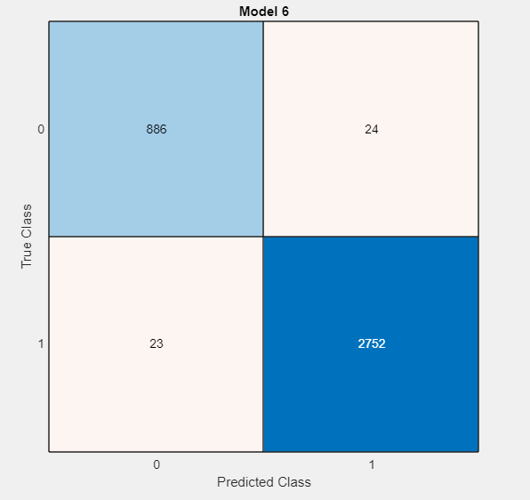
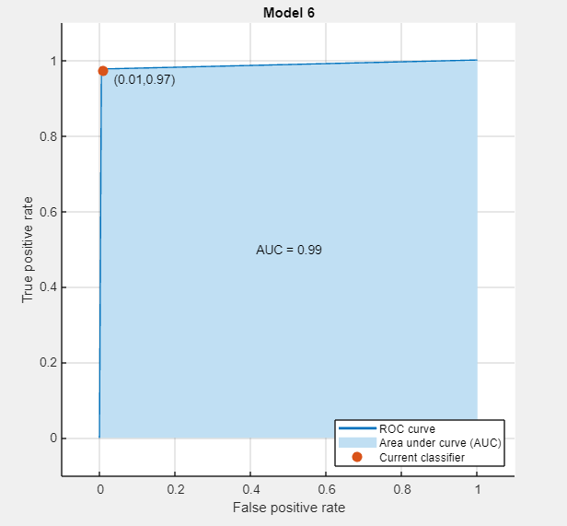
Results (Contd.) - Neural Networks (Training)
Confusion Matrix
ROC Curve

Slide 15

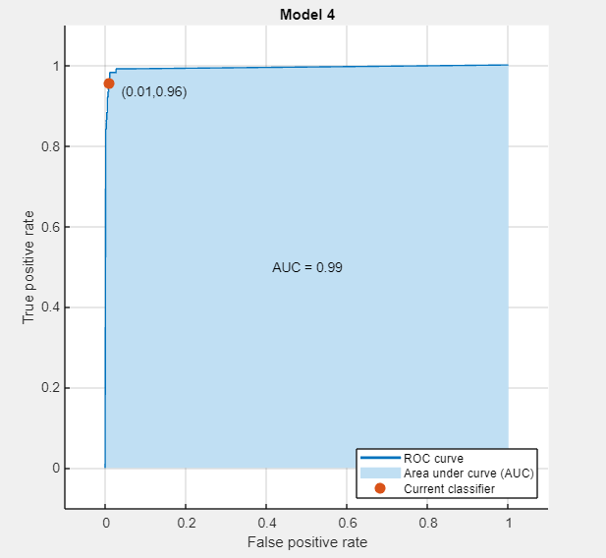
Results (Contd.) - Neural Networks (Tested)
Confusion Matrix
ROC Curve

Slide 16
Results (Contd.)
Logistic Regression:
Validation Accuracy – 99.3%
Test Accuracy – 99%
Gaussian SVM:
Validation Accuracy – 92.5%
Test Accuracy – 89%
Linear Discriminant:
Validation Accuracy— 97.5%
Test Accuracy – 98.3%
Neural Networks:
Validation Accuracy – 99.3%
Test Accuracy – 99.6%

Slide 17
Implementation - Python
We are going to predict the quality of wine on the basis of given features.
Downloaded wine quality dataset from Kaggle
Dataset has the fundamental features which are responsible for affecting the quality of wine
Debited correlations of fundamental features and quality

Slide 18
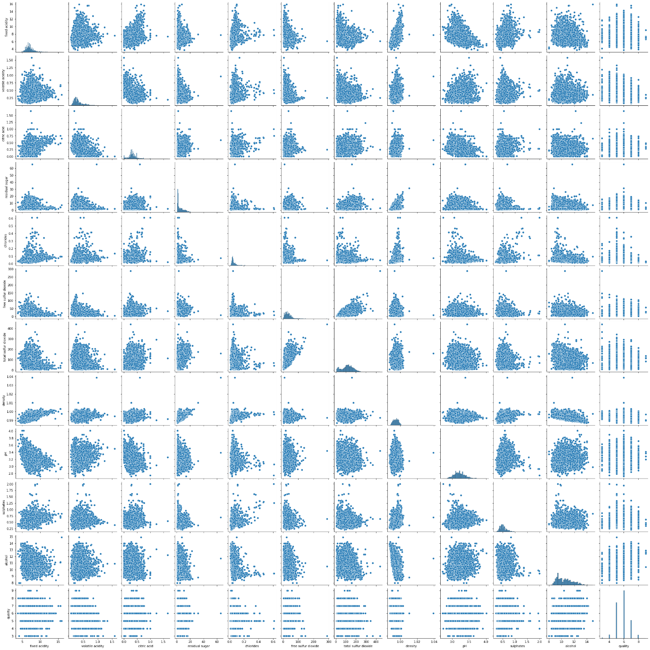
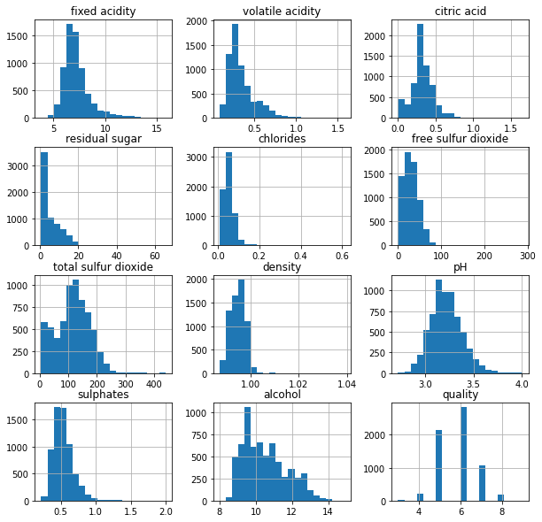
Results (Contd.) - Data Visualization and Histogram

Slide 19
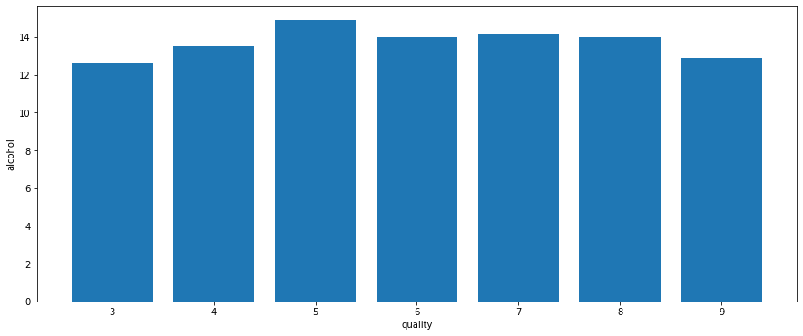
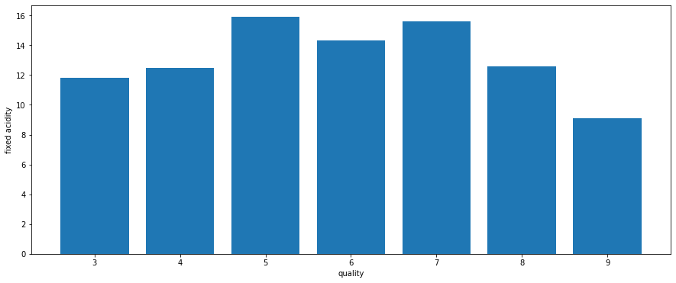
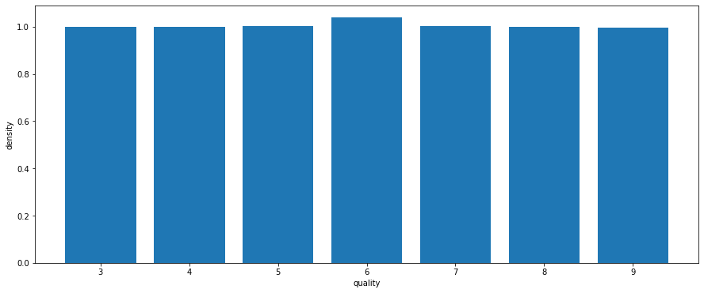
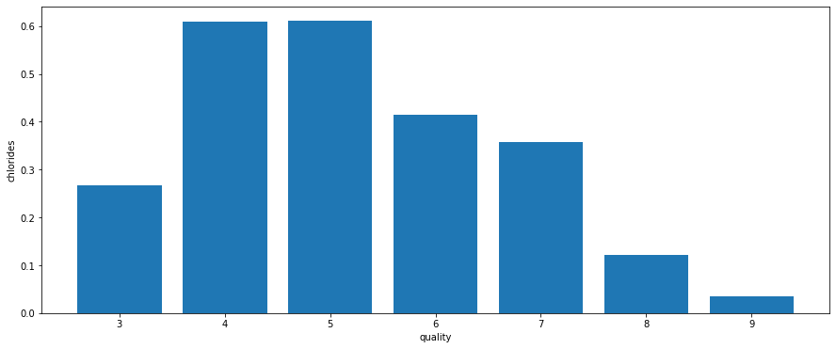
Results (Contd.) - Quality V/S Fundamental features
Quality V/S Alcohol
Quality V/S Fixed acidity
Quality V/S Density
Quality V/S Chlorides

Slide 20
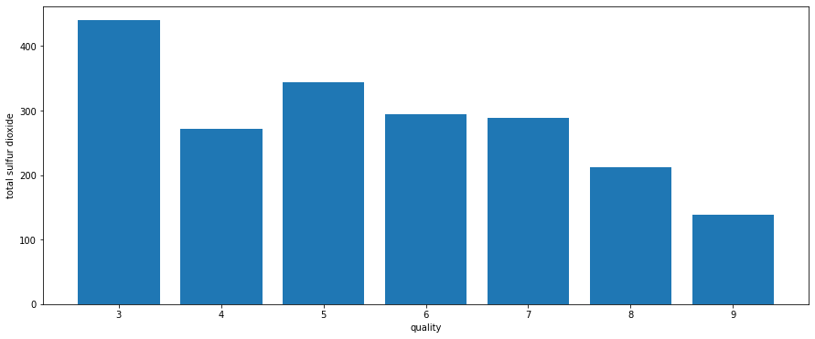
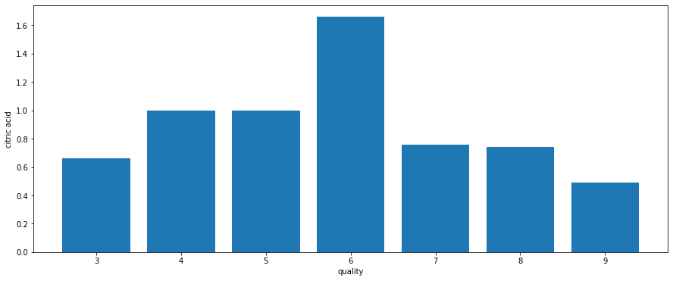
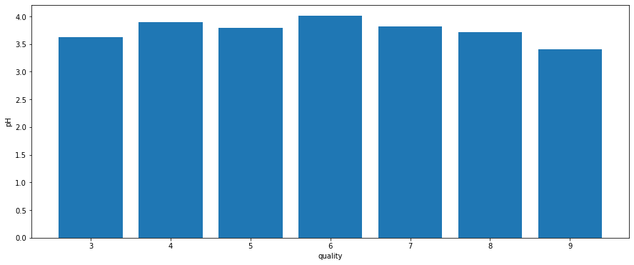
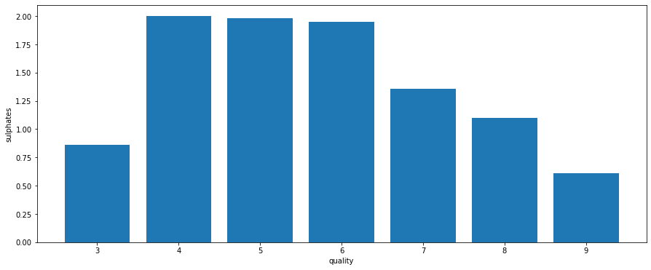
Results (Contd.) - Quality V/S Fundamental features
Quality V/S Sulphur dioxide
Quality V/S Citric acid
Quality V/S PH
Quality V/S Sulphides

Slide 21
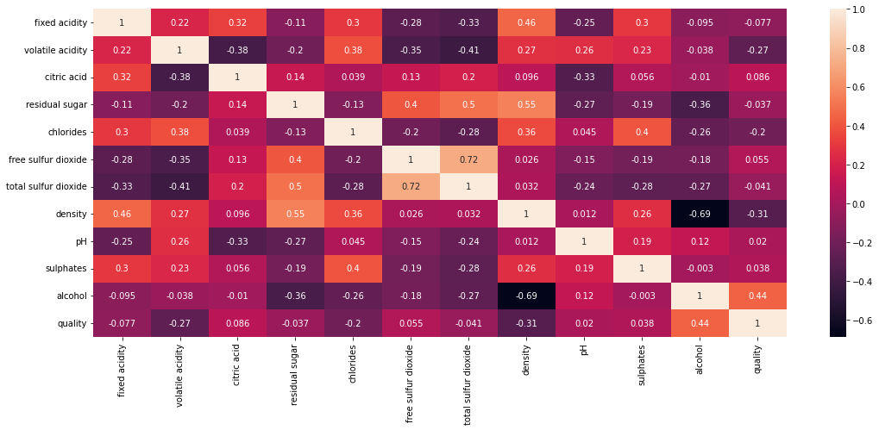
Results (Contd.) - Correlation of Quantitative Variables

Slide 22
Conclusions
Neural Network Classifier classified the wine data more accurately.
Gaussian SVM classifier is less accurate to classify the wine type to white and red
If total sulphur dioxide is less in wine more will be the quality of wine.
More density less will be the quality of the wine

Slide 23
Contribution
Kakarla V S S Pavan Teja(S20190020216) – Python code to plot histogram of all quantitative variables, to plot quality vs different variables, to correlate the quantitative variables, Wine Quality.
K Sreenivasulu Reddy(S20190020217) – Matlab code to classify the wine data using Gaussian SVM and Neural Network Classifier(Training and Testing), Classification App, Generation of Confusion Matrix, ROC Curves, Accuracy, Report.
K Litheesh Kumar(S20190020218) – Loading wine data, Matlab code to classify the wine data using Logistic Regression and Linear Discriminant Classifiers(Training and Testing), Classification App, Generation of Confusion Matrix, ROC Curves, Accuracy, PPT.

Slide 24
References
https://archive.ics.uci.edu/ml/datasets/Wine+Quality
https://www.geeksforgeeks.org/wine-quality-prediction-machine-learning/
https://in.mathworks.com/help/deeplearning/ug/wine-classification.html
https://www.javatpoint.com/classification-algorithm-in-machine-learning

Slide 25
Thank you

