Slide 1

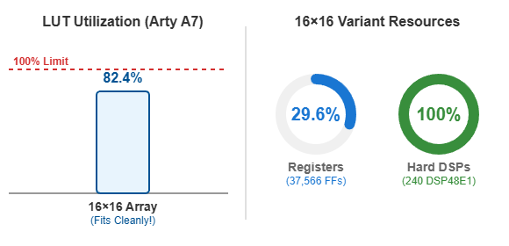
Systolic-Array AI Accelerator
Hardware-Software Co-Design for the Edu4Chip Didactic SoC
Chair of AI Processor Design
Technical University of Munich, Germany
Hengsheng Li*, Yuzhi Cao, Siyang Liu, Jiangchuan Shang, Minjun Zhong
Task & Specification
Challenges & State of the Art
Objective: Hardware-accelerated GEMM IP for the RISC-V Edu4Chip SoC.
I/O Bottleneck: Strict APB handshaking causes severe FSM stalls and CPU polling overhead during SoC integration.
FPGA Limits: A full 16×16 array exhausts routing and logic resources on educational boards (Arty A7).
Our Solution:
Double-Buffered Registers: 2-Bank decoupled architecture eliminated APB race conditions, slashing CPU polling by 97% (2.5× HW Speedup).
16×16 FPGA Deployment: Successfully mapped the full 16×16 array to Arty A7 (82% LUT, 100% DSP, zero timing errors) via smart slot-stubbing.
Specification: INT8 signed inputs, 32-bit accumulation, 16×16 PE grid.
Dataflow Concept (See Diagram):
Matrices A & B stream orthogonally. Partial sums remain stationary, eliminating redundant data movement.
Implementation Details
RTL Implementation & Methodology
Data Skewing: Diagonal streaming ensures synchronous PE accumulation.
Scalable RTL Design:
Parameterized SystemVerilog with stall-safe valid/ready handshakes.
Verification Pyramid:
Formal Proofs: SymbiYosys mathematical verification for FSM & PE.
Cross-Simulator: Fast Cocotb+Verilator (2-state) & rigorous UVM QuestaSim (4-state).
CPU-in-Loop: Bit-exact C golden models executing on the Ibex core.
System Architecture
Memory-Mapped APB: Decoupled interface to the RISC-V Ibex CPU.
Double-Buffered SRAMs: 2-Bank decoupled A/B buffers to eliminate APB stalls.
Control FSM: Orchestrates strict valid/ready data streaming.
Results for the Functional Design Part
System Benchmarking
1024× Array Speedup: 16×16 hardware array computes in 32 cycles vs. 32,768 CPU cycles.
11× System Speedup: End-to-end SoC execution (32×32 GEMM) achieved an 11.02× speedup, overcoming APB I/O bottlenecks.
ASIC Synthesis
..
..
FPGA Prototyping
16×16 on Arty A7: Fully deployed the 256-PE array by stubbing unused SoC slots
Resource & Timing: Pushed physical limits (100% DSP, 82% LUT) with zero placement errors (WNS +0.438ns).
Repository: gitlab.lrz.de/ai-pro-msmcd-labs/2025/os/group5
Course: AI-PRO MSMCD Labs 2025, TUM
Built on the open-source Edu4Chip Didactic SoC (Ibex RISC-V core). Thanks to the course instructors and the Didactic-SoC/Ibex maintainers.
*Corresponding author. Email address: hengsheng.li@tum.de (H. Li).
Notes:
1

