Slide 1
SCGIP
Sanitation Co-Governance Intelligence Platform
An AI-Driven Real-Time Civic Complaint System for Urban Sanitation
🌍 UN SDG 6 — Clean Water & Sanitation
Real-Time · Co-Governed
Born at B2G Hackathon
Lithesh S · Sri Sairam Institute of Technology, Chennai
1M1B AI for Sustainability Virtual Internship — in collaboration with IBM SkillsBuild & AICTE
September 2026

Slide 2
PROBLEM STATEMENT
Reports Go Into a Void
▸ Citizens spot illegal dumping, blocked drains, overflowing garbage — but have no reliable way to report with evidence.
▸ Complaints by phone or in person vanish: no ticket number, no status, no proof anything happened.
▸ The Greater Chennai Corporation cannot prioritise hundreds of scattered reports or verify which are genuine.
▸ Result: recurring sanitation hazards, polluted drains and public spaces — and eroding citizen trust.
How might we use AI to score, route and track citizen sanitation reports transparently —
so that citizens and the municipal corporation can verify and resolve issues together?
SCGIP · 1M1B × IBM SkillsBuild · 02

Slide 3
SUSTAINABILITY FOCUS
SDG Alignment
SDG 6
Clean Water & Sanitation
PRIMARY
Direct action on blocked drains, illegal dumping and public-space sanitation — protecting water systems and community health.
SDG 11
Sustainable Cities & Communities
SECONDARY
Accountable, citizen-inclusive urban governance with measurable response deadlines.
SDG 16
Peace, Justice & Strong Institutions
SECONDARY
Transparency and auditability that build trust in civic institutions.
One primary focus — SDG 6 — with direct secondary contributions to SDG 11 and SDG 16.
SCGIP · 1M1B × IBM SkillsBuild · 03

Slide 4
DESIGN THINKING JOURNEY
From B2G Hackathon Prototype to Working Platform
1. EMPATHIZE
Citizens never see outcomes; officers receive unstructured, unprioritised reports.
2. DEFINE
The real gap is verified closure — nobody confirms the fix, so nobody reports twice.
3. IDEATE
Co-governance: place the citizen inside the workflow as the final verifier.
4. PROTOTYPE
B2G Hackathon prototype → several weeks of iteration into a full real-time platform.
5. TEST & REFINE
End-to-end live pipeline tested across citizen, officer and admin roles.
SCGIP · 1M1B × IBM SkillsBuild · 04

Slide 5
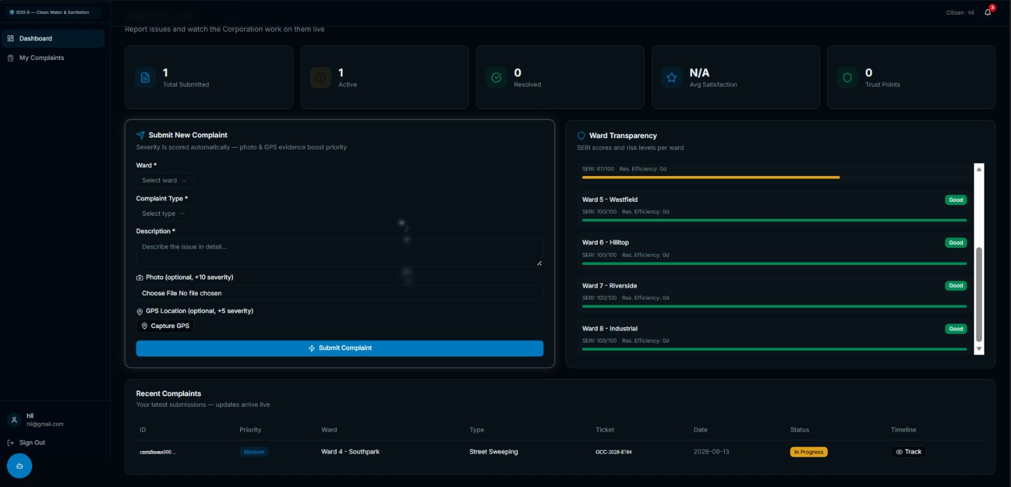
SOLUTION OVERVIEW
SCGIP — Co-Governance by Design
1
Citizen submits complaint — photo + real-time GPS location
2
SERI engine scores severity 0–100 (explainable)
3
Auto-routes to the right department with an SLA deadline (24h–15 days)
4
GCC ticket auto-generated and pushed to Corporation officers
Citizen portal — photo + GPS evidence, severity boosters, live tracking
5
Officer verifies → assigns → resolves, with photo evidence
6
Citizen confirms the fix — loop closed by both sides
Three role-based portals: Citizen · Corporation Officer · Administrator
SCGIP · 1M1B × IBM SkillsBuild · 05

Slide 6
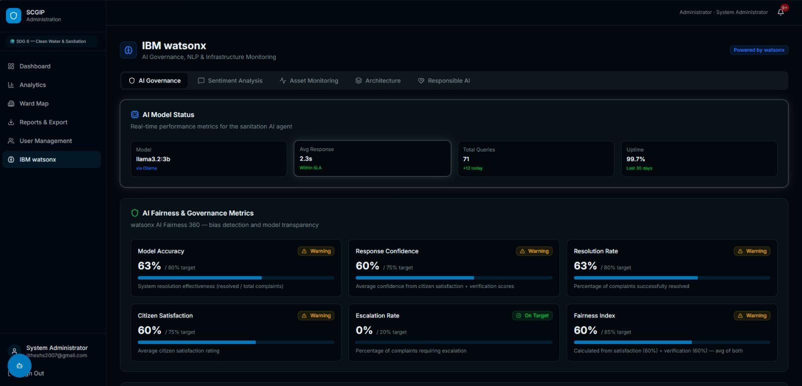
WHERE AI POWERS THE PLATFORM
AI Elements Used
▸ SERI Explainable Severity Engine: complaint type × ward risk index × evidence quality — every score shows "why this severity".
▸ Agentic AI Assistant (Python FastAPI): tool-calling agent answering natural-language queries over live complaint data — grounded, never fabricated.
▸ IBM watsonx NLP: real-time sentiment & emotion classification on citizen complaints (urgency detection).
▸ Geospatial Intelligence: GPS pins with reverse geocoding + ward-risk heat mapping on a live map.
▸ Real-time backbone: Server-Sent Events notifications, SLA auto-escalation, tamper-evident audit log.
AI governance dashboard — model status, fairness & transparency metrics
IBM BOB
Used during ideation to refine the problem framing and co-governance workflow. Prompt engineering guided the assistant's query logic.
SCGIP · 1M1B × IBM SkillsBuild · 06

Slide 7
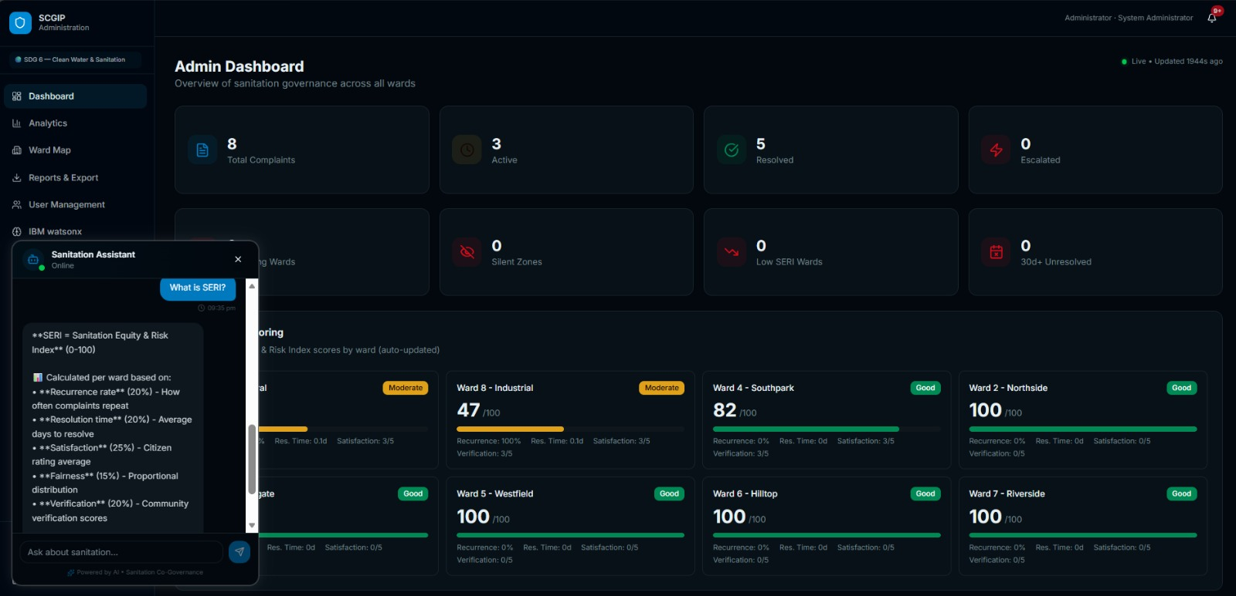
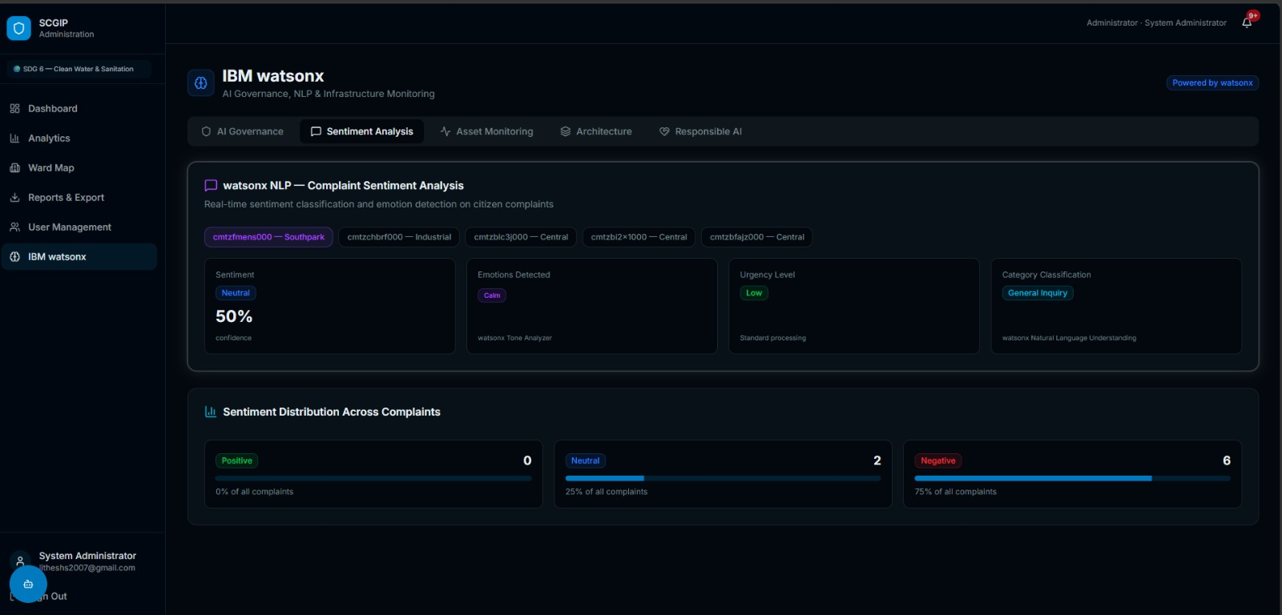
WORKING PROTOTYPE
AI in Action — Assistant & NLP
The agentic assistant explaining the SERI formula — grounded in live data
watsonx NLP — sentiment, emotion & urgency classification per complaint
▸ Grounded answers: the assistant calls tools over the live complaints database — it never fabricates numbers.
▸ Every citizen complaint is classified for sentiment and urgency, feeding priority signals into the SERI engine.
SCGIP · 1M1B × IBM SkillsBuild · 07

Slide 8
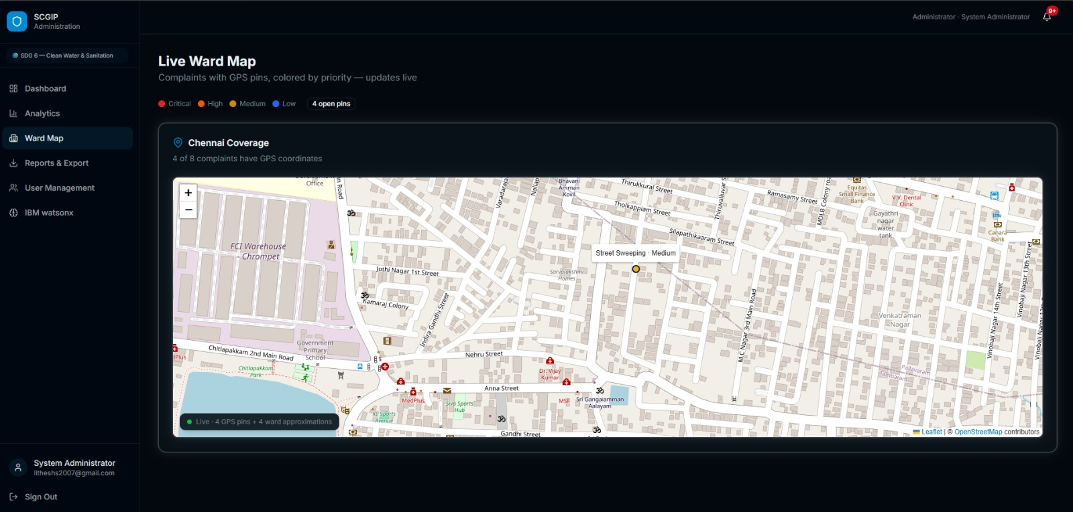
REAL-TIME TRACKING
Live Ward Map — Geospatial Intelligence
▸ Real-time GPS: every complaint drops a pin the moment it is submitted.
▸ Priority colors: critical, high, medium, low at a glance.
▸ Reverse geocoding: pins resolve to street addresses automatically.
▸ Ward approximations: non-GPS complaints placed at ward centroids.
▸ Built on Leaflet + OpenStreetMap.
GPS pins colored by priority — updates live as citizens report
SCGIP · 1M1B × IBM SkillsBuild · 08

Slide 9
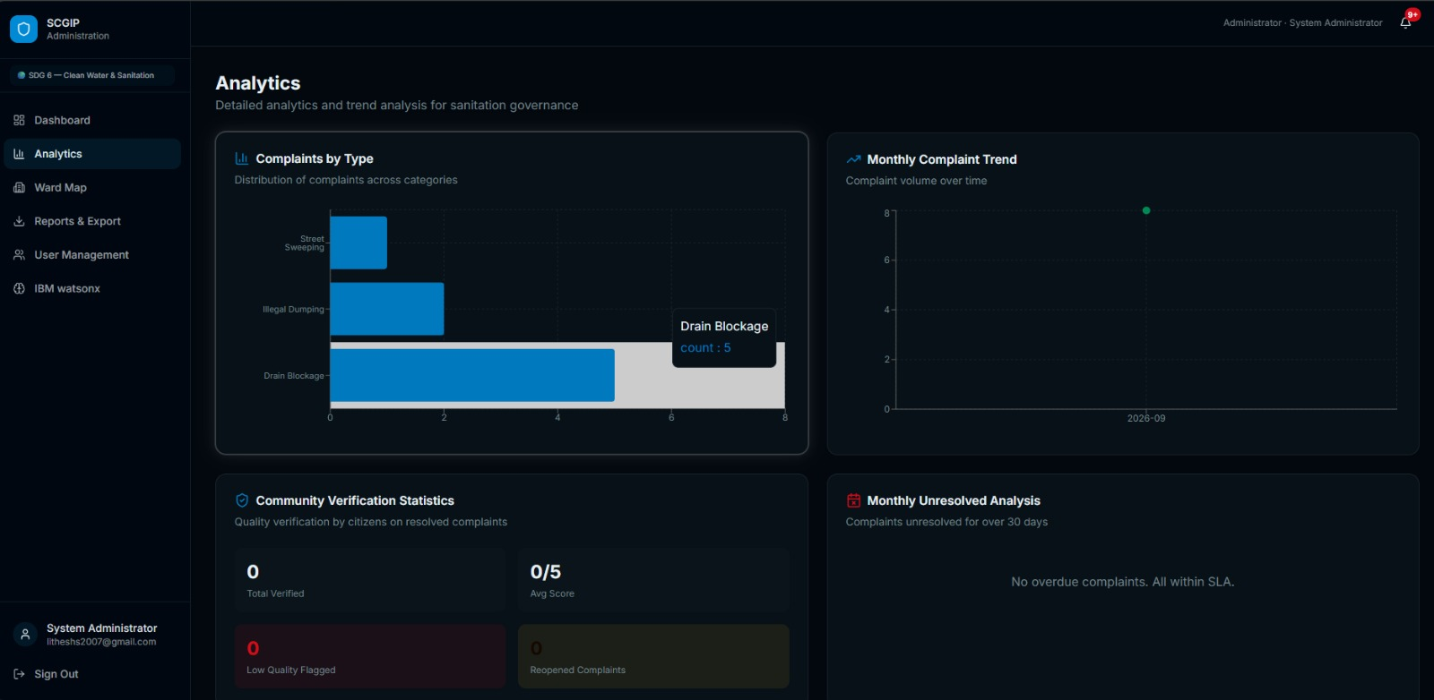
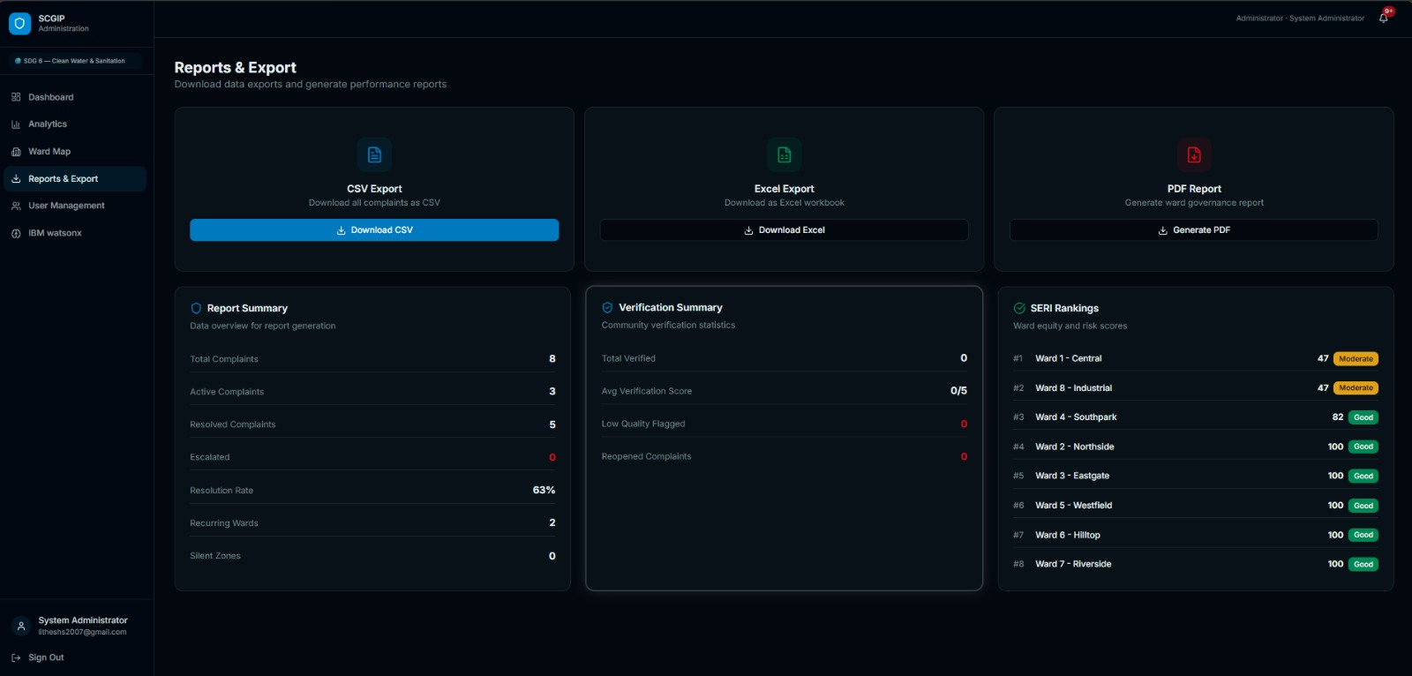
ANALYTICS · SERI RANKINGS · EXPORTS
Data-Driven Governance
Complaint analytics — type distribution & monthly trends
Reports & exports — CSV / Excel / PDF with SERI ward rankings
▸ Ward SERI rankings surface recurring hotspots and silent zones — enabling proactive, preventive action.
▸ One-click exports generate ward governance reports for corporation review meetings.
SCGIP · 1M1B × IBM SkillsBuild · 09

Slide 10
BUILT WITH
Technology Architecture
FRONTEND
Next.js · TypeScript · Tailwind CSS · Leaflet + OpenStreetMap (live ward map)
REALTIME
Server-Sent Events (SSE) — instant notifications across all roles · SLA auto-escalation
BACKEND & DATA
Next.js API routes · Prisma ORM · SQLite · GCC webhook ticket gateway
AI SERVICES
SERI engine + NLP sentiment · Agentic AI assistant (Python FastAPI) · IBM watsonx governance views
SECURITY
bcrypt password hashing · cookie-session auth · role-based access · tamper-evident audit log
SCGIP · 1M1B × IBM SkillsBuild · 10

Slide 11
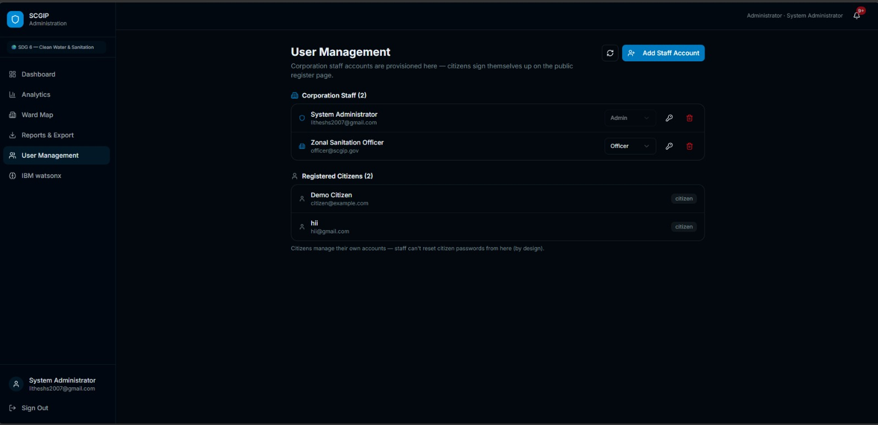
WHO IT SERVES
Target Users
🏙️ Citizens of Chennai
Report with photo + GPS, track live, confirm the fix.
👮 GCC Ward Officers
AI-prioritised queue with SLA deadlines; verify & resolve with evidence.
📊 City Administrators
Live ward map, SLA analytics, ward-level intelligence.
Role-based portals — admin provisions corporation staff; citizens self-register
Designed as a replicable blueprint — adoptable by any municipal body.
SCGIP · 1M1B × IBM SkillsBuild · 11

Slide 12
WHAT CHANGES
Expected Impact
▸ Closed complaint loop: every report tracked from submission to citizen-confirmed resolution — no more complaints into a void.
▸ Faster, fairer response: severity-based prioritisation with SLA deadlines and auto-escalation replaces first-come-first-served handling.
▸ Accountability by design: a tamper-evident audit trail makes every action verifiable by citizens and administrators.
▸ Data-driven prevention: ward-level risk analytics reveal recurring hotspots — proactive action instead of reactive cleanup.
▸ Citizen trust: live visibility of the process itself builds trust in civic institutions.
▸ Scalable blueprint: the co-governance model extends to any ward, any city, any municipal body.
From "reported" to "resolved and verified" — accountability as a system feature, not a promise.
SCGIP · 1M1B × IBM SkillsBuild · 12

Slide 13
MANDATORY — BUILT INTO THE DESIGN
Responsible AI Considerations
FAIRNESS
Severity is normalised against a ward risk index, so wards with historically poorer sanitation are not deprioritised. Every score's factors are visible.
TRANSPARENCY
The SERI engine is explainable — "why this severity" on every complaint. The AI assistant is grounded strictly in live database records; it never fabricates data.
ETHICS
AI only prioritises and informs. Humans verify, resolve and confirm at every decision point — no algorithmic penalties for citizens or officers.
PRIVACY
No personal data exposed publicly; complaint evidence is role-restricted; the audit log records actions, not personal profiles.
SCGIP · 1M1B × IBM SkillsBuild · 13

Slide 14
IBM SKILLSBUILD JOURNEY
Internship → Project: What I Applied
IBM BOB
Ideation & problem framing — refined the co-governance workflow before writing code.
Agentic AI Lab (Aug 2026)
Tool usage, function calling, autonomous workflows — applied directly: our Python agent calls tools over the live complaints database.
Guided Learning Path (GLE)
AI fundamentals + responsible AI principles on IBM SkillsBuild — shaping the explainability and audit features.
Mindset shift
From "calling models with prompts" to building grounded, tool-using agents over real data.
SCGIP · 1M1B × IBM SkillsBuild · 14

Slide 15
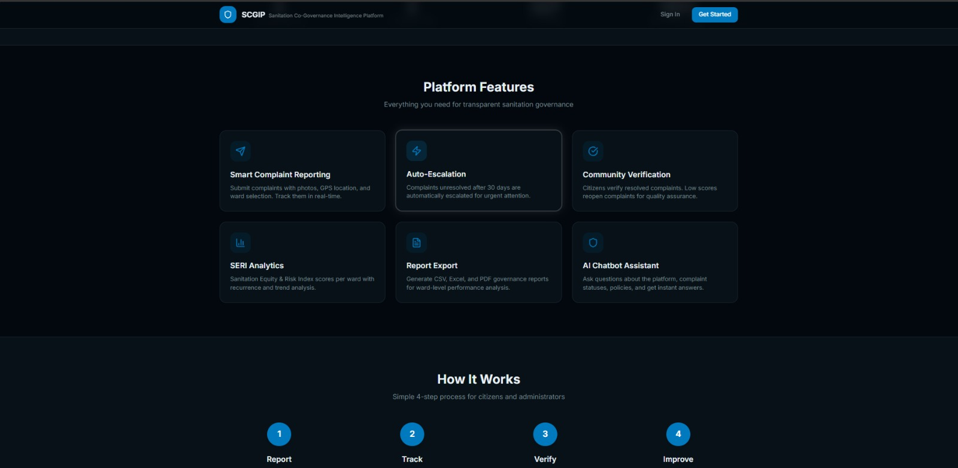
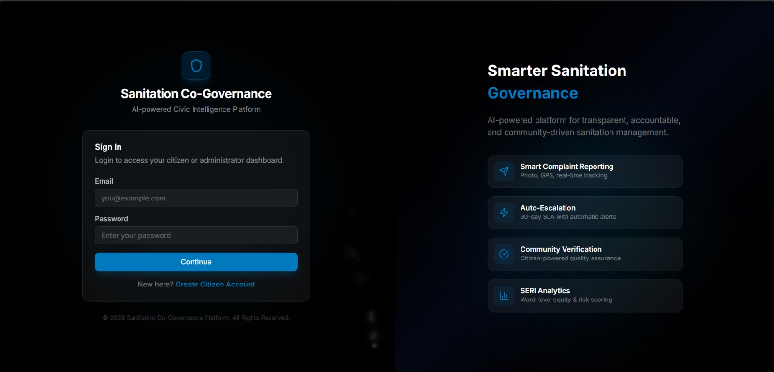
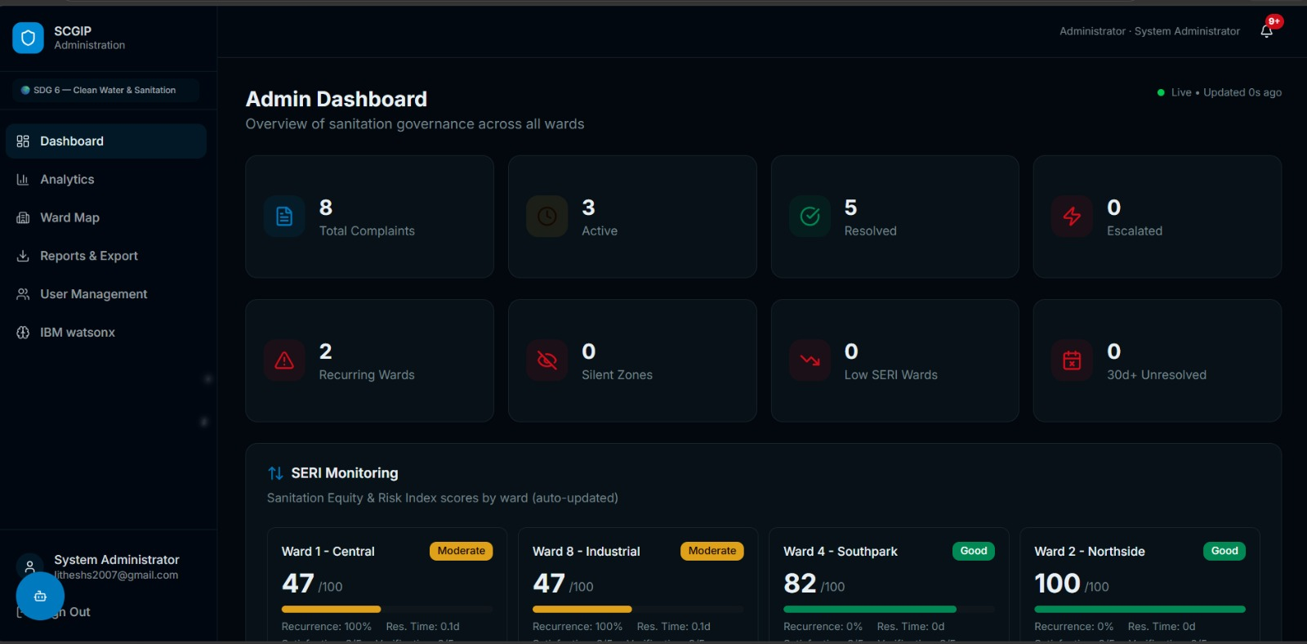
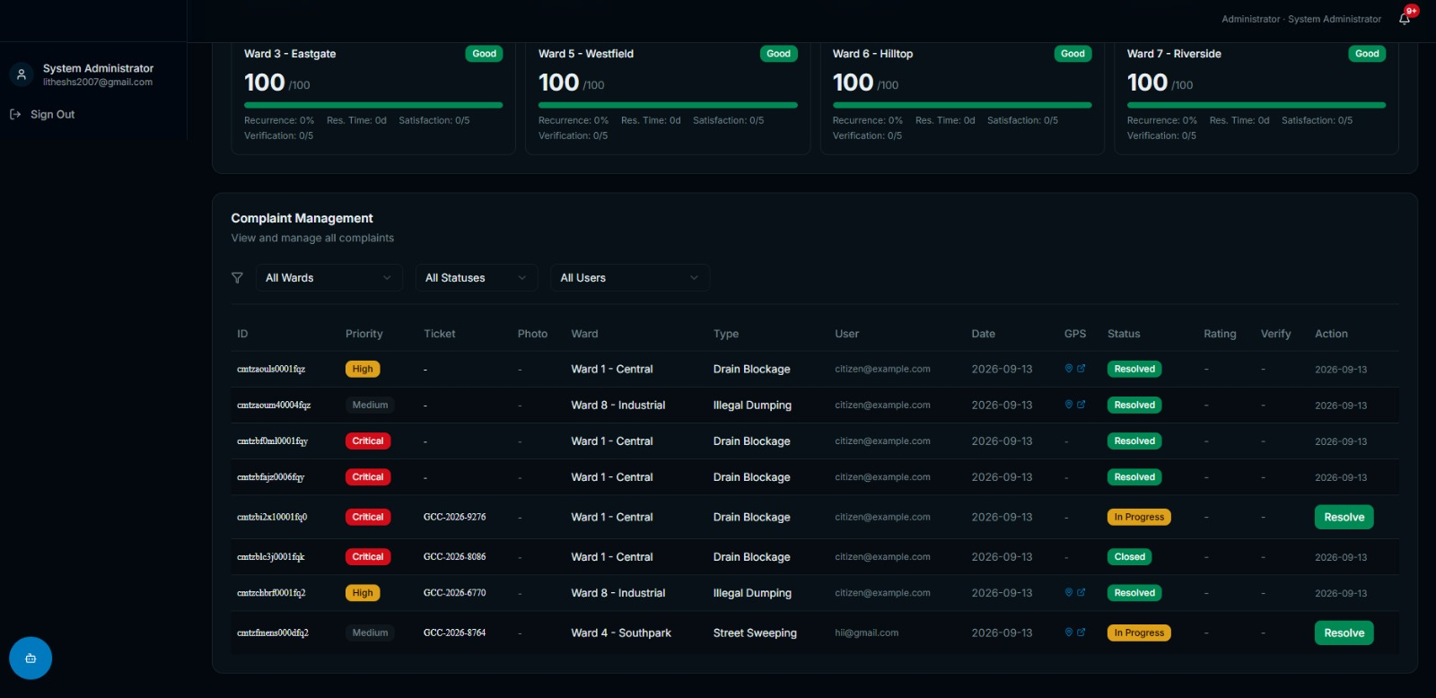
MORE VIEWS FROM THE WORKING SYSTEM
Platform Gallery
SCGIP · 1M1B × IBM SkillsBuild · 15
Additional portal views — citizen, officer and administration sides of the platform.

Slide 16
Every complaint has a story, a status,
and a closing signature from the citizen.
▸ Roadmap: citizen-officer comment threads · before/after photo galleries · multi-city rollout · GCC field pilot.
▸ Full source code published openly on GitHub.
GitHub: github.com/lithes-coder/Sanitation-co-governance
Thank you — Questions? · Lithesh S · Sri Sairam Institute of Technology

