Slide 1
AidFlow
Field report
Adaptive AI-native crisis coordination for NGOs
Bridge blocked near Ward 5; elderly residents need medicine delivery.
From noisy field reports to ranked needs, duplicate warnings, and volunteer dispatch in one live Firebase workspace.
Gemini classification
HIGH
Infrastructure
Cloud deployment: Firebase Hosting + Firestore
Google AI: Gemini Flash
Live MVP verified
Priority board updates in real time
AidFlow | Google Solution Challenge 2026
01

Slide 2
SUBMISSION PROFILE
Team details
Problem statement
Team name
AidFlow
During chaotic crises, NGOs receive repeated, multilingual, and incomplete field reports. Coordinators must manually classify urgency, avoid duplicate dispatches, and match volunteers while conditions keep changing.
Team leader
Lithin C G
Working prototype
AidFlow turns that noisy intake into a live, AI-ranked coordination board for one NGO workspace at a time.
https://smart-resource-allocatio-3e4d2.web.app
AidFlow | Google Solution Challenge 2026
02

Slide 3
WHAT AIDFLOW DOES
Brief about the solution
AidFlow is an AI-powered NGO coordination pipeline built on Firebase and Gemini. Field workers submit text, voice, or OCR reports; Gemini classifies urgency and type; the app checks for duplicate/related reports; coordinators assign volunteers and correct AI outputs when needed.
Multimodal intake
Text forms, in-browser speech recognition, and image OCR.
Adaptive prompts
Recent coordinator overrides become few-shot examples.
Live operations
Firestore listeners update needs, volunteers, and status in real time.
Safer dispatch
Duplicate warnings and transaction-based assignments reduce wasted effort.
AidFlow | Google Solution Challenge 2026
03

Slide 4
WHY THIS IS DIFFERENT
Opportunities
Different from static forms
Solves coordinator overload
USP
AidFlow treats the report stream as messy real-world data: spoken, photographed, multilingual, duplicated, and constantly corrected by humans.
Gemini structures each report, Firestore syncs it instantly, and duplicate checks prevent multiple volunteers from chasing the same incident.
The adaptive learning loop records human overrides and feeds recent corrections back into future prompts, so each NGO can calibrate priority rules over time.
AidFlow | Google Solution Challenge 2026
04

Slide 5
IMPLEMENTED MVP
Features offered by the solution
01
Multilingual Voice-to-Need
02
Gemini OCR Intake
English, Hindi, Kannada, Telugu, and Marathi speech input via Web Speech API, then Gemini extraction.
Image reports are compressed, sent to Gemini Vision-style prompts, extracted, classified, and reviewed.
03
AI Deduplication Check
04
Adaptive AI Learning Loop
Incoming text reports are semantically compared against open reports before save.
Coordinator changes to urgency/type are logged and reused as few-shot calibration examples.
05
Realtime Priority Board
06
Volunteer Dispatch
Firestore subscriptions power live need counts, filters, AI accuracy badge, and status flow.
Gemini ranks free volunteers against open needs; Firestore transactions assign and resolve work.
AidFlow | Google Solution Challenge 2026
05

Slide 6
FROM REPORT TO LEARNING
Process flow diagram
1
3
5
Input
Dedup check
Coordination
Voice, text, or OCR report
Compare against open org reports
Rank and assign volunteers
2
4
6
Gemini processing
Priority board
Learning
JSON urgency/type extraction
Realtime Firestore update
Overrides feed future prompts
The key loop is not just intake. Human coordinator corrections are persisted, measured, and injected back into Gemini prompts.
AidFlow | Google Solution Challenge 2026
06

Slide 7
CORE SCREENS
Wireframes / mock diagrams
Submit Need
Voice Report
Priority Board
Location
Language selector
High Priority count
Problem description
Animated waveform
Status filters
Affected group
Live transcript
Need cards
Classify & Submit Need
Process with AI
Detail modal actions
AidFlow | Google Solution Challenge 2026
07

Slide 8
FIREBASE + GEMINI STACK
Architecture diagram
Auth & Tenant Gate
AI Layer
Firebase Authentication
Org picker + 4-digit PIN join
Gemini Flash API
JSON classification, OCR, ranking, dedup
Frontend
Realtime Database
React 19 + Vite + Tailwind CSS
Hosted on Firebase Hosting
Cloud Firestore
needs, volunteers, orgs, corrections
Adaptive loop: coordinator override -> corrections collection -> few-shot block -> next Gemini classification
AidFlow | Google Solution Challenge 2026
08

Slide 9
VERIFIED FROM CODEBASE
Technologies used
Google Cloud Platform
Firebase Hosting, Cloud Firestore, Firebase Authentication, Firebase Functions scaffold
Google AI
Gemini Flash model for classification, OCR extraction, volunteer ranking, and duplicate analysis
Frontend
React 19.2, Vite 8, Tailwind CSS 3.4, code-split tabs
Browser APIs
Web Speech API for continuous multilingual voice capture
Data safety patterns
Org-scoped queries, authenticated writes, Firestore transactions for assignment state
AidFlow | Google Solution Challenge 2026
09

Slide 10
PROTOTYPE STAGE
Estimated implementation cost
$0.00 / month
Firebase Spark Plan
Hosting, Auth, and Firestore are enough for demo-scale prototype traffic.
Current MVP target using free-tier-friendly Firebase and Gemini development usage.
Gemini free-tier development
Prototype calls use Gemini Flash for low-latency classification and extraction.
Scale path
Move AI calls fully behind Cloud Functions + Secret Manager on Blaze for production security and quotas.
AidFlow | Google Solution Challenge 2026
10

Slide 11
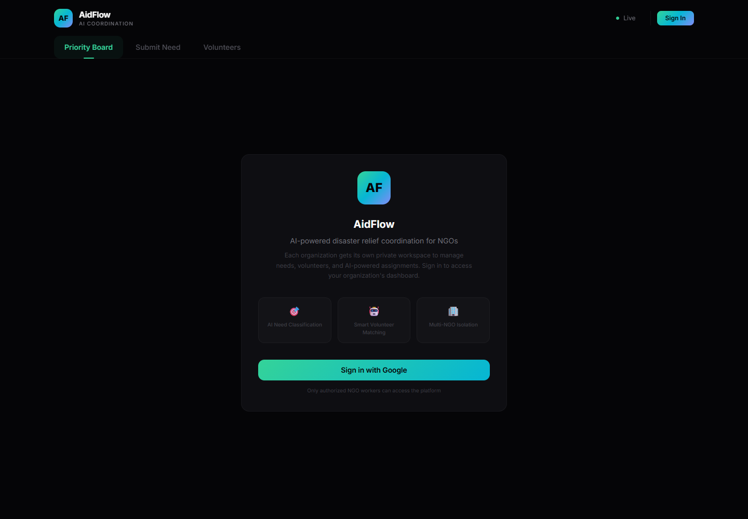
LIVE AND CODE-VERIFIED STATES
MVP snapshots
Voice Report
Hindi
Priority Board
AI 92%
HIGH Medical
MED Food
AI extracts English description + urgency
LOW Infra
Possible Duplicate Detected
AI compares the new report to open Firestore needs and asks the coordinator to cancel, create anyway, or link related reports.
Deployed landing page
Create Anyway
Cancel
Note: internal dashboard screenshots are represented as editable states because the deployed app requires Google sign-in.
AidFlow | Google Solution Challenge 2026
11

Slide 12
ROADMAP
Additional details / future development
v1.1
Hardening
Move direct fallback off in production; enforce Cloud Functions + Secret Manager for all Gemini calls.
v1.2
Offline-first PWA
Cache reports locally and sync when rural field workers reconnect.
v1.3
WhatsApp intake
Accept citizen/field-worker voice notes and route them through the same Gemini pipeline.
v2.0
Predictive resource mapping
Use historical Firestore trends to anticipate shortages and surge needs.
AidFlow | Google Solution Challenge 2026
12

Slide 13
PROTOTYPE ACCESS
Links
MVP / Working Prototype
https://smart-resource-allocatio-3e4d2.web.app
GitHub Public Repository
Add public repo URL before final submission
Demo Video Link
Add YouTube unlisted link before final submission
Submission reminder: replace the two placeholders after your GitHub repo is public and the 3-minute demo video is uploaded.
AidFlow | Google Solution Challenge 2026
13

