Slide 1



INFOSYS SPRINGBOARD INTERNSHIP 6.0
CYBER RISK ASSESSMENT & THREAT INTELLIGENCE PLATFORM
Presented by
Noor Nabeeha
Dhanush P
Sujithraa
Akshay
Eswar

Slide 2
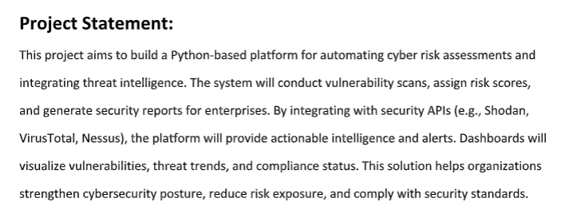

PROJECT STATEMENT:
Python-based platform for automated cyber risk assessment
Integrates threat intelligence (Shodan, VirusTotal, Nessus)
Performs vulnerability scanning and risk scoring
Generates security reports and real-time alerts
Dashboard for vulnerabilities, trends, and compliance
Helps reduce risk and improve cybersecurity posture

Slide 3
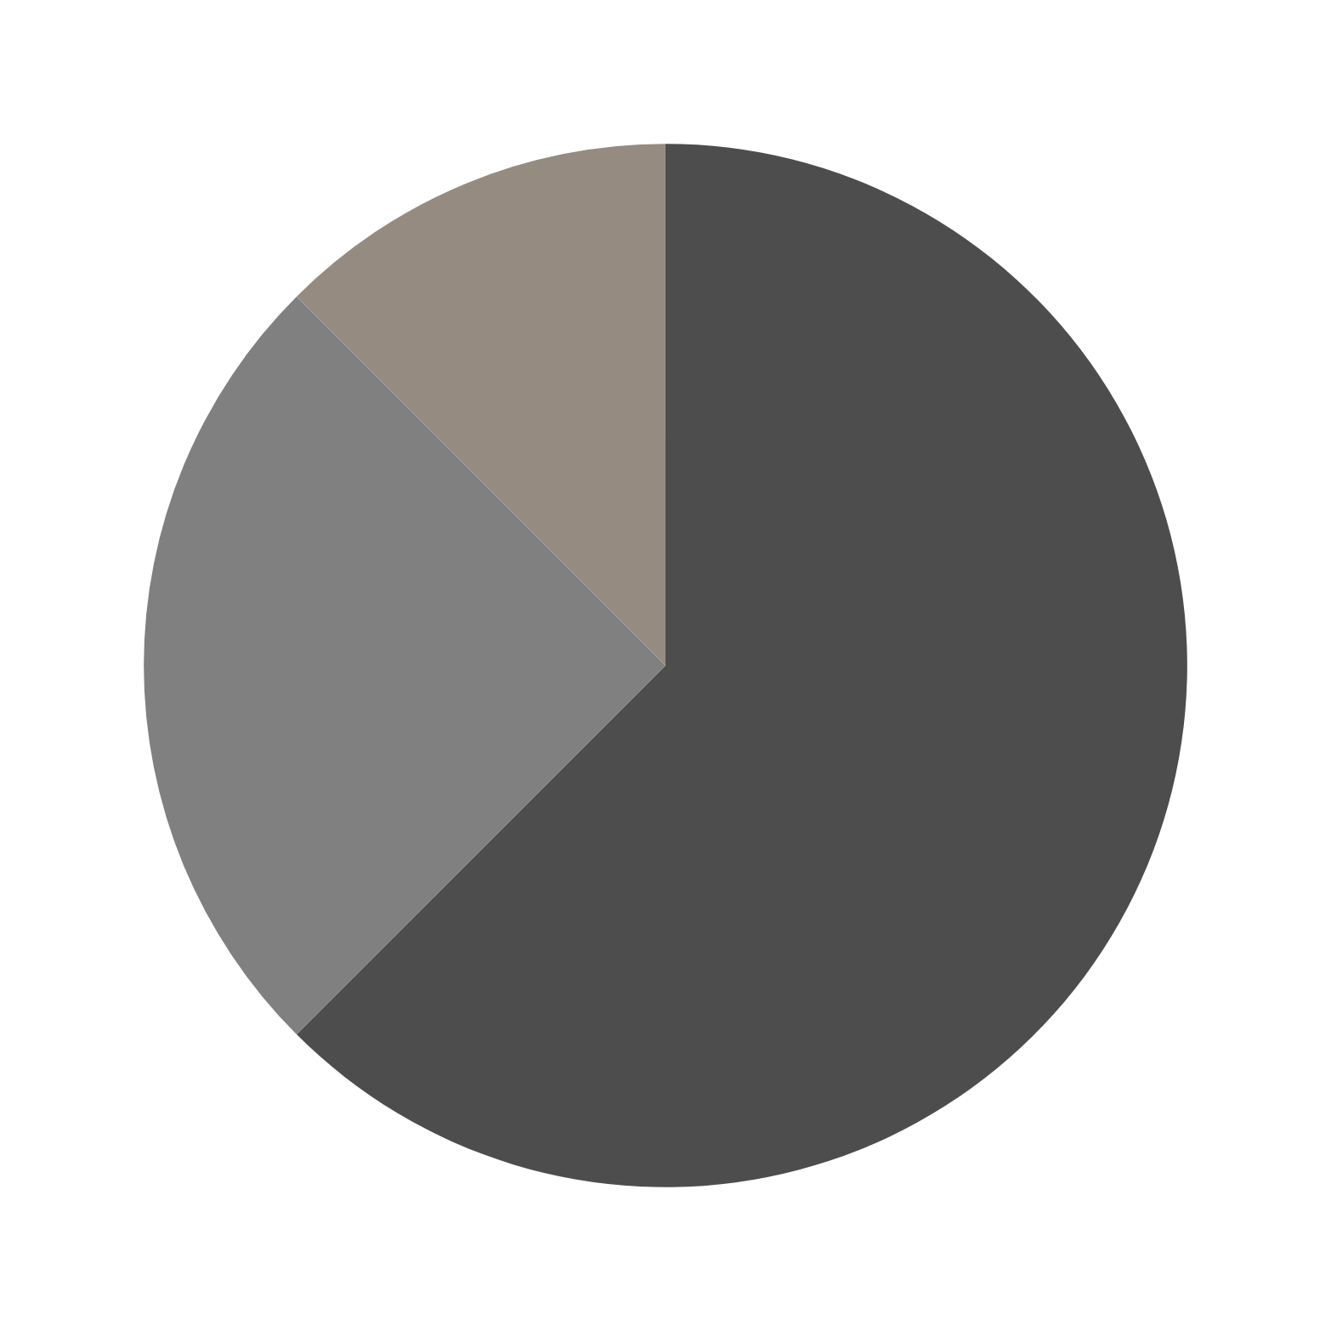
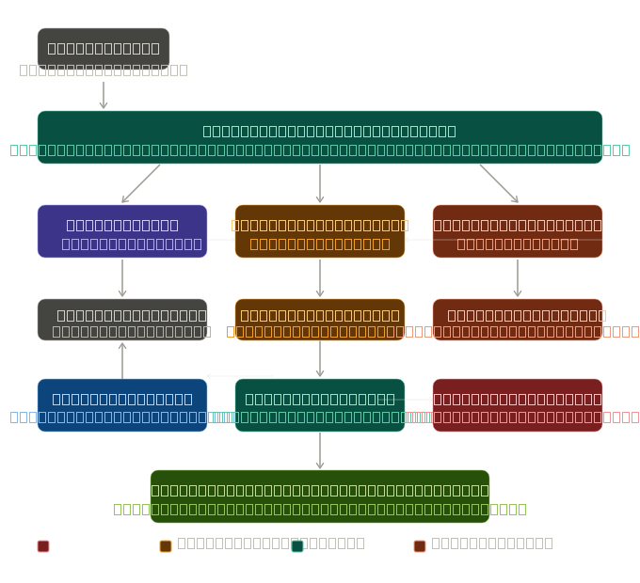
PROJECT ARCHITECTURE

Slide 4
MODULES → SOLUTION
Wraps Nmap as a Python subprocess (-sT -sV -O --script banner -Pn)
Parses XML output to extract open ports, services, OS, SSL tunneling, banners
Tags each port as HIGH / MEDIUM / LOW risk using lookup tables
SSL on a high-risk port auto-downgrades severity (HIGH → MEDIUM)
01
Vulnerability Scanning Engine

Slide 5
MODULES → SOLUTION
Queries VirusTotal API v3 with Base64-encoded target URLs
Retrieves: malicious engine count, suspicious count, reputation score, last scan date
Recursively checks up to 10 outgoing links for malicious flags
API key loaded from .env — never hardcoded
02
Threat Intelligence Integration

Slide 6


RISK SCORING & ANALYTICS CORE
NMAP SCAN
VT SCAN
Nmap score: +40 HIGH port, +20 MEDIUM, +5 open port, −10 SSL, +15 unpatched signal, +20 EOL OS
VT score: weighted penalties for malicious hits, suspicious hits, bad reputation, malicious outlinks, stale data
Composite = 55% Nmap + 45% VT, clamped 0–100
Severity labels: CRITICAL (≥80) · HIGH (≥60) · MEDIUM (≥40) · LOW (≥20) · INFO

Slide 7
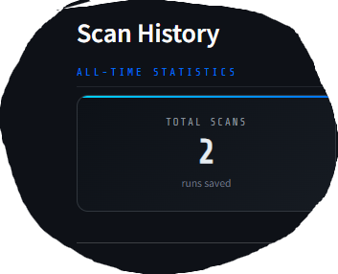
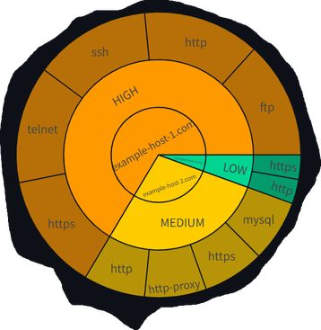
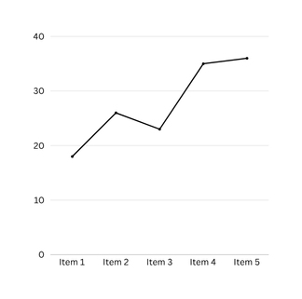
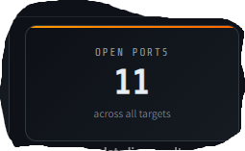
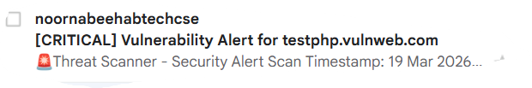
DASHBOARD
SQLite persistence via database.py
metric cards,
Plotly charts,
gauge meters per target
Auto email alert (Gmail SMTP) triggered for any HIGH or CRITICAL result

Slide 8
KEY BENEFITS
Fully automated, on-demand scanning — no manual steps
Scores are deterministic and auditable (documented weights)
Dual-source scoring: network-level (Nmap) + reputation-level (VirusTotal)
Persistent scan history enables trend tracking over time
Instant email alerts for high-severity findings
06

Slide 9
LEARNINGS
Python stdlib alone (subprocess, sqlite3, smtplib, xml) is enough for production-grade security tooling
Dataclasses (PortRisk, RiskReport) make scoring logic clean and testable
Clean module separation: scan → score → persist → present
.env + .gitignore pattern enforces real credential hygiene
07

Slide 10
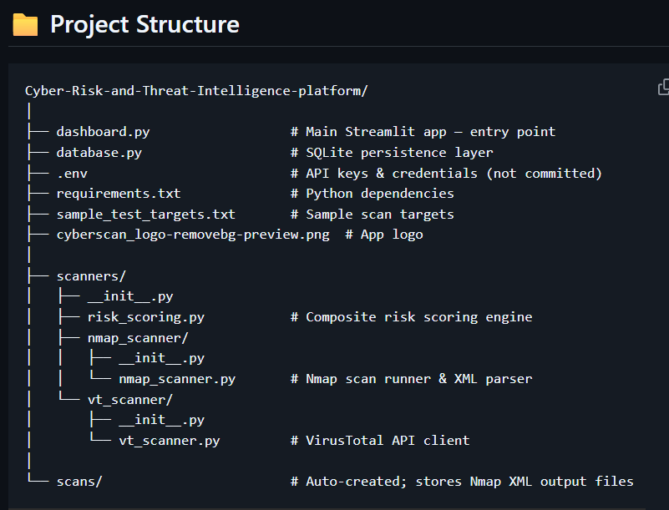
08

Slide 11
CONCLUSION
Delivers on all 4 objectives: scan · score · visualize · alert
Composite scoring gives one actionable number per target
Clean architecture makes it maintainable and extensible
With parallel scanning → ready for enterprise use
09

