Slide 1
IST 718 Project presentation
Group 2: Litin, Nikita, Hua, Meena
2020/4/24

Slide 2

COVID-19 Literature Clustering
Dataset: COVID-19 Open Research Dataset Challenge (CORD-19)
CORD-19 is a resource of over 60,000 scholarly articles, including over 40,000 with full text, about COVID-19, SARS-CoV-2, and related coronaviruses.
Project: Literature Clustering
Given the large number of literature and the rapid spread of COVID-19, it is difficult for health professionals to keep up with new information on the virus. Can clustering similar research articles together simplify the search for related publications? How can the content of the clusters be qualified?

Slide 3

Project goal
Our goal is to build a topic model using LDA (Latent Dirichlet Allocation) to help find other literatures regarding the virus under similar topics easily
Given the large number of literature it would be hard for healthcare workers to keep up with new information on the virus

Slide 4

approach
Data pre-processing :
This is done to get a clean dataset by treating NAs, duplicates etc
Text Preprocessing :
The preprocessing step usually consists of the tasks such as tokenization and filtering out stop words and vectorization
TF-IDF :
By using the TF-IDF weight, the document search can deliver results that are most relevant to what is searched for
Clustering :
We use k-means clustering to partition n documents in the context of text data into k clusters. representative around which the clusters are built
Topic Modeling:
Using LDA (Latent Dirichlet Allocation) for mapping a specific article into the topic space, we can then find related articles
Dimensionality reduction :
This is done using PCA to obtain optimal number of components that capture the greatest amount of variance
Classification : Build three classification models that can be used for recommending similar literatures

Slide 5

contents
Data description & Pre-processing
Text pre-processing & Vectorization
Dimensionality Reduction with PCA
Clustering
Topic Modeling on Each Cluster
Classifcation
Conclusion and Future Work
Problems Found so far and Plans to Solve Them

Slide 6
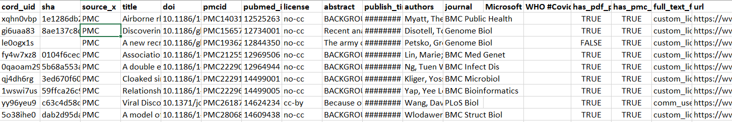
Data description & pre-processing
Each literature in the above metadata dataset is stored in a JSON file and there were 51,000 of them. We took a sample of 10,000 articles for our analysis
Handle null values in the dataset
Removed duplicates from the dataset which could have occurred if the same article was present in different journals

Slide 7
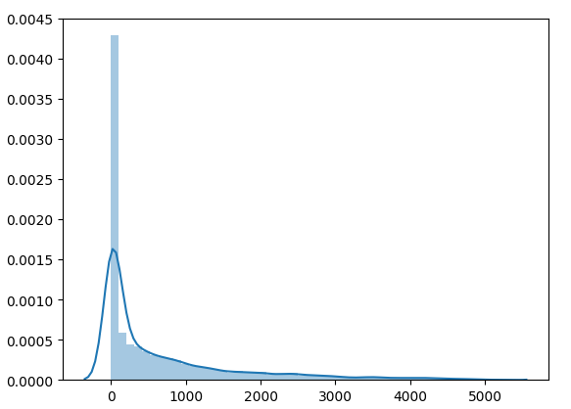
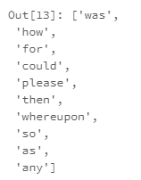
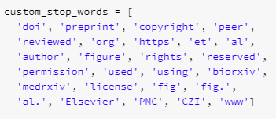
Text pre-processing & vectorization
Stopwords:
Apart from removing the common stop words, we also used the spacy library which remove stop words specific to scientific articles
Word count distribution
body_word_count

Slide 8
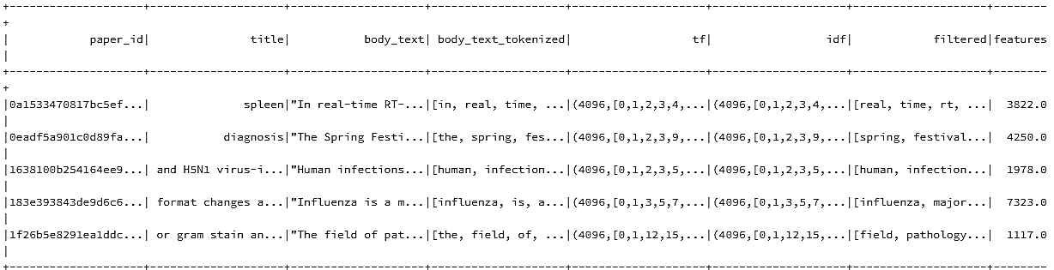
TEXT PRE-PROCESSING & VECTORIZATION
Tokenization
TF-IDF
Vectorization
All of these were a part of one spark pipeline that generated the data frame below

Slide 9
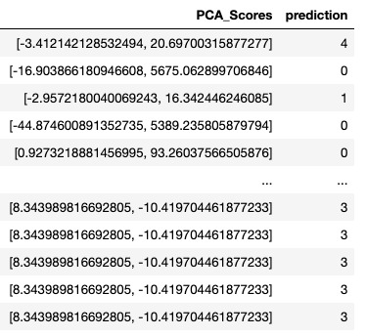
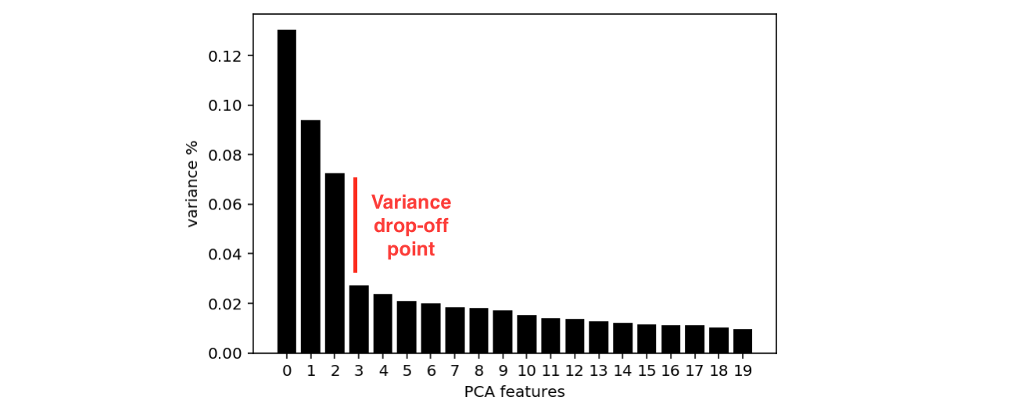
Dimensionality reduction with PCA
We chose the top 2 components from PCA and it explained 96% of the variance
In order to visualize the clusters, we reduce it to a 2 dimensional plane

Slide 10
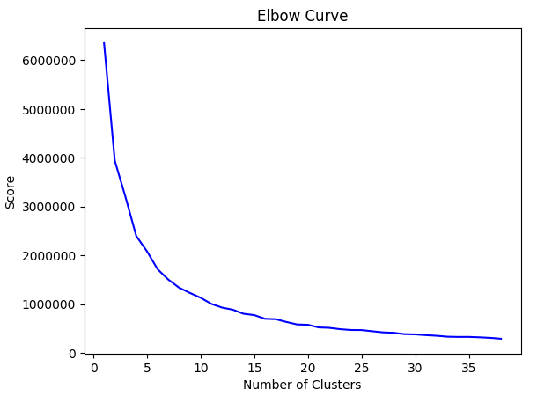
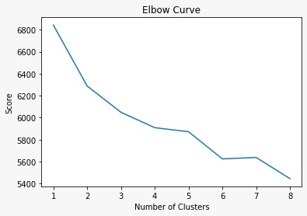
Clustering using k-means
By plotting the elbow plot we obtain the optimal number of clusters
We got 6 when we ran this on the sample dataset and 11 for the complete dataset
Elbow plot for compete dataset
Elbow plot for sample dataset

Slide 11
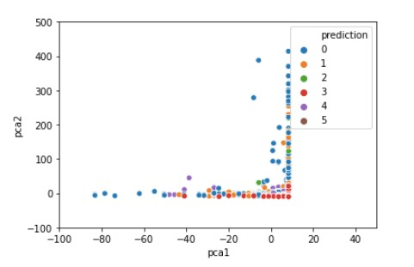
Plotting the clusters
Before running k-means, we standardized our data
We set number to 6, and upon generating the k-means output we used the data that was originally transformed using PCA in order to plot the clusters

Slide 12
Latent Dirichlet Allocation
The topic modelling method LDA is an unsupervised, probabilistic modelling method which extracts topics from a collection of papers. A topic is defined as a distribution over a fixed vocabulary.
Vaccination & Therapeutics
{“vaccine”,”influenza”,”cases”,”sars”,”medicine”…}
Antibodies Literature
{“proteins”,”cells”,”HIV”,”anti”,”antibody”…}
Virus genetics
{“genomes”,”rna”,”DNA”,”strains”,”sequences”,…}
Others
{“t”,”n”,”m”,”h”,”d”,”q”,”r”,”il”,…}
Disease Structure
{“expression”,”replication”,”materials”,”ifn”,”mice”…}
Public Risk Factors
{“Risk”,”children”,”patients”,”health”,”public”,”age”…}

Slide 13
Classification
After running k-means, the data is now clustered and labelled.
Using this we can do supervised learning to see how accurately the literature can be classified into its clusters.
This is just one way to evaluate the if k-means split the data into meaningful clusters
We used three classification techniques which are:
Logistic Regression (Multiclass)
Decision Tees
Random Forest
Multi-Layer Peceptron

Slide 14
Model Details & Evaluation
All the models mentioned below have been trained on the PCA features that we’ve obtained earlier & the dependent variable are the clusters.
Logistic Regression (Multiclass)
Iterations= 50
elasticNet=0.1
Decision Trees
MaxDepth=15
Split=50
Random Forest
MaxDepth= 15
Split=50
Multi-Layered Perceptron
2:4:5:6 Layered sequence
Accuracy(test) = 28%
Family=Multinomial
Accuracy(test)=53%
Accuracy(train)=32%
Accuracy(train)= 60%
Accuracy(train): 38%
Accuracy(test): 30%
NumofTrees= 50
Accuracy(train): 68%
Accuracy(test): 65%

Slide 15



Conclusion And future Work
Based on our findings we were able to cluster the sample of the literature articles
The samples closely match the tasks mentioned in the Kaggle challenge
One way of improving the model could be by using an algorithm other than kmeans for clustering
Problems Found So Far And Plans To Solve Them
Huge dataset takes almost ~2hrs for the sample itself - Plan to migrate to data bricks
SVM implementation – Since it’s a multiclass output variable we’ve to use methods like OneHotEncoding to use the algo

Slide 16


Thank you for listening!
Any questions?

