Slide 1




ART: Adaptive ReTransmission for Wide-Area Loss Recovery in the Wild
IEEE ICNP
October 10–13, 2023
Tong Li¹, Wei Liu¹, Xinyu Ma¹, Shuaipeng Zhu¹, Jingkun Cao¹,
Senzhen Liu², Taotao Zhang², Yinfeng Zhu², Bo Wu³, Ke Xu³
Notes:
Hi, I’m liuwei from Renmin University of China. Today I will introduce you our paper: ART: Adaptive ReTransmission for Wide-Area Loss Recovery in the Wild, and among our collaborators, we have partners from ByteDance and Tsinghua University.

Slide 2

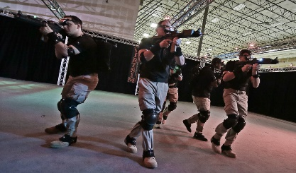





Delay-sensitive applications
Throughput-extensive applications
VR interactive gaming
Remote procedure call
Disaster recovery
Tiktok live
Cloud migration
Remote control
Notes:
An increasing number of applications are pursuing enhanced bandwidth and reduced delay, and these applications are progressively distinguished by their geographically distributed nature.

Slide 3

Impact of loss
Lost
Turkey plr
5.2%
Network
Brazil plr
3.8%
Frame not complete
Lost
Notes:
【】Take a famous content delivery network (CDN) platform as an example, 【】the flows incur an average 5.2% packet loss rate in Turkey and 3.8% in Brazil, respectively. 【】In video applications, video data at the transport layer is transmitted on a frame-by-frame basis to the application layer.【】 When there are no playable video frames available in the application‘s buffer and video frame data in the transport layer cannot be successfully delivered to the upper-layer application due to packet loss, it results in buffering in the application.

Slide 4
How to address loss?
Before loss
After loss
Forward Error Correction(FEC)
Automatic Repeat-reQuest(ARQ)
Prevent
Compensate
Not satisfactory
Notes:
There exist two fundamental ways of loss recovery in transmission control, 【】forward-error-correction (FEC) and 【】automatic-repeat-request (ARQ). However, 【】it is well-studied that FEC is far from satisfactory due to the wide-area loss characteristics such as burstiness in the wild.

Slide 5
FEC can address loss?
Deployment issue
Traffic overhead
Have loss
No loss
Maybe recovery
failed
All redundant packets
wasted
Notes:
【】Although some works are proposed to protect against bursts of losses, they require dual-side modifications. 【】These FEC-based advancements might suffer from deployment issues in the multi-supplier CDN market. In this case, only server-side sending policies can be adjusted by the selected CDN vendors.
【】 Moreover, FEC introduces substantial additional network traffic overhead, irrespective of whether packet loss occurs.【】 When packet loss does happen, if the number of lost packets surpasses the maximum recoverable by FEC, it renders FEC ineffective, making the redundancy packets within this group futile and squandering bandwidth. 【】In cases of no packet loss, all redundancy packets are similarly squandered.

Slide 6
So let‘s enhance ARQ
Goal:
Make receiver receive retransmitted packets
as “soon” as possible
Solution:
Adoption of FEC to improve loss recovery in
ARQ-based protocols
Notes:
In fact, most modern applications only apply the ARQ paradigm to control loss tolerance as the commercial solution, which retransmits data once any packet is detected lost. Unfortunately, from our production network measurement studies, we find that wide-area loss shows characteristics of dynamics and burstiness in the wild. So enhancing ARQ is necessary.

Slide 7
Takeaways
Loss in the wild exhibits two characteristics: dynamics and burstiness
Retransmission loss is ubiquitous
Delay-sensitive transmission suffers from data reassembling starvation
Throughput-intensive transmission suffers from receiving buffer starvation
Accelerating loss recovery with minimized redundancy cost is possible
Notes:
And here are the takeaways.
First,
Loss in the wild does not appear completely randomly;
instead, it exhibits two characteristics：dynamics and burstiness.
Second,
The situation of retransmission lost again is prevalent and cannot be ignored.
Third,
Delay-sensitive transmission suffers from data reassembling starvation.
Fourth,
Throughput-intensive transmission suffers from receiving buffer starvation.
Fifth,
Accelerating loss recovery with minimized redundancy cost is possible.

Slide 8
Takeaways
Loss in the wild exhibits two characteristics: dynamics and burstiness
Retransmission loss is ubiquitous
Delay-sensitive transmission suffers from data reassembling starvation
Throughput-intensive transmission suffers from receiving buffer starvation
Accelerating loss recovery with minimized redundancy cost is possible
Notes:
Let’s start from first one.

Slide 9
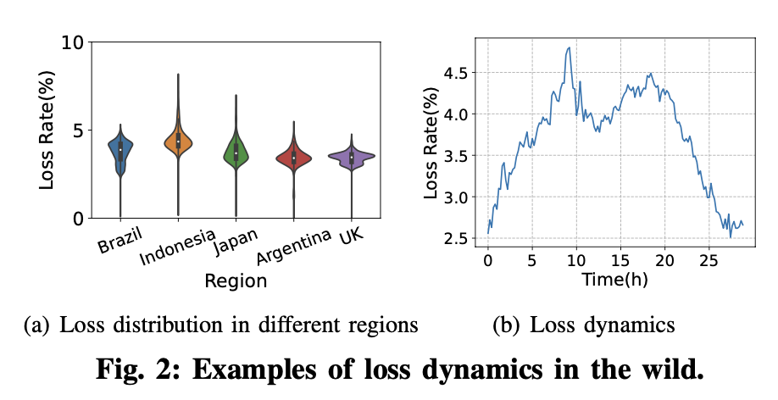
Properties of loss in the wild
37.2%
Bursty
Dynamic
Source: ByteDance
Source: ByteDance
Packet loss pattern in real-network exhibits two characteristics:
dynamics and burstiness
Notes:
We collected logs from our production network over two weeks.
【】We first explore the distribution of the loss rate (every 5 minutes) of each connection in different worldwide regions. Figure 2(a) shows the results. Although there are regions with similar average packet loss rates, they have different packet loss rate deviations
Figure 2(b) further gives an example of how the packet loss rate evolves over time. Specifically, the loss rate is never constant and varies from 2% to 5% during 24 hours.
【】We further explore the burst loss distribution in the production network. Surprisingly, the probability of only one packet being lost is not as high as imagined (i.e., 37.2% ), instead, the probability of losing multiple packets together accounts for a larger proportion.

Slide 10
Takeaways
Loss in the wild exhibits two characteristics: dynamics and burst
Retransmission loss is ubiquitous
Delay-sensitive transmission suffers from data reassembling starvation
Throughput-intensive transmission suffers from receiving buffer starvation
Accelerating loss recovery with minimized redundancy cost is possible
Notes:
Then we give the second takeaway:
Retransmission loss is not unusual in the wild.

Slide 11
Legacy ARQ is far from satisfied.
For delay-sensitive applications, existing packet loss recovery algorithms result in recovery time for lost packets that exceed 1 RTT in over half of the cases.
Source: ByteDance
Notes:
Given a connection, its maximum retransmission times can be computed as the maximum value of retransmission times among all packets in a connection. This Figure shows the results of the distribution of the maximum retransmission times in the production network. We find that the proportion of connections with maximum retransmission times of two or more exceeds forty-three percent. Among them, a considerable portion of the connections have certain packets that are retransmitted even more than 10 times.

Slide 12
Takeaways
Loss in the wild exhibits two characteristics: dynamics and burst
Retransmission loss is ubiquitous
Delay-sensitive transmission suffers from data reassembling starvation
Throughput-intensive transmission suffers from receiving buffer starvation
Accelerating loss recovery with minimized redundancy cost is possible
Notes:
Now we give the third takeaway:
Delay-Sensitive Transmission Suffers From Data Reassembling Starvation.

Slide 13
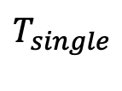



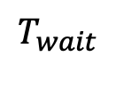
High Speed Rails (HSRs)
Loss leads to high delay
$$T_{wait}$$
Received
Receiver
Ack
Lost
Lost
Packet
_{k=0}
_{k=1}
_{k=2}
k : k^{th} Retransmission Times
Sender
$$T_{single}$$
Time
$$T_{single} ∝ rtt$$
$$T_{wait}=K⋅T_{single}+ \frac{rtt}{2}$$
$$T_{wait} ∝K$$
K larger, delay higher
Notes:
Consider a distributed system that relies on RPC for inter-process communication.
【】If a critical RPC call is lost and experiences a high recovery latency, the client’s request will be delayed, and subsequent dependent operations may be blocked. Under these circumstances, the prioritizing loss recovery attempts to mitigate receiver-side waiting time (Twait) for the lost data and enables delivery of the follow-up data to the application layer. As illustrated in this Figure, we define Twait as the duration between when a packet is sent and when the packet is first received, and Tsingle as the duration between when a packet is sent and when the packet is detected lost. Then we have 【】Twait equals K multiply by Tsingle plus half of rtt ,where rtt refers to the round-trip time and K refers to the retransmission times . Given a certain loss detection algorithm, we have 【】Tsingle is in proportion to rtt . Furthermore, given the RTT, we have 【】Twait is in proportion to K
【】Based on the above analysis, we infer that delay-sensitive transmission suffers from data reassembling starvation in the case of the large K.

Slide 14
Takeaways
Loss in the wild exhibits two characteristics: dynamics and burst
Retransmission loss is ubiquitous
Delay-sensitive transmission suffers from data reassembling starvation
Throughput-intensive transmission suffers from receiving buffer starvation
Accelerating loss recovery with minimized redundancy cost is possible
Notes:
Then we give the fourth takeaway:
Throughput-Intensive Transmission Suffers From receiving buffer Starvation

Slide 15
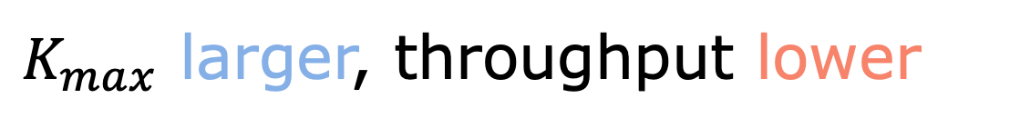
High Speed Rails (HSRs)
Loss leads to low throughput
Loss-based CC(i.e, Cubic):
Loss
Cwnd
reduced
Throughput
lower
Source: pantheon(https://pantheon.stanford.edu)
$K_{max}$ larger, throughput lower
Non-Loss-based CC(i.e, BBR):
Loss
Head-of-Line Blocking
Buffer Starvation
Throughput
lower
Notes:
Whether it's a loss-based congestion control algorithm or a non-loss-based one, packet loss inevitably diminishes their throughput.
【】In the case of loss-based congestion control algorithms like Cubic, packet loss causes a reduction in the cwnd, thereby restricting throughput.
【】Conversely, for non-loss-based congestion control algorithms such as BBR, packet loss results in data arriving out of sequence.Transport protocols like TCP and QUIC provide reliable and ordered byte-stream transmission. 【】As a result, before being handed off to upper applications, the subsequent packets of the lost packet will be stalled in the receiving buffer until the “hole” is filled via retransmissions. However, retransmissions might be lost again.
【】Since the receiving buffer required by a connection is closely related to the maximum times of retransmissions, we focus on the metric of Kmax, the maximum value of K among all packets in a connection. Based on the above analysis, we infer that throughput-intensive transmissions might suffer from receiving buffer starvation in the case of a large Kmax.
【】The Figure shows an example of how high-throughput transmission bottlenecks the receiving buffer in the Pantheon. It is observed that buffer limitation makes TCP only achieve bandwidth utilization of less than 25% even when there is sufficient available bandwidth.

Slide 16
Takeaways
Loss in the wild exhibits two characteristics: dynamics and burst
Retransmission loss is ubiquitous
Delay-sensitive transmission suffers from data reassembling starvation
Throughput-intensive transmission suffers from receiving buffer starvation
Accelerating loss recovery with minimized redundancy cost is possible
Notes:
The solution is the fifth takeaway:
Accelerating loss recovery with minimized redundancy cost is possible.
we propose the adoption of FEC to improve loss recovery in ARQ-based protocols. Unlike the traditional FEC-based approach, which involves sending redundant unlost data packets, our method focuses on sending redundant lost packets without the need for coding, thereby avoiding dual-side modifications and expediting the loss recovery process.

Slide 17
But, simply increasing replicas of lost packets hurts performance
Increasing replicas of lost packets has both “positive effect” and “negative effect”
Replica number increases
*Data is collected by a simulation tool mahimahi (http://mahimahi.mit.edu)
Postive effect:
accelerating recovery time of lost packets
Negative effect:
increasing cost
Notes:
But, simply increase replicas of lost packets hurts performance. 【】As shown in left Figure ,the higher the redundancy level, the lower the Nmax. Intuitively, the optimal redundancy level should be set at the inflection point. However, the experimental results demonstrate that the inflection points vary with the loss rates. We then infer that the redundancy level should be set dynamically according to network dynamics.
【】 As shown in right Figure, , when the redundancy level increases, there is a corresponding rise in the redundancy cost.

Slide 18

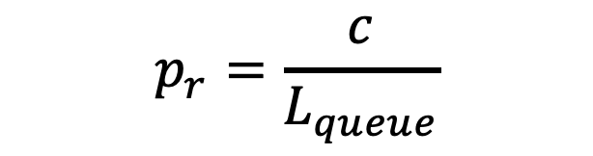
How to adaptively change replicas?
Key idea: replica loss rate
Redundancy Adaptation Modeling:
$$R=R+1$$
$$E<1$$
Replica Loss Rate
$$R=R−1$$
$$E≥2$$
$$E=R⋆\left( 1 −p_{r} \right)$$
Replica Number
sliding-window-based bitmap queue
Noop
Otherwise
$$p_{r}=\frac{c}{L_{queue}}$$
E: number of replicas expected to be
received by receiver
E < 1
replicas
not received
replicas
need more
c: number of 1 in queue
R: number of replicas of lost packet, i.e. redundancy level
E $≥$ 2
replicas
was received multiple times
replicas
need less
Notes:
【】Primarily, we establish the replica loss rate (pr) by dividing the number of lost replicas by the total number of sent replicas. While it is acknowledged that redundancy levels should be adjusted according to the loss rates, it is imperative to consider pr instead of the general packet loss rate (p) for a more accurate design of the Redundancy Adapter. 【】In this paper, we propose a sliding-window-based way to predict pr according to the historical packet delivery information. 【】 In this case, pr is computed as the proportion of “1” in the queue.
【】Then the expected number of successfully delivered replicas can be computed as follows: E equals R multiply by (one minus pr). In general, to ensure the effectiveness of redundant retransmission where we only send the number of replicas that is exactly required by the loss recovery, we should keep E equals 1. 【】This is because the unnecessary traffic cost arises when E bigger than 1, and recovery latency arises when E smaller than 1. To accomplish this, a step-by-step online algorithm is applied.

Slide 19
How to send these replicas?
Goal:
Make receiver receive replica as “soon” as possible.
So we should send all these replicas at once?
Notes:
So how should we send these copies after generating them? Our goal is making receiver receive replica as soon as possible. 【】so we should send all these replicas at once?

Slide 20
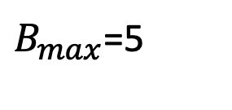
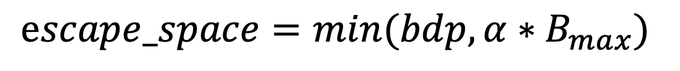
No, because of “burst loss”
Key idea:
Scheduling
$B_{max}$=5
Replicas
QUIC
Burst Size
Normal Packets
W/o Scheduler
Sending all replicas like legacy loss recovery may cause all replicas lost.
W/ Scheduler
Randomize
Upper bound
Scheduling these replicas makes their send timing distributed in 1 RTT, thereby escaping “burst loss”.
$$escape_space=\min{(bdp, α∗B_{max})}$$
Notes:
No, because the redundant replicas might be lost together again when burst losses occur. Instead of sending out all the replicas at once, the Replica Scheduler randomly disperses the multiple replicas into a certain number of sending cycles. That is, replicas are interspersed with normal packets.
【】we define the escape space of the lost packet as the total number of sent packets from starting sending its first replica to finishing sending its last replica. For example, as shown in this Figure, for the traditional QUIC, we have escape space equals 1. For ART without applying the Replica Scheduler, the escape space of each packet equals the redundancy level.
We use B to denote the burst size of loss during transmission. when B smaller than R, the Replica Scheduler is not a mandatory measure that should be taken. However, when B bigger than R, ART depends on the Replica Scheduler to expand the escape space. This assures that at least one replica “escapes” the burst loss and is successfully delivered. 【】On the other hand, all replicas should be sent in one RTT to ensure an orderly control loop. 【】Based on these observations, we finally give the guideline of how to determine the escape space as follows:
escape space equals minimum value between bdp and α multiply Bmax ,where α refers to a scaling coefficient, and Bmax refers to the maximum burst size of the loss in the past several RTTs。 Figure shows an example of the ART applying the Replica Scheduler, only ART featuring the Replica Scheduler demonstrates resilience against the ramifications of burst loss.

Slide 21
Features of ART-based retransmission mechanism
Adaptively change recovery ability
Enhance ability of recovery when network is deteriorated.
Fall back to legacy loss recovery when network is good.
Mitigate the impact of “burst loss”
Guarantee at least one replica could be received by receiver.
Provide a upper bound to limit the degree of dispersion
For more details,
please refer to the paper.
ART module design
Notes:
We propose ART to accelerate loss recovery. The main objective of ART is to ensure the successful reception of each lost packet by the receiver, minimizing the receiver-side waiting time of each packet. However, in order to effectively implement ART in production networks where cloud services charge based on traffic volume, it is vital to not only accelerate quick recovery of lost packets but also minimize redundancy cost and prevent any detrimental impact on regular packet transmission.
【】ART is a sender-side modification to the protocol stack whose key modules are illustrated in Figure.

Slide 22
ART workflow
Goal: Adaptively change recovery ability according to network
Notes:
To explain this more clearly, we further give an example of the ART workflow in this Figure. Assuming a packet (packet number = 18) is detected lost. And then the redundancy adapter compute the redundancy level for packet 18, we assume redundancy level = 3. Then ART runs the replica scheduler to determine when to send each replica. For example, the 3 replicas should be sent in 0 us, 65 us, and 300 us, respectively. As a result, the replicas are sent out with packet numbers 21, 23, and 27, respectively. Since the 3 replicas are sent at various intervals, it can greatly enhance the likelihood of a successful retransmission.

Slide 23
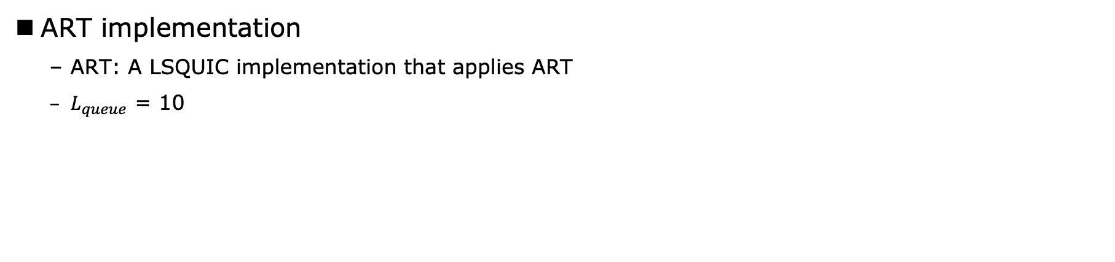
Evaluation
ART implementation
ART: A LSQUIC implementation that applies ART
$L_{queue}$ = 10
Experiment setup
Trace-driven testbed network using the mahimahi simulation software(https://mahimahi.mit.edu)
Production network deployment involved the implementation of ART on a QUIC server
Notes:
We implement ART in the user-space QUIC protocol based on LSQUIC.
【】In our evaluation, we utilized two distinct networks to assess the performance of our approach, namely:
(1) Trace-driven testbed network using the mahimahi simulation software (2) Production network deployment involved the implementation of ART on a QUIC server..

Slide 24
Mitigating Data Reassembling Starvation of Delay-Sensitive Transmissions
Reducing retransmission rounds of lost packets.
Reducing loss recovery latency.
Notes:
we first investigate how ART reduces N, and then investigate how ART reduces the loss recovery latency Twait. 【】We compute the reduction of the retransmission round as ∆N equals the retransmission round of a packet in traditional QUIC minus the retransmission round of the packet in QUIC applying ART. It shows that ART may significantly reduce the retransmission rounds of lost packets, especially in the worst cases.
【】We compute the reduction of the loss recovery latency ∆T as the recovery latency of a packet in QUIC without applying ART minus the recovery wait latency of the packet in QUIC applying ART. It is observed that ART significantly reduces the recovery latency of lost packets.

Slide 25
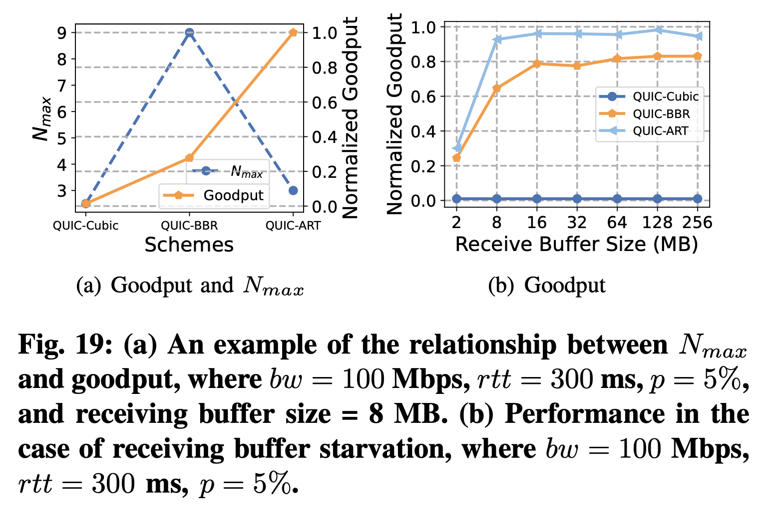
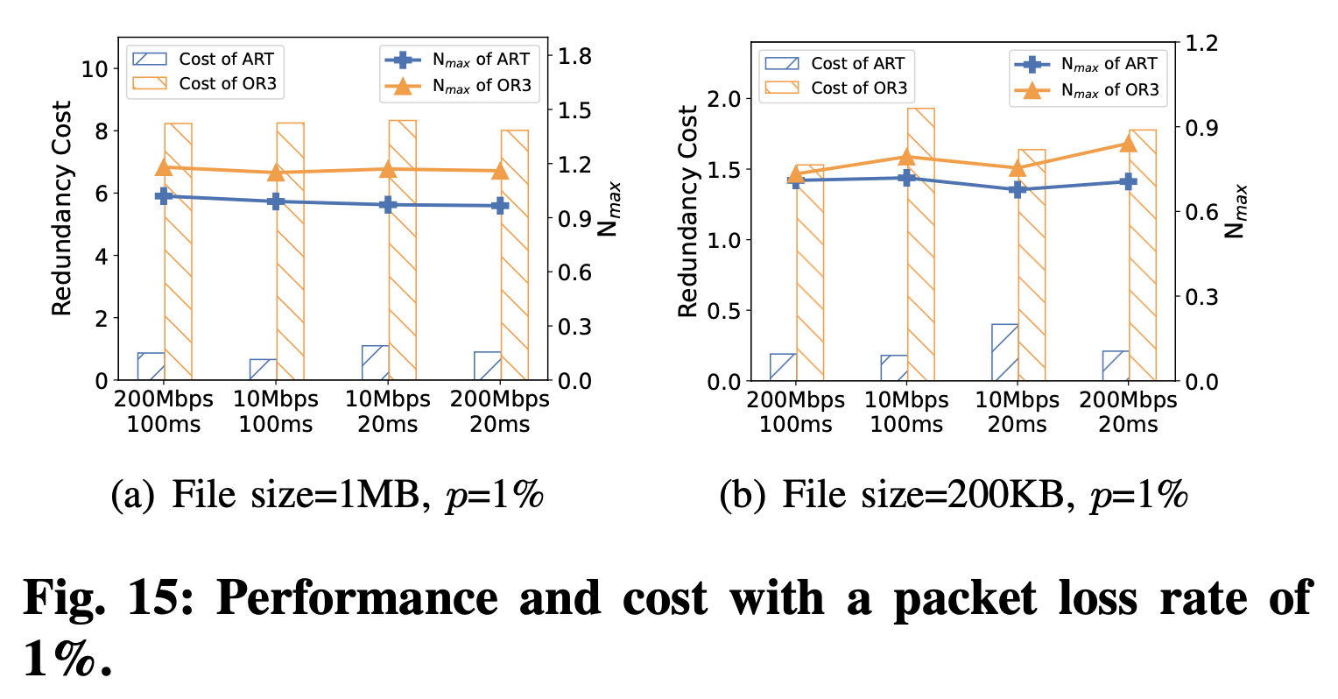
Mitigating Receiving Buffer Starvation of Throughput-Intensive Transmissions
Reducing maximum retransmission rounds.
Improving goodput.
Notes:
we investigate how ART reduces Nmax, and then investigate how ART improves the goodput.
【】 Figure 15 shows ART reduce Nmax varies across different network environments.
【】As shown in Figure 19(a), we give an example of the relationship between Nmax and goodput. It is demonstrated that ART greatly increases the goodput by decreasing the Nmax. Figure 19(b) further shows that ART still fills up the pipe when the receiving buffer size is insufficient for QUIC.

Slide 26
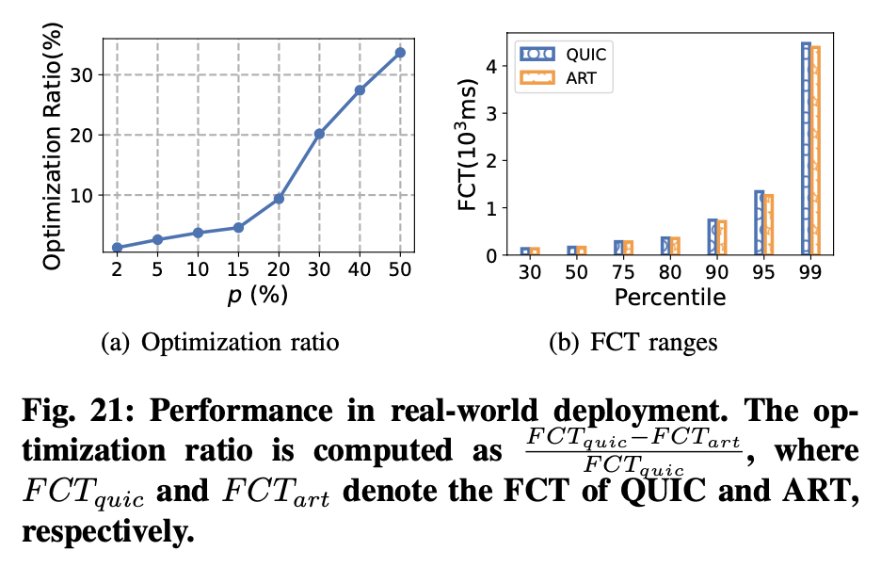
Real-world Deployment
Notes:
To verify that ART indeed accelerates packet recovery speed, we used the actual FCT in the production network as our measurement metric..
We conducted comprehensive testing of two key scenarios: RPC transmission and small file downloading.
Figure 21(a) demonstrates that the optimization effect becomes more pronounced as the packet loss rate increases, with improvements reaching approximately 34%.
Figure 21(b) shows an overall reduction in FCT of about 2%. Our deployment experience further shows that this reduction is especially significant for users with higher access bandwidth.

Slide 27
Takeaways
Loss in the wild exhibits two characteristics: dynamics and burstiness
Retransmission loss is ubiquitous
Delay-sensitive transmission suffers from data reassembling starvation
The bigger retransmission times, the higher delay
Throughput-intensive transmission suffers from receiving buffer starvation
The bigger max retransmission times, the lower throughput
Accelerating loss recovery with minimized redundancy cost is possible
Redundancy Adapter can adaptively change number of replica to address dynamic nature of loss
Replica Scheduling can control sending time of replica to escape influence of ”burst loss”
Notes:
I would like to conclude today’s talk by summarizing the takeaways.
First, Loss in the wild exhibits two characteristics：dynamics and burstiness.
Second, retransmission loss is ubiquitous.
Third, Delay-sensitive transmission suffers from data reassembling starvation, and the bigger retransmission times, the higher delay.
Fourth, Throughput-intensive transmission suffers from receiving buffer starvation, and the bigger max retransmission times, the lower throughput.
Fifth, Accelerating loss recovery with minimized redundancy cost is possible. ART-based retransmission mechanism can adapt to dynamic nature in the wild and ensure at least one replica can be received by receiver.

Slide 28
Thank You! Email: 2022104277@ruc.edu.cn Q & A

