Slide 1
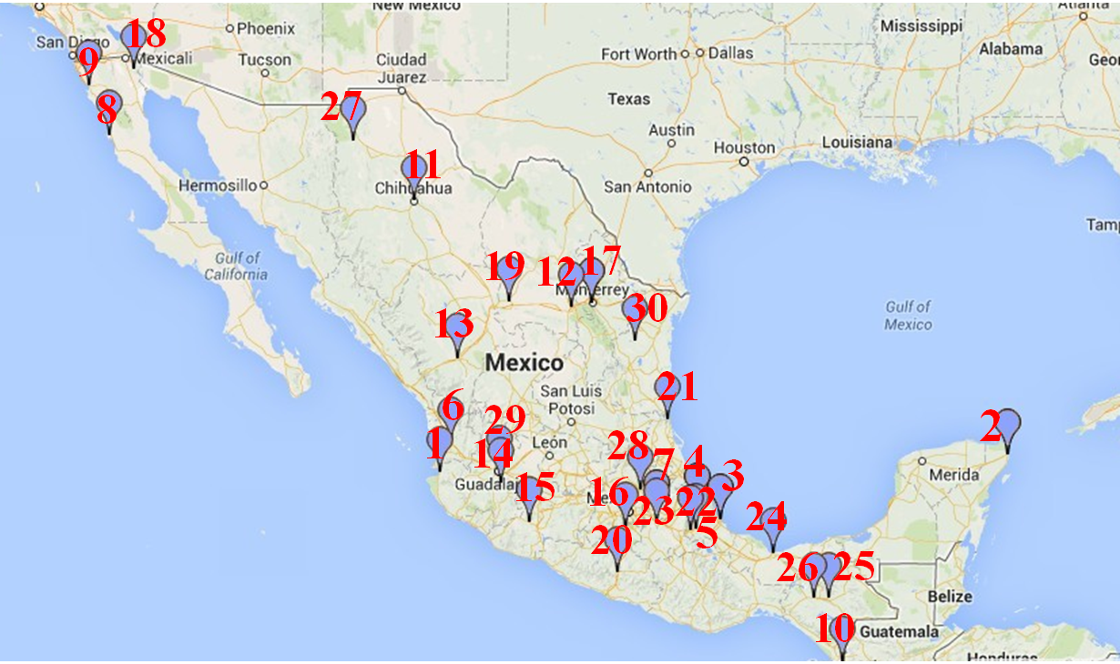
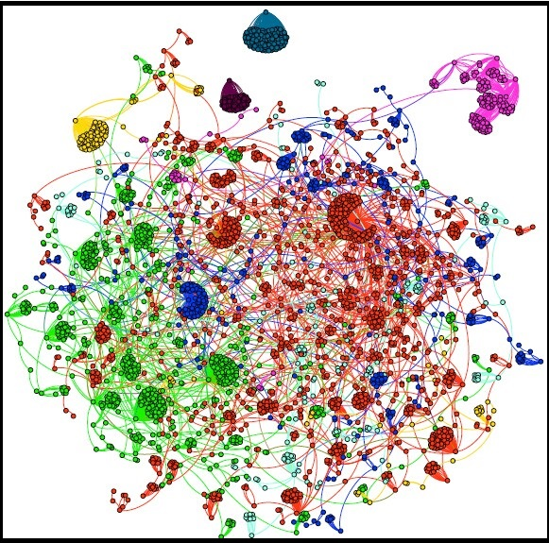
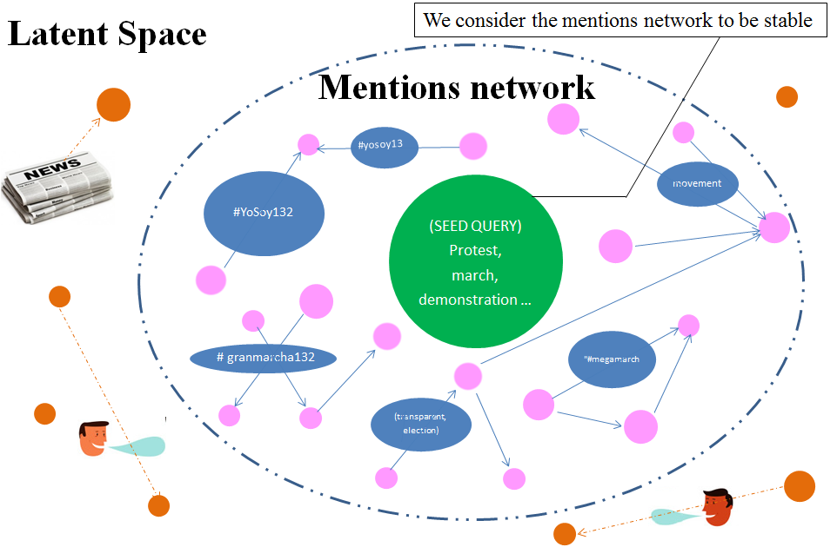
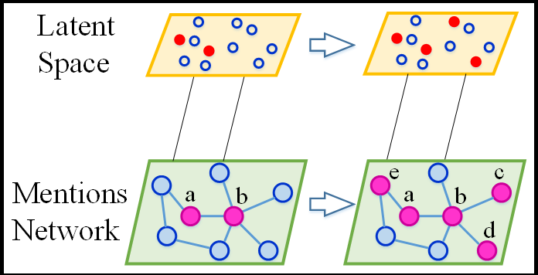
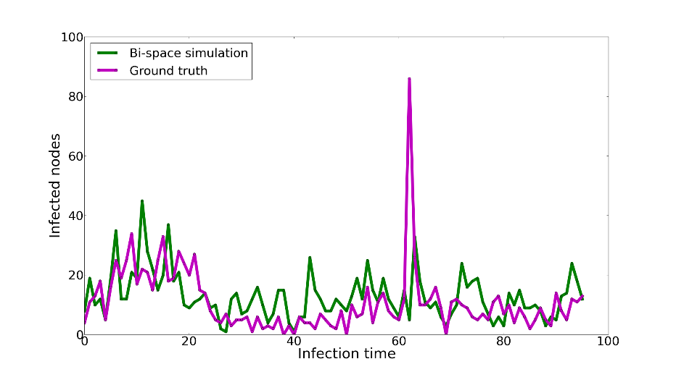
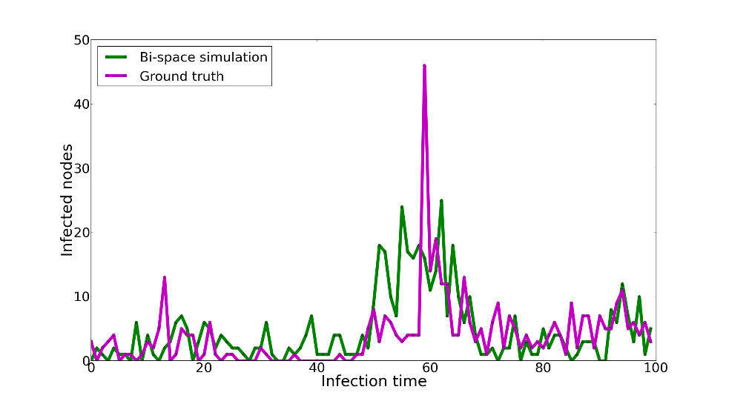
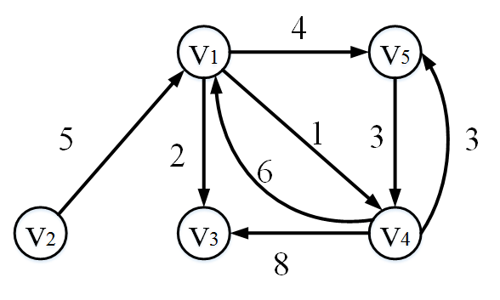

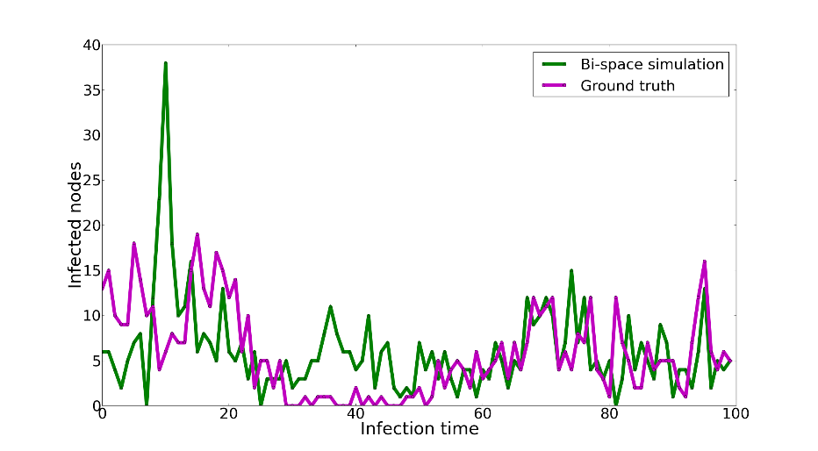
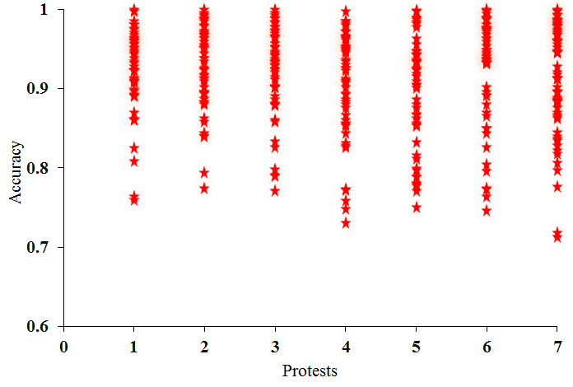
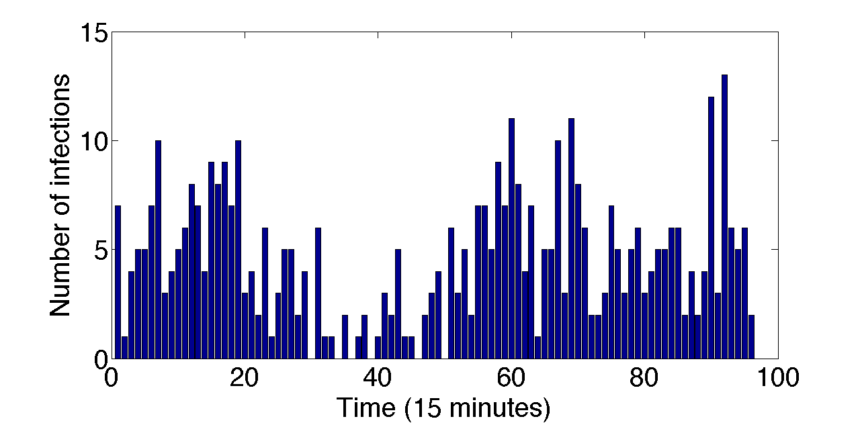

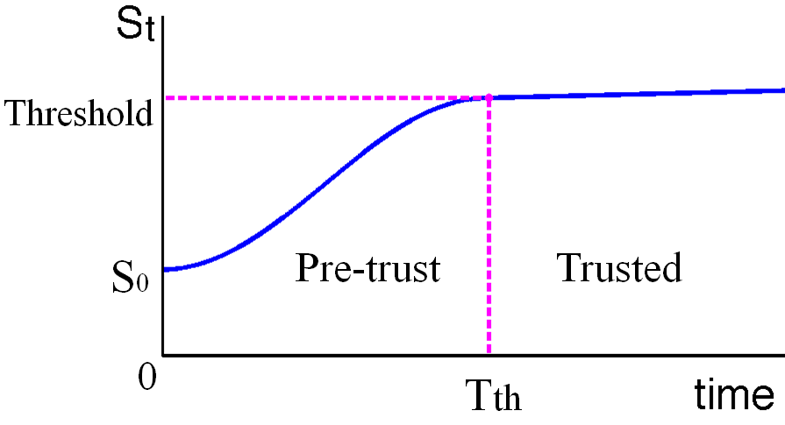
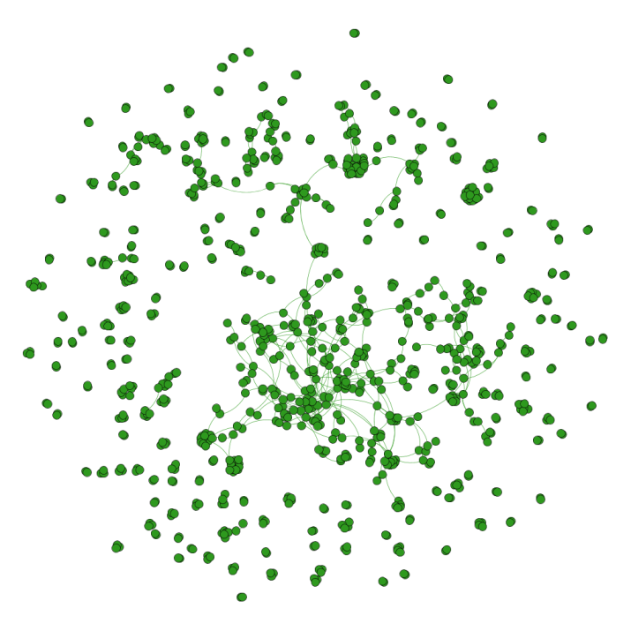
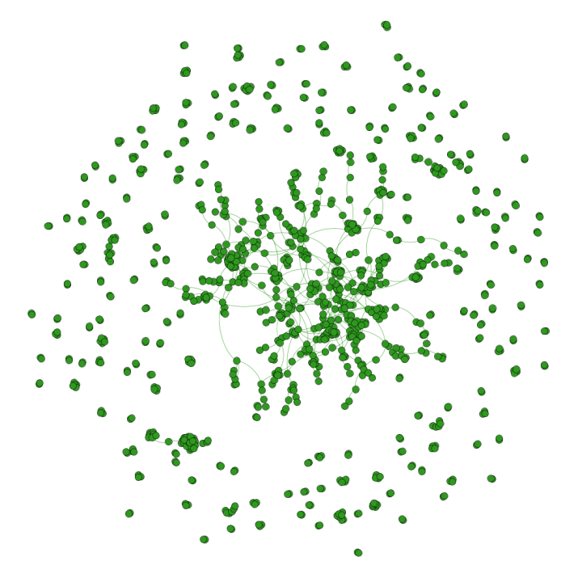
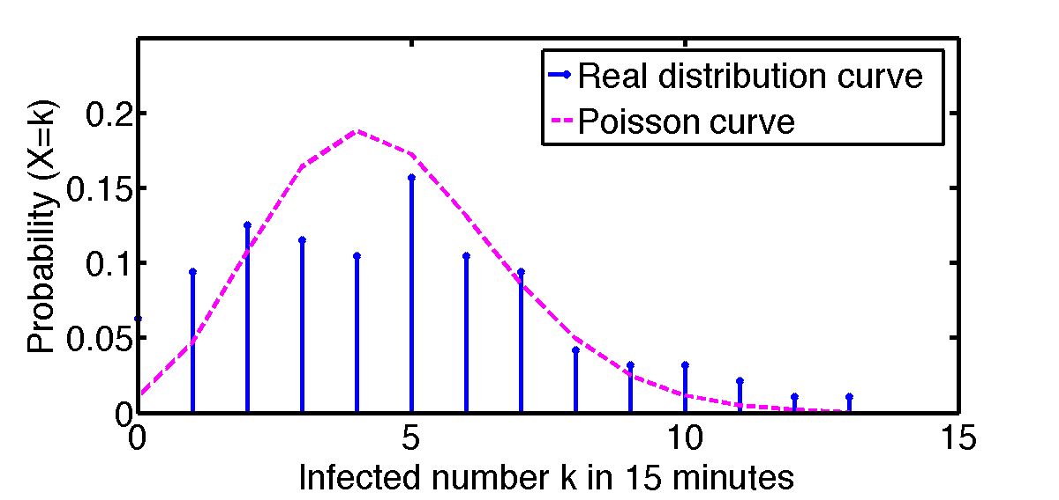



Modeling Mass Protest Adoption in Social Network Communities
using Geometric Brownian Motion
Fang Jin^{1,2}, Rupinder Paul Khandpur^{1,2}, Nathan Self ^{1,2}, Edward Dougherty², Sheng Guo³, Feng Chen⁴, B. Aditya Prakash^{1,2}, Naren Ramakrishnan^{1,2}
¹ Discovery Analytics Center, ² Virginia Tech, ³ LinkedIn Inc., ⁴ University at Albany
Introduction
Approach
Bispace model
Latent space： Poisson model
Protest examples
Mentions network: geometric Brownian motion (GBM)
Mass movement in Twitter
Propagation model
Goal:
Model the growth of protest participants within a social network.
Understand the underlying social network and structural dynamics
Challenge:
The intrinsic random nature of individuals adopting a Twitter topic.
The dissemination of information via non-Twitter sources.
Bispace modeling:
We have empirically verified in the latent space that the probability of newly infected users fits the Poisson distribution.
GBM is used to model inside influences dependent on the mentions network distance and trust function.
Methodology
Evaluation
Propagation rate evaluation
Geometric Brownian Motion (GBM)
Latent space: Poisson process
Brownian distance
We empirically verified the probability of the number of newly infected users, X, in a given time interval satisfies the Poisson distribution:
Mexican teachers’ protest
Colombia anti-government protest
Mexican Yosoy132 protest
Simulation accuracy
Trust function
Infected nodes in latent space
Subgraph structure evaluation
We modeled the trust function S_{t} as a GBM process
Simulated infection subgraph
True infection subgraph
Infection condition: ln (S_{t}^{ij} ) ≥ d_{ij}
Poisson distribution fit (λ = 4.18)
 | Average degree | Diameter | Graph density | Connected components | Average clustering coefficient | Average path length
Simulation | 1.791 | 11 | 0.002 | 183 | 0.083 | 4.786
Ground truth | 1.726 | 18 | 0.002 | 204 | 0.008 | 6.261
Bispace simulation results for Mexican teachers’ protest event on Sep 2, 2013
This work was supported by the Intelligence Advanced Research Projects Activity (IARPA) via Department of Interior National Business Center (DoI/NBC) contract number D12PC000337.

