Slide 1
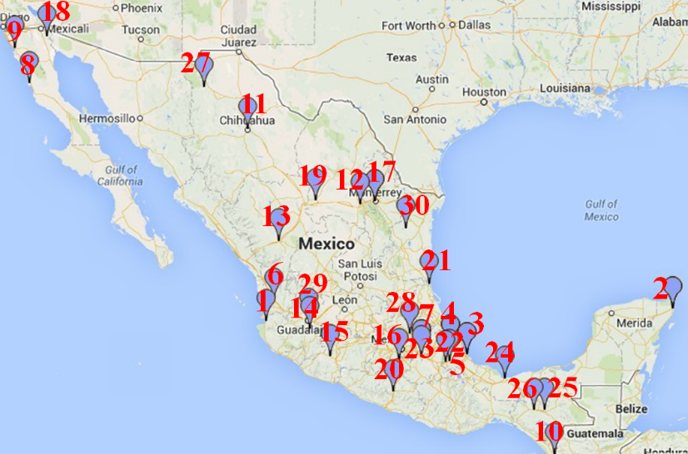
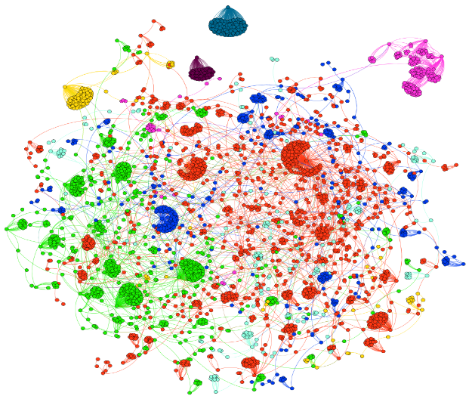



Modeling Mass Protest Adoption in Social Network Communities using Geometric Brownian Motion
Fang Jin^{1,2}, Rupinder Paul Khandpur^{1,2}, Nathan Self ^{1,2}, Edward Dougherty², Sheng Guo³, Feng Chen⁴, B. Aditya Prakash^{1,2}, Naren Ramakrishnan^{1,2}
¹ Discovery Analytics Center, ² Virginia Tech, ³ LinkedIn Inc., ⁴ University at Albany
Mexican teachers’ protest
Geometric Brownian motion
What types of mobilization patterns underlie protests?
Can we employ geometric
Brownian motion to capture adoption in social networks?
Notes:
I am Fang Jin from the Discovery Analytics Center Virginia Tech,
We are interested in studying mass movements in social networks
and how they spread.
Can we develop a model to capture this spread?
We have developed a geometric Brownian motion approach
and applied it to the Mexican teacher's protest of Sep 2013.
Come to my talk to learn more!
2:45pm in NY Ballroom East

