Slide 1

Epidemiological Modeling of News and Rumors on Twitter
Fang Jin, Edward Dougherty, Parang Saraf, Peng Mi,
Yang Cao, Naren Ramakrishnan
Virginia Tech
Aug 11, 2013
Notes:
Good afternoon, every one! I am Fang Jin, from Virginia Tech. Today, I am going to talk about epidemic model of news and rumor on Twitter.

Slide 2
Outline
Motivation
Approach
Implementation
Results and Analysis
Conclusions & Limitation
Notes:
An epidemic model is a means of describing the transmission of disease through individuals.

Slide 3
Motivation
  Can twitter data (news and rumor) be represented by epidemic models?
  Can we gain insight into the acceptance, comprehension, and spread of information?
      How effectively does information spread via twitter?
      What is the rate of information propagation?
  Can we observe any differences between news spreading and rumor spreading?
Notes:
So we are thinking, for news spreading on Twitter, can that be represented by epidemic model? Can we understand the topic’s propagation speed, or how effective does it spread? Questions like that.
Also, when we see some topics on Twitter, we don’t know if they are real news or rumors, for example, a post said: “White House was attacked and Obama was injured”, and so on. So we are trying to see, can we find some slight difference of news and rumor spreading over twitter?

Slide 4
Twitter VS disease
Ideas spread model: SIS and SEIZ
Both infectious
May take time to accept
Have transmission route
。。。
Idea spreading is an intentional act
It is advantageous to acquire new ideas
Idea spreading on twitter has no (intrinsic) spatial concept
Idea: no immune system, no “R”
Notes:
Let us see what is the similarities and difference between idea and disease. Here the idea refers to both real news /rumors.
The similarity includes, they both are …… They also have clear difference, …
One most important difference is, the idea has no immune system, so we will not use "R" compartment. So, in our research, we only apply SIS model and SEIZ model. Let us see the SIS and SEIZ model description.

Slide 5
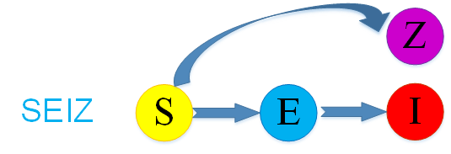
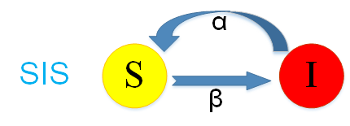




Epidemic Model
Susceptible
Infected
Exposed
Skeptics
Twitter accounts
Believe news / rumor, (I) post a tweet
Be exposed but not yet believe
Skeptics, do not tweet
Disease
Twitter
Notes:
In SIS and SEIZ model, S means susceptible, on Twitter application, S refers to susceptible Twitter accounts.
I means infected, on Twitter application, if one post a tweet, we think he believes the news/rumors, he is I.
E means exposed, on Twitter application, it means be exposed but not yet believe.
Z means skeptics., we assume skeptics do not tweet.

Slide 6
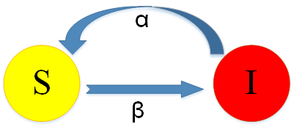
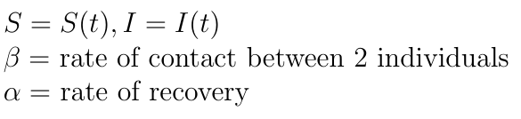

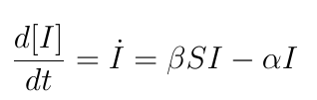
S I S
Model Description
Disease Applications:
  Influenza
  Common Cold
Twitter Application Reasoning:
  An individual either believes a rumor (I),
  or is susceptible to believing the rumor (S)
http://www.me.ucsb.edu/~moehlis/APC514/tutorials/tutorial_seasonal/node2.html
Notes:
For a SIS model, infected individuals return to the susceptible class immediately.

Slide 7




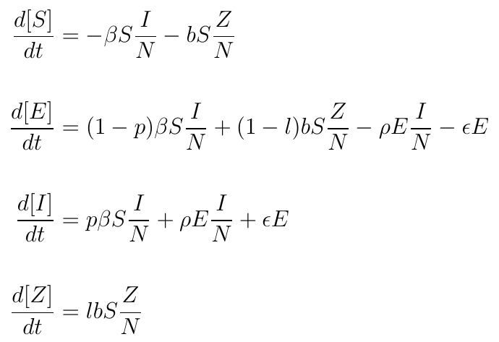
SEIZ Model Description
Probability of (S → I)
given contact with adopters
p
E-I contact rate
S-I contact rate
β
ρ
(1-p)
Probability of (S →E)
given contact with adopters
b
(1-l)
S-Z contact rate
Probability of (S → E)
given contact with skeptics
l
Probability of (S → Z)
given contact with skeptics
Notes:
For the SEIZ model, an individual can become skeptic with rate of b, can believe immediately with rate of beta, and be exposed but not yet believe. Given contact with skeptics, he can also transfer from S to Z with rate of l, or from S to E with rate of (1-l).
Given contact with adopters, he can also transfer from S to I with rate of p, Or transfer from S to E with rate of (1-p). He may transfer from E to I with rate of ρ．
--The SEIZ model is not a typical disease model. It incorporates competition between adopters and skeptics.

Slide 8






Challenges
  We have very little information: no rate, no initial compartments
  Population == Number of Twitter Accounts
Following none: 56M
Total:175M
Active: 39M
No followers: 90M
Fake:0.5M
  Time Zone Differences
  Users “unplugging”, they may offline
http://techcrunch.com/2012/07/30/analyst-twitter-passed-500m-users-in-june-2012-140m-of-them-in-us-jakarta-biggest-tweeting-city/
Notes:
Even though the SEIZ model are really reasonable, yet we still have several challenges:
－We have very little information, －No rate constants --No initial compartment sizes ---The only data we have is related to “Infected”
2) Another challenge is population, the concept of "Population” in epidemic model is, the number of individuals who could be potentially Infected.
But can we simply use the Number of Twitter Accounts as the population? Let take an example to see why, it says by June 2012,
US Twitter Accounts: ~175 M; US Active Accounts: ~39 M; US Accounts with no followers: ~90 M; US Accounts following none: ~56 M; “Fake” followers: ~ 50,000 per user who spend money to buy followers
………..Why it is a challenge?
Because in traditional epidemic model, if we did happen to know these values, we could simply just specify/substitute their values in the equations. Since we don't have reliable values for them, they must be determined through the fitting process. Let us see our approach.

Slide 9
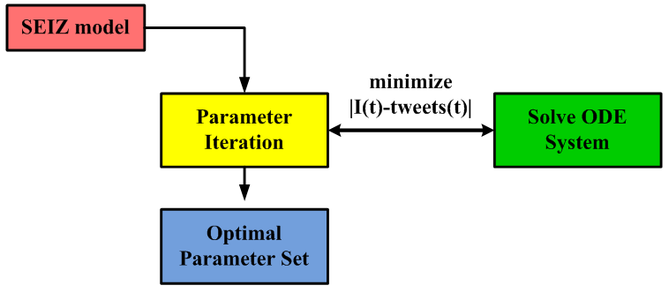
Approach
Assumptions:
  No vital dynamics
  N, S(t0), E(t0), I(t0), Z(t0) are unknown
Implementation:
  Nonlinear least squares fit, using lsqnonlin function
  Selecting a set of parameter values, solve ordinary differential equation(ODE) system
  Minimize the error of |I(t) – tweets(t)|
Notes:
The implication of this assumption is that total population size (N), and initial population sizes for each compartment (S(t0), E(t0), I(t0), and Z(t0)) are treated as unknowns, and so they are treated as parameters in the parameter fit routine. So, these 5 variables are fitted right along with the other model parameters (beta, b, p, and so on.). ……. lsqnonlin function, solve nonlinear least-squares (nonlinear data-fitting) problems.
ODE, ordinary differential equation

Slide 10
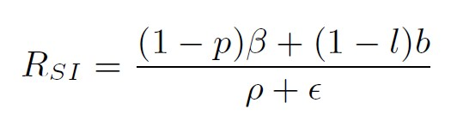
Rumor Identification
By SEIZ model parameters
p
bl: effective rate of S → Z
βp: effective rate of S → I
b(1-l): effective rate of S → E via contact with Z
β(1-p): effective rate of S → E via contact with I
Є: E-I Incubation rate
ρ: E-I contact rate
β
ρ
Є
(1-p)
b
(1-l)
l
RSI, a kind of flux ratio, the ratio of effects entering E to those leaving E.
Notes:
The SEIZ model has generated a set of valuable parameters, the effective rate of S-Z, S-I, E-I incubation rate, E-I contact rate, and so on. By anlyzing those ratios, will help us study the system dynamics.
A most interesting ratio is R_SI, it is a ratio of effects entering E to those leaving E. Let us see the R_SI for the eight stories.
A R_SI value greater than 1, means that the inflow into the exposed compartment is greater than the outflow. Similarly, a value less than 1 indicates that members are added to the exposed group more slowly than they are removed.
Next, let us see our datasets and their fitting results.

Slide 11
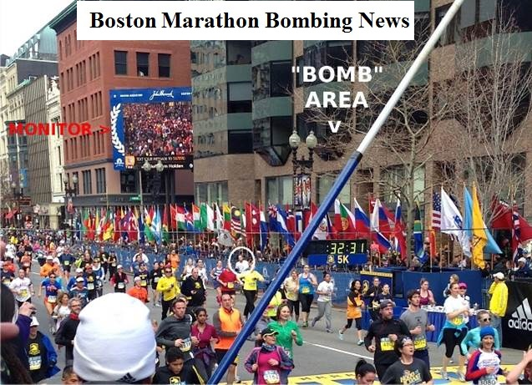
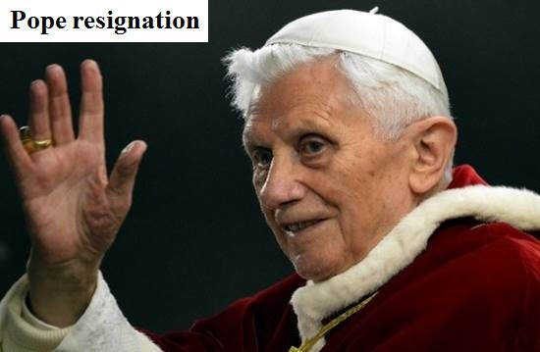
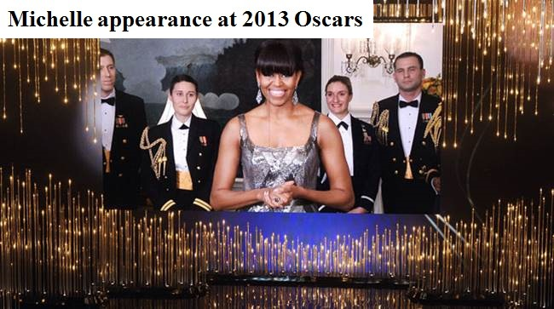
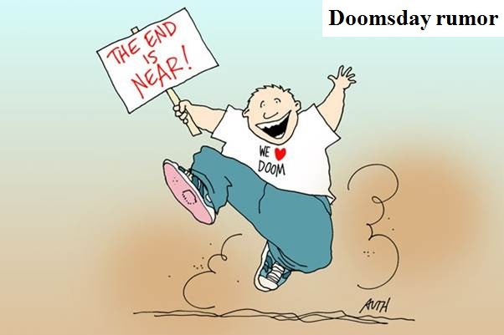
Datasets
Boston Marathon Explosion. 04-15-2013
Pope Resignation. 02-11-2013
Venezuela's refinery explosion. 08-25-2012
Michelle Obama at the 2013 Oscars. 02-24-2013
Obama injured. 04-23-2013
Doomsday rumor. 12-21-2012
Fidel Castro’s coming death. 10-15-2012
Riots and shooting in Mexico. 09-05-2012
Notes:
We select four real news and four rumors. The first is Boston Marathon bombing,
the second is Pope 16th resignation.
The third is a refinery explosion in Venezuela.
The fourth is Michelle Obama's appearance at this year's Oscars, in fact, Mechelle herself did not really show up to the Oscar awards, she simply appeared remotely via video telecast.
We also have four rumors stories. The first rumor is “White house was attacked and Obama was injured “.
The second rumor is very famous, that is Doomsday.
The third is about Fidel Castro's coming death.
The last rumor spreading on Twitter is, the fake riot and shooting in Mexico.

Slide 12
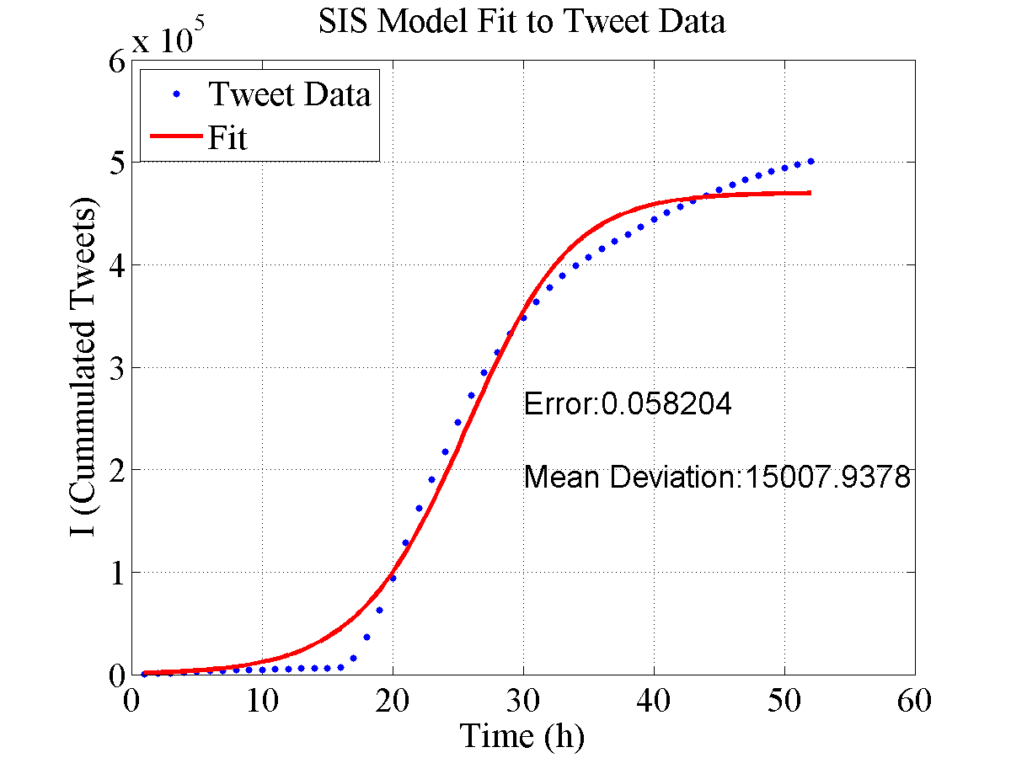
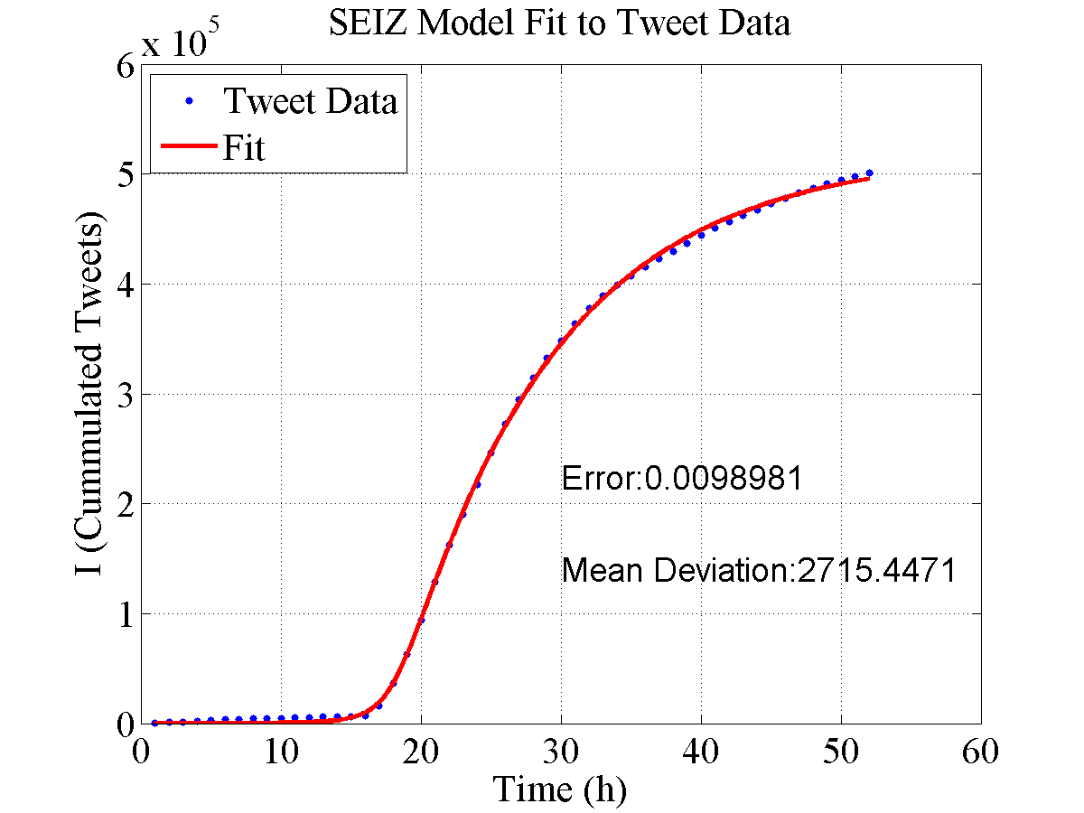
Boston Marathon Bombing
SIS Model
SEIZ Model
Error = norm( I – tweets ) / norm( tweets )
SEIZ models Twitter data more accurately than SIS model, specially at the initial points.
Notes:
Here is the Boston Marathon Bombing fitting result. The left picture is SIS model fitting result, the right one is SEIZ fitting result. We can see the fitting error for SIS is 0.058, while the fitting error for SEIZ is much smaller, close to 0.01. Also, look at the initial points, the SIS model cannot fit the beginning points very well, but the SEIZ model fits really perfect.

Slide 13
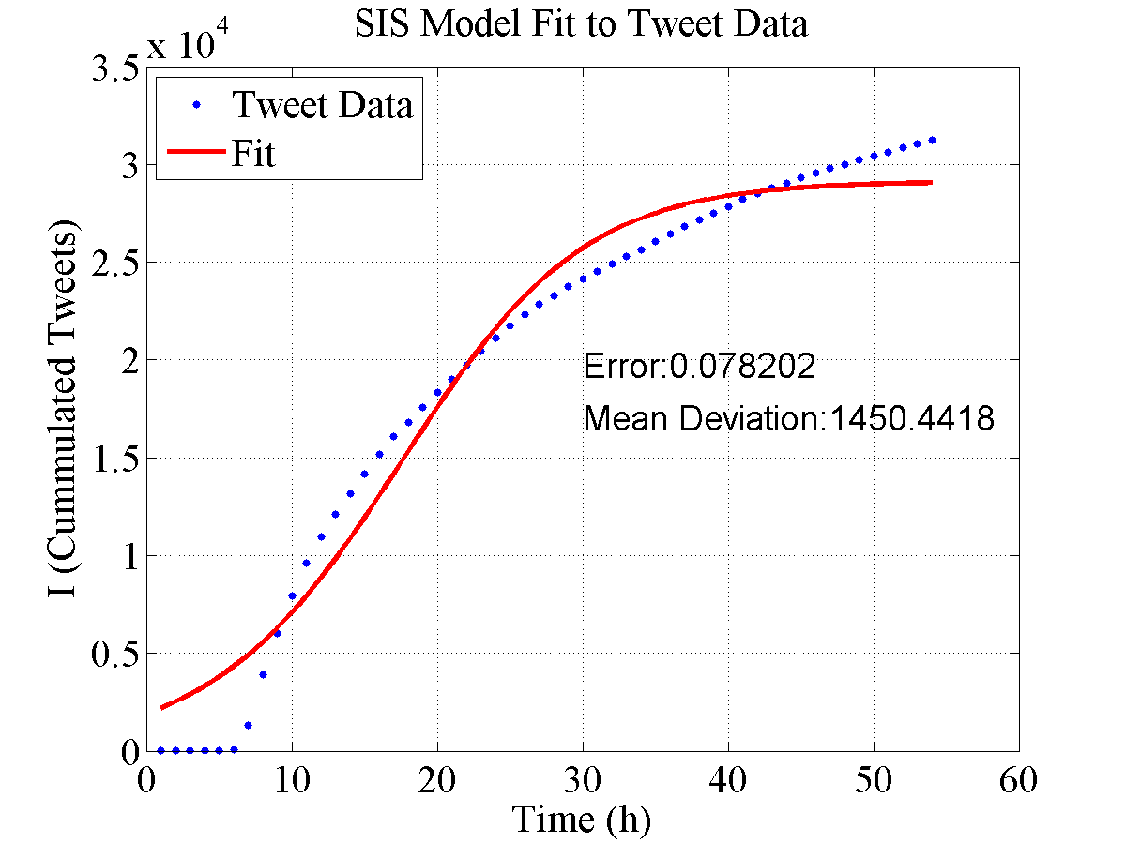
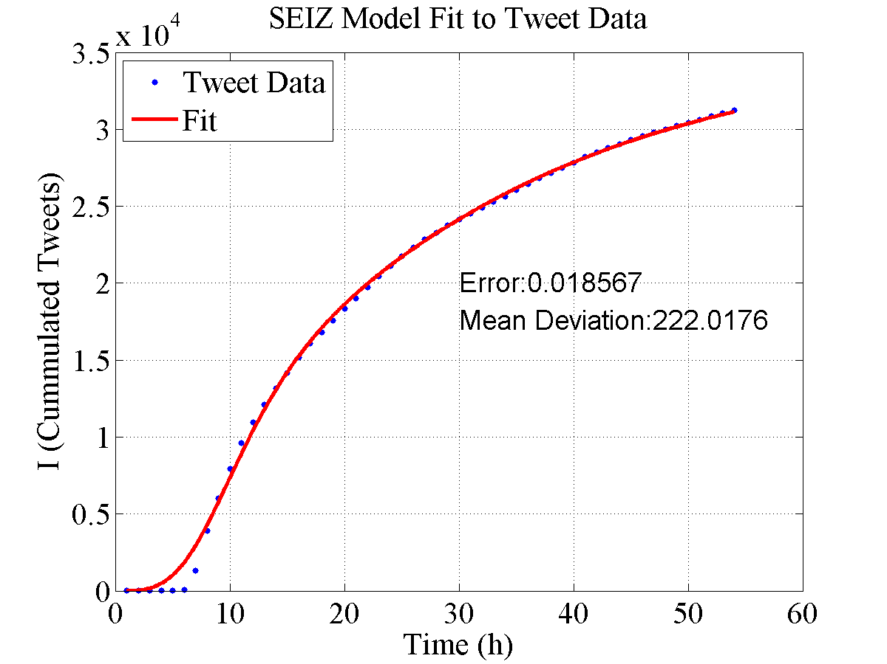
Pope Resignation
SIS Model
SEIZ Model
SEIZ models Twitter data more accurately than SIS model, specially at the initial points.
Notes:
For the Pope resignation story, the SIS model cannot fit the initial points properly, but the SZIE is much better, also, the error is much smaller.

Slide 14
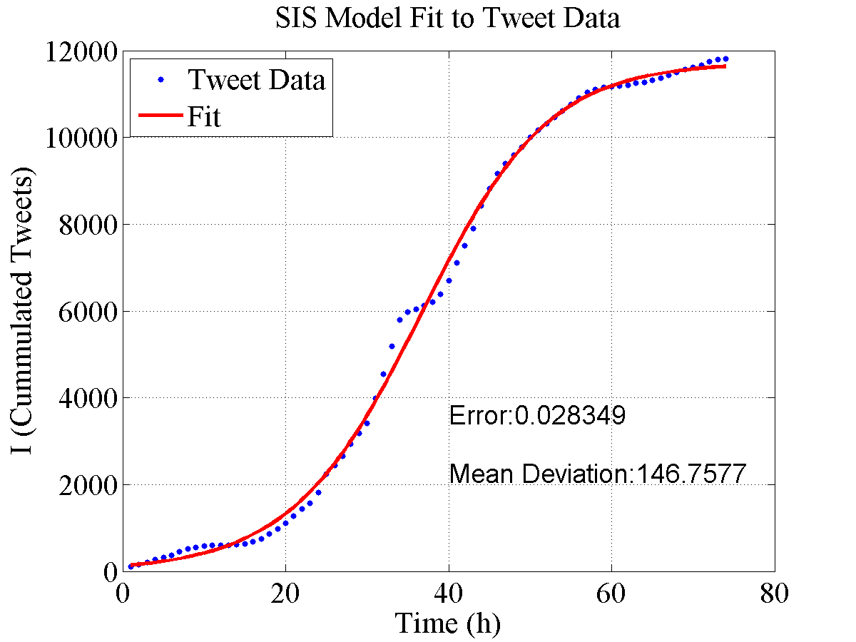
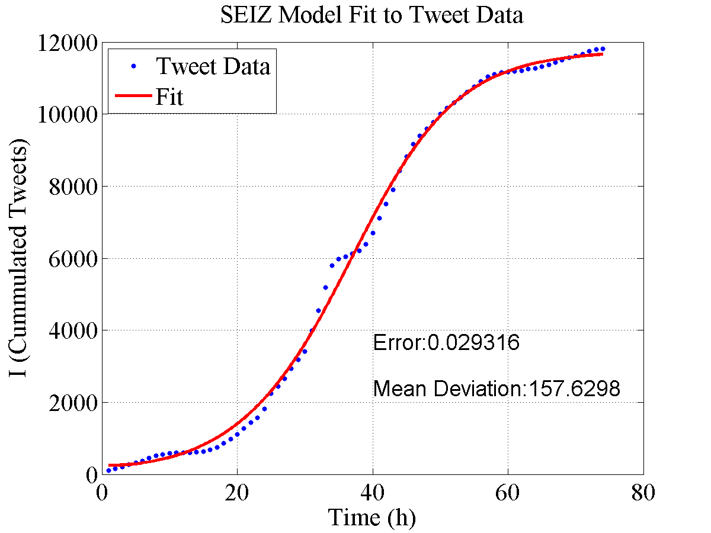
Doomsday
SIS Model
SEIZ Model
Notes:
This is doomsday

Slide 15

SIS VS SEIZ
Fitting error of SIS and SEIZ models:
 | Boston | Pope | Amuay | Michelle | Obama | Doomsday | Castro | Riot | Average
SIS | 0.058 | 0.041 | 0.058 | 0.088 | 0.102 | 0.028 | 0.082 | 0.088 | 0.0680
SEIZ | 0.010 | 0.004 | 0.027 | 0.061 | 0.101 | 0.029 | 0.073 | 0.093 | 0.0499
What can we deduce?
SEIZ models Twitter data more accurately than SIS model
SEIZ models Twitter data (via I(t) function) well
Notes:
Let us have a close look at the summary result. Generally speaking, the SEIZ models twitter data more accurately than SIS model. Also, the SEIZ model is more accurate in modeling the initial spread of news or rumor, than SIS model.

Slide 16
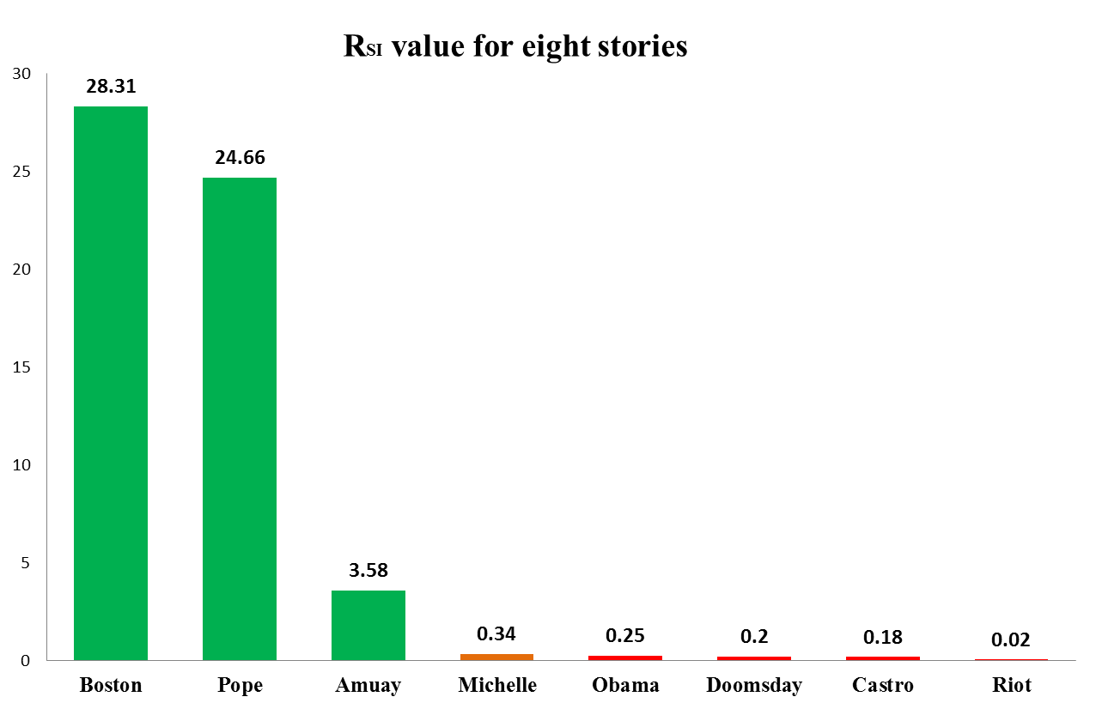
Rumor detection via SEIZ model
SEIZ model parameter result
Notes:
As we known, if R_SI value greater than 1, it means that the inflow into the exposed compartment is greater than the outflow. Similarly, a value less than 1 indicates that members are added to the exposed group more slowly than they are removed.
Look at the bar graph. We found generally, news have a larger R_SI value, while the rumor has a smaller R_SI value.
For Michelle Obama's presence at Oscar, what do you think? Is it a news, or rumor?
Since Mechelle herself did not really show up to the Oscar awards, she simply appeared remotely via video telecast. So, it is arguable to say this topic is a rumor or news.
If set the threshold of R_SI equal to 1, according to our analysis, it will be ascribed to a rumor.
------------------------------------------------------------------------------------
(when the entering E and leaving E arrived to a balance, Rsi = 1. )

Slide 17
Conclusion
  Twitter stories can be modeled by epidemiological models.
  - SEIZ models Twitter data (via I(t) function) well
  - SEIZ models Twitter data more accurately than SIS model, especially at initial points
  Generate a wealth of valuable parameters from SEIZ
  These parameters can be incorporated into a strategy to support the identification of Twitter topics as rumor vs news.
Notes:
In this paper,
1) We demonstrate news and rumor over Twitter can be modelled by epidemiologically-based population models. Also, SEIZ model is more accurately than SIS model, especially in modeling the initial spread of topics.
2) We generated a set of valuable of parameters, which can support the identification of rumor or news.

Slide 18
Limitations
Tweets could be suppressing rumor or news
  A tweet could contain skeptical information
Our study does not incorporate follower information
May be possible to incorporate some level of population information
More accurate models, based on more reasonable assumptions.
Notes:
We also have some limitations:
(1) One is the assumption, we suppose Skeptics, Z, do not tweet, in fact, a tweet could contain skeptical information.
(2) More accurate models, based on more reasonable assumptions are necessary.
Good news is, we have developed a more reasonable model, to show the skeptics and infected transmission more accurately.

Slide 19

Fang Jin: jfang8@cs.vt.edu
Notes:
Thank you very much! Any questions are welcome.

