Slide 1
Smart and Connected Water Resource Management via Social Media and Community Engagement
Long Nguyen, Rattikorn Hewett, Akbar S. Namin, Nicholas Alvarez, Cristina Bradatan, Fang Jin
Department of Computer Science,
Texas Tech University

Slide 2
Outline
Overview of Existing Platforms
Motivations & Objectives & Approach
Solution Design
Methodology
Demo

Slide 3
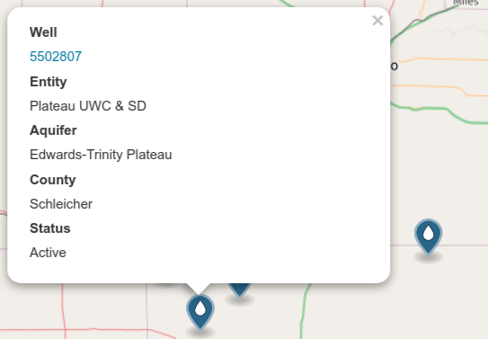
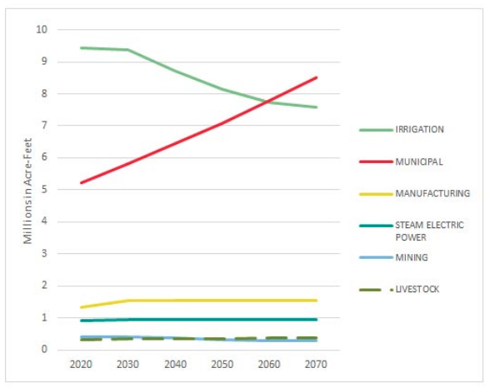
Existing Platform
Water Data for Texas
Texas Water Development Board
Basic well water information
Water planning until year 2070
https://waterdatafortexas.org/groundwater
http://www.twdb.texas.gov/waterplanning/index.asp

Slide 4
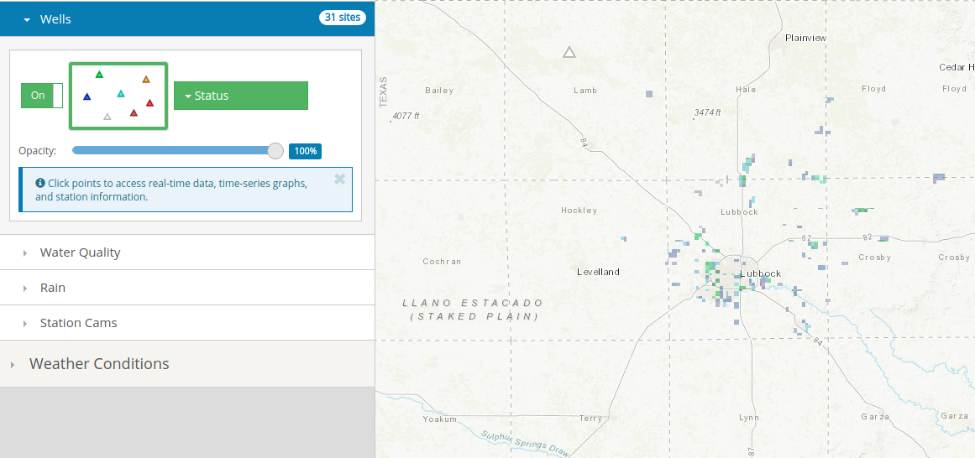
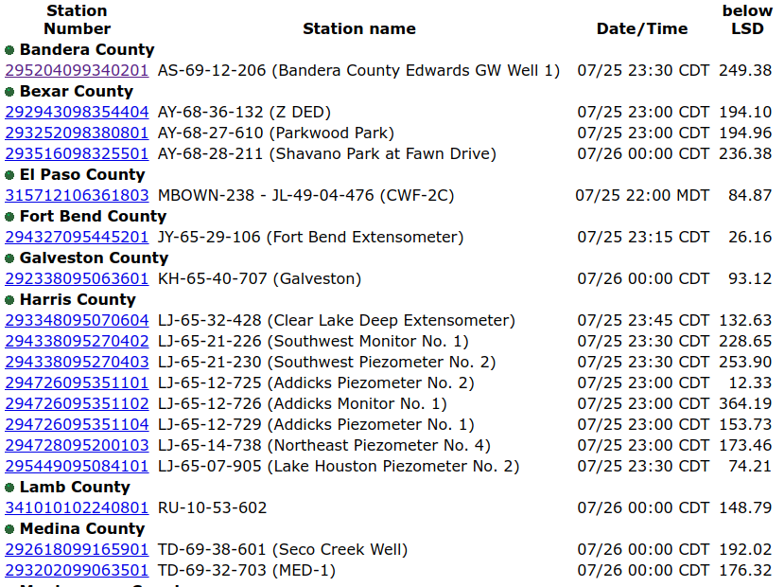
Existing Platform
United States Geological Survey
United States Geological Survey – raw data
Well distribution - NOT updated
Only water raw data. Limited analytics.
https://txpub.usgs.gov/txwaterdashboard
https://waterdata.usgs.gov/tx/nwis/current/?type=gw&group_key=county_cd

Slide 5
Limitation
Most of the websites focus on a small part of specific water resource information
No comprehensive water resource management website that could integrate information
The information is delivered as one-way data reporting (administration boards to the public). No community engagement.

Slide 6
Project Motivation
Motivations
To provide a multi-source information sharing platform
To allow collaboration among different parties
To encourage community engagement in water resource management.
To improve water use efficiencies across the industries
Approaches
Smart Platform
Information Integration
Connecting Communities
Objectives
Design for everyone via unified view of water related information.
Advanced analytics support
Integrate concerns via social media
Community engagement via knowledge sharing and discussion board

Slide 7
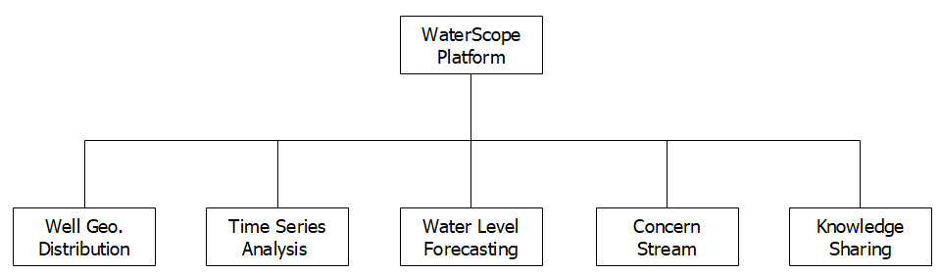
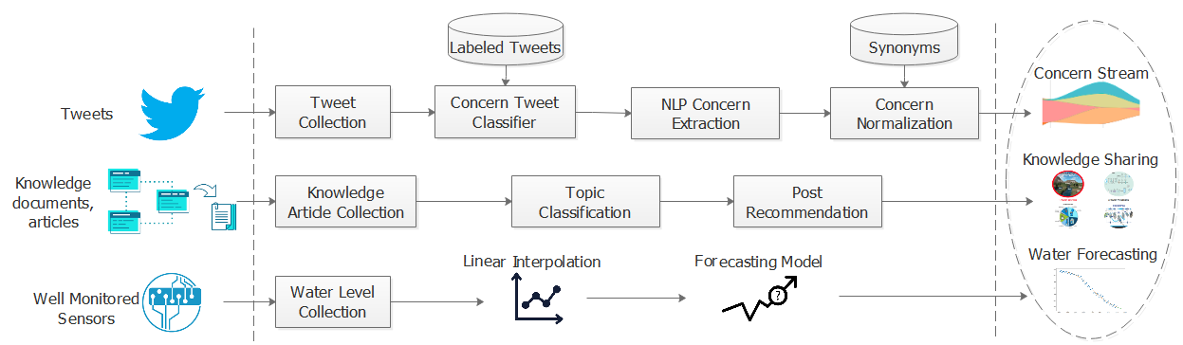
Solution Design

Slide 8
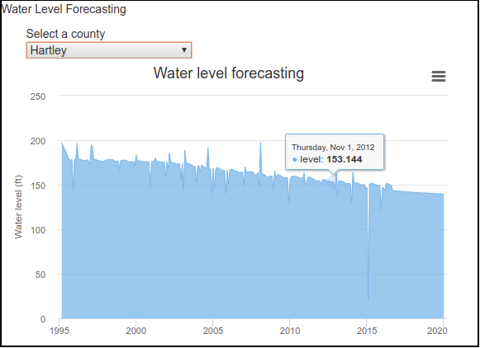
Methodology
Water Supply Forecasting (using LSTM).
Notes:
Why?

Slide 9
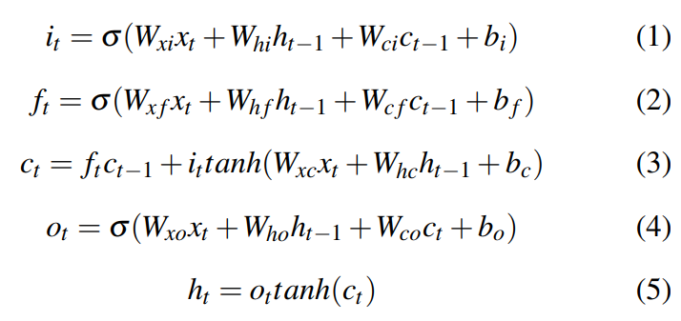
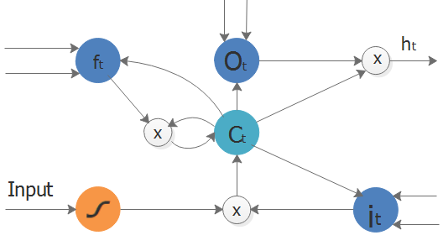
Methodology
Water Supply Forecasting.
Notes:
Why?

Slide 10
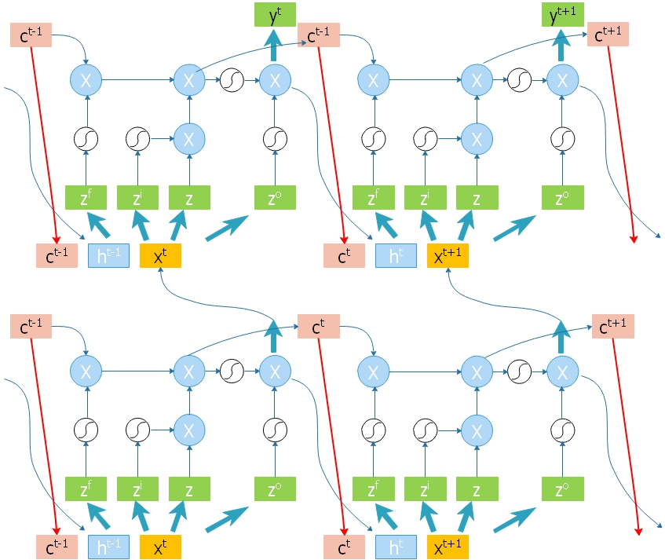
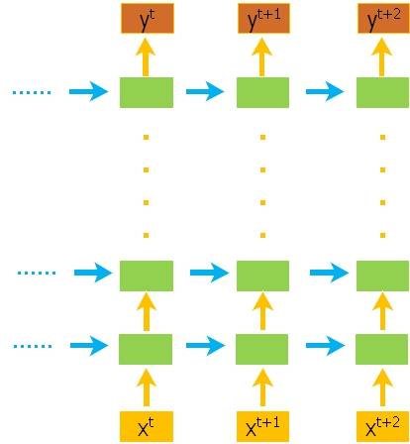
Methodology
Water Supply forecasting with LSTM

Slide 11
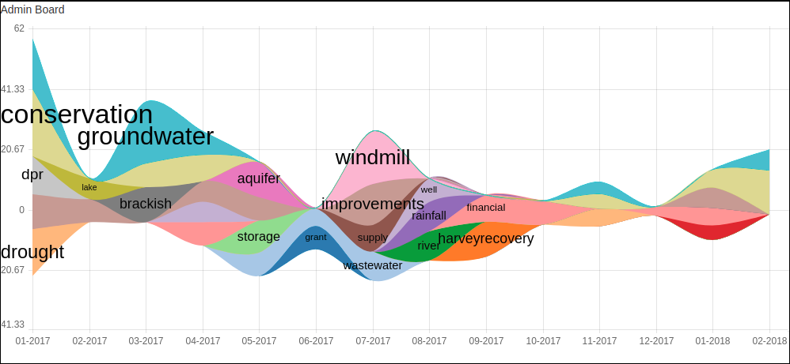
Methodology
Social media data => SVM classifier + Natural Language Processing => Concern stream

Slide 12
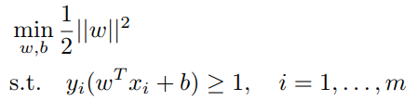
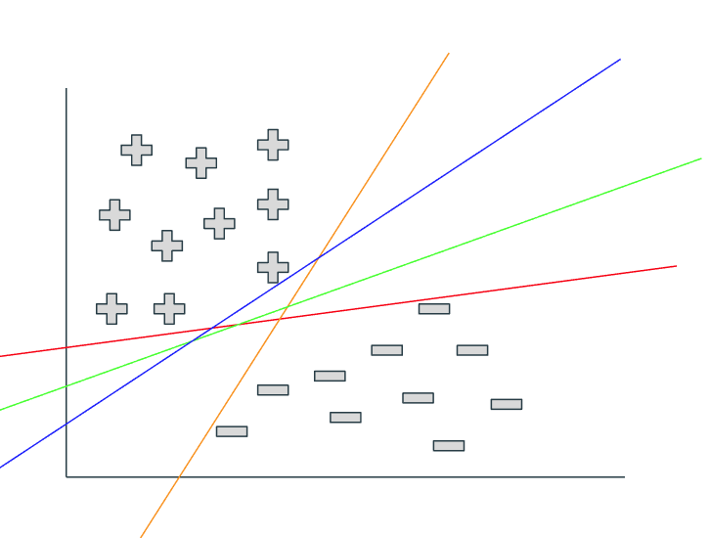

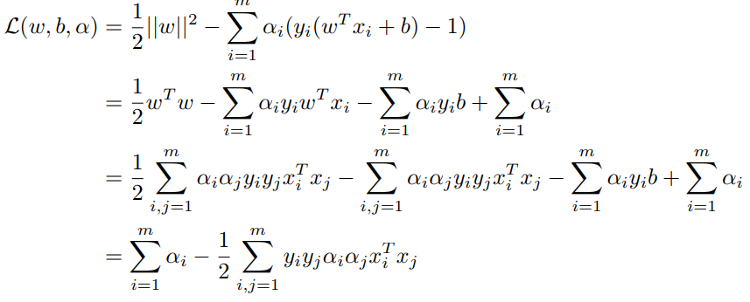
Methodology
SVM classifier
Constraint transformed:
Lagrangian:
which classifier is the best?

Slide 13
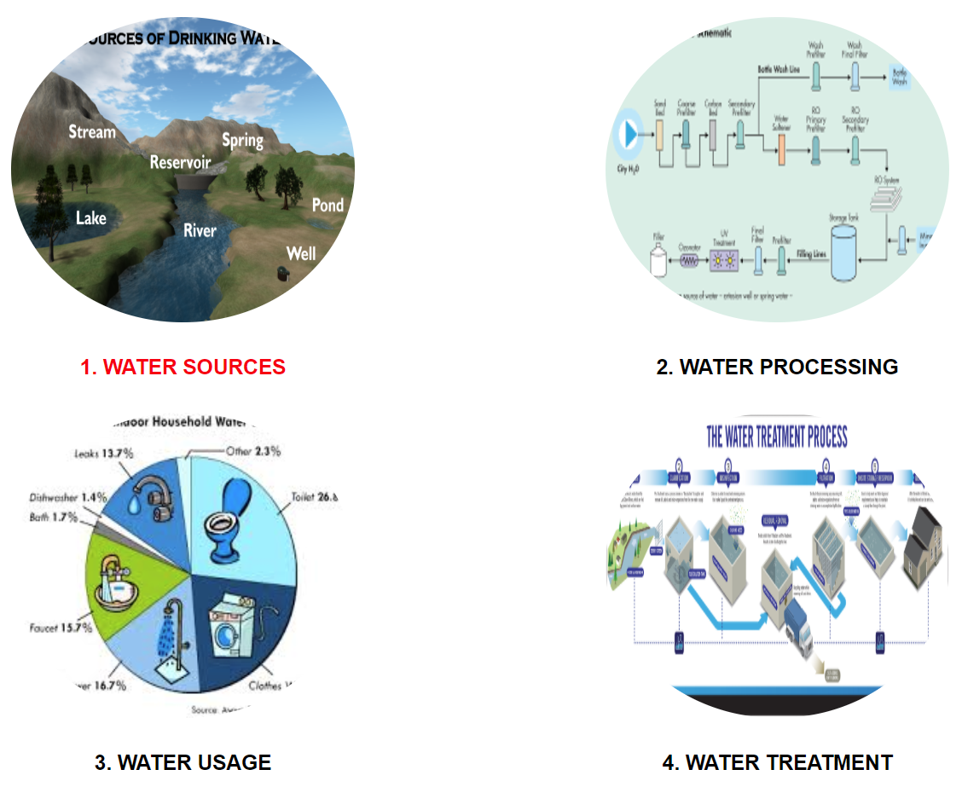
Methodology
Topic modeling with LDA

Slide 14
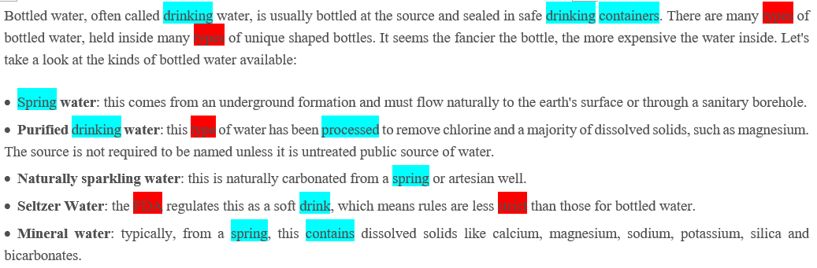
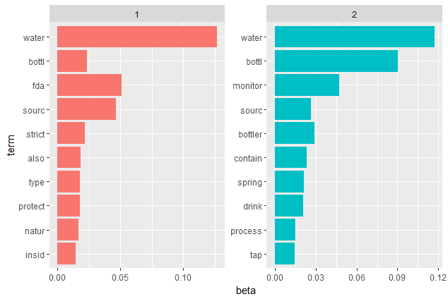
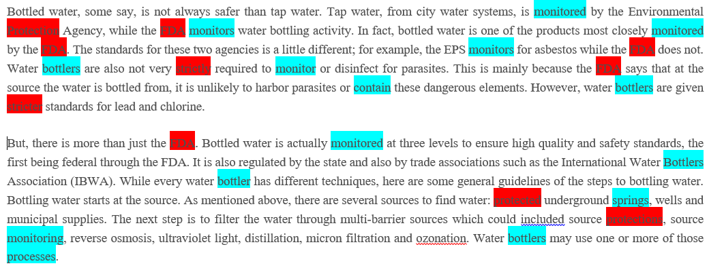
Methodology
Topic modeling with LDA
Water regulation
Water processing

Slide 15
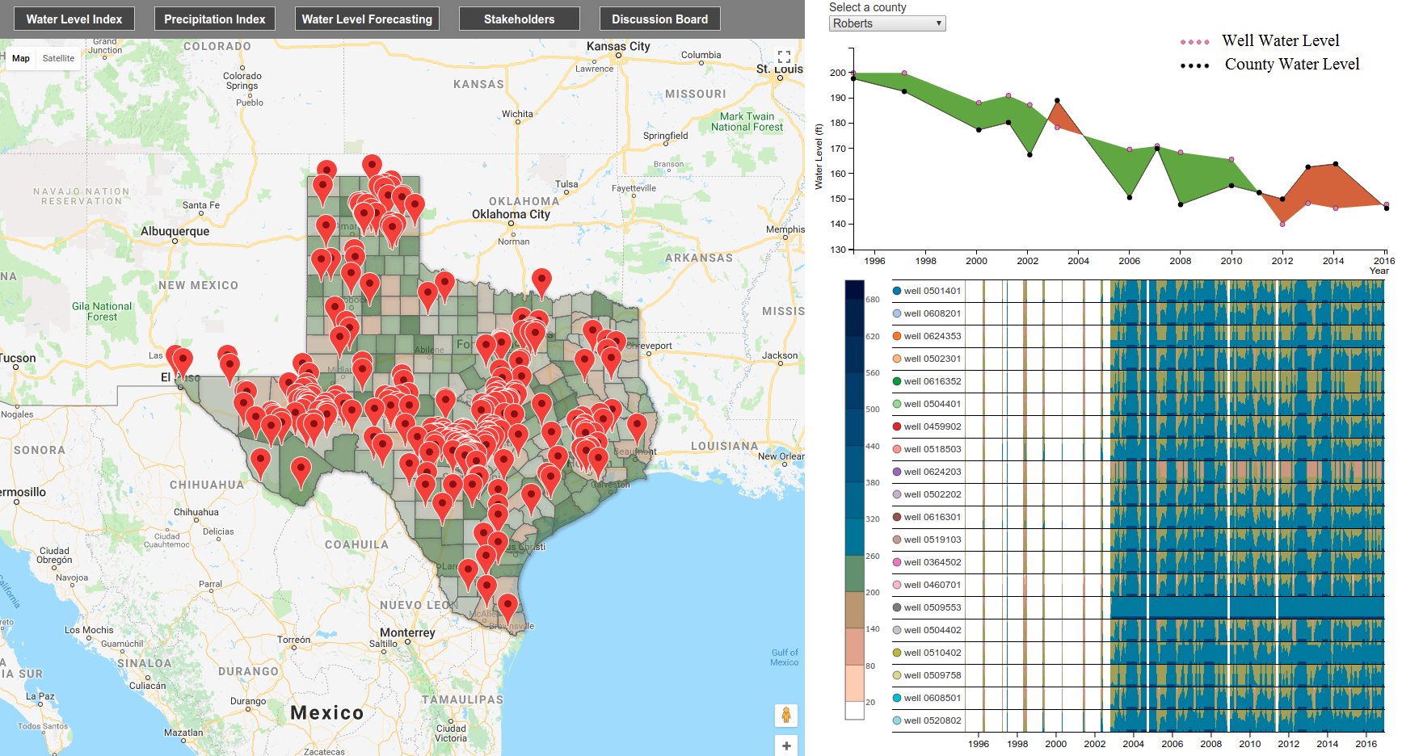
Overview

Slide 16
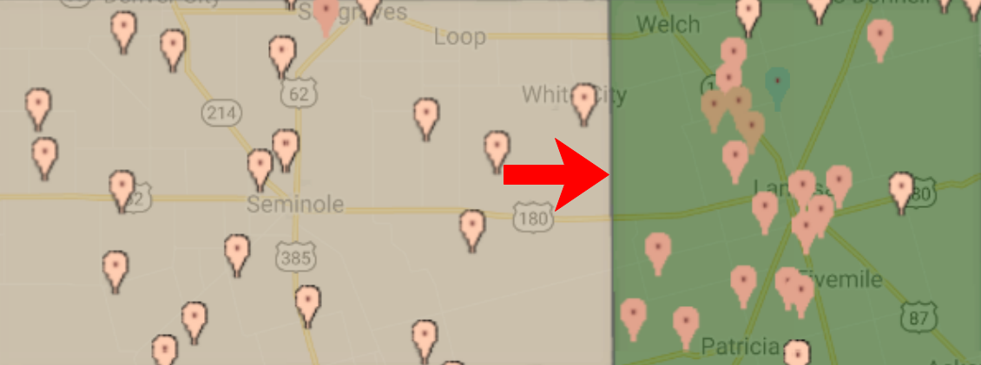
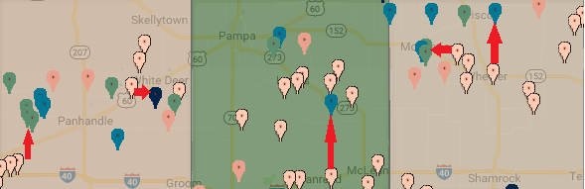
Demonstration 1 - Water Logistics
Between counties
water logistics
Between wells
water logistics

Slide 17
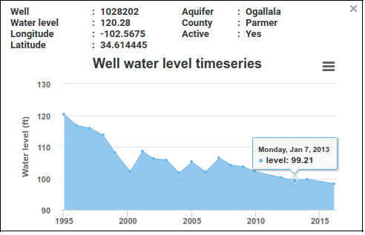
Demonstration 2 - Water Trend and Forecast
Water trend with time series data
Water forecasting

Slide 18
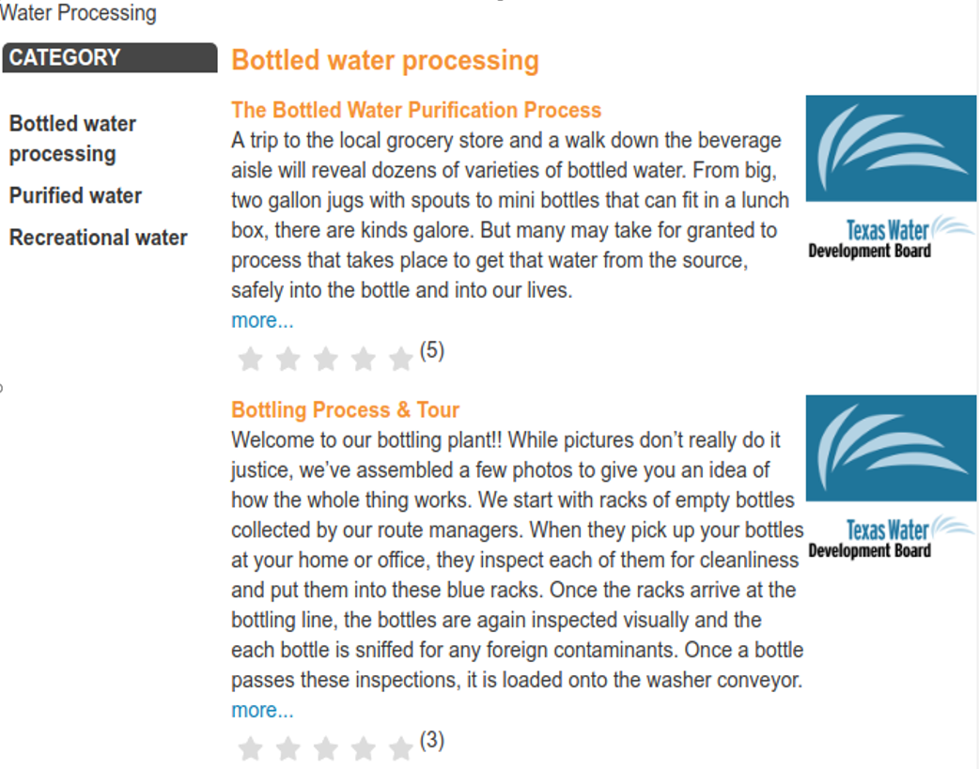
Demonstration 3 - Knowledge Sharing
Water related sub-topics
Water related topics

Slide 19
Demo 4 - Concerns from Texas Water Development Board
What are the HOTTEST concerns?

Slide 20
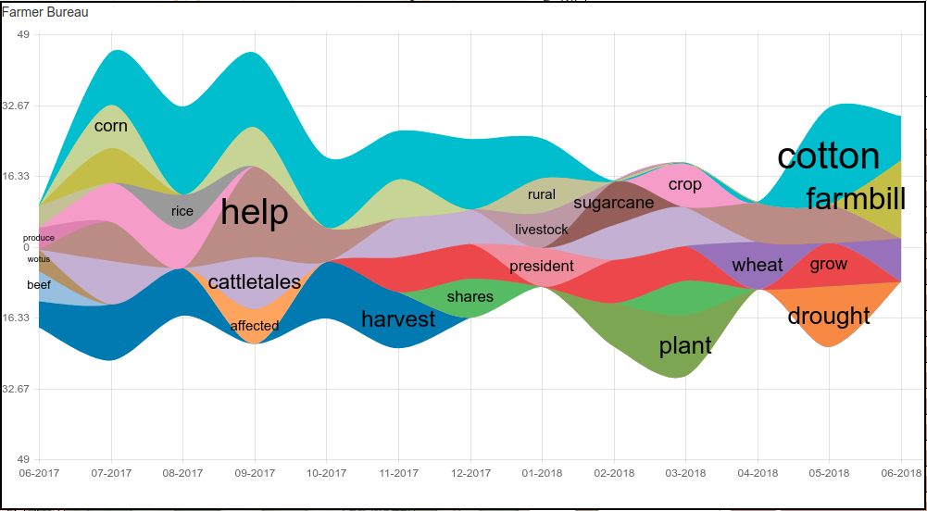
Demonstration 5 - Concerns from Farmer Bureau

Slide 21
Online Demo
http://myweb.ttu.edu/fjin/projects/west-tx-water/

Slide 22

Thank you
Q & A

