Slide 1

Group-7 Project
Predicting Life Expectancy based on socio economic indicators
July 2019

Slide 2
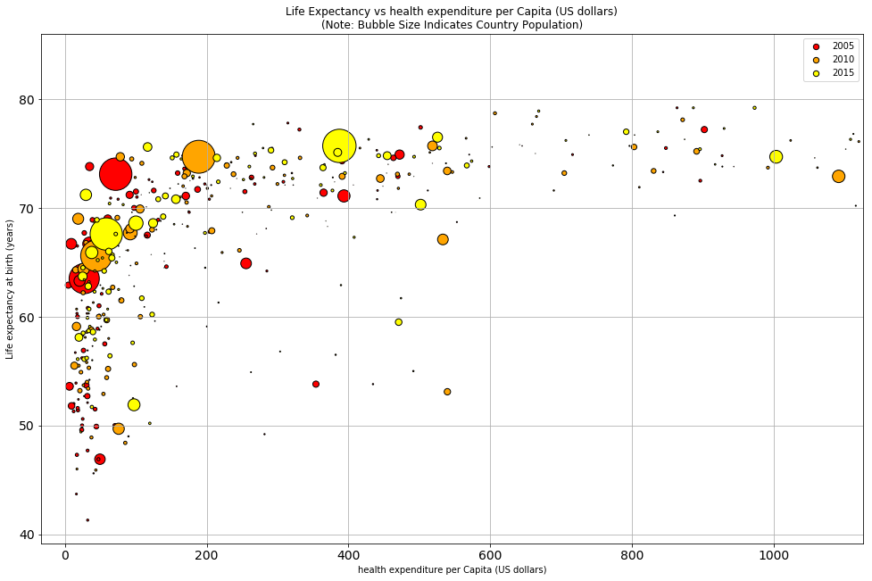
Life Expectancy Vs Health Expenditure

Slide 3
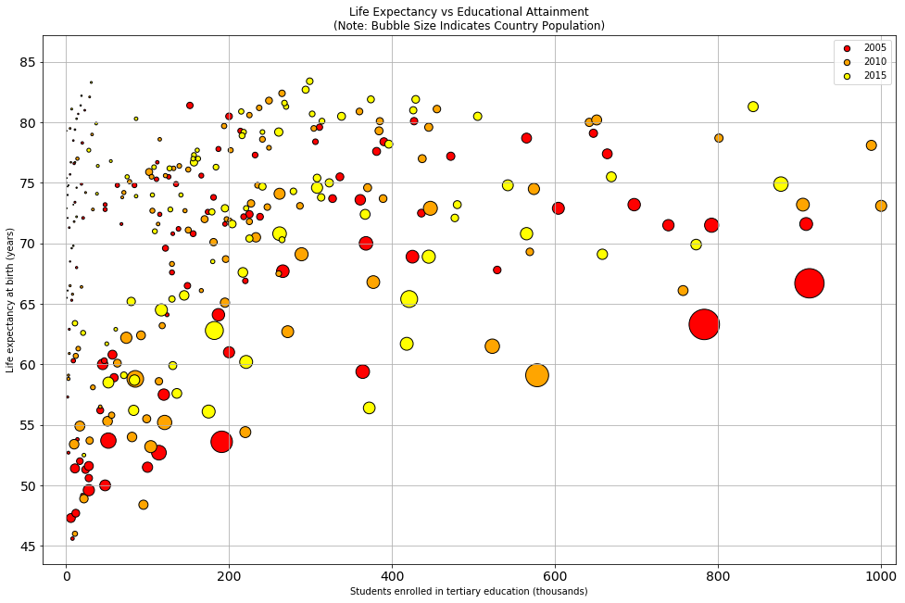
Life Expectancy Vs Education

Slide 4
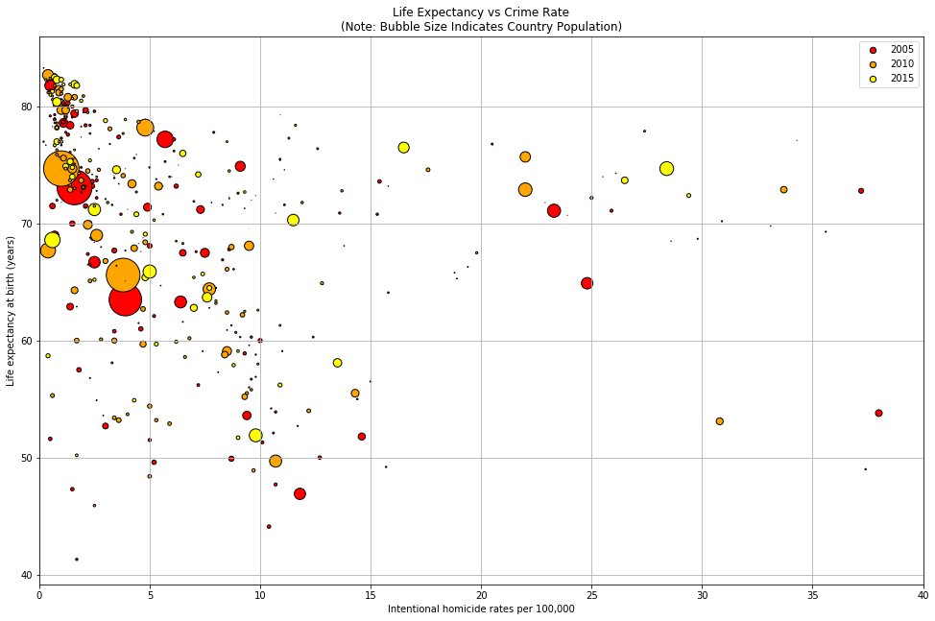
Life Expectancy Vs Homicide

Slide 5
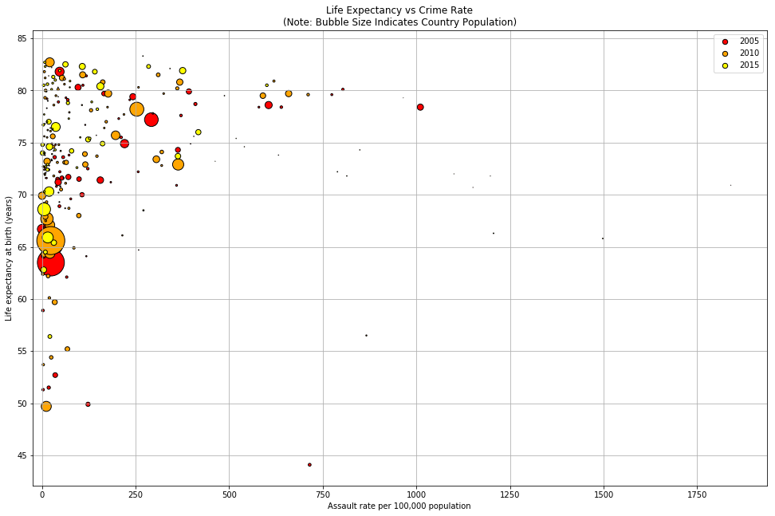
Life Expectancy Vs Assault Rate

