Slide 1

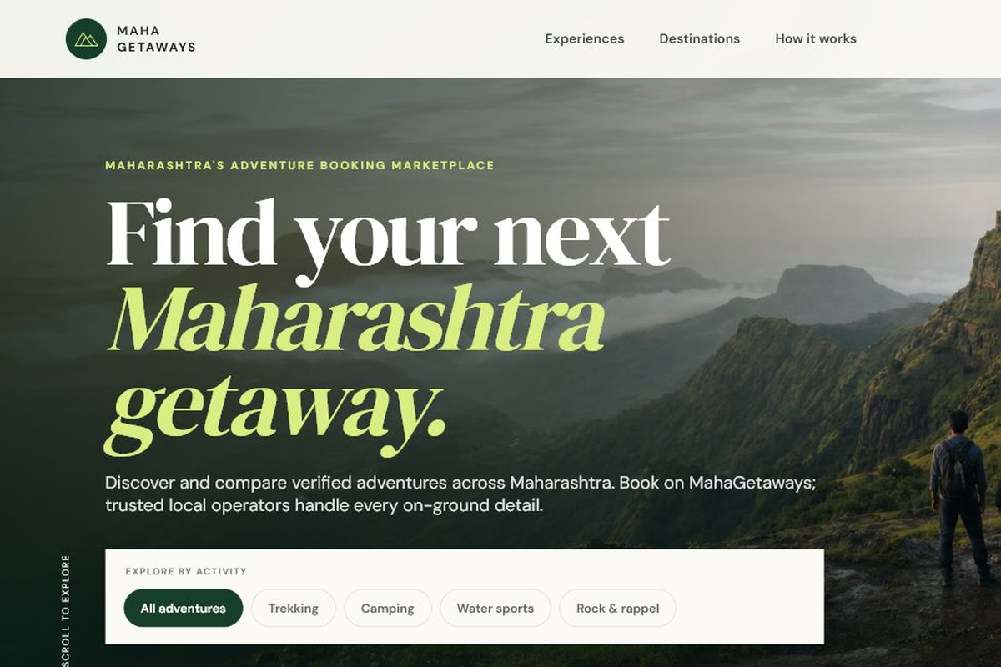
A marketplace for discovering and booking adventure experiences across Maharashtra.
Explore Maharashtra's adventures.
All in one place.
Team name: Lucy Chen
2026/06/30
Hackathon: Zero to Live Website Challenge

Slide 2
MahaGetaways
Explore Maharashtra's adventures, all in one place.
Hackathon: Zero to Live Website Challenge

Slide 4
02
Problem & Solution
MahaGetaways
The Problem
Our Solution
• Adventure experiences are scattered across social media and individual operator pages.
• Comparing experiences is difficult.
• Booking lacks transparency and trust.
MahaGetaways brings verified local adventure operators together into one marketplace where travellers can discover, compare, and book experiences with transparent pricing and a consistent booking process.
Traveller
↓
MahaGetaways Marketplace
↓
Verified Local Operator

Slide 5
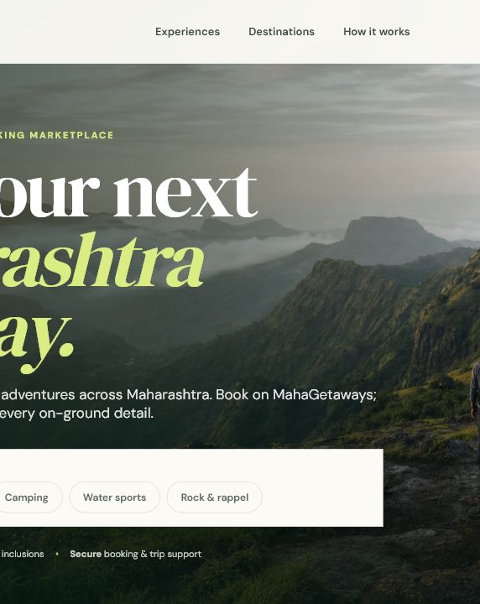
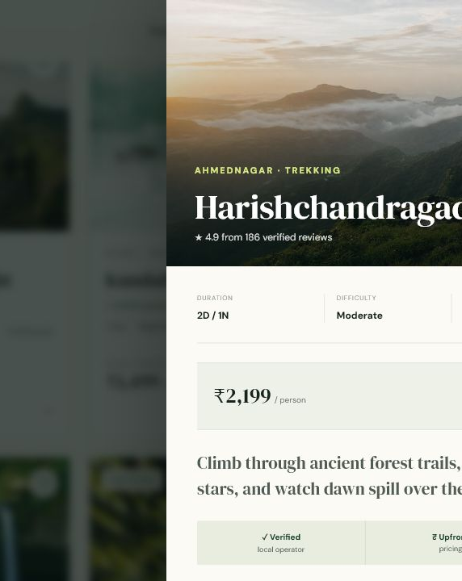
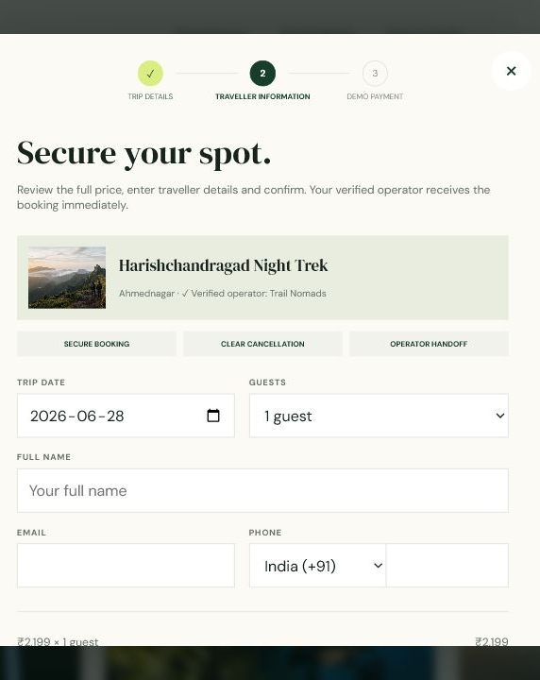
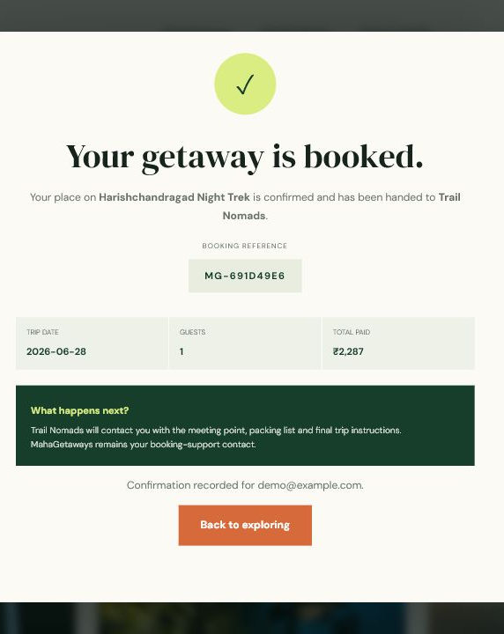
03
Product Walkthrough
MahaGetaways
→
→
→
Homepage
Experience Details
Booking
Confirmation
Browse curated adventures
Review itinerary and operator
Choose date and traveller details
Receive reference and handoff
A simple path from discovery to confirmed operator handoff.

Slide 6
04
Key Features
MahaGetaways
⌕
Adventure Discovery
▣
Smart Filtering
☰
Detailed Pages
Browse six curated outdoor experiences across Maharashtra.
Narrow trips by activity or destination.
See itinerary, inclusions, difficulty and operator info.
₹
Transparent Pricing
✓
Verified Operators
→
Guided Booking
Review cost and 4% platform fee before checkout.
Profiles show ratings, trips and hosting history.
Choose date, group size and traveller details.
●
Demo Payment
#
Confirmation
▱
Responsive Design
Simulated checkout; no real card data is stored.
Get a booking reference and operator handoff.
Adapts across desktop, tablet and mobile layouts.

Slide 7
05
Technology Stack
MahaGetaways
⌘
Frontend
{}
Backend
• Next.js 16
• React
• HTML, CSS, JavaScript
• Next.js API Routes
• Server-side validation
• Booking reference generation
• Pricing calculation
↗
Deployment
◇
Development
• Vercel
• Git
• GitHub

Slide 8
06
Future Roadmap
MahaGetaways
Platform
Booking
Experience
• Authentication
• Operator Dashboard
• Verified Reviews
• Stripe Integration
• Database Storage
• Live Availability
• Email / SMS / WhatsApp confirmations
• Cancellation & Refund workflows
“Our goal is to make outdoor adventures across Maharashtra easier to discover while helping local operators reach more travellers through one trusted marketplace.”

