Slide 1
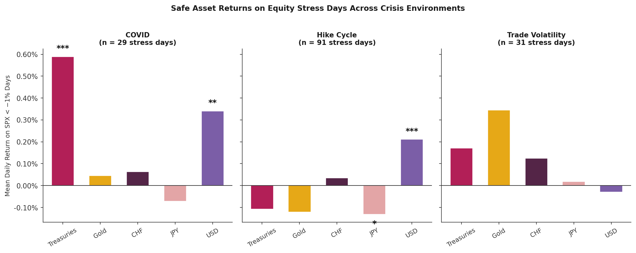
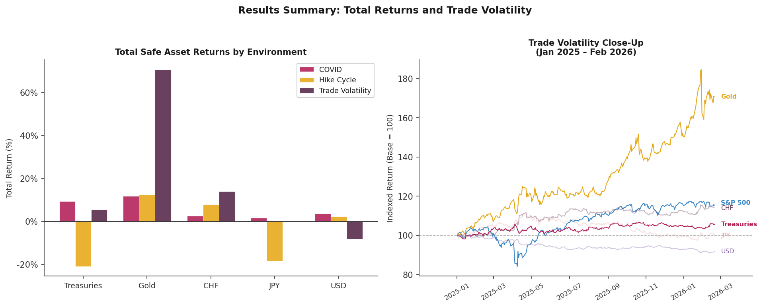
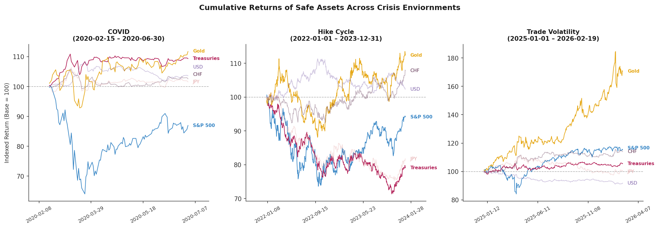
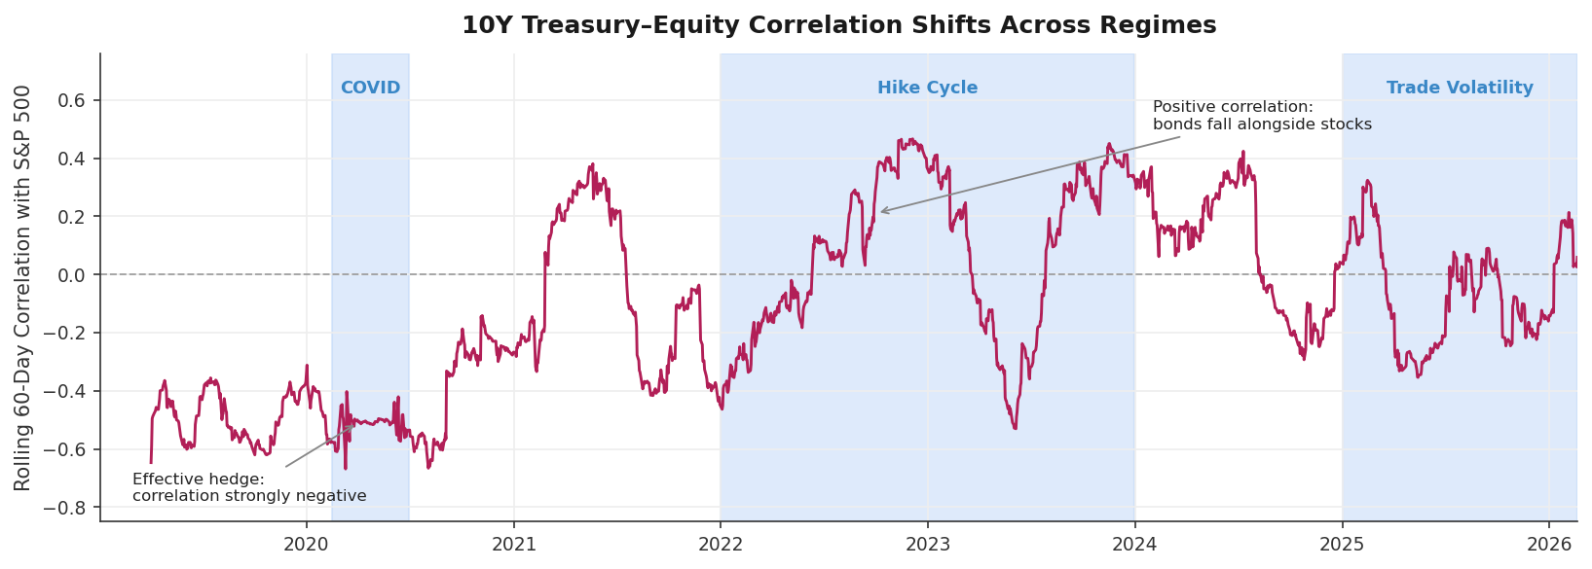
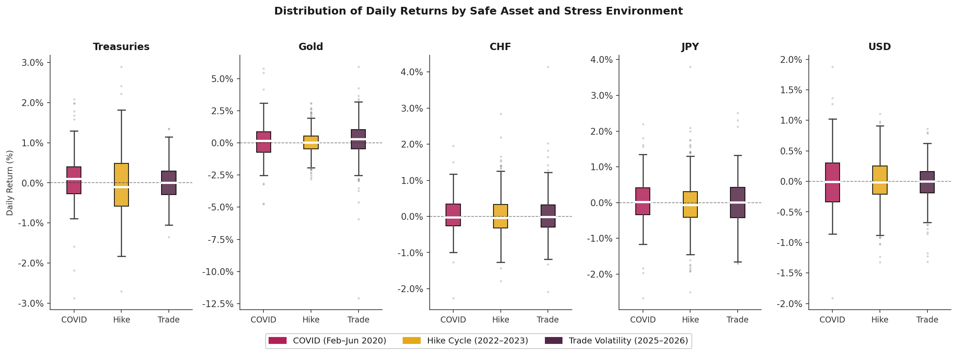

Brunnermeier, Markus K. Flight-to-Safety Capital Flows and the Global Financial Architecture. Princeton University, presentation at the Federal Reserve Bank of New York.
Eisenbach, Thomas, and Gregory Phelan. Fragility of Safe Asset Markets. Federal Reserve Bank of New York, 2022.
Li, Wenhao. A Discussion of “Fragility of Safe Asset Markets” by Thomas Eisenbach and Gregory Phelan. University of Southern California Marshall School of Business, Oct. 2022.
Safe Asset Performance: Hedging Behavior across COVID, Rate Hikes, and Trade Volatility
Yousra Belgaid Woods College of Advancing Studies, Boston College
Abstract
Which safe assets protect investors when equities fall? Does that answer depend on what is driving the crisis? Using daily data from 2019 to 2026, this study evaluates the hedging performance of Treasuries, Gold, the Swiss Franc (USD/CHF), the Japanese Yen (USD/JPY), and the US Dollar (DXY) across three environments: the COVID market shock, the Federal Reserve rate hike, and the ongoing and recent trade volatility period.
Results show that no single asset consistently hedge equities across all three stress environments. Treasuries provided strong protection during the COVID shock but failed during the rate hike cycle, as rising yields caused bonds and equities to fall together. Gold delivered strong cumulative returns but did not reliably hedge acute equity stress. Across all stress environments, the DXY emerges as the most consistent hedge. These results suggest that safe asset performance is conditional on the interest rate environment, not the crisis type itself.
Results
Safe asset performance varied across different crisis regimes. The same asset can act as either a reliable protector or a source of additional losses depending on the nature of the shock
Stress-Day Performance (Days when S&P 500 fell more than 1%)
During COVID, Treasuries (+0.589%, p<0.001) and the US Dollar (+0.340%, p<0.01) were the only statistically significant hedges.
During the Rate hike cycle, the hedge relationship inverted. Treasuries turned negative and JPY became a significantly negative hedge (-0.132%, p<0.05), driven by carry trade unwinding.
The US Dollar was the only asset to remain a statistically significant hedge across both COVID and the hike cycle (+0.211%, p<0.001).
During trade volatility, no asset reaches statistical significance. Though, the small sample (n=31) limits inference and Gold’s descriptive performance (+0.345%) hints an emerging role.
Discussion
The Yield Channel
The regression completed confirms that yield environment that determines whether Treasuries protect or amplify equity drawdowns.
When yields rise, bonds and stocks fall together; when yields fall, the classic flight-to-safety relationship holds.
Investors should monitor yield direction, not crisis type, when selecting safe-haven allocation.
Gold’s Dual Role
No statistically significant protection on individual stress days in any environment, yet the strongest cumulative performer in two out of the three.
Daily volatility (std =1.716% during COVID) makes Gold too noisy to reliably hedge on individual bad days. It functions as a store of value over longer horizons, not a single shock day absorber.
As of late January 2026, Gold touched nearly $5,600 per ource, which was an all-time high driven by trade volatility, a weakening dollar, and policy uncertainty.
Limitations
Trade Volatility has only 31 stress days and conclusions remain descriptive as stress regime is still unfolding.
High condition number (35,456) indicates multicollinearity meaning that directional findings are robust, but coefficient magnitudes should be interpreted carefully.
Total returns (left) show Gold as the dominant long-horizon performer in two of three environments; the Trade Volatility close-up (right) shows a regime still unfolding with no clear acute hedge emerging.
Asset (n=stress days) | COVID (n=29) | Rate Hike Cycle (n=91) | Trade Volatility (n=31)
Treasuries | +0.589%*** | -0.108% | +0.171%
Gold | +0.046% | -0.122% | +0.354%
CHF | +0.063% | +0.036% | +0.124%
JPY | -0.071% | -0.132%* | +0.018%
USD | +0.340%** | +0.211%*** | -0.030%
Introduction & Methods
The traditional view in portfolio management holds that certain assets such as US Treasuries, Gold, and safe-haven currencies, reliably protect investors when equities fall. Yet the 2022 rate hike cycle challenged this assumption, as bonds and stocks declined together for the first time in decades. This raises an important question:
Does the type of crisis determine what safe assets protect investors?
This study examines five assets: 10-year Treasuries, Gold, the Swiss Franc (CHF), the Japanese Yen (JPY), and the US Dollar (DXY), using daily trade data from January 2019 through February 2026. Three stress environments are studied, each representing fundamentally different economic shocks.
The chart below illustrates the core motivation, which is the rolling 60-day correlation between Treasuries and the S&P 500 flips signs across environments, confirming that the hedging relationship is not stable and depends heavily on what is driving the crisis.
Approach
In this study, we begin to identify the worst days for equities (when the S&P 500 fell more than 1%) and measured how each of these safe assets performed on those specific days. This tells us directly whether an asset protected investors. We then track how the relationship between each asset and equites evolved over time using rolling 60-day correlations, capturing how hedge effectiveness shifted across different stress environments. Finally, we run a regression to test whether is is rising yields, rather than the crisis itself, that cause US Treasuries to breakdown.
(* p<0.05 ** p<0.01 *** p<0.001)
Cumulative Returns
A fundamentally different story can be seen ---
During COVID, Gold and Treasuries were top performers, both appreciating roughly 10% as equities fell to 35% at their worst point.
The rate hike cycle saw Treasuries and JPY fall in almost identical trajectories, both losing approximately 25-30%.
In trade volatility, Gold climbed approximately 85%, dwarfing every other asset in every environment in this study.
Environment | Period | Driver
COVID Shock | Feb– Jun 2020 | Panic, deflation, flight to cash
Rate Hike Cycle | June 2022 – Dec 2023 | Inflation, rapidly rising rates
Trade Volatility | June 2025 – Present | Tariff Escalation, Policy Uncertainty
Cumulative Returns
Conclusion
No single asset consistently hedges equities across all stress environments. Safe asset performance is conditional on the interest rate environment, and not the crisis type itself. Treasuries protected investors during COVID but failed during the rate hike cycle, as rising yields caused bonds and equities to fall together. Gold delivered strong cumulative returns across environments, touching nearly $5,600 per ounce in early 2026, but remained unreliable as an acute hedge. The DXY emerged as the most consistent stress-day protector across all three environments. As policy uncertainty continues to shape markets, understanding which assets protect (and under what conditions) is a question with real consequences for portfolio construction.
Treasuries: Mean return flips from +0.098% (COVID) to –0.044% (hike cycle) at near identical volatility (std ≈ 0.74%), the direction changed, but not the risk.
Gold: Highest volatility of all assets (std up to 1.716%), with a single-day loss of 12.066%. However, too noisy to reliably hedge on individual stress days.
CHF: Stable volatility across all environments (std = 0.574%, 0.535%, 0.576%) with occasional large upside days during trade volatility (skew = 1.49).
JPY: Mean turns negative during the hike cycle (–0.038%), maximum daily move of 3.796% — driven by widening US-Japan rate differentials.
USD: Standard deviations shrink from 0.529% to 0.307% over time. The most stable and predictable hedge in the study.
References
Brunnermeier, Markus K. Flight-to-Safety Capital Flows and the Global Financial Architecture. Princeton University, presentation at the Federal Reserve Bank of New York.
Eisenbach, Thomas, and Gregory Phelan. Fragility of Safe Asset Markets. Federal Reserve Bank of New York, 2022.
Li, Wenhao. A Discussion of “Fragility of Safe Asset Markets” by Thomas Eisenbach and Gregory Phelan. University of Southern California Marshall School of Business, Oct. 2022.
Regression
Treasury hedging depends on yield movements rather than the type of crisis itself.
(OLS with Newey–West HAC errors; N = 1,709; R² = 0.990). Yield increases are highly significant (β = 89.99, p < 0.001), while crisis indicators are not (p = 0.068, 0.563, 0.311), indicating that rising yields push bonds and equities to fall together.

