Slide 1
Probabilistic Planning For Symbiotic Autonomy In Domestic Robots
Nuno Laurentino Mendes
Supervisor: Prof. Rodrigo Martins de Matos Ventura

Slide 2
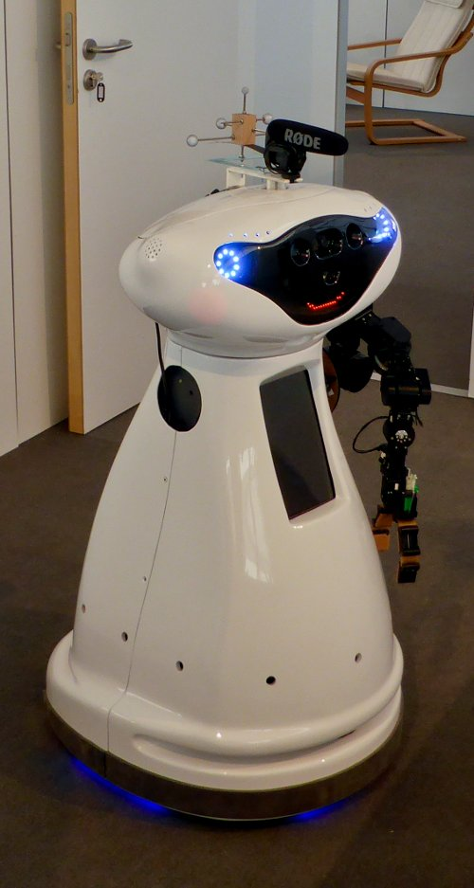
Problem Description
Problem
Objectives
Background
State of the Art
Methodology
Robot in a domestic environment.
Should he complete a mission by himself or should he request help.
Planning problem.
Notes:
In a symbiotic autonomy domain, every agent is acting autonomously in the environment, but when the agent thinks he cannot complete an action that it was assigned to him, help must be requested to a nearby agent.
This way the robot can overcome its own limitations, augmenting its ability to complete objectives in the world.
Why is this useful? Couldn’t we equip the robot with manipulators, better sensors and so forth? Well we could, but frequently it is too expensive to equip the robot with those items. And even by doing that, there is no guaranty that would suffice to make the robot complete every mission he is assigned.
Testbed robot

Slide 3
Objectives
Problem
Objectives
Background
State of the Art
Methodology
Formally describe the Symbiotic Autonomy Domain.
Develop a probabilistic planner based on existing frameworks.
Benchmark the system in a competition

Slide 4
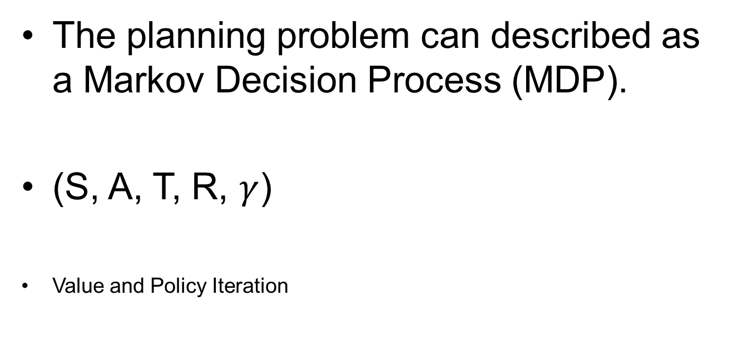
Background
Problem
Objectives
Background
State of the Art
Methodology
The planning problem can described as a Markov Decision Process (MDP).
(S, A, T, R, $γ$)
Value and Policy Iteration
Notes:
Explain what it is a MDP – What is it? What is necessary to describe it in this manner? What is the solution of a problem like this?
Make the remark about the picture and explain the meaning of each one symbol.
Markovian assumption – transition from one state to another only depends on the current state.
How to solve them – classical and new ways.

Slide 5
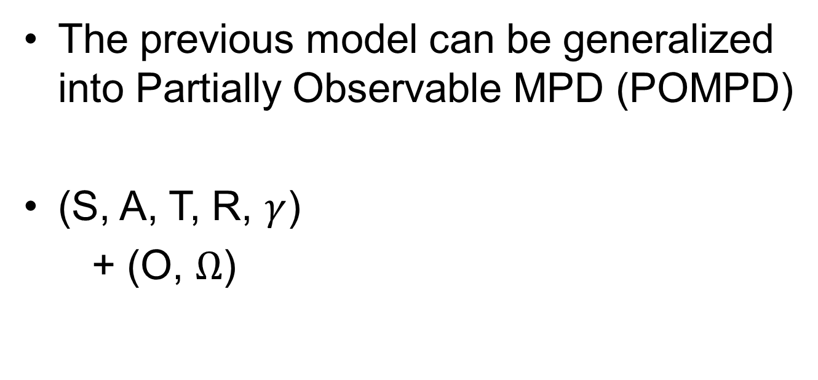
Background
Problem
Objectives
Background
State of the Art
Methodology
The previous model can be generalized into Partially Observable MPD (POMPD)
(S, A, T, R, $γ$)
+ (O, $Ω$)
Notes:
When the current state is not fully determined, it must expressed as a belief, a probability distribution over all states.
Describe the new parameters of the POMDP
Can be seen as a generalization of a MDP (when the observation function is always equal to 1)
Very large number of states and operating under beliefs, so the solution of this decision problem will be reduced to policies over beliefs.

Slide 6
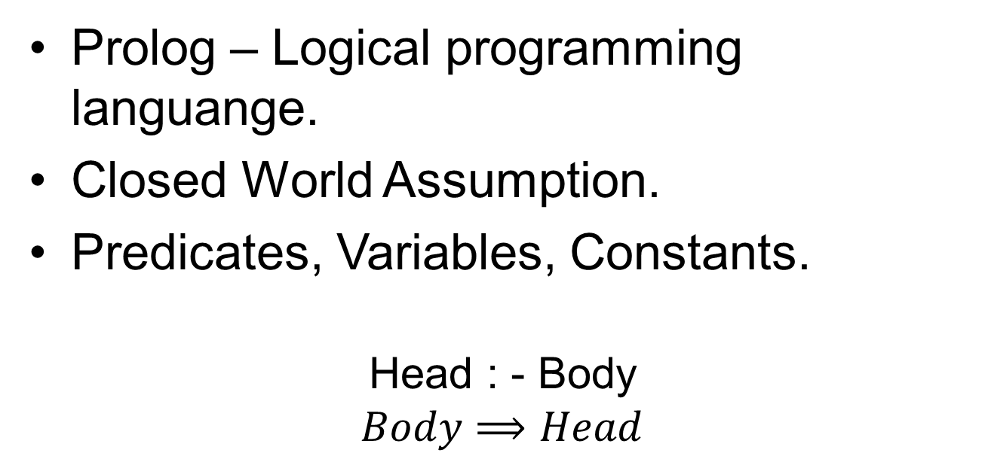
Background
Problem
Objectives
Background
State of the Art
Methodology
Prolog – Logical programming languange.
Closed World Assumption.
Predicates, Variables, Constants.
Head : - Body
$$Body⟹Head$$
Notes:
Prolog is a logical programming language based on the concepts of classical first order logic.
The execution of a logic program starts by running a query over the knowledge base of relations using resolution, returning yes if the program can prove it, and false otherwise.
Closed world assumption

Slide 7
Background
Problem
Objectives
Background
State of the Art
Methodology
If a person is not working, then she is available.
available(Human) :- \+ working(Human).
If an object is visible and the grasp simulation was successful, the object is reachable.
reachable(Object) :- visible(Object), grasp_simulation(Object).
Predicate
Variable
Constant

Slide 8
Background
Problem
Objectives
Background
State of the Art
Methodology
If the robot and the human are at the same location, the robot is near the human.
near(Human) :- robot_at_loc(X), located(Human, X).
If the object is not visible, the robot needs help to find it.
need_help(to_find, Object) :- \+ visible(Object).
Predicate
Variable
Constant

Slide 9
Background
Problem
Objectives
Background
State of the Art
Methodology
If the object is not reachable and he does not need help to find it, he
needs help to grasp it.
need_help(to_grasp, Object) :- \+ reachable(Object),
\+ need_help(to_find, Object).
If there is an available human near the robot and he needs help, he asks for help
to the same human agent.
ask_help(Human, To, Object) :- near(Human), available(Human), need_help(To, Object).
Predicate
Variable
Constant

Slide 10

Background
Problem
Objectives
Background
State of the Art
Methodology
located(robert, kitchen).
working(robert).
visible(cup).
located(melanie, kitchen).
grasp_simulation(cup).
visible(tv).
robot_at_loc(kitchen).

Slide 11
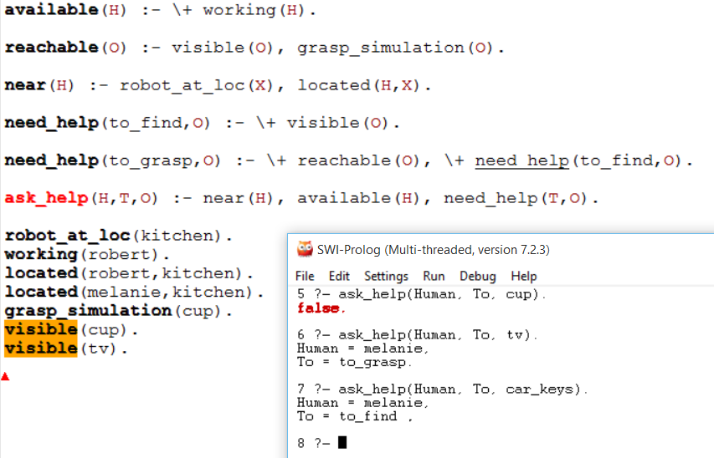
Background
Problem
Objectives
Background
State of the Art
Methodology

Slide 12
Background
Problem
Objectives
Background
State of the Art
Methodology
ProbLog – Extending Prolog with probabilities.
Facts labeled with probabilities, behaving like mutually independent random variables.
Probabilistic inference.
Notes:
Program specifies a distribution of its non-probabilistic subprograms.
When a fact is not labeled, it’s success probability is equal to one.
The standard inference method provides an exact solution to the query, however, that’s not always possible (exponential time to compute), leaving the local search inference method the only feasible method.

Slide 13

Background
Problem
Objectives
Background
State of the Art
Methodology
0.2 :: located(robert, kitchen).
0.6 :: working(robert).
Queries
query(ask_help(Human, To, car_keys)).
query(ask_help(Human, To, cup)).
0.9 :: visible(cup).
0.9 :: located(melanie, kitchen).
grasp_simulation(cup).
0.1 :: visible(car_keys).
0.3 :: working(melanie).
robot_at_loc(kitchen).

Slide 14
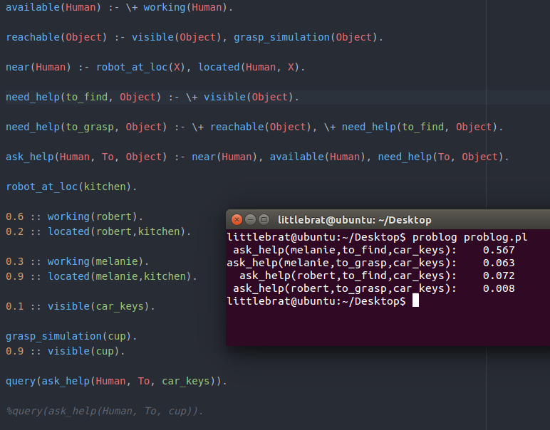
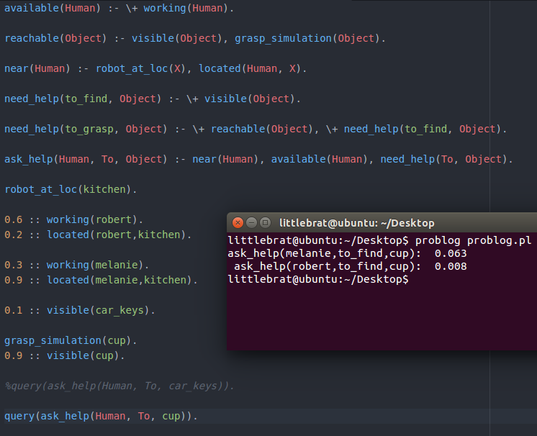
Background
Problem
Objectives
Background
State of the Art
Methodology

Slide 15
State of the Art
Problem
Objectives
Background
State of the Art
Methodology
Planning Languages
STRIPS
1971
PDDL 2.1
2001
PDDL 2.2/ 3
2004
RDDL
2011
PDDL 1.2
1998
PPDDL
2004
time
Notes:
Planning languages are important in order to formally explain the physics behind a domain. This means to know which predicates are available, which actions can an agent make in a certain state and what changes by performing them.
By having a language that is broadly used among ai peers, the focus will be on how to solve them and not the different ways to describe them.
- STRIPS was the first attempt at describing domains and it included an integrated solver. This lead to problems because it was not efficient enough to solve some problems.
PDDL began as an effort to standardize the planning language used in planning competitions, in 1998, it has a formal syntax, broadly described in the literature. It separates the planning problem in two parts: the domain description and the domain instance. By having this format, it is possible to make a solver that reads the “rules” of the domain and solves a planning problem in its own way.
From the time it was introduced, PDDL suffered several extensions, with the addition of actions with continuous effects and objective functions in 2001; timed initial literals and derived literals in 2004; and finally the inclusion of preferences over states, actions and even goals in pddl 3.
Well, but until this point only deterministic outcomes of actions can be modelled. From this gap, PPDDL was born, capable of describing probabilistic effects of actions, as well as rewards.
But from ppddl being an extension of an existing framework like pddl, its deterministic counterpart evolved while this one remain static, incapable of describing new complex domains. From this opportunity,
a completely new language was born, RDDL – able to describe domains with concurrent actions, multiple agents, external actions and events.

Slide 16
State of the Art
Problem
Objectives
Background
State of the Art
Methodology
Solvers
FF-Replan
Monte Carlo Tree Search methods
Notes:
Well, now I’m going to talk about state of the art solvers that directly compete with the one that will be implemented.
The planner that had most success in the first planning competitions was FF-Replan. It would transform the probabilistic planning problem into a deterministic one, by only taking into account the outcome with the biggest probability of occurring and replanning if some unexpected event occurred. It was very successful in domains described in PPDDL, but failed to compete on complex probabilistic domains, described in RDDL.
More recently, state of the arts planners use Monte Carlo Tree Search methods to solve these planning problems. It works by selecting the node to explore next, expanding it, plan simulation and backpropagation of the result to the antecessors of the leaf node. One of these planners is PROST, winning the two previous IPC.

Slide 17
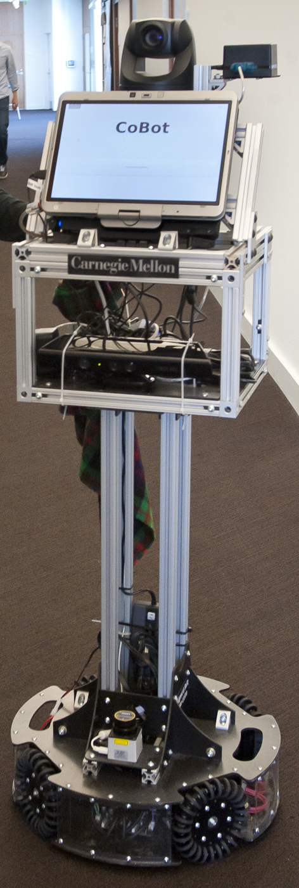
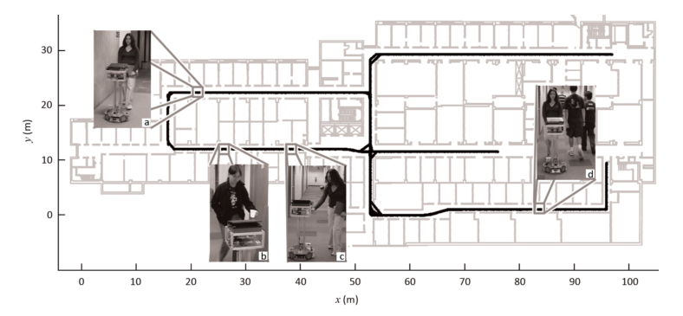
State of the Art
Problem
Objectives
Background
State of the Art
Methodology
Symbiotic Autonomy
Notes:
Talking now about symbiotic autonomy, one of the most interesting examples of it in action was done by the CORAL group in CMU with the COBOT robot.
This robot was designed to serve as a companion robot, escorting visitors to scheduled meetings and fulfilling other needs they could have.
In this scenario, the visitor doesn’t know the building’s layout and the robot is unable to do activities which require physical manipulation of objects.
On the other hand, the visitor has millions of years of evolution that gives him the capability to easily grab an object and locate its exact position on a map, while the robot can easily find the optimal route between two locations.
The robot can ask for help if he finds himself in a situation where the uncertainty about its exact position is above a given threshold. He also asks for help, if he needs to grab something for a visitor.
The planning language used for this task was PDDL with probabilistic extensions. It was studied when to ask for help when the uncertainty of its location reaches a boiling point.

Slide 18
Methodology
Problem
Objectives
Background
State of the Art
Methodology
DT-ProbLog
Adds utilities and decision making to original ProbLog.
Uses the standard inference methods from ProbLog.
Notes:
Looking back at ProbLog, it is useful to know the probability of occurrence that some predicates have. But, in multiple situations, and if we want to adapt it to decision making, this is not simply enough.
First of all, it doesn’t allow decisions, which of course are needed to establish a policy over the current state or belief. So that, is of course needed.
Ok, but imagine for a second that decisions can be described in a Problog program. By having some event which is very likely to happen if one decision is made and another that has a low probability of occurring if the ,
can the program infer if the agent should make that decision? Well probably not, if the first has a very low reward and the second has a very high reward, which decision should be made? Intuitively, it should give the decision which
provides the highest expected reward.
Decision theorethic ProbLog fills those gaps by adding decision facts and utilities. Lets see it in action by heading back to the symbiotic autonomy example

Slide 19
Methodology
Problem
Objectives
Background
State of the Art
Methodology
If the object is reachable and the robot decides to grasp it, he is successful in picking up the object.
success(action(grasp), Object) :- action(grasp), reachable(Object).
If the robot should ask for help and he decides to do it, he is successful in
receiving help.
success(action(To), Object) :- ask_help(Human, To, Object), action(To).

Slide 20

Methodology
Problem
Objectives
Background
State of the Art
Methodology
Ask for help to grasp
Cost: 2
Ask for help to find
Cost: 3
Success
Reward: 5
Grasp it himself
Cost: 1
Decisions
Notes:
Live Demo

Slide 21
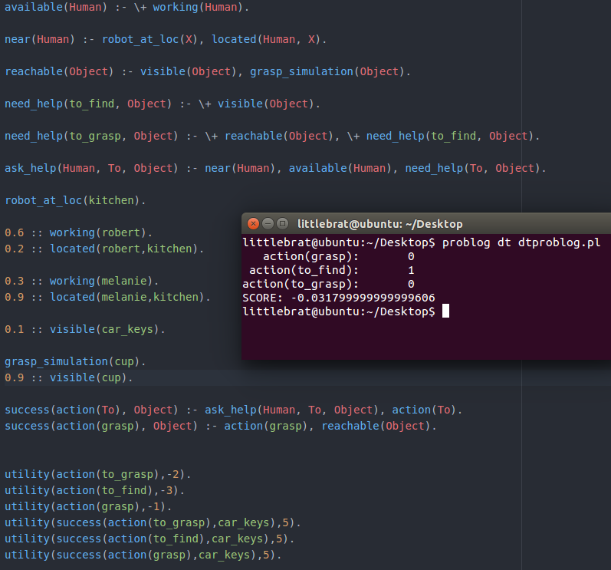
Methodology
Problem
Objectives
Background
State of the Art
Methodology

Slide 22
Planning
Problem
Objectives
Background
State of the Art
Methodology
Review other methods of probabilistic planning.
Describe the domestic domain in a planning language.
Implement the planner based on the planning language and the solver.
Benchmark the system in RoboCup@Home competition.

Slide 23
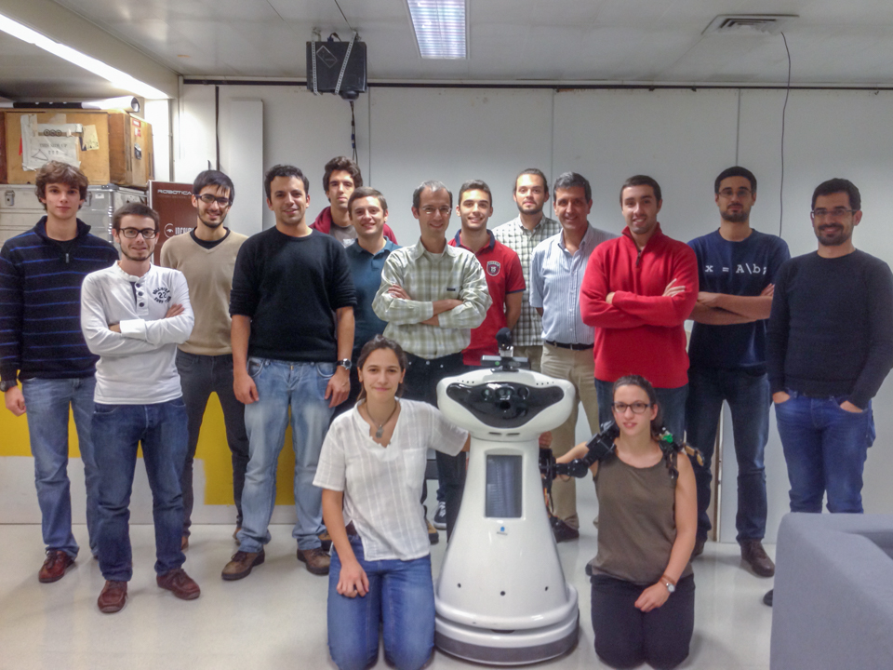
SocRob @Home

Slide 24
Questions

