Slide 1


Map matching algorithm for data conflation – an open source approach
Wenchao Jiang
Supervisor: Suchith Anand

Slide 2
Presentation Overview
Background
Why map matching techniques?
Methodology
Results
Evaluation
Summary
Future work

Slide 3
Background
Datasets used:
Ordnance Survey ITN(authoritative) data
OpenStreetMap (OSM, wiki-type) data
Study area: Portsmouth, UK
Software development based on Open Source GIS (QGIS + Python scripting)

Slide 4
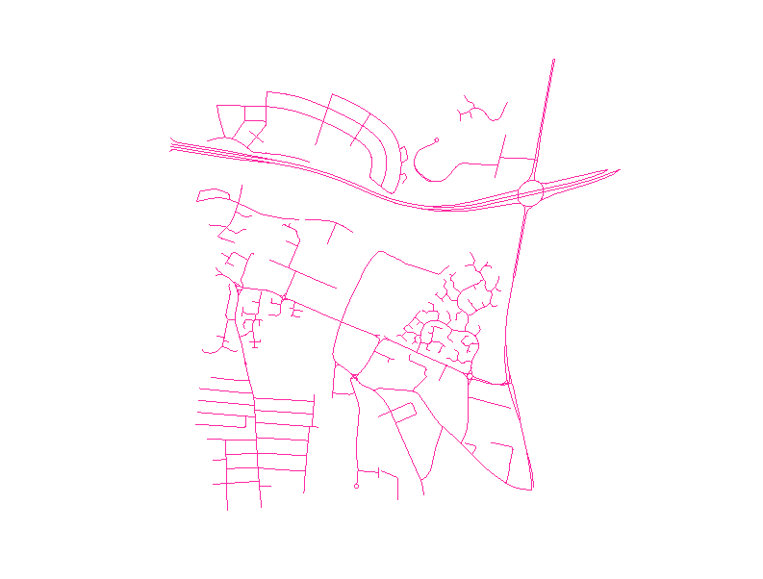
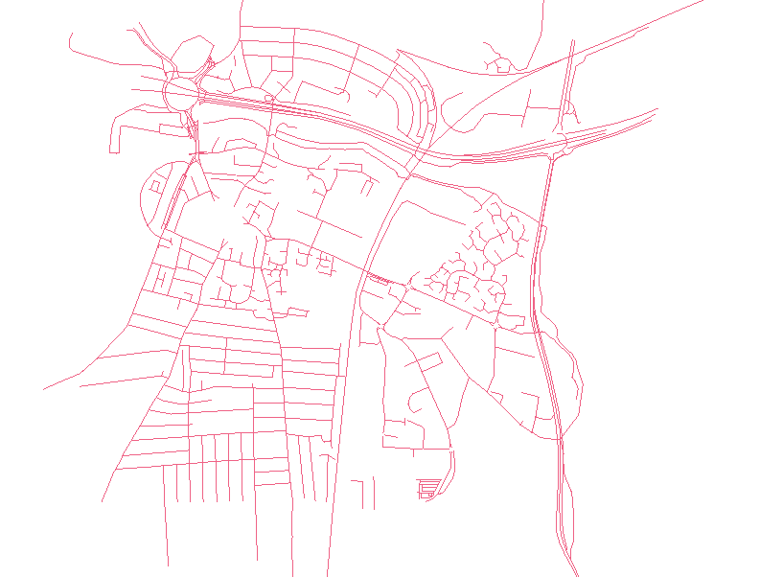
ITN
OSM

Slide 5
Map Matching
Automated Map Matching is a fundamental research topic in GIS
Map matching is a technique combining base map information with location information to obtain the real position of the vehicles

Slide 6
Research question
How can map matching techniques be used for mash-up of authorised data and crowd-sourced data to improve quality of both data sets?

Slide 7
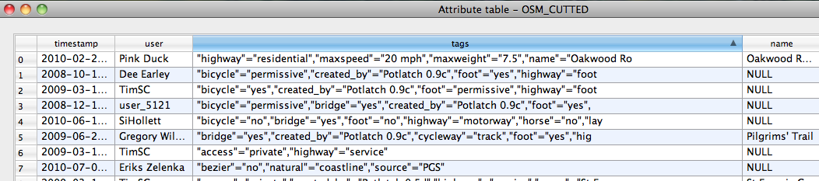
Key features
1. ITN is more accurate than OSM
2. OSM has rich attribute information

Slide 8
Objective
-a merged data set
Use ITN data as base data
For each road section in ITN data set, finding its correspondence in OSM data set.
Assign OSM attributes to its ITN correspondence

Slide 9
Methodology
Challenge: how to automatically recognize correspondent features in two data sets?
Developing Map Matching Algorithm

Slide 10

Methodology
Map Matching Algorithm
- position matching
average angle θ
ITN
C = W1×D + W2×θ
OSM
average distance D

Slide 11
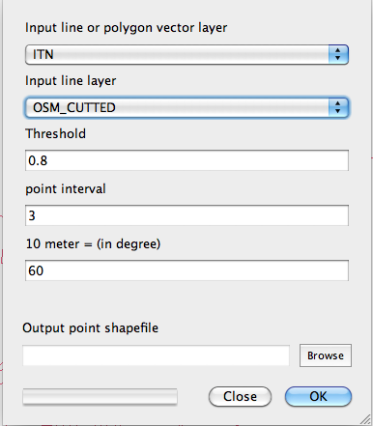
Process
Map Matching Algorithm Interface

Slide 12
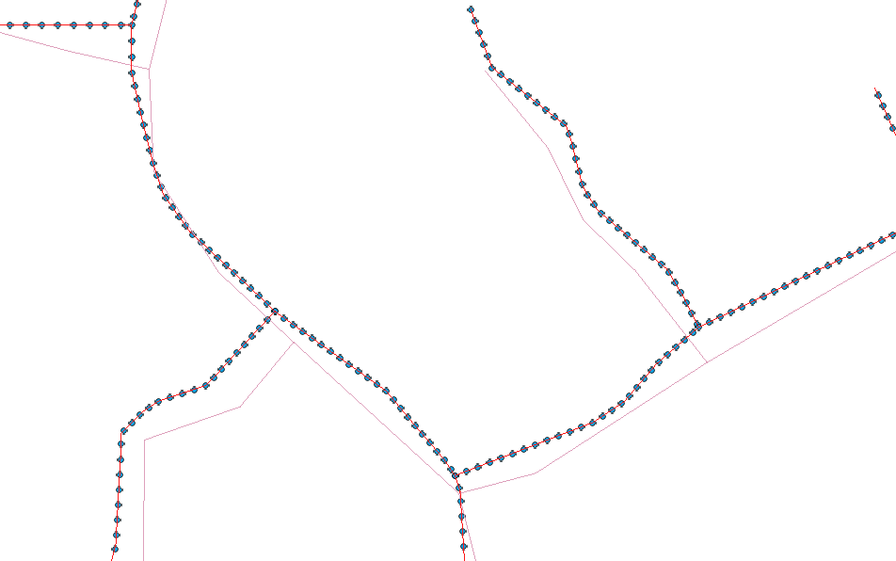
Result

Slide 13
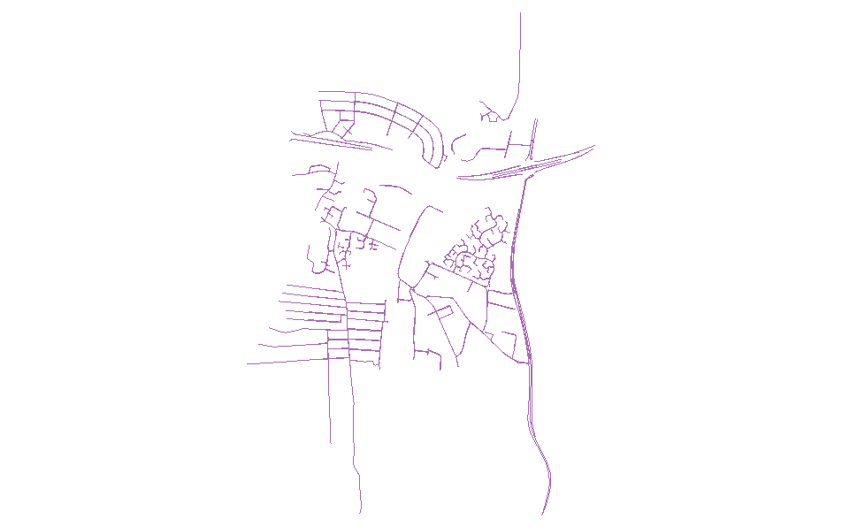
Result
ITN
OSM
merged

Slide 14
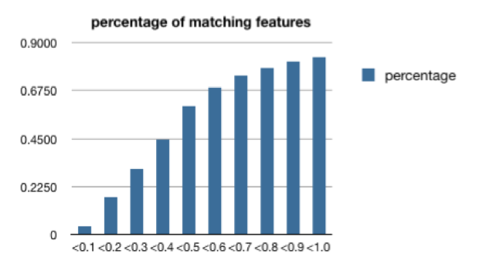
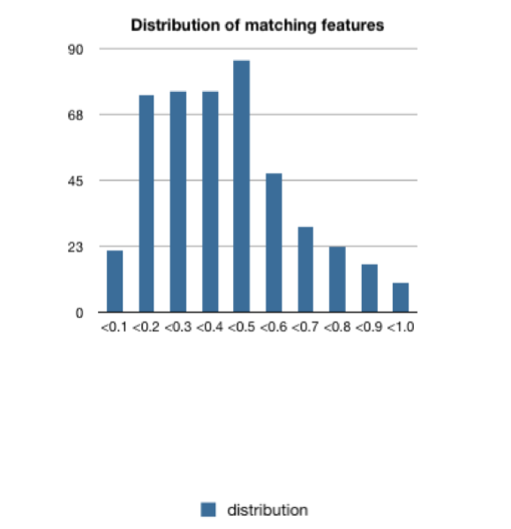
Result
Threshold | matching_features | percentage | distribution
<0.1 | 21 | 4% | 21
<0.2 | 95 | 17% | 74
<0.3 | 170 | 31% | 75
<0.4 | 245 | 45% | 75
<0.5 | 331 | 60% | 86
<0.6 | 378 | 69% | 47
<0.7 | 407 | 74% | 29
<0.8 | 429 | 78% | 22
<0.9 | 445 | 81% | 16
<1.0 | 455 | 83% | 10
threshold
weight: 10 meters = 60 degree
threshold
Threshold

Slide 15
Evaluation
1. Features should not be matched together but they are mistakenly matched by program
- matching error
2. Features should be matched together but they are not
- omission

Slide 16
Evaluation
name conflict analysis
<0.8 | 429 | 78%
ITN NAME | OSM NAME | OCCURRENCE
NAMED | NULL | 50
A288 | Copnor Road | 25
A2030 | Eastern Road | 17
GREEN FARM GARDENS | green farms gardens | 5
ST BARBARA WAY | Saint Barbara Way | 2
KESTREL ROAD | Kestrel Close | 4
LIMBERLINE SPUR | Limberline Spur Industrial Estate | 1
NORWAY ROAD | Merlin Drive | 1
HARTWELL ROAD | Plumpton Gardens | 1
HAWTHORN CRESCENT | Highbury Grove | 1
Copnor Road | Station Road | 1
ACKWORTH ROAD | Artillery Row | 3
 | total | 111
weight:10meter=60degree
threshold:0.8
total conflicts:111
problematic conflicts:7
matching errors: 3

Slide 17
Evaluation
name conflict analysis
Outcome:
Only 3 matching errors among name-conflict matching features
very effective algorithm!
but, should aware that
matching errors could occur in NAMED-NULL matching,
and also name-consistent matching features.

Slide 18
Evaluation
name conflict analysis
1. features should not be matched together but they are mistakenly matched by program
- matching error
2. features should be matched together but they are not
- omission

Slide 19
Result
ITN
OSM
merged

Slide 20
Problem
Section to Section matching
in one data set, a road is represented as small sections
in other data set, a road is represented as one large section

Slide 21
Position matching
length of red section is very small,
average distance between 2 features becomes very
long,so, small sections can not be matched to its correspondence

Slide 22
Even a small section can be matched to a long feature in other data set, does it make sense?
We can not presume a one to one feature matching relationship.
are they matching features?
perhaps a one to many relationship is appropriate

Slide 23
Even a small section can be matched to a long feature in other data set, does it make sense?
We can not presume a one to one feature matching relationship.
Divide
Group

Slide 24
Solution:
curve matching + topological information
Step 1
construct a topological network
ITN data contains topological information, OSM does not
but we can construct topological network according to overlap of end nodes
overlap of End nodes of 2 features

Slide 25
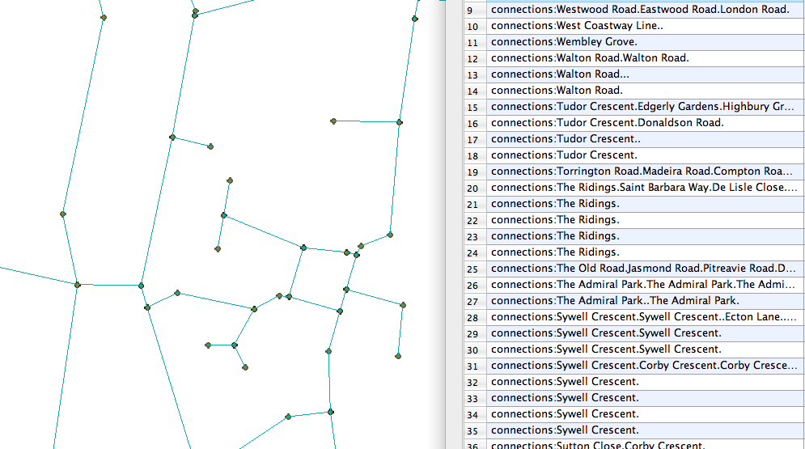
Result
-the topological network

Slide 26
Summary
Map matching shows good potential for application in data integration
Applied to create a merged data set
Position matching implemented
shows promising result
Evaluation
- Name conflict analysis
- Section to section matching problem

Slide 27
Future work
Finish coding for the proposed algorithm
Carry out evaluation experiments
Devise a method to identify useful information in unstructured attributes of OSM data set.
Develop optimization techniques for refining the algorithm

