Slide 1
Scala
What is Scala?
Why Scala?
Learn Scala

Slide 2
Scala
What is Scala?
  Scala = scale + language !
  What is a scale language then ?
    Scripts ---> big system
    Seamless coorperation with Java
    Static type^{[1]} + OOP + FP + DP
[1] static typed?

Slide 3

Scala
Why scala?
  Concise: less word, consice meaning
  Flexible: less word change

Slide 4

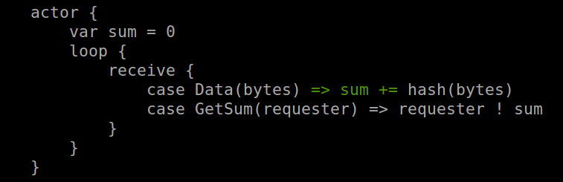
Scala
Why scala? (cont.)
  Barzaar: (cathedral vs barzaar)
    New type
    New control

Slide 5

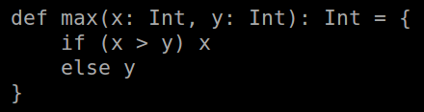
Scala
Learn Scala
  Value and variable
  Function

Slide 6
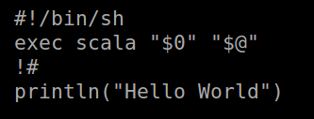
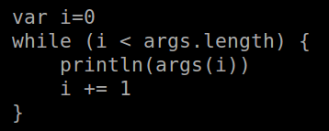

Scala
Learn Scala
  Scripts
  Loop

Slide 7
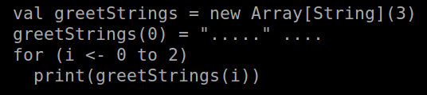
Scala
Learn Scala
  Parameterized Array (mutable)

Slide 8
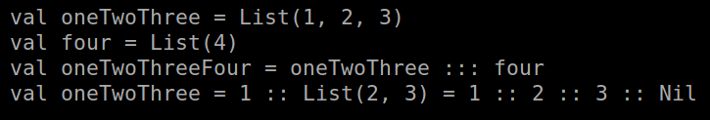

Scala
Learn Scala
  List (immutable)
  Tuple (immutable)

