Slide 1
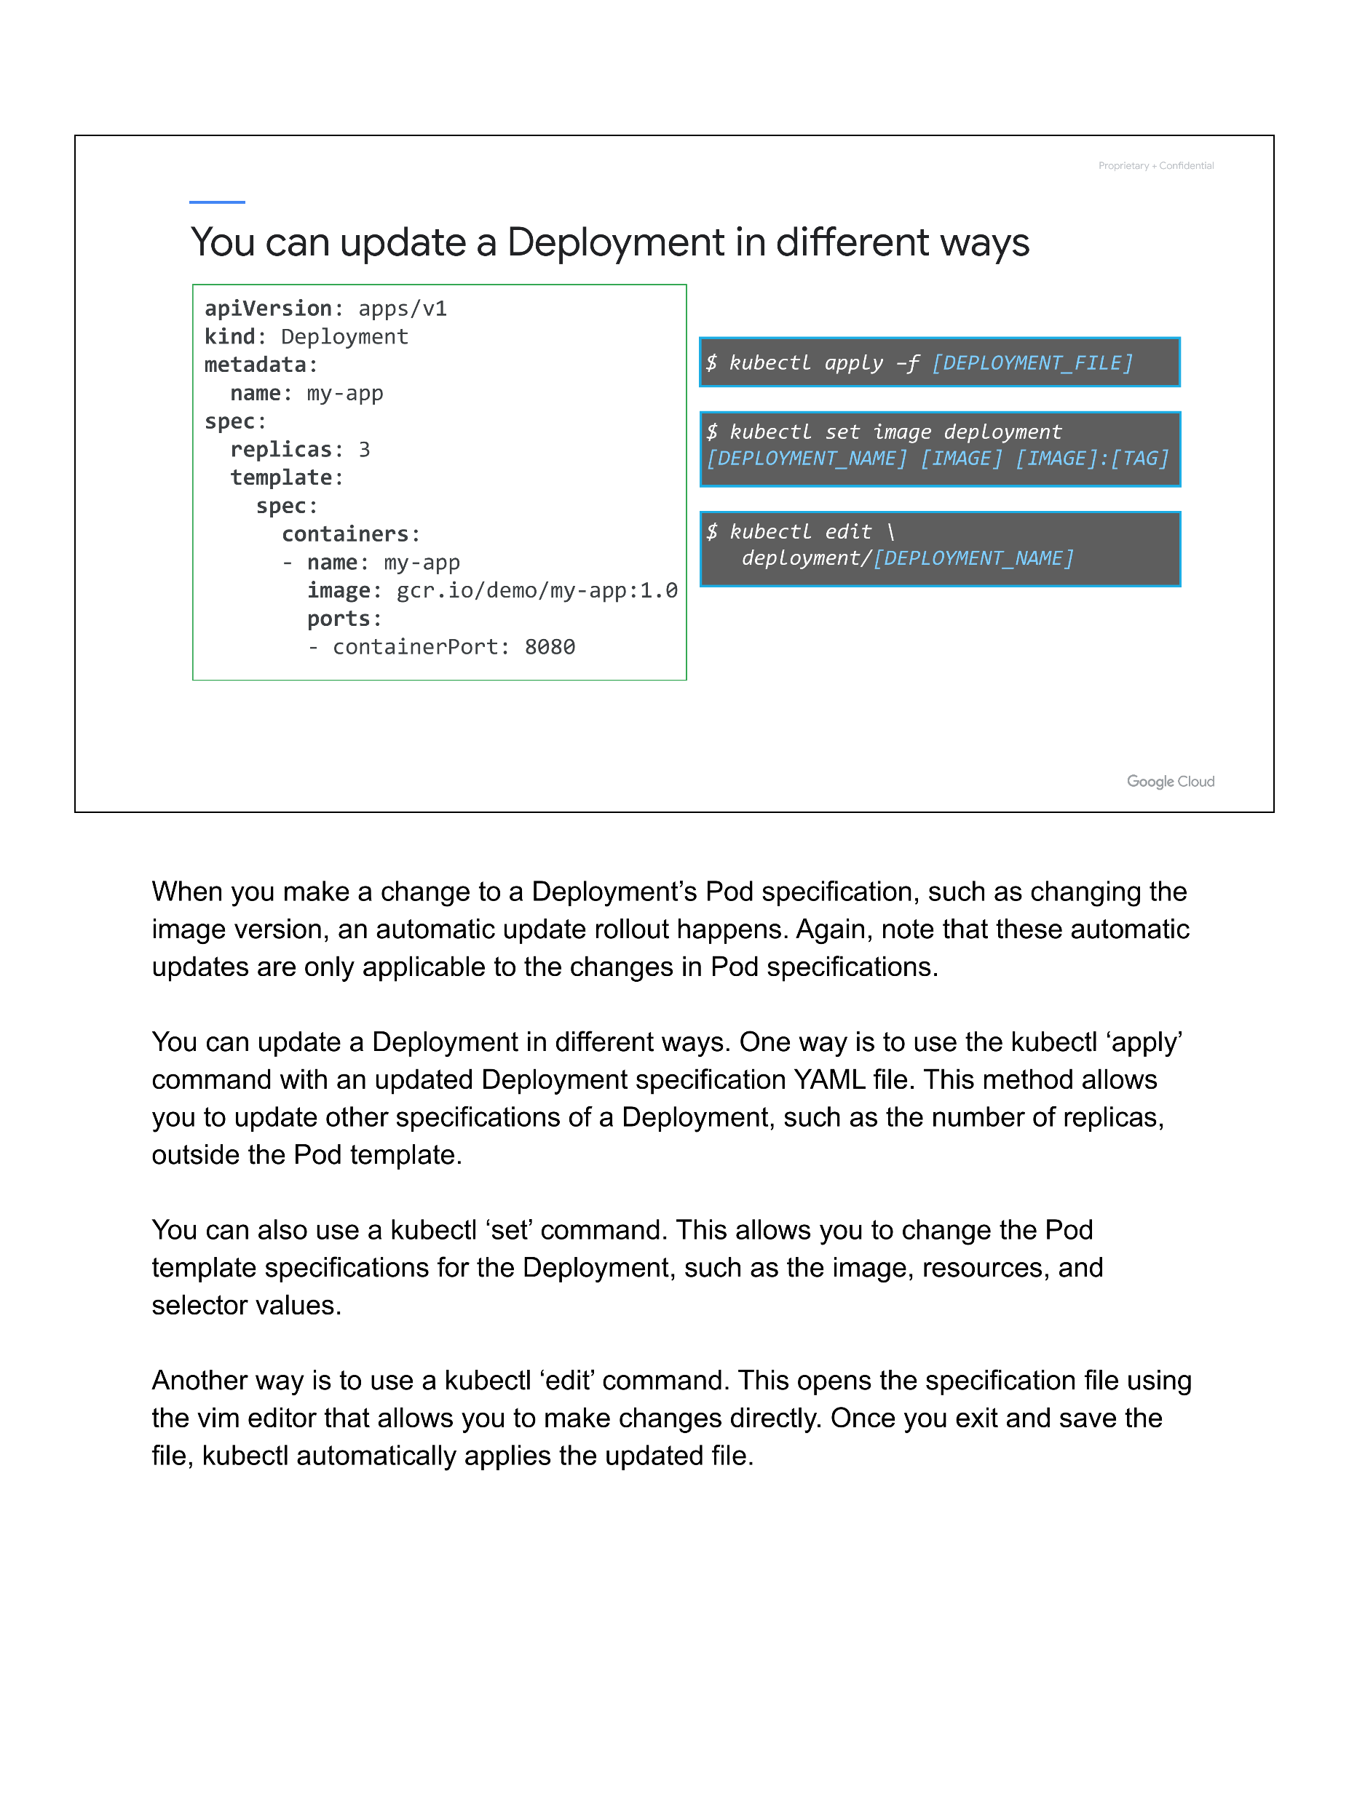

Slide 4
x1 <- 1.05
y1 <- 1.89
x2 <- 18
y2 <- 11.44
str_geo <- paste0((x2-x1)/19.05*img_info$width, "x",
(y2-y1)/25.4*img_info$height, "+",
(x1)/19.05*img_info$width, "+",
(y1)/25.4*img_info$height)
img_fix <- image_crop(image = img, geometry = str_geo)

