Slide 1


Slide 3
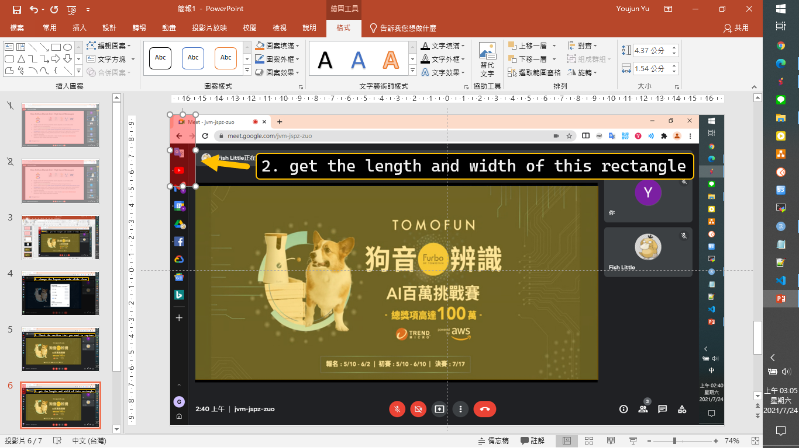

Slide 4
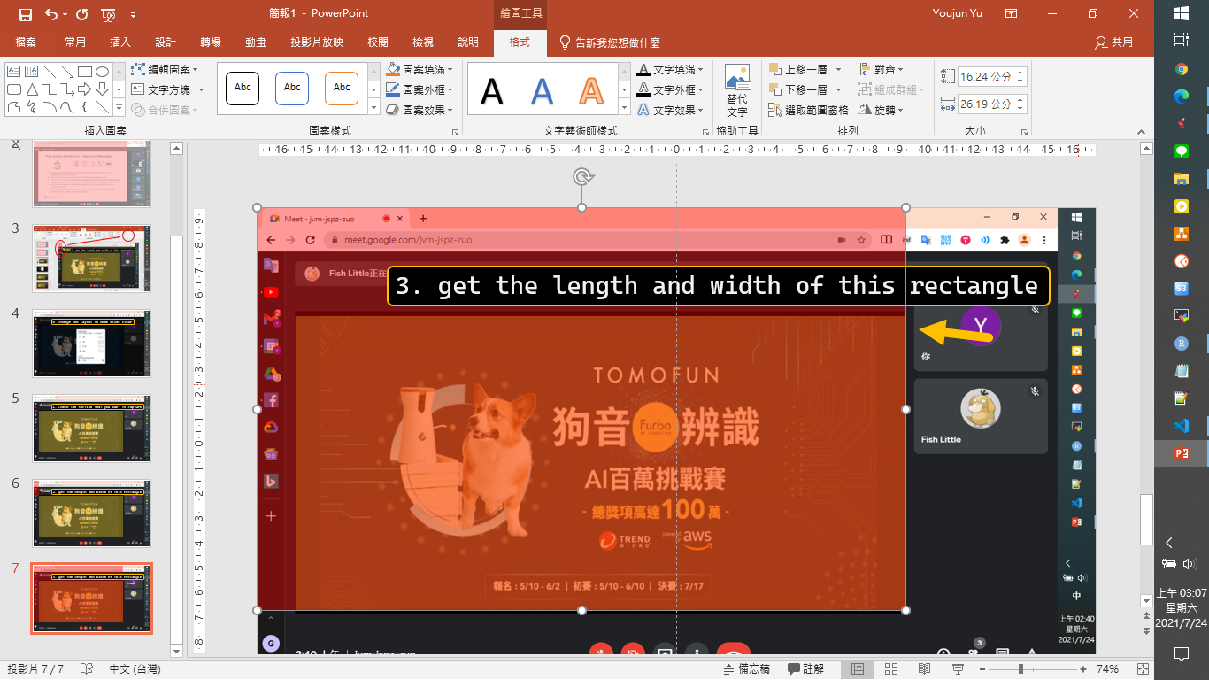

Slide 5
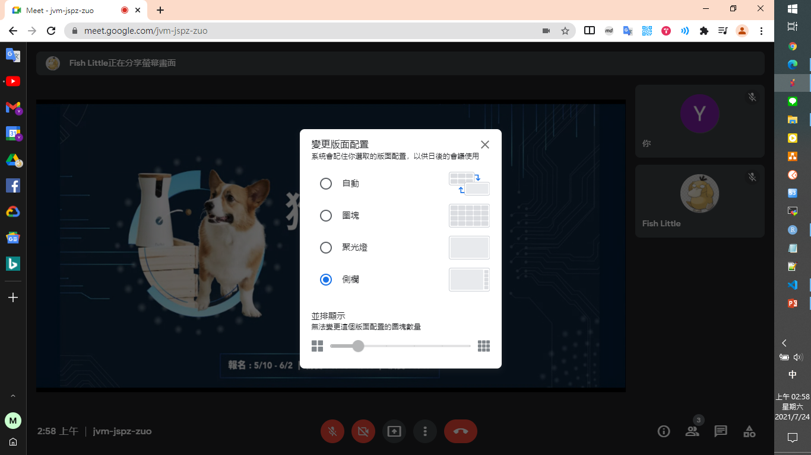
0. change the layout to make slide clear

Slide 6

1. Check the section that you want to capture

Slide 7
2. get the length and width of this rectangle

Slide 8
3. get the length and width of this rectangle

