Slide 1
Session 1
Buscar en la web...
Training
The Basics of Programming
More info

Slide 2
What and Why Programming?
What is Programming?
A set of instructions that can perform a task
Why Programming?
Very applicable
Central Development of websites, artificial intelligence, data analytics, etc.

Slide 3
Applications of Programming
Electronic Devices
Phones, watches, home devices
Web Applications
Apps for learning, entertainment, etc.
Healthcare
Medical diagnostics, patient management systems
Transportation
GPS for navigation, self-driving cars, public transport systems
Finance
Trading, fraud detecting, managing transactions

Slide 4
Data Types
Buscar en la web...
Search “Python online IDE”

Slide 5
Data Types
Stores information in the computer
10
Named “price”

Slide 6
Data Types
Price is not the same as price or PrIcE!
Case sensitive!!
Variables like “price” are in lowercase letters
If two words like “student grade” use
student_grade
studentGrade

Slide 7
Data Types
01
03
Integers
Boolean
02
04
Floats
Strings
age =2
grade = 100
classSize = 20
isGray = true
isLoggedIn = false
pi = 3.14
average = 14.2
temperature = 36.558
name = “Jane Doe”
City = “NY”

Slide 8
Example
Declare three variables that holds information about a restaurant: the rating, name, and whether the restaurant is full. The restaurant is named “Python Cafe,” has a 4.9 star rating, and is not full. Declare the variables and its values.

Slide 9
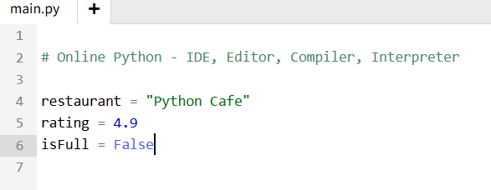
Solution

Slide 10
Syntax
Buscar en la web...
Input, operations, commenting, and indentations

Slide 11
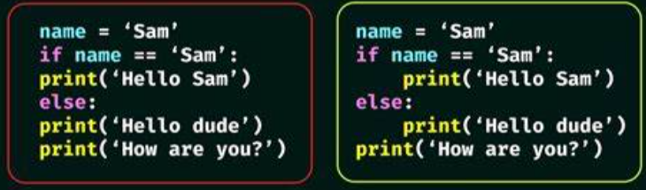
Syntax
Blocks of code are defined by their indentation
Important for loops and conditional statements

Slide 12
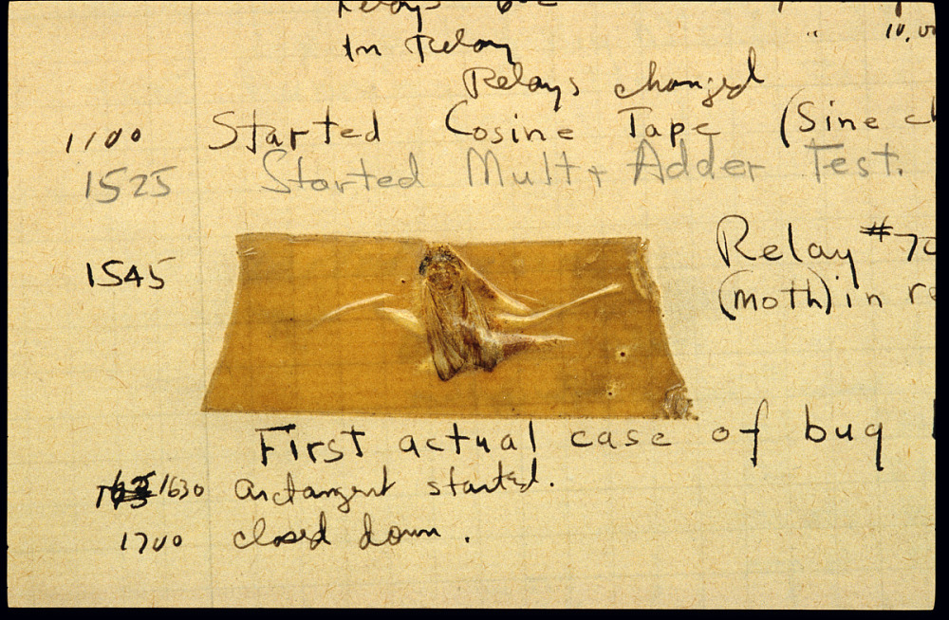
Bugs
Error that occurs within a program
Can be syntax, logic, run-time, etc.
Identify the bug by understanding what the program is supposed to do, and see what causes the error to occur

Slide 13
Session 2
Buscar en la web...
Training
The Basics of Programming
More info

Slide 14
Logic
Buscar en la web...
Comparison operations, logicals, if-statements

Slide 15
Logic
Used to create conditions, which creates conditional statements
Useful for decision-making and controlling program flow

Slide 16
Comparison Operators
01
03
>, <
== (not =)
02
04
>=, <=
!=
4 > 3 returns TRUE
4 < 3 returns FALSE
“Hello!” == “Hello!” returns TRUE
“Hi” == “hi” returns FALSE
5 >= 3 returns TRUE
5 >= 5 returns TRUE
3 <= 1 returns FALSE
“Whatup” != “Bye” returns TRUE
“Hey” != “Hey” returns FALSE

Slide 17
Logical Operators
01
02
and
or
03
not
(4 > 3) and (4 > 1) returns TRUE
(4 > 3) and (4 > 6) returns FALSE
(4 > 3) or (4 > 6) returns TRUE
(21 < 2) or (9 > 10) returns FALSE
random = true
not random returns FALSE
! random = false

Slide 18
If-Statements
Buscar en la web...
If, elif, if-else

Slide 19
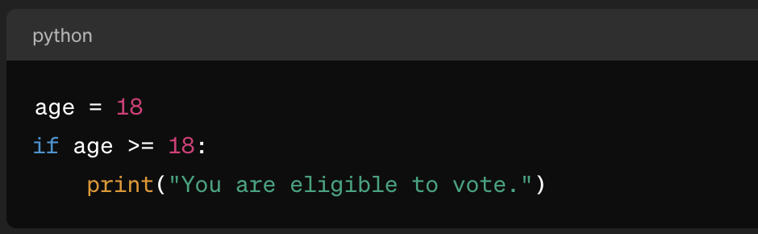
If-statements
Condition would determine if a block of code will be executed

Slide 20
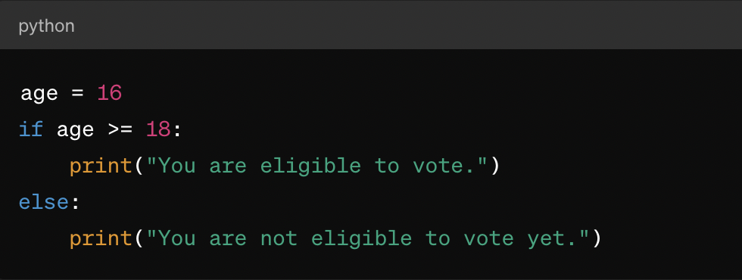
If-else
If condition is not met then else statement will run

Slide 21
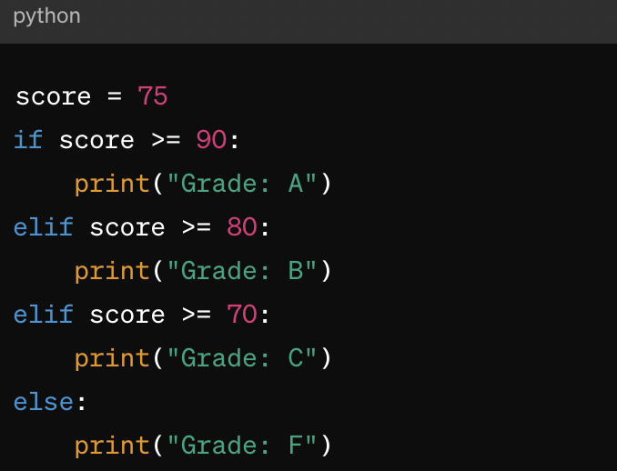
Elif statements
Used for testing multiple conditions

Slide 22
Example
Set price to 50. Make an Elif statement that first checks if the price is greater than 100. If it is, print out “Too expensive!”. If it is not greater than 100, check if it is equal to 100. If it is, print out “I can bargain!”. Lastly, if none of the conditions are met, print “This is a good price!”

Slide 23
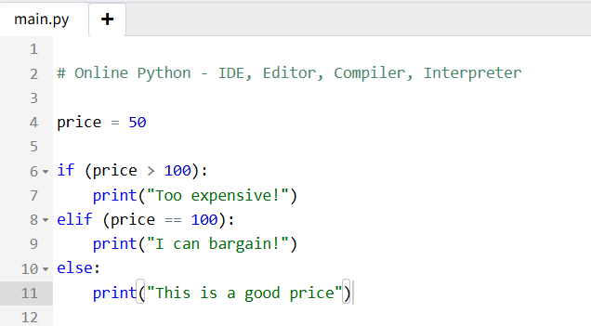
Solution

Slide 24
Session 3
Buscar en la web...
Training
The Basics of Programming
More info

Slide 25
Lists
Buscar en la web...
Lists and some methods

Slide 26
Loops
Buscar en la web...
While and for loops

Slide 27
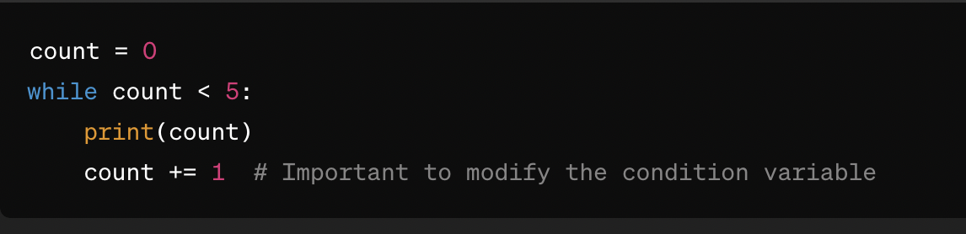
While-loop
Executes as long as the condition remains true
Be careful of infinite loops!

Slide 28
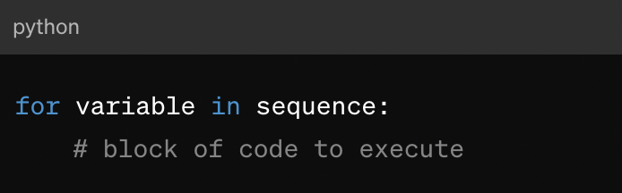
For-loop
Iterates over a sequence

Slide 29
Example
Create a multiplication list for 5. Use for loops to print 5 * i, where i goes up to 12.

Slide 30

Solution

Slide 31
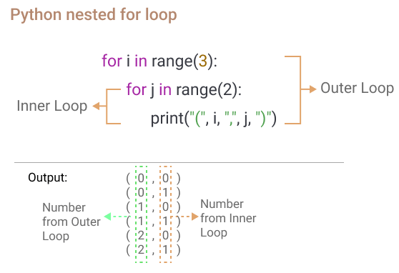
Nested Loop
A loop inside another loop. Inner loop executes completely for each iteration of the outer loop

Slide 32
Session 4
Buscar en la web...
Training
The Basics of Programming
More info

Slide 33
Functions
Buscar en la web...
Built-in and User-Defined

Slide 34
Functions
print( ) or input( ) to “call” a function
Block of statements that perform a specific task
Increases code READABILITY and REUSABILITY

Slide 35
Functions
Built-in functions
User-defined functions
min( )
max( )
print( )
Make your own! :)

Slide 36
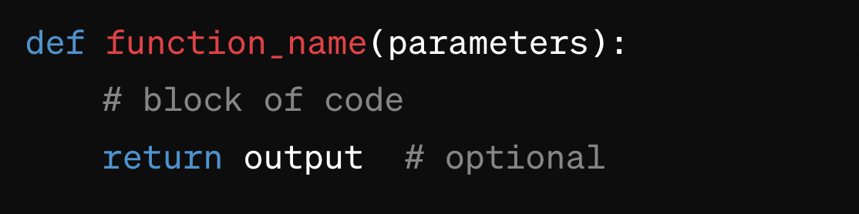
Functions
Use the “def” keyword, followed by function name and parentheses
Optional: add parameters inside parentheses
Optional: return a specific value
To call functions, use function name. If it has parameters, provide the parameter value within parenthesis

Slide 37
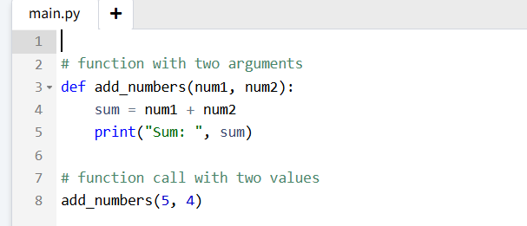
Functions
Here’s an example of a function with parameters

Slide 38
You did it!

Slide 39
Session
Buscar en la web...
Review
Training Slides 1 - 4
More info

Slide 40

Variables
10
Named “price”

Slide 41
Data Types
01
03
Integers
Boolean
02
04
Floats
Strings
age =2
grade = 100
classSize = 20
isGray = true
isLoggedIn = false
pi = 3.14
average = 14.2
temperature = 36.558
name = “Jane Doe”
City = “NY”

Slide 42
Bugs
Error that occurs within a program
Identify the bug by understanding what the program is supposed to do, and see what causes the error to occur

Slide 43
Comparison Operators
01
03
>, <
== (not =)
02
04
>=, <=
!=
4 > 3 returns TRUE
4 < 3 returns FALSE
“Hello!” == “Hello!” returns TRUE
“Hi” == “hi” returns FALSE
5 >= 3 returns TRUE
5 >= 5 returns TRUE
3 <= 1 returns FALSE
“Whatup” != “Bye” returns TRUE
“Hey” != “Hey” returns FALSE

Slide 44
Logical Operators
01
02
and
or
03
not
(4 > 3) and (4 > 1) returns TRUE
(4 > 3) and (4 > 6) returns FALSE
(4 > 3) or (4 > 6) returns TRUE
(21 < 2) or (9 > 10) returns FALSE
random = true
not random returns FALSE

Slide 45
If-else Statements

Slide 46
Elif Statements
Used for testing multiple conditions

Slide 47
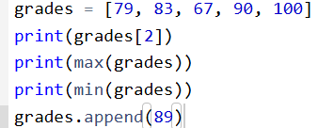
Lists
Prints 67, 100, 67
Adds 89 to the end of the list

Slide 48
While-loop
Executes as long as the condition remains true
Be careful of infinite loops!

Slide 49



For-loop
Prints all the contents of grades
Prints all numbers from 0 to 9
Prints all contents of grades

Slide 50
Nested Loop
A loop inside another loop. Inner loop executes completely for each iteration of the outer loop

Slide 51
Functions
Here’s an example of a function with parameters

Slide 52
That’s all!

