Slide 1



Mastercard Data
Quest : Identifying hidden commercial activity based on individuals' transaction data
‘’ Outsiders ‘’
Urazova Alina
Kemelkhan Alikhan
Rudkovskaya Arina
Slepokurova Violeta

Slide 2
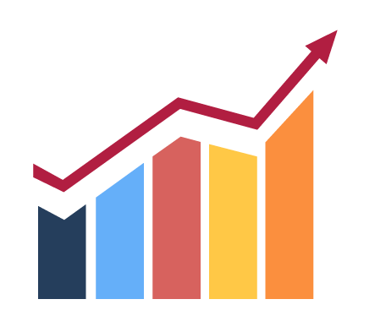
Business value
Money
Time
Risks
Right now, these hidden businesses pay us almost nothing in acquiring fees (0–0.5%). If we move them to business pricing, we get 1.5–2.5% on their turnover. That's pure upside. Plus we can sell them loans, RKO accounts, and POS terminals.
Fraud team currently spends 20+ hours a week manually hunting for suspicious patterns. A good model would cut that down to 2 hours — just validating the top candidates. We need that time back.
Hidden businesses are risky. They trigger AML alerts, get cards blocked, generate chargebacks. We've already seen clients leave because we froze their card by mistake. A model helps us catch the real cases without annoying regular customers.

Slide 3

What we're trying to predict :
We're building a binary classifier that answers one question:
"Is this person actually running a business using their personal card?"
Target:
1 = hidden business (takes payments for goods/services)
0 = regular individual (just spending on themselves)

Slide 4
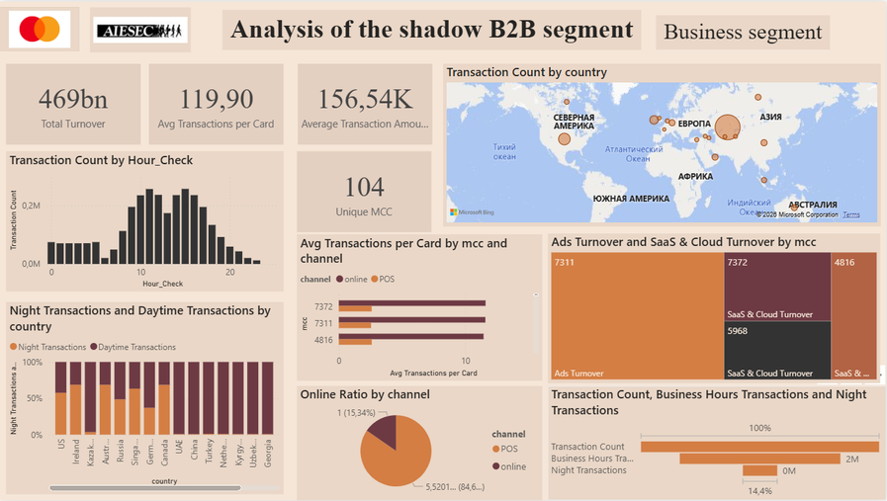
Primary analysis: Business segment
The second stage of the exploratory analysis involved investigating the transaction data of individuals using the Consumer Segment Dashboard. As a result, massive systemic anomalies were uncovered, indicating that hidden entrepreneurs are operating under the guise of regular citizens.
High average check and large turnover
business segment demonstrates a high average transaction value—around 156,000 KZT per transaction. This is consistent with real commercial behavior, as companies operate with:
wholesale procurement;
infrastructure expenses;
B2B services;
corporate subscriptions.
Concentrated MCC structure
Night activity
International payments
business segment uses a limited number of MCC categories—only 104. This is an important behavioral indicator, as legitimate businesses do not spend funds randomly, but within a constrained set of professional categories. The highest concentration of operations is observed in:
MCC 7311 — advertising services;
MCC 7372 — SaaS;
MCC 4816 — cloud.
One of the most interesting findings was the presence of stable business activity during nighttime hours. However, this activity is not related to “live” purchases, but is mainly driven by automated processes:
automatic payments;
cloud billing;
SaaS subscriptions;
advertising payments.
Geographical analysis also revealed a high concentration of international payments in certain countries. A significant share of business transactions is directed to:
the United States;
Ireland;
China.

Slide 5
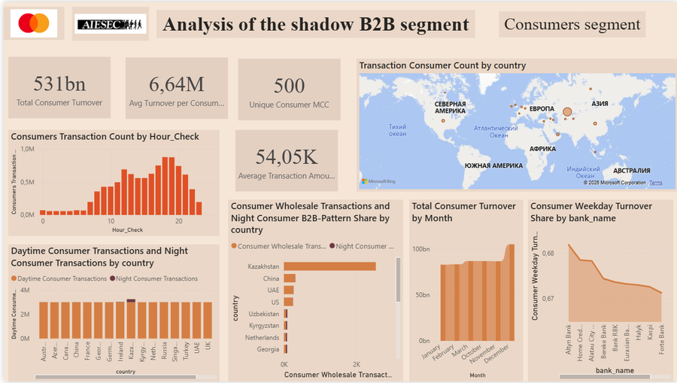
Primary analysis: Customers segment
The initial stage of project implementation involved preliminary data processing and exploratory analysis of transactional data. For this purpose, a dashboard for the business segment was designed and built.
Anomalous Nighttime Activity
Examifying the transaction distribution chart by time of day revealed a paradoxical fact. While official businesses show virtually no transaction volume at night, the individual segment experiences a massive surge in activity during typical hours of rest (from 00:00 to 06:00).Transactions are logged consistently throughout the entire workweek, completely refuting the hypothesis of personal or entertainment-related nighttime spending by citizens.
Incursion into Commercial Categories
Cross-Border Transit Pattern
Emergence of a "Dual" Profile
Unlike legitimate businesses, which are concentrated within a narrow list of industries, the consumer segment exhibits highly fragmented usage across hundreds of MCCs. However, within this mass, distinct anomalous clusters of capital concentration are clearly visible.Standard debit cards belonging to citizens are generating massive turnover in purely professional categories, such as Advertising Services, Information Services and Cloud Infrastructure.
The integrated geographic map of consumers provided the ultimate proof of mimicry. If individuals were using their cards solely for personal purposes, the geography would reflect domestic retail or classic international tourism.On the consumer map, the largest trade turnover "bubbles" inflated precisely in the same global hubs as the official business segment—namely, the United States, Ireland, and China.
During an initial filtering of the top 20 most active individual cards, it became evident that they combine two completely distinct behavioral patterns.On one hand, the card registers typical day-to-day retail spending .On the other hand, the exact same card simultaneously runs multi-million transactions in commercial MCC categories.

Slide 6
Primary analysis: Identifying differences and correlations
We conducted a comparative analysis of two transaction data segments: the business segment, which serves as our benchmark for legitimate commercial activity, and the consumer segment of individual clients. The primary objective was to uncover statistical overlaps and structural discrepancies that allow us to identify anomalous behavioral patterns.
Ticket Size and Transaction Power
MCC Structure
Nighttime Distribution
While high average checks (~156K KZT) characterize corporate spending, the consumer segment generally consists of low-value, everyday purchases. However, we discovered a persistent "long tail" of large-scale consumer transactions that falls directly into the business value range. This financial correlation indicates that a specific subset of individual accounts regularly moves large sums of money that match corporate spending capacities rather than typical personal budgets.
The business segment is concentrated within a stable set of 104 merchant codes, while consumers naturally display fragmented usage across hundreds of lifestyle categories. However, filtering consumer data by total turnover revealed a massive concentration correlation in professional categories, specifically advertising services, software/SaaS, and cloud infrastructure. This proves that a significant portion of consumer transaction volume is functionally identical to business expenditures, showing that individual cards are acting as B2B tools.
Nighttime activity (00:00 to 06:00) in the business segment is entirely driven by automated processes like cloud billing and recurring subscriptions. When mapping consumer data, we found a synchronized positive correlation, as individual accounts experience identical traffic peaks during these exact late-night hours throughout the workweek. This structural alignment eliminates human spontaneity, proving that automated payment gateways are actively tied to these consumer accounts.

Slide 7
Primary analysis: Identifying differences and correlations
Geographic Correlation
Payment Regularity
Cross-Segment Behavioral
Registered corporations route their international payments directly into global technological and logistics hubs based on official supply chains. The consumer map completely mirrors this corporate model, with the largest cross-border transaction clusters inflating in the exact same three destinations: the United States, Ireland, and China. This heavy geographic overlap proves that these individual users are bypassing standard retail or tourism patterns to fund global digital advertising networks and overseas wholesale platforms.
While official businesses execute periodic transactions based on subscription contracts, individual accounts exhibit identical calendar-based frequency and cyclical debits within the same IT and software categories. Time-series analysis shows these consumer transactions repeating from month to month with absolute mathematical precision. This clear correlation points to a shared financial logic, proving that a specific subset of individual accounts operates under a standard corporate recurring billing model.
At the macro level, normal consumers have irregular retail habits, while businesses display strictly professional patterns; however, on the individual card level, we discovered a distinct combined profile. We identified users who use the same card for small household purchases (groceries, pharmacies) while simultaneously running multi-million transactions in business MCCs that perfectly match the commercial benchmark in geography and nighttime execution.
The correlation analysis between the business and consumer segments established that a significant correlation exists within the MCC structure of digital services, a powerful alignment is present among cross-border geographic clusters, and time patterns regarding nighttime activity and calendar cycles demonstrate an identical structural distribution.

Slide 8
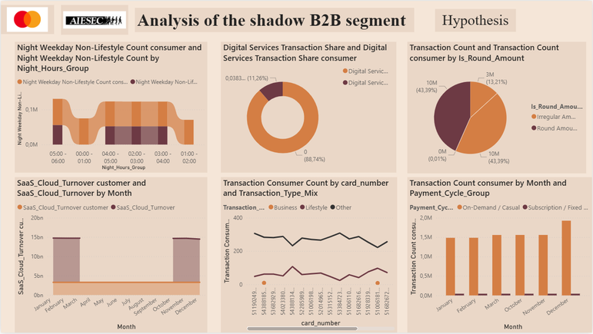
Primary analysis: Hypotheses
1. Late-Night Weekday Transactions for Digital Advertising and Services
This hypothesis assumes that hidden commercial activity manifests as high-value, late-night transactions (00:00–06:00) during the workweek.
2. Regular Expenditures on Digital Advertising
This hypothesis suggests that the systematic outflow of large sums in favor of global marketing platforms indicates illegal business
3. Systematic and Cyclical Subscriptions to SaaS and Cloud Infrastructure
This hypothesis suggests that a shadow business can be identified by looking for regular, recurring monthly debits for professional software, web hosting, and cloud infrastructure like AWS or international server providers.
4. The "Dual-Profile" Card
5. Fixed-Price Invoicing
6. Recurring Business Payments
This pattern assumes that shadow entrepreneurs do not use separate accounts, causing a single consumer card to display a conflicting, two-sided behavioral profile.
This hypothesis is based on the assumption that B2B settlements, wholesale rates, and fixed invoices result in perfectly rounded transaction amounts, such as 5,000, 50,000, or 100,000 KZT, instead of fractional retail totals that include irregular change and taxes.
This hypothesis assumes that shadow commercial activity manifests as highly predictable, repeating transaction streams executed with absolute mathematical precision (day-to-day and month-to-month) toward specific counterparties or vendors.
Building upon the cross-segment anomaly analysis and the validation of our six initial assumptions, we have derived ten definitive hypotheses that will be mathematically tested within the personalized scoring model.

Slide 9
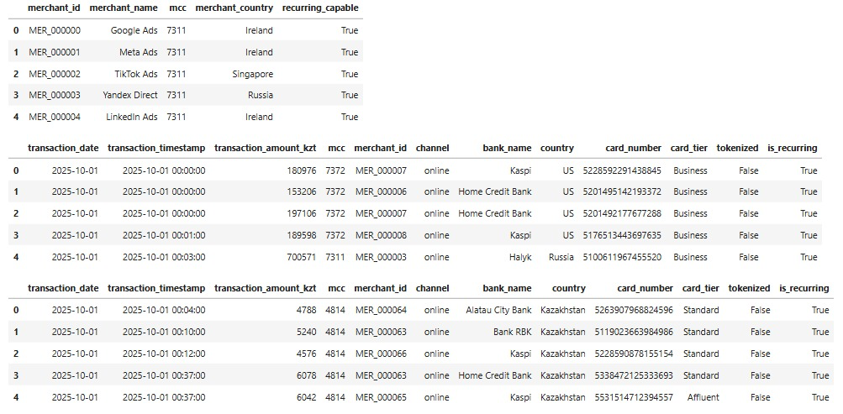
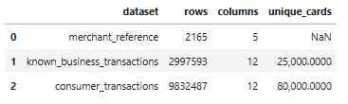
Code : General Data Overview and Converting Data Types
In this step, we make General overview of loaded datasets:
We also convert MCC codes to string format and transform date columns into datetime format for further time-based analysis
The initial data overview confirms that all three datasets were loaded correctly. The merchant reference table contains merchant-level information, while the business and consumer datasets contain transaction-level records with the same structure. Business transactions cover 25,000 unique cards, and consumer transactions cover 80,000 unique cards. MCC codes and date fields were converted to appropriate formats for further behavioral analysis and feature engineering

Slide 10
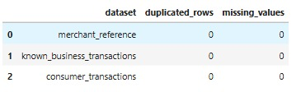
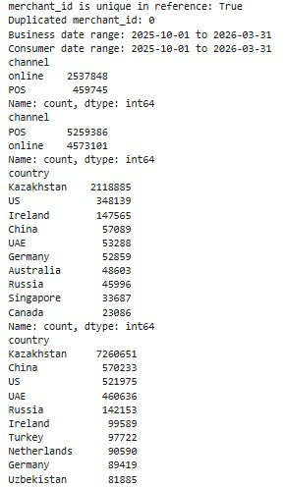
Code : Data Quality Checks
In this step, we check for duplicates and zero values:
In this step, we make initial data quality checks and exploratory overview:
We checked the data quality before analysis. No missing values ​​or duplicates were found in the datasets, and the merchant directory has unique merchant_id s. Furthermore, both sets of transactions cover the same time period—October 2025 to March 2026—enabling a valid comparison of business and consumer behavior.

Slide 11
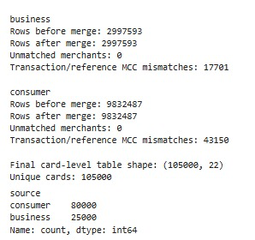
Code : Hypothesis Preparation
The behavioral patterns must be calculated at transaction level before aggregation. The separate script performs a validated ⁠ many_to_one ⁠ left merge with the merchant reference, creates transaction flags, and only then builds one row per card. It raises an error if the merge changes row counts or leaves unmatched merchants.
The transaction ⁠ mcc ⁠ is retained as the source of MCC behavior. Merchant reference fields enrich transactions with merchant identity and country. Any transaction/reference MCC disagreement remains visible in the merge audit rather than silently replacing original transaction information.

Slide 12

Hypotheses (№1)
“Individuals who have payments on weekdays from 02:00 to 06:00, excluding lifestyle MCC 5411, 5541, 5812, are more likely to be considered hidden businesses.”
High share:
night_non_lifestyle_share >= 5%
consumer_rate = 8.90%
business_rate = 78.14%
lift = 8.78
p-value = 0.0
According to average:
night_non_lifestyle_share:
consumer_mean = 1.90%
business_mean = 8.04%
lift = 4.22
night_non_lifestyle_count:
consumer_mean = 2.09
business_mean = 8.45
lift = 4.05
Conclusion: Use not just the presence, but the threshold: 2+ such transactions or better yet, a share of >= 5%.
Result: confirmed as a strong business signal, especially if the share of such payments is >= 5%.

Slide 13
Hypotheses (№2)
“Individuals who spend money on advertising, such as Google Ads, Meta Ads, TikTok Ads, and Yandex Direct, may be considered hidden entrepreneurs.”
Stricter option:
2+ ad payments or ad share >= 5% consumer_rate = 8.46% business_rate = 83.91% lift = 9.91 p-value = 0.0
According to average:
ads_share:
consumer_mean = 2.85%
business_mean = 9.54%
lift = 3.35
ads_count:
consumer_mean = 3.20
business_mean = 10.86
lift = 3.39
Conclusion: MCC 7311 is one of the strongest indicators. For a manual rule, it's best to use: ads_count >= 2 OR ads_share >= 5%.
Result: confirmed as a strong business signal

Slide 14
Hypotheses (№3)
“Individuals who regularly pay for SaaS, cloud, hosting, and software platforms are more likely to be entrepreneurs.”
Strict option:
2+ payments or share >= 8% consumer_rate = 13.41% business_rate = 96.22% lift = 7.18p-value = 0.0
According to average:
saas_cloud_share:
consumer_mean = 1.38%
business_mean = 22.13%
lift = 16.03
saas_cloud_count:
consumer_mean = 1.52
business_mean = 25.40
lift = 16.76
Conclusion: This is one of the clearest signs of an online business. Manual rule: saas_cloud_count >= 2 OR saas_cloud_share >= 8%.
Result: confirmed very strongly.

Slide 15
Hypotheses (№4)
“If a single personal card contains both household expenses and advertising expenses, the card can be used for a combination of personal and business expenses.”
Household MCC: supermarkets, taxis, restaurants, clothing, pharmacies, marketplaces, etc.
Business part: 7311.
mixed_household_ads:
consumer_rate = 8.52%
business_rate = 61.22%
lift = 7.19
p-value = 0.0
Interpretation:
A person uses one card for both life and business promotion.
Conclusion: This is stronger than simply "there are household + some business MCCs." Manual rule: has_household = 1 AND has_ads = 1.
Result: confirmed as a strong mixed personal-business signal.

Slide 16
Hypotheses (№5)
“If you have household expenses and an IT/software MCC on one card, this could be a sign of freelancing, an online business, a digital product, or a small business.”
mixed_household_it:
consumer_rate = 9.43%
business_rate = 53.84%
lift = 5.71
p-value = 0.0
According to average:
it_software_share:
consumer_mean = 0.59%
business_mean = 8.37%
lift = 14.25
it_software_count:
consumer_mean = 0.65
business_mean = 9.59
lift = 14.65
Conclusion: A good pattern for hidden business, especially in combination with recurring, night or foreign online.
Result: confirmed

Slide 17
Hypotheses (№6)
“Entrepreneurs often have regular write-offs for business-related MCCs: advertising, SaaS, cloud, logistics, professional services.”
recurring_business_2plus_or_5pct:
consumer_rate = 14.74%
business_rate = 99.31%
lift = 6.74
p-value = 0.0
According to average:
recurring_business_share:
consumer_mean = 1.25%
business_mean = 14.87%
lift = 11.94
recurring_business_count:
consumer_mean = 1.26
business_mean = 15.38
lift = 12.16
Conclusion: Recurring itself can be a regular subscription, but recurring specifically on a business MCC is a strong indicator. Manual rule: recurring_business_count >= 2 OR recurring_business_share >= 5%.
Result: very strong signal

Slide 18
Hypotheses (№7)
“If the card pays online to foreign merchants via business-MCC, this is similar to SaaS, ads, cloud, international platforms, or working with foreign partners.”
online_foreign_business_2plus_or_5pct:
consumer_rate = 16.53%
business_rate = 99.51%
lift = 6.02
p-value = 0.0
According to average:
online_foreign_business_share:
consumer_mean = 3.15%
business_mean = 23.14%
lift = 7.35
online_foreign_business_count:
consumer_mean = 3.52
business_mean = 25.75
lift = 7.31
Conclusion: Online foreign business payments are significantly more common among business cards
Result: confirmed, but the signal is wider and softer than ads/SaaS.

Slide 19

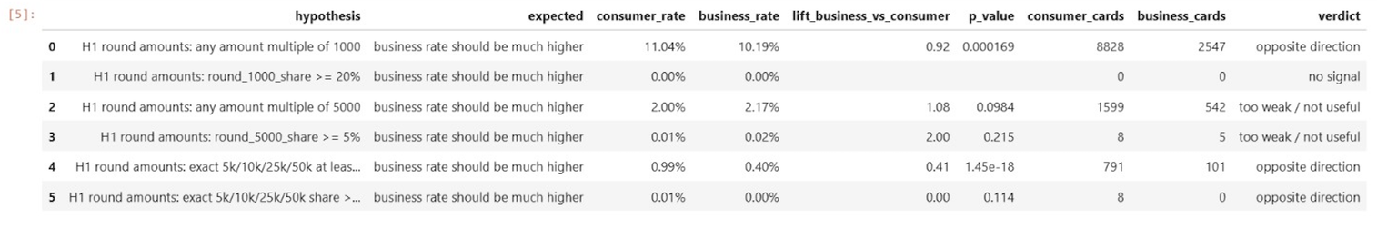
Hypotheses (№8)
“if a card is used as hidden business, it may receive or spend many round amounts such as 5,000 / 10,000 / 25,000 / 50,000 KZT.”
h1_binary = binary_results [
binary_results ["hypothesis"]. str.startswith("H1", na=False)
1. reset_index(drop=True)
format_ for_display(h1_binary)
Conclusion: Result: the signal is rejected because business cards do not show a strong useful advantage over consumer cards.

Slide 20
Hypotheses (№9)
“Grey or old POS terminals may have lower tokenized transaction share.”
h2_binary = binary_results[
binary_ results ["hypothesis"]. str. startswith("H2", na=False)
]. reset_index(drop=True)
format_for_display(h2_binary)
Result: this hypothesis is rejected because the direction is opposite. Low tokenized share is not a useful hidden-business signal here.

Slide 21
Hypotheses (№10)
“Hidden business may receive repeated payments from the same payer to the same recipient card.”
h3_summary = rejection_ summary []
rejection_summary ["hypothesis"].str. startswith("H3", na=False)
].reset_index(drop=True)
h3_summary
Result: this hypothesis cannot be tested with the current dataset because the parquet files do not contain a recipient-card column. merchant_id is not the same as recipient card, so using it would test a different hypothesis.

Slide 22
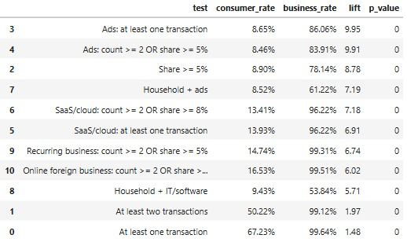
Code : Combined Hypothesis Summary
The hypothesis testing stage confirmed that all seven behavioral hypotheses show statistically significant differences between known business cards and the consumer comparison portfolio. The results show that business-like card activity is not defined by one isolated transaction type, but by a combination of repeated commercial patterns: advertising payments, SaaS/cloud subscriptions, recurring business payments, online foreign business payments, mixed household-commercial usage, and weekday night non-lifestyle transactions.
The strongest signals by lift are advertising payments, high-share weekday night non-lifestyle payments, household plus advertising activity, SaaS/cloud subscriptions, recurring business payments, and online foreign business payments. These features show that business cards are much more likely to pay for digital advertising, software, cloud infrastructure, foreign online services, and recurring business-related MCC categories.
Mixed spending patterns also provide useful evidence.

Slide 23


Code : Selection of Clean Ordinary Consumers
The hypothesis tests identified behavioral patterns that are significantly more common among known business cards than among consumer cards.
For model training, the entire consumer portfolio cannot be labeled as class 0, because it may contain hidden business activity. Therefore, we select a conservative subset of consumer cards that do not demonstrate any confirmed strong business-like signals.
These cards will be used as a reliable negative proxy class for model training.
Consumer cards without any confirmed strong business-like signal are selected as the clean ordinary consumer group. This group is not assumed to be a perfect ground-truth negative class, but it is a substantially more reliable negative proxy than labeling the entire consumer portfolio as non-business.
The remaining consumer cards are not labeled at this stage. They represent an uncertain portfolio to which the final trained model will later be applied.

Slide 24
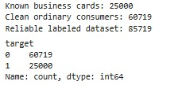

Code : Preparation of Reliable Training Dataset
The full consumer portfolio cannot be used as class 0 because it may contain hidden business activity. Therefore, the supervised training sample is built only from:
known business cards as class 1;
clean ordinary consumer cards as a reliable negative proxy class 0.
Consumer cards with at least one strong business-like signal remain unlabeled at this stage and will be scored only after model validation.

Slide 25
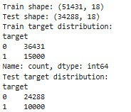
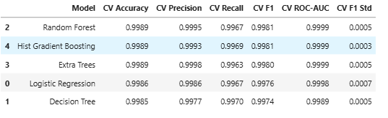
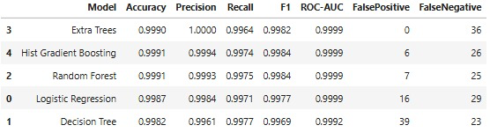
Code : Model Comparison
Multiple models are compared on the same dataset with a 60/40 split and default 0.50 threshold before final selection — a stricter threshold will come later
Cross-validation results show that all models performed very strongly, with accuracy, F1, and ROC-AUC close to 1.0. Random Forest achieved the best overall result with the highest CV F1 score (0.9981) and very low variability, making it the most stable and reliable model for final scoring.
All models achieved ROC-AUC near 1.00. Extra Trees is selected because it produced zero false positives while keeping high recall and F1-score — critical for avoiding mislabeling ordinary consumers. Hist Gradient Boosting and Random Forest performed well but had several false positives, making them less suitable for this business priority

Slide 26
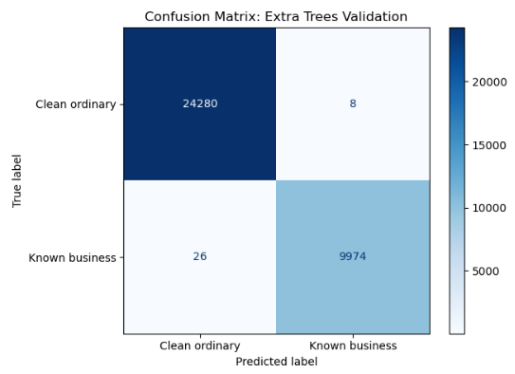
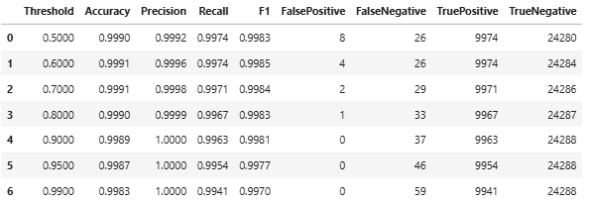
Code : Final Model Selection & Probability Threshold Review
Among the compared classifiers, Extra Trees is selected as the final model.
Although Random Forest and Hist Gradient Boosting achieve slightly higher F1 scores, Extra Trees produces zero false positive classifications on the reliable validation sample while maintaining very high recall and ROC-AUC.
The predicted probability is first used as a hidden business potential score. Then, together with the number of strong business-like signals, it is converted into the final binary prediction.
For the selected Extra Trees model, thresholds above 0.50 preserve very high precision on the reliable validation sample.
However, the final solution does not rely on a single binary threshold. The probability score is combined with the number of strong business-like signals to assign each card to Low potential, Medium potential, or High potential.
In the final segmentation, 0.50 is used as an initial elevated-probability level, while 0.90 is used as the high-confidence probability level.

Slide 27
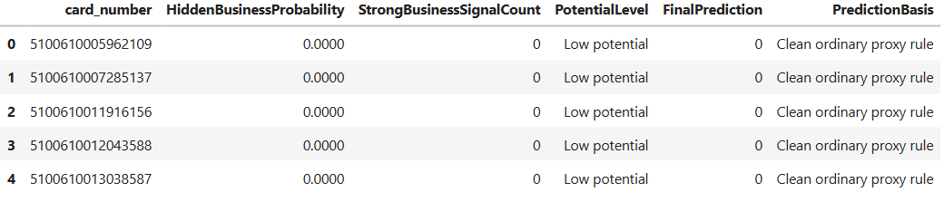
Code : ⁠Model-Based Scoring of Uncertain Consumers
The selected Extra Trees model is trained on the complete reliable labeled dataset and applied to previously unlabeled uncertain consumer cards.
The model first estimates the hidden business probability for each uncertain consumer card. Then cards are assigned to small supporting potential groups: Low potential, Medium potential, or High potential.
These groups are used only as an interpretation layer. The final model output is converted into a binary prediction:
0: ordinary consumer or insufficient hidden-business evidence;
1: high-confidence hidden business candidate.
19 281 uncertain consumer cards scored.
  High potential: 11,540 (59.85%)
  Medium: 2539 (13.17%)
  Low: 5202 (26.98%)
Not all business signals are equal. Model separates strong from weak candidates. Ready for segmentation.

Slide 28
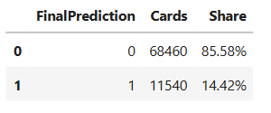
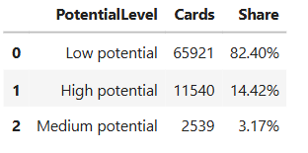
Code : ⁠Final Binary Prediction Summary
The final prediction summary shows that 11,540 consumer cards, or 14.42% of the full consumer portfolio, were classified as potential hidden business cards. The remaining 68,460 cards, or 85.58%, were not classified as hidden business activity.
The potential level summary gives a more detailed segmentation: 65,921 cards, or 82.40%, were assigned low potential, 2,539 cards, or 3.17%, were assigned medium potential, and 11,540 cards, or 14.42%, were assigned high potential. This means the model does not simply flag every uncertain card, but separates the consumer portfolio into clear risk-based groups.
Overall, this block provides the final business-facing output of the project: a full consumer segmentation with binary hidden-business predictions and potential levels for further review, reporting, or targeted business actions.

Slide 29
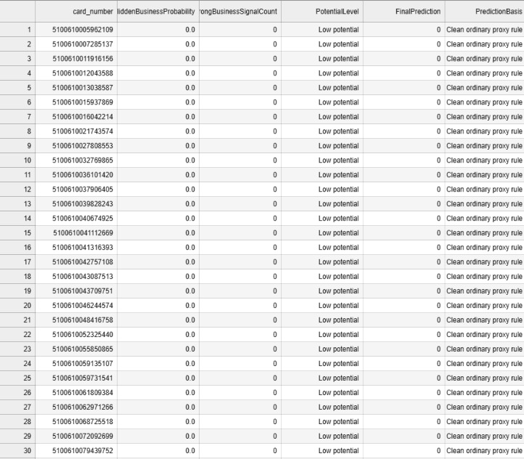
Code : ⁠⁠Final Output
The final csv and parquet files contain one row per consumer card.
The key output column is FinalPrediction, where 0 means ordinary consumer or insufficient hidden-business evidence, and 1 means high-confidence hidden business candidate.
The probability score and potential level are kept as supporting interpretation fields.

Slide 30

Ethical and practical framework for using the model
DO 🙋🏻‍♀️
Use the model for soft targeting
Find customers who are likely to benefit from the business product.
Ranking customers by likelihood
Suggest first to those who are highly confident in running a business.
Offer useful products
Tap on Phone, SBCA for loans, discounts on business services, automated accounting.
Collect feedback
Record who switched to the business card and who declined. Understand why.
Update the model
Add new data and improve the quality of predictions.
DON'T 🙅🏻
Don't use the model for blocking
The model shows the probability, not the fact, of a violation.
Don't accuse a client of illegal activity.
The entrepreneur is not violating anything. They simply don't know a better solution.
Don't consider the score as legal proof.
It's an analytical tool, not evidence.
Don't make automatic negative decisions.
Blocks, freezes, and fines should only be based on human review.
Don't ignore false positives.
If the model is wrong, figure out why. Otherwise, clients will lose trust.

Slide 31

5 Whys: Why Customers Choose Personal Cards Over Business Accounts
Why 1
“Why do entrepreneurs use personal cards instead of business accounts?”
Because for them, a business account is complicated, scary, and inconvenient. But a personal card is familiar, simple, and already on their phone.

Slide 32


Why 2
“Why is a business account so complicated and scary for them?”
Because we, the bank, speak the language of accountants and regulators, and not the language of a hairdresser, taxi driver or manicurist.
They hear:
  "Open a current account"
  "Provide your incorporation documents"
  "Complete Form 328-A"
  "Pay the personal income tax, social security, compulsory pension insurance, and voluntary medical insurance"
They want to hear:
  "Click here and you can accept cards."
  "We'll calculate the taxes ourselves, just take a look."

Slide 33

Why 3
“Why are they afraid of taxes even in places where taxes are low (4-6%)?”
Because 0% is already working. No one blocks anything on their personal card, fines them, or comes. Why should they pay 4-6%? They don't see what they're getting in return.

Slide 34

Why 4
“Why don't clients trust the bank in this matter?”
Anti-fraud and compliance systems are focused on "identifying and punishing," not "explaining and helping." You've created an environment where clients fear you. And now you wonder why they're hiding on their personal cards and not coming to you for a business product.

Slide 35

Why 5
“Why haven't you solved this problem yet, even though you've known about it for years?”
The problem isn't technical or product-related. It's organizational. You don't have ownership of this client. Therefore, no one is willing to develop a proper product, proper communications, or proper service for them. And we, Mastercard, can't sell you our tools because you don't have demand—after all, no one is responsible for this segment.

Slide 36
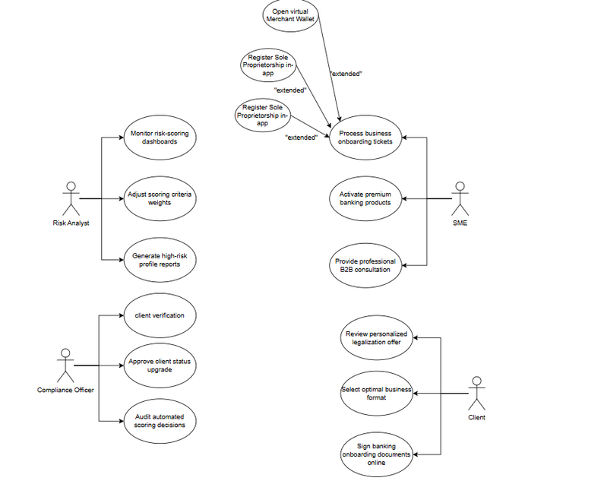
Mastercard: Recommendations for migrating customers from personal cards to the business
Information system for working with hidden businessmen
The key advantage of the proposed system is that it not only detects hidden business activity, but also helps clients transition into the official business sector.
Based on transactional behavior, the system automatically identifies the client’s business type, generates personalized offers, and recommends relevant Mastercard financial solutions.
After detection, clients receive:
legalization recommendations;
access to business products;
support from digital assistants and banking specialists;
simplified onboarding through the mobile banking application.
As a result, the system transforms hidden entrepreneurs from the “grey” economy into users of the Mastercard digital business ecosystem.

Slide 37
Mastercard: Recommendations for migrating customers from personal cards to the business
Online Commerce / Digital Entrepreneur
Clients identified as online commerce entrepreneurs receive a personalized onboarding offer focused on digital payments and e-commerce infrastructure. The system offers:
  Tap on Phone technology for contactless payment acceptance;
  Click to Pay integration for online stores, business cards;
  access to Cashflow Analytics tools for monitoring online sales and customer activity.
IT / Software / Freelance Digital Services
Clients classified as IT specialists or freelancers receive offers centered around digital infrastructure and expense optimization. The system recommends:
  business cards
  Expense Management solutions,
  cybersecurity services,
  cloud spending analytics
  simplified onboarding for professional digital activity.
Subscription-Based Online Business
For subscription-based businesses, the system provides solutions focused on recurring payments and financial flow stability. Clients are offered:
  recurring billing infrastructure
  automated expense management
  virtual business cards
  analytical tools for forecasting cash flow and monitoring subscription performance.
Small Online Seller / Social Commerce
For small online sellers and social commerce businesses, the system generates lightweight onboarding offers focused on fast payment acceptance and business formalization. Clients are offered:
  Tap on Phone
  Click to Pay
  simplified sole proprietorship registration
  access to Mastercard educational programs for small businesses.

Slide 38
Mastercard: Recommendations for migrating customers from personal cards to the business
Digital Services / Online Professional Activity
Clients providing digital or professional online services receive offers focused on financial management and operational optimization. The system provides:
  business cards, online payment acceptance tools,
  Virtual C-Suite services,
  analytics for tracking income and recurring payments.
Small Retail / Mixed Household-Business Trade
For clients combining personal and commercial retail activity, the system offers solutions for separating business and household finances. These include:
  merchant wallets
  small retail acquiring
  Tap on Phone
  business onboarding services
  transaction analytics for retail activity monitoring.
Marketing / Advertising-Related Business
Clients identified as advertising or marketing-related businesses receive offers focused on digital advertising optimization. The system provides:
  premium business cards
  cashback programs for advertising platforms
  Cashflow Analytics
  expense automation tools
  access to corporate B2B tariffs.

Slide 39

Mastercard: Recommendations for migrating customers from personal cards to the business
Mastercard's AI assistant is right in the bank's app
Entrepreneurs press one button, and the AI ​​does everything for them:
  Registers as a sole proprietor using their passport (without a notary visit)
  Explains fees in simple terms (not "1.5% acquiring fee," but "1,500 tenge commission for 100,000 tenge")
  Automatically deducts taxes from turnover and transfers them to the budget
  Keeps track of income and expenses
  Suggests which expenses can be deducted from taxes
  Reminds about reporting deadlines
  Answers questions 24/7 in Kazakh and Russian
An entrepreneur doesn't want to be an accountant. They want to do their own thing: cut hair, drive, teach, bake, repair. AI takes care of all the bureaucracy. People simply press the "Do it for me" button. It's their natural desire to delegate what they don't understand and don't like.

Slide 40

Why AI might work
Free is about money. AI is about the mind. An entrepreneur isn't afraid of a 1,500 tenge commission, but of missing something, forgetting something, or making a mistake. AI takes that fear away. It makes a business product as simple as a personal card. Maybe even simpler. That's conversion.
Mastercard has powerful tools for businesses. But entrepreneurs don't see them — they're hidden behind complex words and fears. AI becomes the bridge. It takes all the complexity upon itself. And leaves the person with only simple, understandable buttons

