Slide 1
React
Unit testing Reactjs with jasmine and karma

Slide 2
React
React is a JavaScript library for creating user interfaces by Facebook and Instagram. Many people choose to think of React as the V in MVC.
We built React to solve one problem: building large applications with data that changes over time. To do this, React uses two main ideas: simple and declarative

Slide 3
JSx
JSX is a JavaScript XML syntax transform recommended for use with React.
React works out of the box without JSX. Simply construct your markup using the functions on React.DOM.
* This snippet should be pasted in the beginning of the jsx file to tell the compiler to process that file:
/**
* @jsx React.DOM
*/

Slide 4
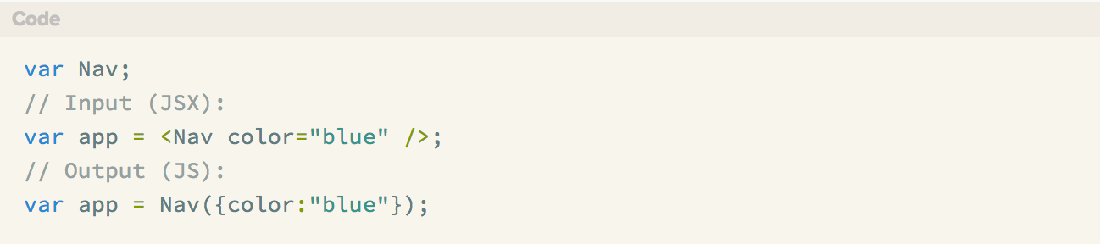
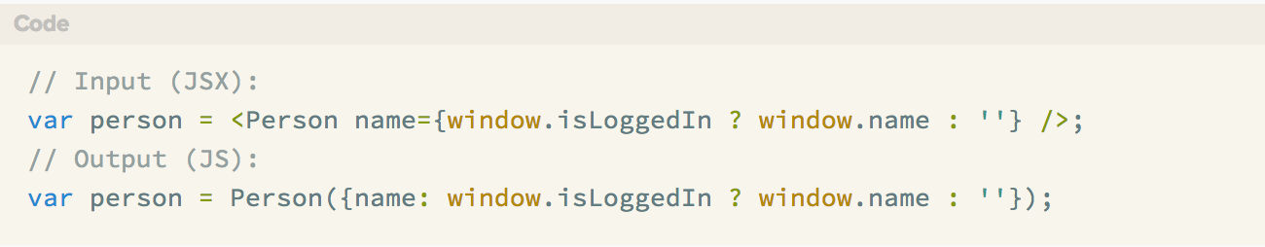
JSx
To use a JavaScript expression as an attribute value, wrap the expression in a pair of curly braces ({})

Slide 5
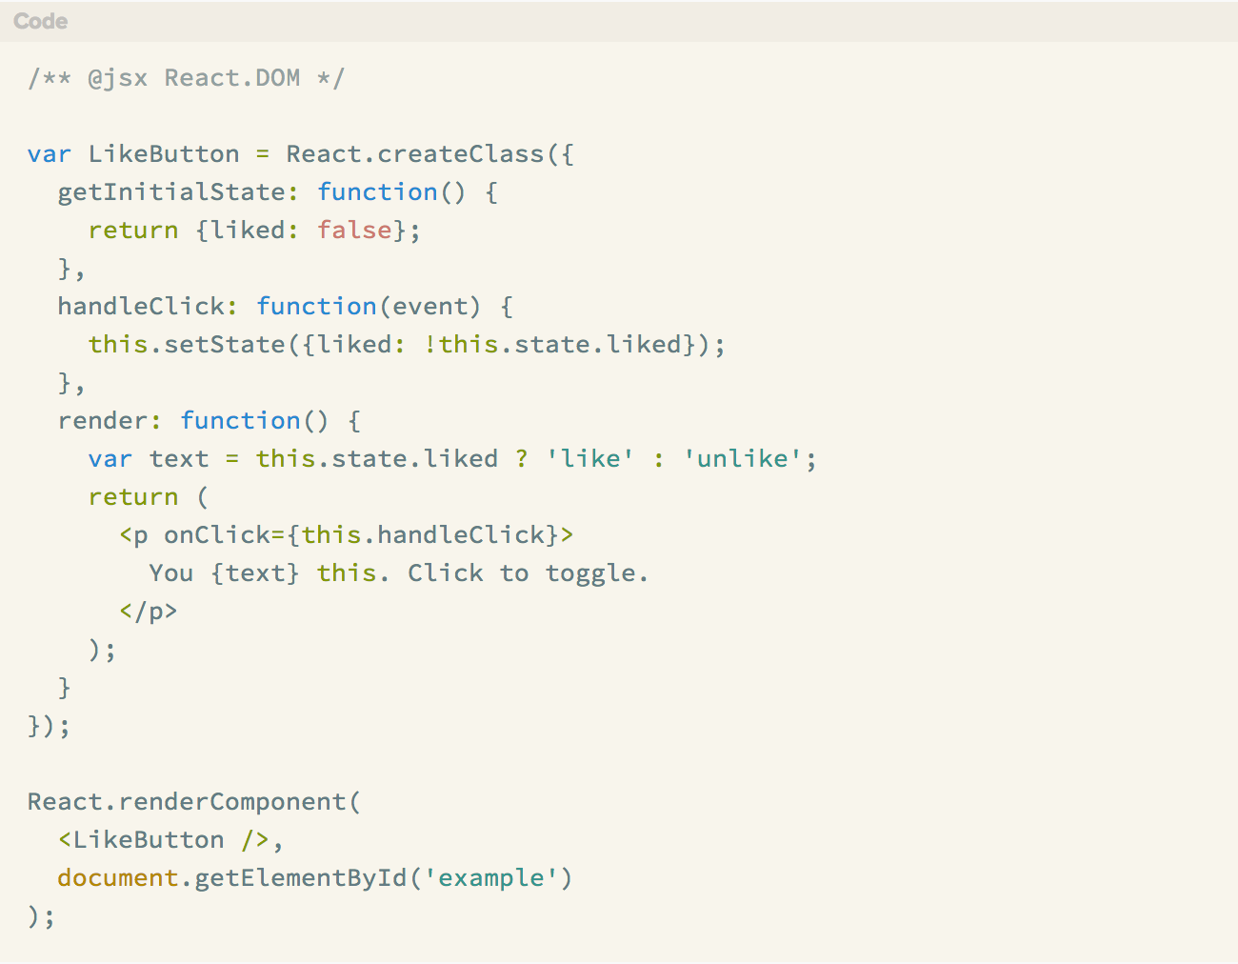
A Simple example

Slide 6
Events
With React you simply pass your event handler as a camelCased prop similar to how you'd do it in normal HTML. React ensures that all events behave identically in IE8 and above by implementing a synthetic event system.
If you'd like to use React on a touch device (i.e. a phone or tablet), simply call React.initializeTouchEvents(true); to turn them on.
Under the Hood: Autobinding and Event Delegation

Slide 7
State
Components are Just State Machines
How State Works
A common way to inform React of a data change is by calling setState(data, callback). This method merges data into this.state and re-renders the component. When the component finishes re-rendering, the optional callback is called. Most of the time you'll never need to provide a callback since React will take care of keeping your UI up-to-date for you.

Slide 8
How to deal with states
Try to keep as many of your components as possible stateless.
State should contain data that a component's event handlers may change to trigger a UI update.
What Shouldn't Go in State?
Computed data;
React components;
Duplicated data from props.

Slide 9
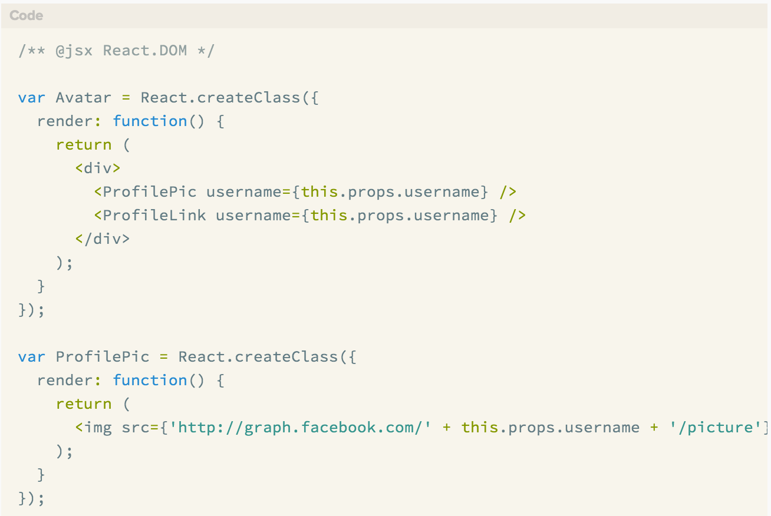
Multiple components

Slide 10
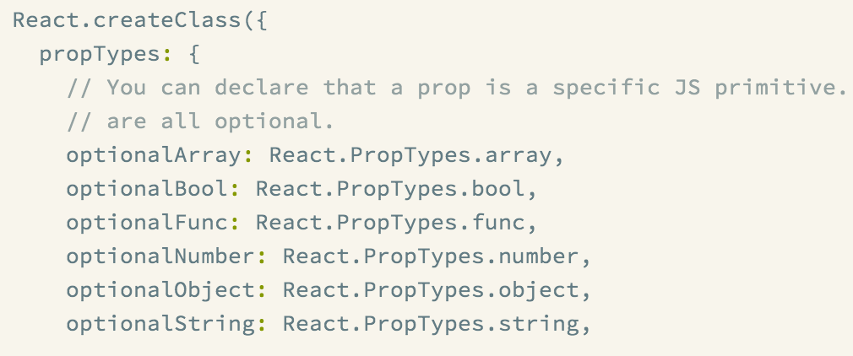
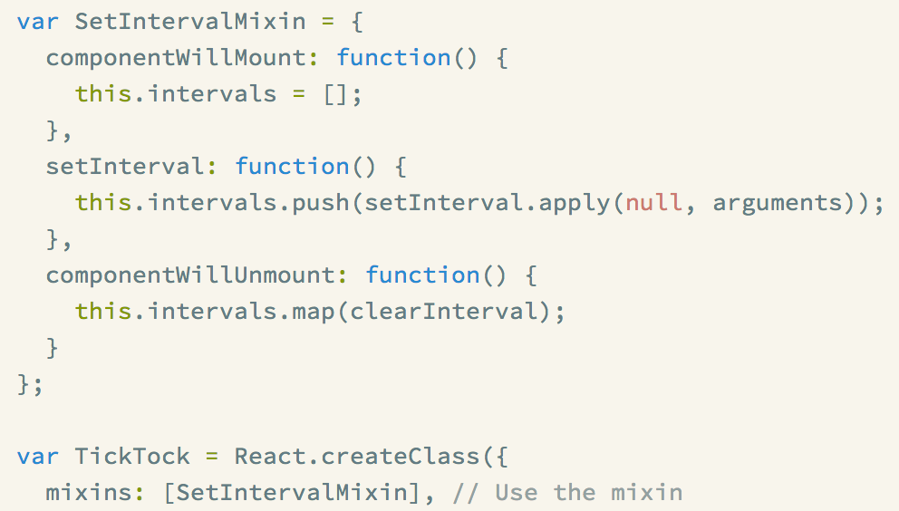
Cool things
Validation
Mixins

Slide 11
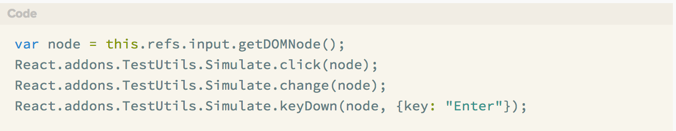
Test utilities add-on
React.addons.TestUtils makes it easy to test React components in the testing framework of your choice (we use Jasmine with jsdom).
Simulate
renderIntoDocument

Slide 12
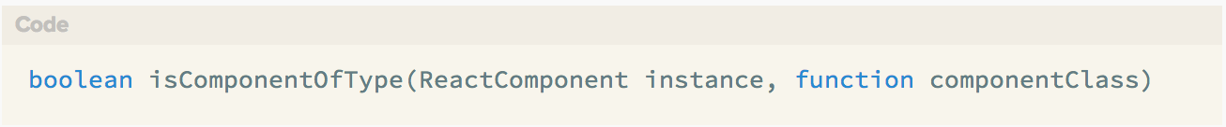
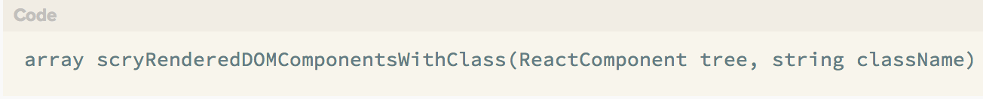
Test utilities add-on
mockComponent
isComponentOfType
isDOMComponent
scryRenderedDOMComponentsWithClass

Slide 13
Test utilities add-on
And time for small live demo

Slide 14
Any questions?

