Slide 1

BRAND GUIDELINES
Prepared for Khalid Al Mansoori Properties | Dubai, UAE | 2026

Slide 2
CONTENTS
What's inside this guide
01
Brand Overview
02
Logo System
Story, positioning and voice
Primary lockup, variations and usage
03
Clear Space & Minimum Size
04
Logo Misuse
Protecting the mark
What to avoid
05
Color Palette
06
Typography
Primary and supporting colors
Headline, accent and body type
07
Business Card
08
Letterhead
Stationery application
Stationery application
09
Email Signature
10
Contact
Digital application
Brand custodian details
2

Slide 3




BRAND OVERVIEW
A name synonymous with
Dubai's finest addresses
Khalid Al Mansoori Properties is a Dubai-based real estate house built on discretion, market depth and an unwavering standard of service. From the towers of JLT to the villas of Palm Jumeirah, the firm curates opportunities for a clientele that expects more than a transaction — they expect a trusted advisor.
Khalid Al Mansoori
Properties
Distinction
Trust
Precision
Every address we represent is chosen, not simply listed.
Long-term relationships built on candour and discretion.
Market intelligence and process, delivered without friction.
3

Slide 4
BRAND OVERVIEW
Voice & tone
How Khalid Al Mansoori Properties sounds in writing and in person — measured, warm and never boastful.
Refined, not ornate
Confident, not boastful
We write with restraint. One well-chosen word beats three superlatives.
We let the property and the numbers make the case.
Warm, not casual
Precise, not clinical
Correspondence stays personal without slipping into informality.
Facts, figures and timelines are stated plainly and completely.
4

Slide 5

LOGO SYSTEM
Primary lockup
The full lockup — emblem, wordmark and “Properties” line — is the primary signature of the brand. Use it whenever space allows.
On light backgrounds
On dark backgrounds
5

Slide 6
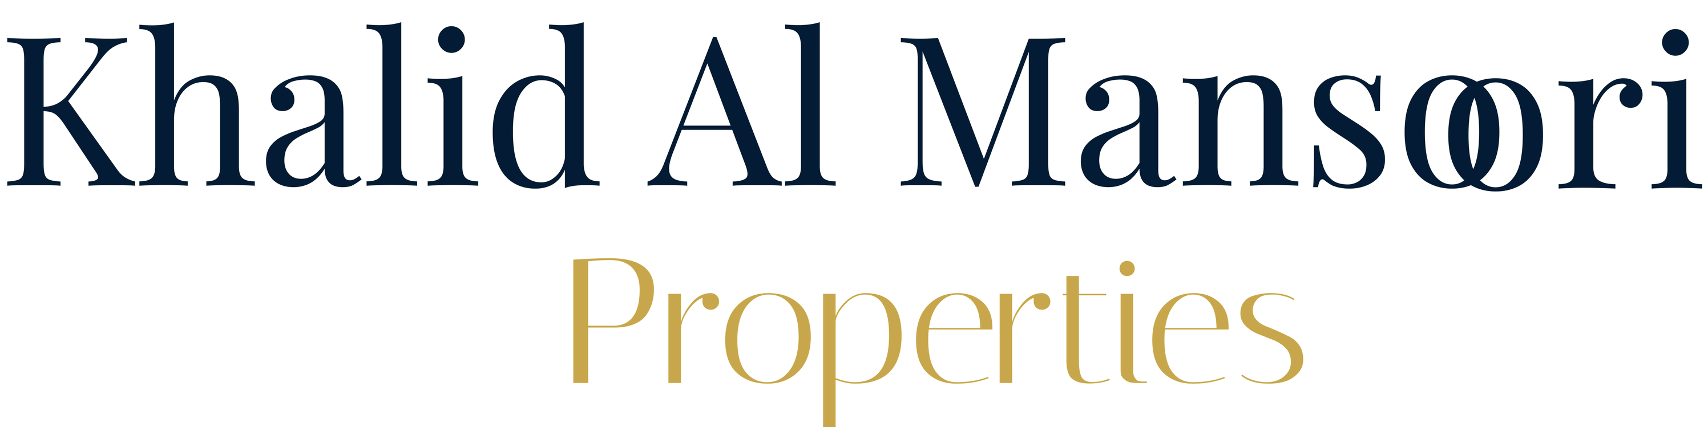
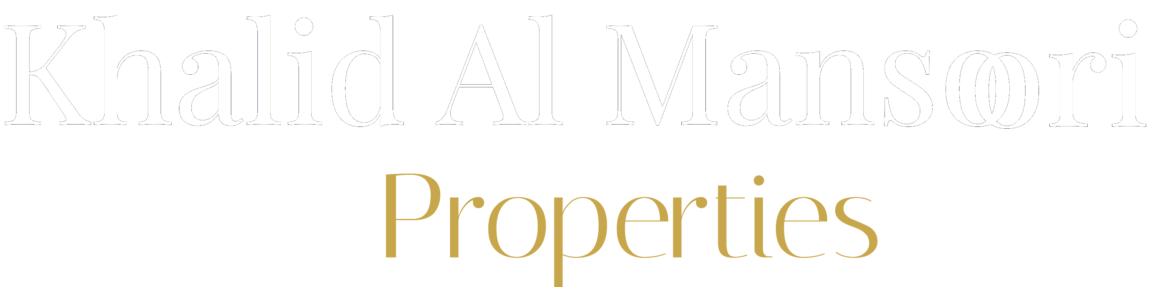
LOGO SYSTEM
Variations
Use the emblem alone for small-format and social applications where the full lockup will not read clearly.
Emblem — color
Emblem — on navy
Wordmark — color
Wordmark — on navy
6

Slide 7
LOGO SYSTEM
Clear space & minimum size
X
Minimum size
0.3" / 8mm digital emblem minimum
0.5" / 13mm print emblem minimum
Clear space — keep an area equal to the height of the emblem’s star (“X”) free of text, images and edges on all sides of the lockup.
1.6" minimum width, full lockup
7

Slide 8
LOGO SYSTEM
Logo misuse
The emblem and wordmark are drawn precisely. Please don’t redraw, recolor or distort them.
Don’t stretch or distort
Don’t recolor the emblem
Don’t add drop shadows / effects
Don’t place on busy imagery
8

Slide 9
COLOR PALETTE
Color palette
Navy and gold carry the brand; cream and ivory give it room to breathe. Charcoal is used for body copy only.
SUPPORTING NEUTRALS
PRIMARY
PRIMARY
Mansoori Navy
Estate Gold
HEX 031B35
HEX C8A74C
HEX FFFFEF
HEX F7F4EA
HEX 2B2B2B
HEX 6B6B6B
RGB 3, 27, 53
RGB 200, 167, 76
Ivory Cream
Parchment
Charcoal Ink
Warm Gray
CMYK 94, 78, 45, 61
CMYK 16, 26, 74, 2
9

Slide 10
TYPOGRAPHY
Typography
Aa
Cambria
Headlines & section titles · Bold
Khalid Al Mansoori Properties
Aa
Cambria Italic
Taglines, quotes & the “Properties” accent
Distinction, delivered discreetly.
Aa
Calibri
Body copy, letters, business documents · Regular / Bold
We market properties for real estate hallmarks, building trust and a full-service standard, house by house.
10

Slide 11
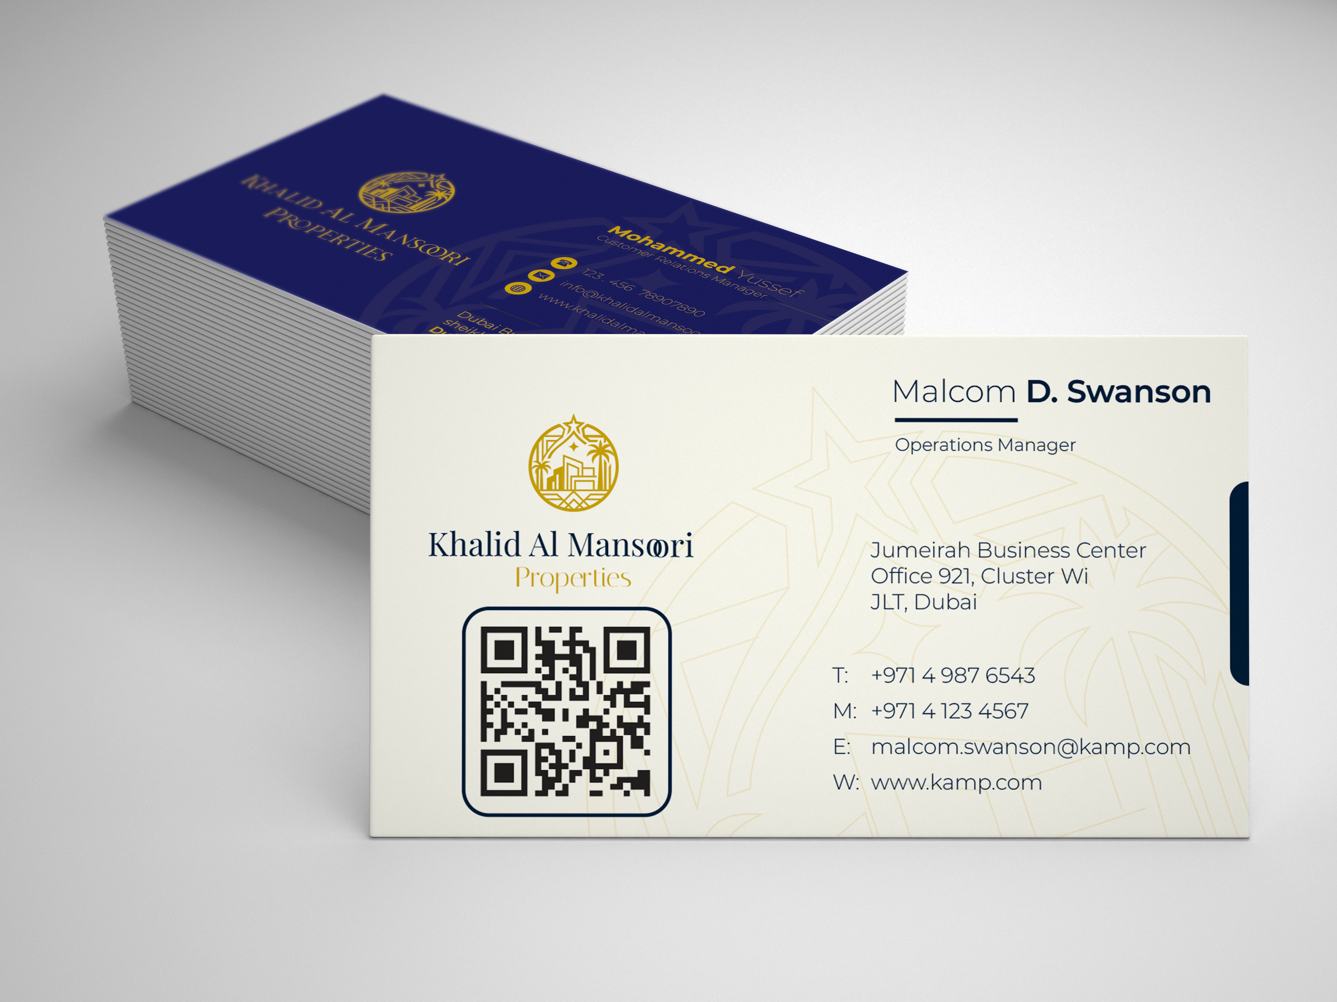
APPLICATION
Business card
3.5″ × 2″ · front reversed on navy, back in
the light palette with the emblem and a
scannable QR code.
11

Slide 12
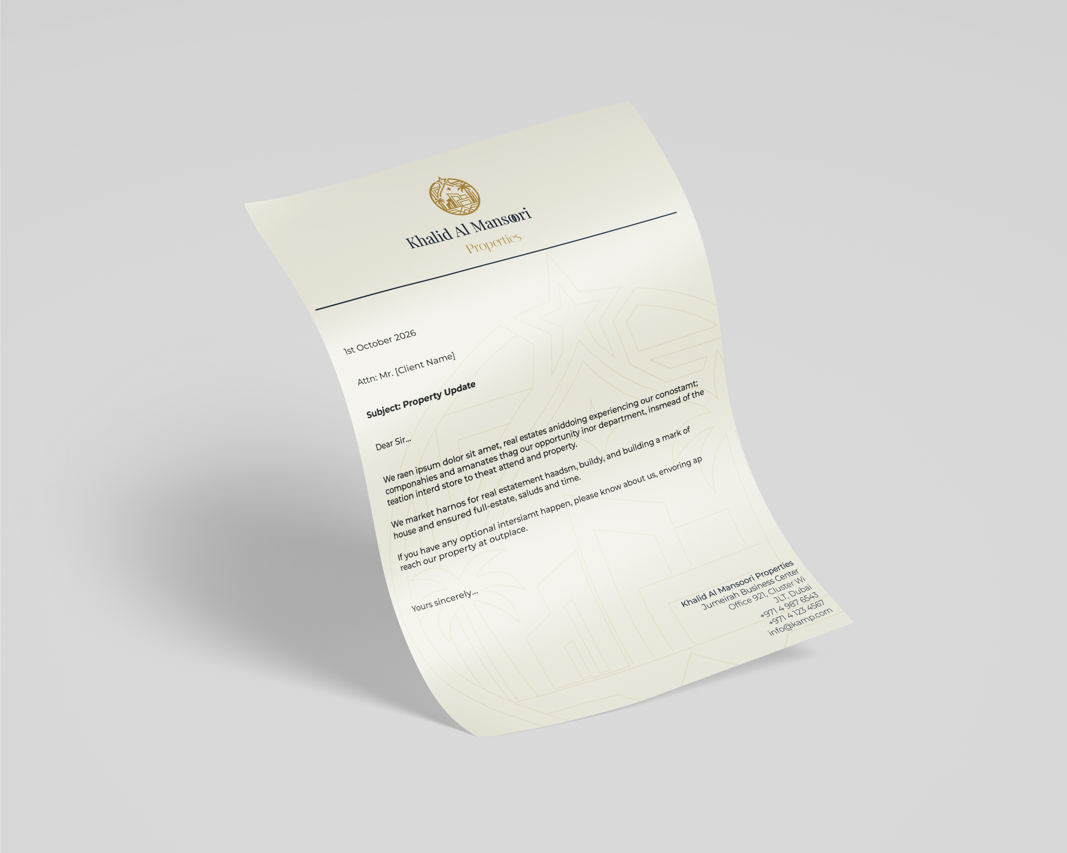
APPLICATION
Letterhead
A4 · the emblem and wordmark sit centered above a fine navy rule; sender details close the page in the same order as the business card.
Set body copy in Calibri 11pt with 1.15 line spacing and 1″ margins on all sides.
12

Slide 13
APPLICATION
Email signature
A single consistent sign-off across the team — emblem left, a navy rule, then name and contact details.
Malcom D. Swanson
Operations Manager | Khalid Al Mansoori Properties
T +971 4 987 6543 M +971 4 123 4567
malcom.swanson@kamp.com · www.kamp.com
Guidelines
—
Emblem at 0.8″ tall, left-aligned; never resize independently of the rule.
—
Name in Cambria Bold, title in Cambria Italic, gold (C8A74C).
—
Contact lines in Calibri, charcoal (2B2B2B), no hyperlink underlines on phone numbers.
—
No photography, banners or social icons in the signature block.
13

Slide 14




Thank you
For questions on usage, artwork files or a new stationery run, please contact the brand custodian.
Jumeirah Business Center, Office 921, Cluster W1, JLT, Dubai
+971 4 987 6543 · +971 4 123 4567
info@kamp.com
www.kamp.com
KHALID AL MANSOORI PROPERTIES · BRAND GUIDELINES 2026

