Slide 1
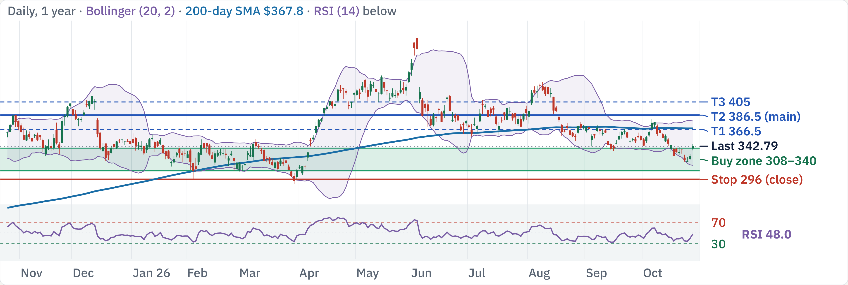
AVGO at $342.79: mixed trend, buy only at support
200-day SMA
RSI (14)
MACD hist
ADX (14)
ATR
$367.8 · Bearish
48 · Neutral
−1.07 · Bearish
25.6 · Trending
3.4% · Medium vol
Mixed trend; buying now is 0.9:1 to $386.5. Wait for $308–340.
Est. win rate to $386.5 (3–6 mo)
65–75% · clears your 60% goal
AVGO technical review · Daily, 1 year · Source: Yahoo Finance, TradingView, Oct 27, 2026 close · 1 / 5

Slide 2
Factors: elite AI growth, but the chart is stuck
Factor
Reading
Verdict
Momentum
1m −1.9%, 3m −7.4%, 6m −14%, 12m −3.2%
Headwind
Growth
FQ3 revenue +86%, AI chips +221% YoY; FQ4 AI guide +236%
Tailwind
Value
P/E 43.7 trailing, 19.7 forward; EV/EBITDA 31.9
Neutral
Quality
Op. margin 48.8%, ROIC 30.7%, FCF $39.4B (44% margin)
Tailwind
Leverage
Net debt $35.4B (debt 59.4B, cash 24.0B); D/E 0.60
Neutral
Beta
1.48 (5Y); realized vol 60d 39%, 20d 42%
Headwind
Capital return
Dividend 0.76%; buyback yield −1.0% (net share issuance)
Neutral
Crowding
Short interest 1.15% of float, 2.0 days to cover
Neutral
Analysts
30 analysts: 97% Buy; avg target $524 (range 400–630)
Tailwind
Size
$1.64T market cap; ~21.2M shares (~$7.3B) a day
Neutral
AI growth and margins are elite; a 29% drawdown and customer concentration cap it.
Sources: Yahoo Finance; stockanalysis.com (Oct 27); Futu (Oct 27); Broadcom FQ3 results via news summaries · 2 / 5

Slide 3
Buy support in 3 tranches; stop at $296
Buy ladder: 3 × 33%, limit VWAP
Resistance
Note
$366.5
T1: 200d SMA
Tranche
Limit
Zone
Why it holds
$357
50d SMA · 2× pivot
1
$340
$337.5–342.5
swing pivot
$350
swing pivot
2
$330
$327–332.5
2× pivot
$343
2× pivot
3
$308
$305.5–310.5
2× pivot
Exit and risk
Support
Note
$340
swing pivot
Level
Price
Role
R:R, 1 → 3 fills
$336
swing pivot
Stop
$296
Daily close below support
Risk $44 → 30
$330
2× pivot
T1
$366.5
Partial · 200d SMA
0.6 → 1.4
$321.5
swing pivot
T2
$386.5
Main · swing pivot
1.1 → 2.0
$296
Stop level
T3
$405
Stretch · swing pivot
1.5 → 2.6
Average cost: $340 with 1 fill, $326 with all 3. R:R is measured to the $296 stop.
AVGO technical review · Levels from daily chart, Oct 27, 2026 close · 3 / 5

Slide 4
Next 3 months: macro and company catalysts
Macro
Company-specific
FOMC: Oct 28 hold, Dec 9 hike priced
Fiscal Q4 results ~Dec 10 (est.)
Rate 3.75–4.00%; ~90% hold Oct, ~80% Dec hike odds
Guide: AI rev $21.7B, total ~$34.8B (below $35.0B est.)
Data: CPI and jobs
AI revenue ramp
CPI Nov 10, Dec 10 · Jobs Nov 6, Dec 4 · PCE Nov 25
FY26 AI rev ~$58B; FY27 ~$115B, FY28 ~$230B targets
US midterm elections
Gross margin dilution
Nov 3 · Nov up in 21 of 24 midterm years (one source)
~73% expected in FQ4 vs 78% a year ago (custom chips)
US–China trade truce
Customer financing
Runs to Jan 10, 2027; chip export curbs unchanged
Report: >$50B being arranged for the OpenAI chip (WSJ)
AI capex and chip policy
Analyst view
Hyperscaler capex; US chip curbs on China unchanged
Truist cut target $550→$520, kept Buy; Futu avg $524
Sources: Fed calendar; fedratecalc.com; CNBC; Broadcom results via Reuters/LSEG summaries · 4 / 5

Slide 5
Execution risks and how to trade around them
Macro and the Fed
Earnings gap
AI customer concentration
Fed funds 3.75–4.00%; a Dec 9 hike is
Next print Dec 10 (per stockanalysis.com).
Hitting FY28 targets needs the two largest
largely priced. CPI 3.7%, jobs +29k.
FQ3 beat, but the stock fell on a soft guide.
customers to keep raising capital.
Do: Stage fills around Nov 3 and Dec 9; no
Do: No new tranche within 3 days of the
Do: Keep size modest; watch OpenAI and
all-in entry.
print.
Google financing news.
Margin dilution
Drawdown and trend
Ladder rules
Memory in custom chips cuts gross margin
Price is 29% below its high with a mixed
3 × 33%, limit VWAP capped at 340 / 330
to ~73% from 78%.
trend (ADX 25.6).
/ 308
Do: Treat margin guidance as the key
Do: Buy only at the ladder limits; respect
Next tranche only after the last one fills
number at the next print.
the stop.
and holds
Exit all on a daily close below $296
Partial at 366.5, main exit 386.5, runner
to 405
Sources: Bloomberg; CNBC; company filings; stockanalysis.com, Oct 27, 2026 · 5 / 5

Slide 6
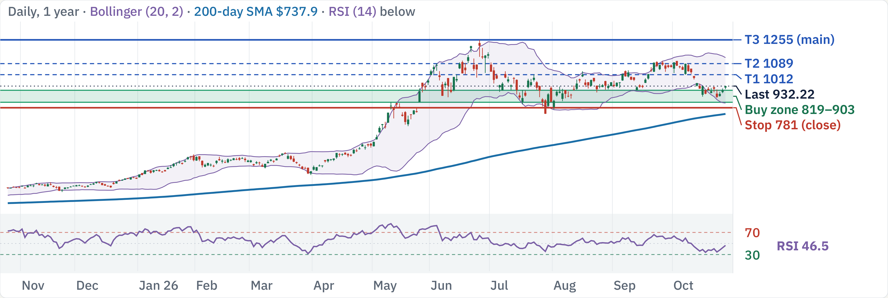
MU at $932.22: uptrend, entry clears 2:1
200-day SMA
RSI (14)
MACD hist
ADX (14)
ATR
$737.9 · Bullish
47 · Neutral
−7.83 · Bearish
29.5 · Trending
4.9% · Medium vol
Uptrend; buying now is 2.1:1 to $1255. Clears your bar.
Est. win rate to $1255 (3–6 mo)
71–81% · clears your 60% goal
MU technical review · Daily, 1 year · Source: Yahoo Finance, TradingView, Oct 27, 2026 close · 1 / 5

Slide 7
Factors: peak-cycle margins, huge growth, 2.2 beta
Factor
Reading
Verdict
Momentum
1m −12%, 3m +26%, 6m +85%, 12m +326%
Tailwind
Growth
FQ4 revenue $54.2B vs $11.3B a year ago; FQ1 guide $61.5B
Tailwind
Value
P/E 12.5 trailing, 5.3 forward; EV/EBITDA 8.9
Tailwind
Quality
Gross margin 80.7%, op. margin 74.6%, FCF $59.0B (44%)
Tailwind
Leverage
Cash $43.4B vs debt $5.2B; D/E 0.04
Tailwind
Beta
2.23 (5Y); realized vol 60d 53%, 20d 53%
Headwind
Capital return
Dividend 0.06%; buyback yield −1.6%; return to rise Dec 9
Neutral
Crowding
Short interest 2.31% of float, 1.0 day to cover
Neutral
Analysts
27 analysts: 96% Buy; avg target $1,626 (range 1,200–3,000)
Tailwind
Size
$1.05T market cap; ~26.5M shares (~$25B) a day
Neutral
Record margins and cash versus a cyclical peak and a 2.2 beta; scale in.
Sources: Yahoo Finance; stockanalysis.com (Oct 27); Futu (Oct 22); Micron FQ4 results via CNBC · 2 / 5

Slide 8
Buy support in 3 tranches; stop at $781
Buy ladder: 3 × 33%, limit VWAP
Resistance
Note
$1089
T2: swing pivot
Tranche
Limit
Zone
Why it holds
$1039
2× pivot
1
$903
$895–910
swing pivot
$1012
T1: swing pivot
2
$854
$848–861
swing pivot
$991
50d SMA · swing pivot
3
$819
$812–825
BB lower · swing pivot
Exit and risk
Support
Note
$903
swing pivot
Level
Price
Role
R:R, 1 → 3 fills
$890
2× pivot
Stop
$781
Daily close below support
Risk $122 → 77.67
$854
swing pivot
T1
$1012
Partial · swing pivot
0.9 → 2.0
$819
BB lower · swing pivot
T2
$1089
Stretch · swing pivot
1.5 → 3.0
$781
Stop level
T3
$1255
Main · 52w high
2.9 → 5.1
Average cost: $903 with 1 fill, $858.67 with all 3. R:R is measured to the $781 stop.
MU technical review · Levels from daily chart, Oct 27, 2026 close · 3 / 5

Slide 9
Next 3 months: macro and company catalysts
Macro
Company-specific
FOMC: Oct 28 hold, Dec 9 hike priced
FQ1 results ~Dec 16 (est.)
Rate 3.75–4.00%; ~90% hold Oct, ~80% Dec hike odds
Guide: revenue ~$61.5B, EPS ~$38.15, margin ~86%
Data: CPI and jobs
Memory pricing (DRAM, HBM)
CPI Nov 10, Dec 10 · Jobs Nov 6, Dec 4 · PCE Nov 25
Spot DRAM at records; HBM to outgrow DRAM through 2028
US midterm elections
Supply committed
Nov 3 · Nov up in 21 of 24 midterm years (one source)
>75% of FY27 output already committed; 2028 talks open
US–China trade truce
Capital return
Runs to Jan 10, 2027; chip export curbs unchanged
Return to rise from Dec 9 (buyback size: verify)
AI capex and chip policy
SK hynix results
Hyperscaler capex; US chip export curbs unchanged
Peer print due late Oct; a beat can support pricing view
Taiwan union talks
Labour talks flagged as a supply risk (one report)
Sources: Fed calendar; fedratecalc.com; CNBC; Micron FQ4 release via news summaries · 4 / 5

Slide 10
Execution risks and how to trade around them
Macro and the Fed
Earnings gap
Cycle reversal
Fed funds 3.75–4.00%; a Dec 9 hike is
Next print Dec 16 (per stockanalysis.com).
Margins of 80%+ are price-driven (one
largely priced. CPI 3.7%, jobs +29k.
FQ4 beat; the stock eased on capex worries.
analysis); a DRAM price turn hits earnings
Do: Stage fills around Nov 3 and Dec 9; no
Do: No new tranche within 3 days of the
fast.
all-in entry.
print.
Do: Size small; the stock fell 6%+ on Oct
22 alone.
Liquidity and volatility
Taiwan and supply
Ladder rules
~26M shares (~$25B) a day; realized vol is
Union talks in Taiwan and helium supply
3 × 33%, limit VWAP capped at 903 / 854
high and beta is 2.2.
were flagged as supply risks.
/ 819
Do: Limit VWAP at 5–10% of volume; one
Do: Check headlines before each tranche.
Next tranche only after the last one fills
tranche per day.
and holds
Exit all on a daily close below $781
Partial at 1012, main exit 1255, runner
to 1255
Sources: Bloomberg; CNBC; company filings; stockanalysis.com, Oct 27, 2026 · 5 / 5

Slide 11
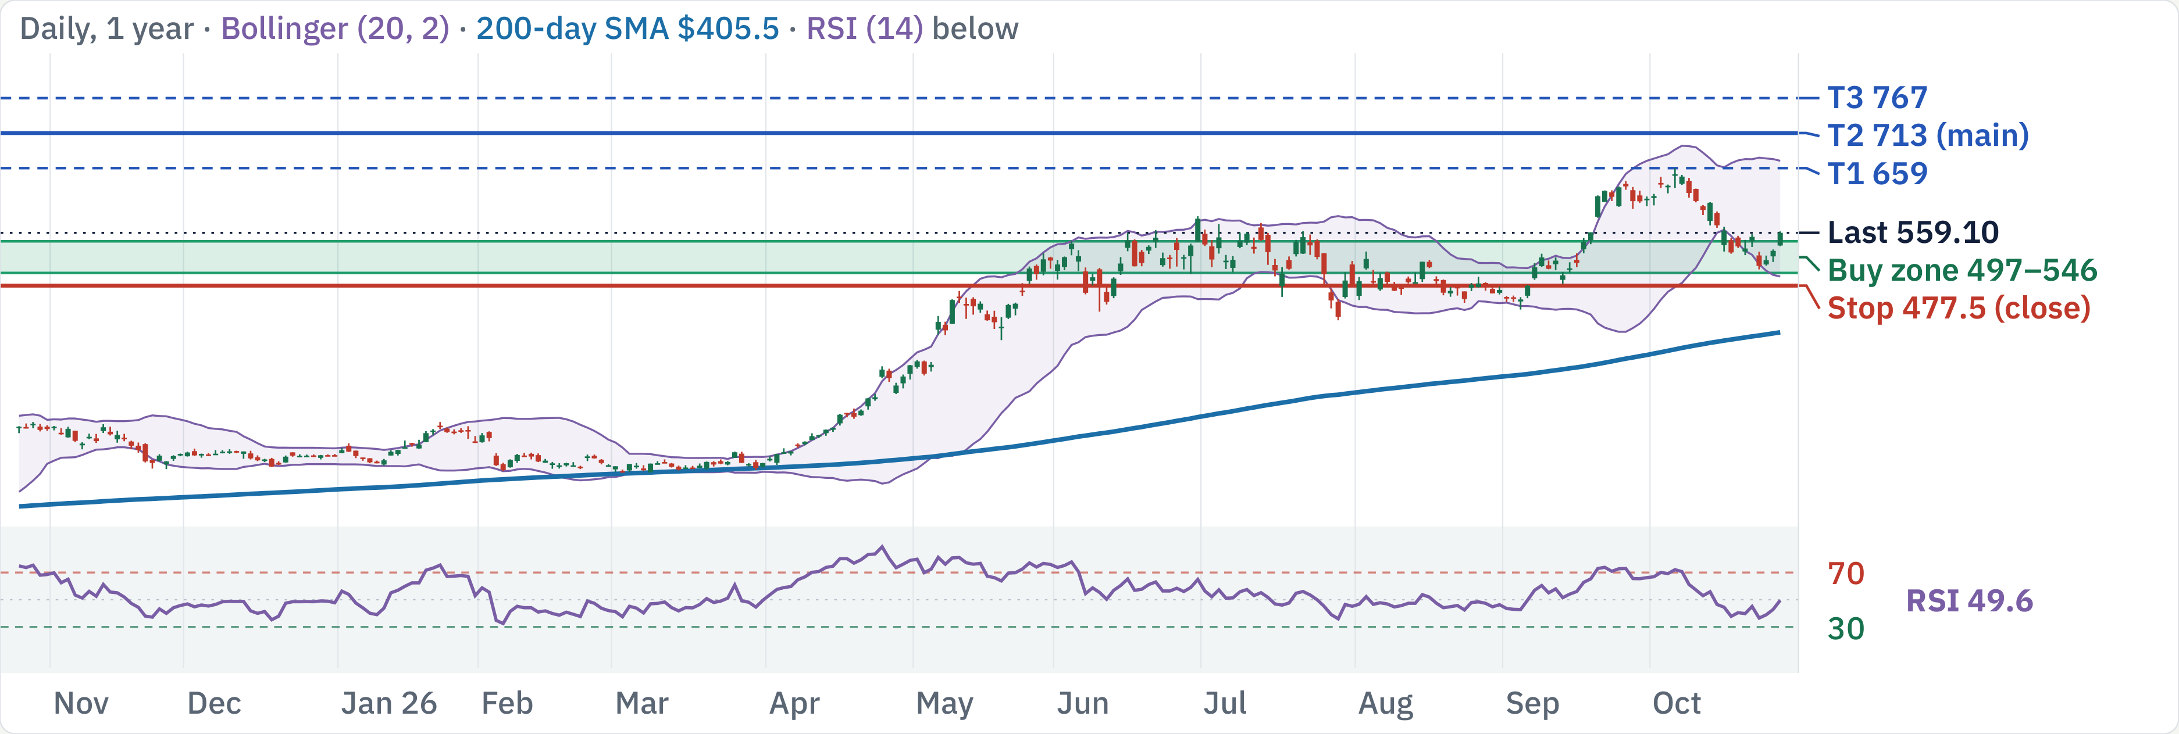
AMD at $559.1: earnings Nov 3 first, then buy dips
200-day SMA
RSI (14)
MACD hist
ADX (14)
ATR
$405.5 · Bullish
50 · Neutral
−8.39 · Bearish
22.7 · Emerging
4.8% · Medium vol
Uptrend; Nov 3 earnings first. Then ladder $497–546; buying now is 1.9:1 to $713.
Est. win rate to $713 (3–6 mo)
68–78% · clears your 60% goal
AMD technical review · Daily, 1 year · Source: Yahoo Finance, TradingView, Oct 27, 2026 close · 1 / 5

Slide 12
Factors: big AI order book, rich valuation, 2.5 beta
Factor
Reading
Verdict
Momentum
1m −8.0%, 3m +30%, 6m +73%, 12m +121%
Tailwind
Growth
Q3 guide ~$13.0B (+41% YoY); server revenue +80% in H2
Tailwind
Value
P/E 143 trailing, 50.3 forward; EV/EBITDA 89.8
Headwind
Quality
Gross margin 55.7%, op. margin 15.8%, FCF $8.4B (20%)
Neutral
Leverage
Net cash $8.8B (cash 13.1B, debt 4.3B); D/E 0.06
Tailwind
Beta
2.45 (5Y); realized vol 60d 57%, 20d 56%
Headwind
Capital return
No dividend; buyback yield −1.1% (net issuance)
Neutral
Crowding
Short interest 2.42% of float, 1.8 days to cover
Neutral
Analysts
34 analysts: 85% Buy; avg target $670 (range 540–1,250)
Tailwind
Size
$912B market cap; ~19.0M shares (~$11B) a day
Neutral
MI450 and OpenAI demand are real; a 50× forward P/E and beta 2.5 leave little room.
Sources: Yahoo Finance; stockanalysis.com (Oct 27); Futu (Oct 27); AMD guidance via Yahoo/Wedbush previews · 2 / 5

Slide 13
Wait for the Nov 3 print, then ladder in; stop $477.5
Buy ladder: 2 × 50%, limit VWAP
Resistance
Note
$659
T1: 52w high
Tranche
Limit
Zone
Why it holds
$585
swing pivot
1
$546
$542–551
50d SMA · swing pivot
$574
swing pivot
2
$497
$493–501
BB lower · 2× pivot
$562
2× pivot
Exit and risk
Support
Note
Level
Price
Role
R:R, 1 → 2 fills
$546
50d SMA · swing pivot
Stop
$477.5
Daily close below support
Risk $68.5 → 44
$530
swing pivot
T1
$659
Partial · 52w high
1.6 → 3.1
$517
swing pivot
T2
$713
Main · ATR projection
2.4 → 4.4
$497
BB lower · 2× pivot
T3
$767
Stretch · ATR projection
3.2 → 5.6
$477.5
Stop level
Average cost: $546 with 1 fill, $521.5 with all 2. R:R is measured to the $477.5 stop.
AMD technical review · Levels from daily chart, Oct 27, 2026 close · 3 / 5

Slide 14
Next 3 months: macro and company catalysts
Macro
Company-specific
FOMC: Oct 28 hold, Dec 9 hike priced
Q3 results Nov 3, after the close
Rate 3.75–4.00%; ~90% hold Oct, ~80% Dec hike odds
Guide ~$13.0B ±$0.3B, GM ~56%; consensus EPS ~$1.94
Data: CPI and jobs
MI450 / Helios ramp
CPI Nov 10, Dec 10 · Jobs Nov 6, Dec 4 · PCE Nov 25
Helios rack due late Q3; first OpenAI GW in H2 2026
US midterm elections
Customer commitments
Nov 3 · Nov up in 21 of 24 midterm years (one source)
OpenAI 6 GW, Anthropic up to 2 GW (from H1 2027)
US–China trade truce
2027 outlook
Runs to Jan 10, 2027; chip export curbs unchanged
Data-center revenue to more than double in 2027 (mgmt)
AI capex and chip policy
Server CPU demand
Hyperscaler capex; US chip export curbs unchanged
Server revenue +80% in H2 (mgmt); Wedbush sees upside
Inventory
$8.5B in Q2 to support the ramp; watch the Q3 build
Sources: Fed calendar; fedratecalc.com; CNBC; Yahoo Finance; Wedbush; Hudson Labs · 4 / 5

Slide 15
Execution risks and how to trade around them
Macro and the Fed
Earnings gap
AI trade sentiment
Fed funds 3.75–4.00%; a Dec 9 hike is
Reports Nov 3, after the close. A gap can
Coverage flags credit stress and an
largely priced. CPI 3.7%, jobs +29k.
jump the stop; the Q3 guide is ~$13.0B
Anthropic IPO filing rattling AI names.
Do: Stage fills around Nov 3 and Dec 9; no
revenue (+41% YoY).
Do: Stage fills; pause if the AI group breaks
all-in entry.
Do: Wait for the print; recheck levels. No
down.
fills before it.
Execution
Valuation and beta
Ladder rules
Helios timing and the OpenAI warrant
50× forward P/E and beta 2.45 mean large
2 × 50%, limit VWAP capped at 546 / 497
structure (160M-share warrant) are watch
swings either way.
Wait for the Nov 3 print before any fill
items.
Do: Size small; the stop is structural, not
Exit all on a daily close below $477.5
Do: Re-read the levels after the Nov 3 call.
tight.
Partial at 659, main exit 713, runner to
767
Sources: Bloomberg; CNBC; company filings; stockanalysis.com, Oct 27, 2026 · 5 / 5

Slide 16
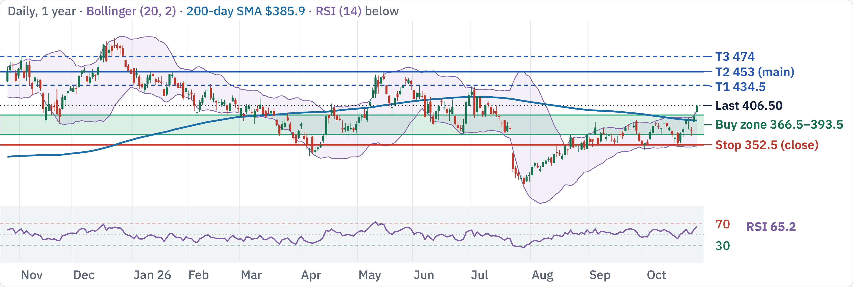
TSLA at $406.54: mixed trend, buy only at support
200-day SMA
RSI (14)
MACD hist
ADX (14)
ATR
$385.9 · Bullish
65 · Strong
+2.53 · Bullish
13.5 · No trend
3.4% · Medium vol
Mixed trend; buying now is 0.9:1 to $453. Wait for $366.5–393.5.
Est. win rate to $453 (3–6 mo)
40–50% · below your 60% goal
TSLA technical review · Daily, 1 year · Source: Yahoo Finance, TradingView, Oct 27, 2026 close · 1 / 5

Slide 17
Factors: net cash, but priced for a robotaxi future
Factor
Reading
Verdict
Momentum
1m +14%, 3m +36%, 6m +8.1%, 12m −6.3%
Mixed
Growth
Q3 revenue $28.1B flat YoY; GAAP op. income −56%
Headwind
Value
P/E 446 trailing, 190 forward; P/S 15.0
Headwind
Quality
Gross margin 19.3%, op. margin 3.0%, FCF $3.3B (3.2%)
Headwind
Leverage
Net cash $29.0B (cash 45.5B, debt 16.5B); D/E 0.18
Tailwind
Beta
1.92 (5Y); realized vol 60d 40%, 20d 38%
Headwind
Capital return
No dividend; buyback yield −0.5%; 2026 capex cut to ~$20B
Neutral
Crowding
Short interest 2.51% of float, 1.8 days to cover
Neutral
Analysts
22 analysts: 59% Buy, 36% Hold; avg target $439 (230–550)
Mixed
Size
$1.61T market cap; ~36.8M shares (~$15B) a day
Neutral
Net cash and auto margin recovery versus 190× forward P/E; the AI payoff is unproven.
Sources: Yahoo Finance; stockanalysis.com (Oct 27); Futu (Oct 27); Tesla Q3 results via CNBC/Investing.com · 2 / 5

Slide 18
Buy support in 3 tranches; stop at $352.5
Buy ladder: 3 × 33%, limit VWAP
Resistance
Note
$434.5
T1: 2× pivot
Tranche
Limit
Zone
Why it holds
$424.5
swing pivot
1
$393.5
$390.5–397
swing pivot
$417.5
swing pivot
2
$381.5
$378.5–384.5
200d SMA · 3× pivot
$409.5
swing pivot
3
$366.5
$363.5–369
50d SMA · 2× pivot
Exit and risk
Support
Note
$393.5
swing pivot
Level
Price
Role
R:R, 1 → 3 fills
$387.5
200d SMA · swing pivot
Stop
$352.5
Daily close below support
Risk $41 → 28
$381.5
200d SMA · 3× pivot
T1
$434.5
Partial · 2× pivot
1.0 → 1.9
$366.5
50d SMA · swing pivot
T2
$453
Main · 2× pivot
1.5 → 2.6
$352.5
Stop level
T3
$474
Stretch · swing pivot
2.0 → 3.3
Average cost: $393.5 with 1 fill, $380.5 with all 3. R:R is measured to the $352.5 stop.
TSLA technical review · Levels from daily chart, Oct 27, 2026 close · 3 / 5

Slide 19
Next 3 months: macro and company catalysts
Macro
Company-specific
FOMC: Oct 28 hold, Dec 9 hike priced
Q3 reported Oct 21
Rate 3.75–4.00%; ~90% hold Oct, ~80% Dec hike odds
Adj. EPS $0.48 vs ~$0.43–0.46 est.; revenue $28.05B
Data: CPI and jobs
Auto margin recovery
CPI Nov 10, Dec 10 · Jobs Nov 6, Dec 4 · PCE Nov 25
Auto GM ex-credits 18.1% vs 16.3% in Q2; energy GM 33.1%
US midterm elections
Capex and AI spend
Nov 3 · Nov up in 21 of 24 midterm years (one source)
2026 capex cut to ~$20B (from >$25B); R&D +69%
US–China trade truce
Robotaxi and Cybercab
Runs to Jan 10, 2027; chip export curbs unchanged
Austin Cybercab rides since Sep 3; units by year-end
Q3 earnings season
Demand
S&P 500 Q3 EPS growth ~+26% est. (FactSet)
Q3 deliveries 486,532; biggest backlog in 4 years
Next earnings
Late Jan 2027 (est.; not announced)
Sources: Fed calendar; fedratecalc.com; CNBC; Tesla Q3 release via Investing.com and CNBC · 4 / 5

Slide 20
Execution risks and how to trade around them
Macro and the Fed
Valuation vs execution
Regulatory approvals
Fed funds 3.75–4.00%; a Dec 9 hike is
Market cap $1.6T on a 3% operating margin;
FSD and robotaxi approvals are uncertain
largely priced. CPI 3.7%, jobs +29k.
analyst targets run $230–$550.
and vary by region.
Do: Stage fills around Nov 3 and Dec 9; no
Do: Buy only the ladder limits; the stop is
Do: Watch regulatory headlines; size small.
all-in entry.
structural.
Spending ramp
No clear trend
Ladder rules
JPMorgan expects spending to keep rising
ADX 13.5 means no trend; the stock is mid-
3 × 33%, limit VWAP capped at 393.5 /
into 2027–28 (robotaxi, Optimus, compute).
range after the earnings slide.
381.5 / 366.5
Do: Track capex and free cash flow at the
Do: Wait for a dip to support; avoid
Next tranche only after the last one fills
next print.
chasing.
and holds
Exit all on a daily close below $352.5
Partial at 434.5, main exit 453, runner to
474
Sources: Bloomberg; CNBC; company filings; stockanalysis.com, Oct 27, 2026 · 5 / 5

Slide 21
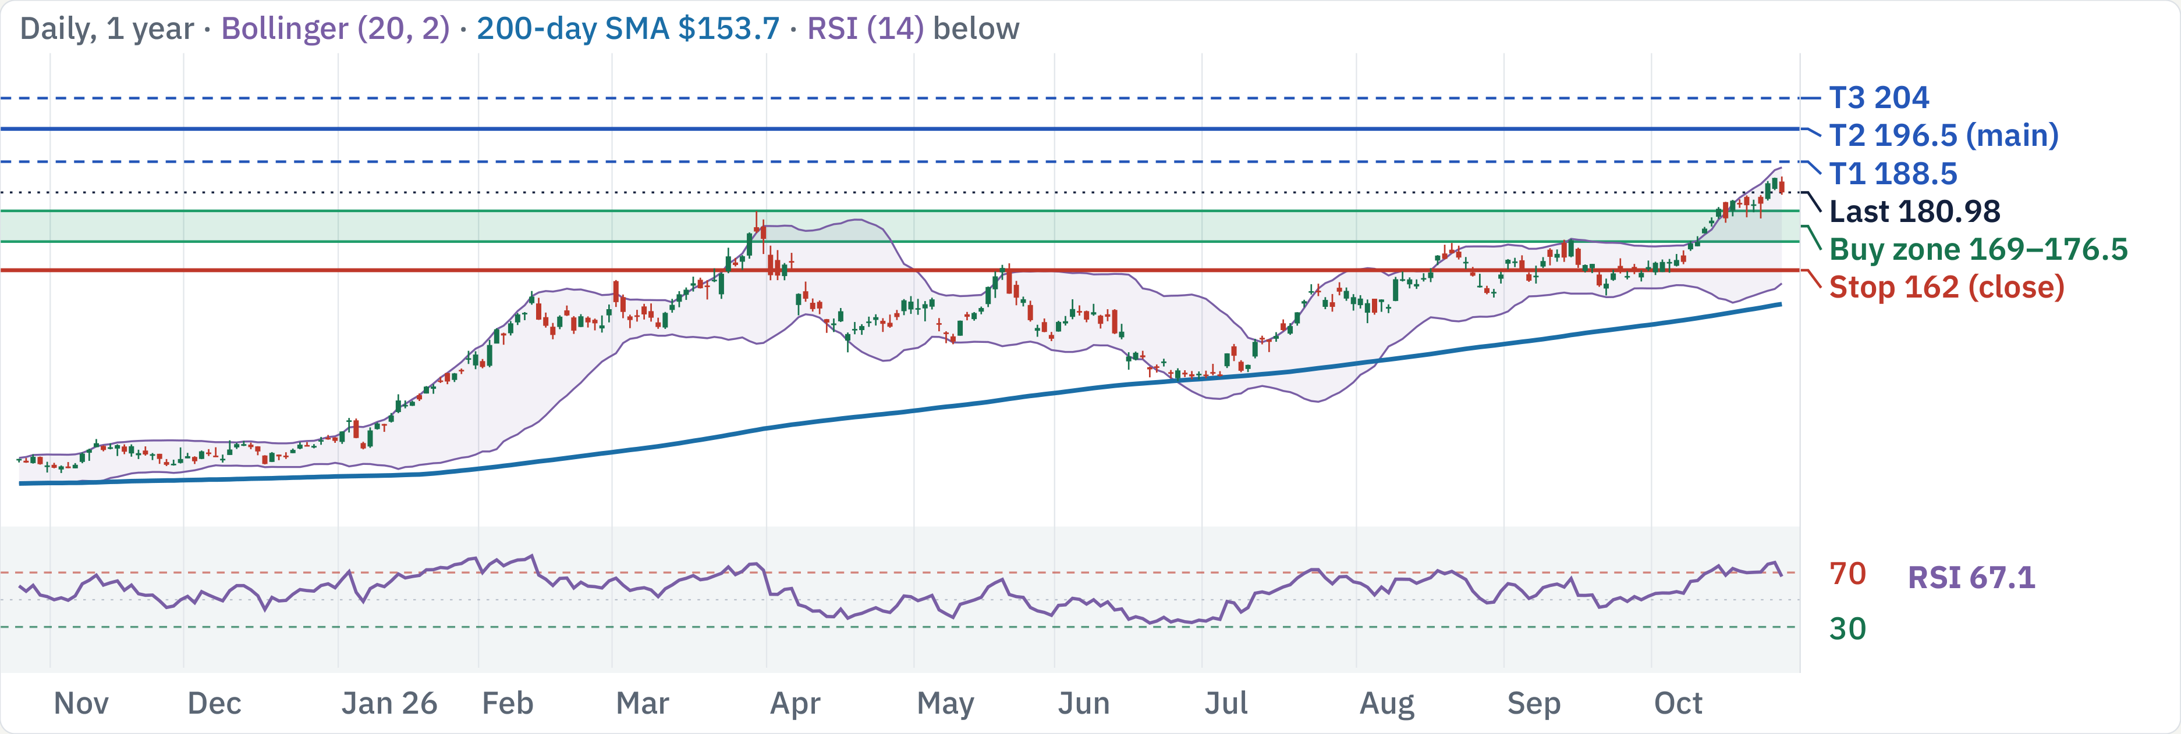
XOM at $180.98: earnings Oct 30 first, then buy dips
200-day SMA
RSI (14)
MACD hist
ADX (14)
ATR
$153.7 · Bullish
67 · Strong
+0.78 · Bullish
30.0 · Trending
2.1% · Low vol
Uptrend; Oct 30 earnings first. Then ladder $169–176.5; buying now is 0.8:1 to $196.5.
Est. win rate to $196.5 (3–6 mo)
72–82% · clears your 60% goal
XOM technical review · Daily, 1 year · Source: Yahoo Finance, TradingView, Oct 27, 2026 close · 1 / 5

Slide 22
Factors: cash-rich energy major, priced near consensus
Factor
Reading
Verdict
Momentum
1m +11%, 3m +15%, 6m +20%, 12m +57%
Tailwind
Growth
Q3 EPS est. ~$4.03 vs $1.88 a year ago; refining +$4.5B QoQ
Tailwind
Value
P/E 23.3 trailing, 12.4 forward; EV/EBITDA 11.6
Neutral
Quality
Op. margin 11.2%, ROIC 10.0%, FCF $30.6B (8.5% margin)
Neutral
Leverage
Net debt $31.8B (debt 42.4B, cash 10.6B); D/E 0.16
Tailwind
Beta
0.21 (5Y); realized vol 60d 24%, 20d 20%
Tailwind
Capital return
Dividend 2.3% + buyback 3.9%; $20B buybacks planned 2026
Tailwind
Crowding
Short interest 0.96% of float, 2.8 days to cover
Neutral
Analysts
15 analysts: 47% Buy, 53% Hold; avg target $180 vs price $180
Neutral
Size
$743B market cap; ~11.2M shares (~$2.0B) a day
Neutral
Cash returns and a refining windfall support it; no analyst upside and oil risk cap it.
Sources: Yahoo Finance; stockanalysis.com (Oct 27); Futu (Oct 27); company guidance · 2 / 5

Slide 23
Wait for the Oct 30 print, then ladder in; stop $162
Buy ladder: 2 × 50%, limit VWAP
Resistance
Note
$204
T3: ATR projection
Tranche
Limit
Zone
Why it holds
$196.5
T2: ATR projection
1
$176.5
$175–178
swing pivot
$188.5
T1: ATR projection
2
$169
$168–170.5
2× pivot
$185
52w high · swing pivot
Exit and risk
Support
Note
Level
Price
Role
R:R, 1 → 2 fills
$176.5
swing pivot
Stop
$162
Daily close below support
Risk $14.5 → 10.75
$169
2× pivot
T1
$188.5
Partial · ATR projection
0.8 → 1.5
$166.5
50d SMA · swing pivot
T2
$196.5
Main · ATR projection
1.4 → 2.2
$164.5
2× pivot
T3
$204
Stretch · ATR projection
1.9 → 2.9
$162
Stop level
Average cost: $176.5 with 1 fill, $172.75 with all 2. R:R is measured to the $162 stop.
XOM technical review · Levels from daily chart, Oct 27, 2026 close · 3 / 5

Slide 24
Next 3 months: macro and company catalysts
Macro
Company-specific
FOMC: Oct 28 hold, Dec 9 hike priced
Q3 results Oct 30, before the open
Rate 3.75–4.00%; ~90% hold Oct, ~80% Dec hike odds
Consensus EPS ~$4.03, revenue ~$106B (estimates vary)
Data: CPI and jobs
Refining windfall
CPI Nov 10, Dec 10 · Jobs Nov 6, Dec 4 · PCE Nov 25
Company flagged +$4.5B Energy Products earnings vs Q2
US midterm elections
Upstream and oil price
Nov 3 · Nov up in 21 of 24 midterm years (one source)
Liquids −$1.3B vs Q2; EIA sees Brent ~$105 in Q4
US–China trade truce
Middle East supply disruption
Runs to Jan 10, 2027; chip export curbs unchanged
Q2 lost ~10% of upstream output; Q3 recovery unclear
Oil and the Strait of Hormuz
Buybacks and dividend
Brent $114 in Sept; EIA sees ~$105 Q4; STEO Nov 10
$20B of 2026 buybacks planned; yield 2.3% + 3.9%
Investor events
No dated events found for Nov–Jan
Sources: Fed calendar; fedratecalc.com; EIA; MarketBeat; Alphastreet; Benzinga · 4 / 5

Slide 25
Execution risks and how to trade around them
Macro and the Fed
Earnings gap
Oil price reversal
Fed funds 3.75–4.00%; a Dec 9 hike is
Reports Oct 30, before the open. A gap can
Prices hinge on Hormuz flows; a ceasefire
largely priced. CPI 3.7%, jobs +29k.
jump the stop; consensus EPS ~$4.03 vs
could drop Brent fast (−13% in a day in
Do: Stage fills around Nov 3 and Dec 9; no
$1.88 a year ago.
April).
all-in entry.
Do: Wait for the print; recheck levels. No
Do: Size small; a ceasefire headline can
fills before it.
reverse oil fast.
Derivative timing noise
Analyst target = price
Ladder rules
Q3 may include a ~$2.5B paper derivative
Futu's average target ($180) equals the
2 × 50%, limit VWAP capped at 176.5 /
loss (one preview); focus on underlying EPS.
price; only 47% rate it a Buy.
169
Do: Judge the print on underlying earnings,
Do: Do not chase; buy support dips with
Wait for the Oct 30 print before any fill
not headline EPS.
the stop in place.
Exit all on a daily close below $162
Partial at 188.5, main exit 196.5, runner
to 204
Sources: Bloomberg; CNBC; company filings; stockanalysis.com, Oct 27, 2026 · 5 / 5

Slide 26
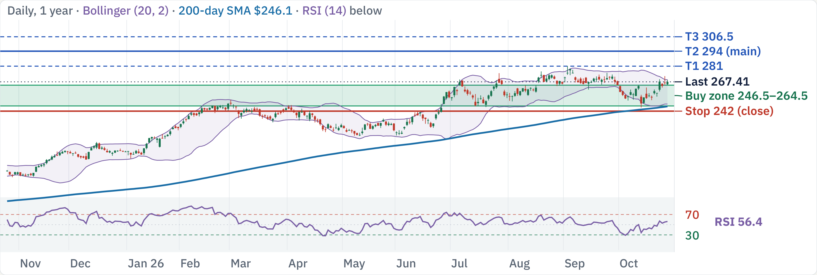
JNJ at $267.41: uptrend, buy the pullback
200-day SMA
RSI (14)
MACD hist
ADX (14)
ATR
$246.1 · Bullish
56 · Neutral
+1.58 · Bullish
16.2 · No trend
2.4% · Low vol
Uptrend; buying now is 1.0:1 to $294. Wait for $246.5–264.5.
Est. win rate to $294 (3–6 mo)
80–90% · clears your 60% goal
JNJ technical review · Daily, 1 year · Source: Yahoo Finance, TradingView, Oct 27, 2026 close · 1 / 5

Slide 27
Factors: defensive compounder, fully valued after +41%
Factor
Reading
Verdict
Momentum
1m −1.7%, 3m +0.7%, 6m +17%, 12m +40%
Tailwind
Growth
Q3 sales +5.9%, pharma +7.7%; MedTech +2.5% (below plan)
Mixed
Value
P/E 40.6 trailing (talc charge), 24.0 forward; EV/EBITDA 19.4
Neutral
Quality
Gross margin 67.8%, op. margin 26.6%, FCF $20.6B (21%)
Tailwind
Leverage
Net debt $27.4B (debt 44.7B, cash 17.2B); D/E 0.55
Neutral
Beta
0.21 (5Y); realized vol 60d 23%, 20d 32%
Tailwind
Capital return
Dividend 2.0%; buyback yield −0.8% (net issuance)
Neutral
Crowding
Short interest 0.92% of float, 3.5 days to cover
Neutral
Analysts
16 analysts: 69% Buy; avg target $290 (range 270–320)
Tailwind
Size
$643B market cap; ~7.6M shares (~$2.0B) a day
Neutral
Low beta and cash flow support it; a 41% run leaves modest upside to targets.
Sources: Yahoo Finance; stockanalysis.com (Oct 27); Futu (Oct 27); J&J Q3 release via CNBC/Qz · 2 / 5

Slide 28
Buy support in 2 tranches; stop at $242
Buy ladder: 2 × 50%, limit VWAP
Resistance
Note
$294
T2: ATR projection
Tranche
Limit
Zone
Why it holds
$281
T1: 52w high
1
$264.5
$262.5–266.5
50d SMA · swing pivot
$275.5
3× pivot
2
$246.5
$244.5–248.5
200d SMA · 2× pivot
$269.5
BB upper · swing pivot
Exit and risk
Support
Note
Level
Price
Role
R:R, 1 → 2 fills
$264.5
50d SMA · swing pivot
Stop
$242
Daily close below support
Risk $22.5 → 13.5
$251.5
swing pivot
T1
$281
Partial · 52w high
0.7 → 1.9
$246.5
200d SMA · 2× pivot
T2
$294
Main · ATR projection
1.3 → 2.9
$241.5
swing pivot
T3
$306.5
Stretch · ATR projection
1.9 → 3.8
$242
Stop level
Average cost: $264.5 with 1 fill, $255.5 with all 2. R:R is measured to the $242 stop.
JNJ technical review · Levels from daily chart, Oct 27, 2026 close · 3 / 5

Slide 29
Next 3 months: macro and company catalysts
Macro
Company-specific
FOMC: Oct 28 hold, Dec 9 hike priced
Q3 reported Oct 13
Rate 3.75–4.00%; ~90% hold Oct, ~80% Dec hike odds
Adj. EPS $2.59 vs $2.53 est.; sales $25.4B (+5.9%)
Data: CPI and jobs
Guidance raised
CPI Nov 10, Dec 10 · Jobs Nov 6, Dec 4 · PCE Nov 25
2026 adj. EPS ~$11.10 midpoint; sales ~$101.2B
US midterm elections
Talc settlement
Nov 3 · Nov up in 21 of 24 midterm years (one source)
Proposed resolution booked a special charge in Q3
US–China trade truce
Orthopaedics
Runs to Jan 10, 2027; chip export curbs unchanged
Management leaning toward a spin (CNBC)
Q3 earnings season
MedTech softness
S&P 500 Q3 EPS growth ~+26% est. (FactSet)
Q3 operational growth 2.5%, below expectations
Next earnings
Mid-Jan 2027 (est.; not announced)
Sources: Fed calendar; fedratecalc.com; CNBC; J&J Q3 8-K via Qz and SEC summaries · 4 / 5

Slide 30
Execution risks and how to trade around them
Macro and the Fed
Litigation
Limited upside
Fed funds 3.75–4.00%; a Dec 9 hike is
The talc resolution is proposed, not final;
Average target ~$290 is only ~8% above the
largely priced. CPI 3.7%, jobs +29k.
charges already cut Q3 GAAP EPS to $0.09.
price, so R:R is thin near highs.
Do: Stage fills around Nov 3 and Dec 9; no
Do: Watch court and settlement headlines.
Do: Buy the ladder limits; do not chase.
all-in entry.
MedTech drag
Defensive behaviour
Ladder rules
MedTech missed management's own plan; a
Beta 0.21 means it lags in risk-on rallies and
2 × 50%, limit VWAP capped at 264.5 /
spin adds execution risk.
holds in selloffs.
246.5
Do: Track MedTech growth at the next
Do: Use it as ballast, not a growth bet.
Next tranche only after the last one fills
print.
and holds
Exit all on a daily close below $242
Partial at 281, main exit 294, runner to
306.5
Sources: Bloomberg; CNBC; company filings; stockanalysis.com, Oct 27, 2026 · 5 / 5

Slide 31
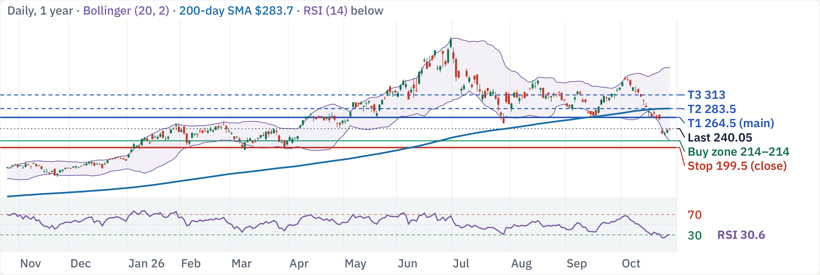
LRCX at $240.05: mixed trend, buy only at support
200-day SMA
RSI (14)
MACD hist
ADX (14)
ATR
$283.7 · Bearish
31 · Weak
−7.24 · Bearish
29.2 · Trending
5.9% · High vol
Mixed trend; buying now is 0.6:1 to $264.5. Wait for $214–214.
Est. win rate to $264.5 (3–6 mo)
45–55% · below your 60% goal
LRCX technical review · Daily, 1 year · Source: Yahoo Finance, TradingView, Oct 27, 2026 close · 1 / 5

Slide 32
Factors: strong margins, but down 45% from its high
Factor
Reading
Verdict
Momentum
1m −24%, 3m −4.9%, 6m −4.4%, 12m +58%
Mixed
Growth
Sep-qtr revenue $8.22B vs $8.14B est.; Dec EPS guide ~$2.33
Tailwind
Value
P/E 35.7 trailing, 23.3 forward; EV/EBITDA 29.1
Neutral
Quality
Op. margin 37% TTM (>40% in Sep qtr), ROIC 79%, FCF $6.5B
Tailwind
Leverage
Net cash $3.7B (cash 7.4B, debt 3.7B); D/E 0.27
Tailwind
Beta
1.85 (5Y); realized vol 60d 58%, 20d 59%
Headwind
Capital return
Dividend 0.55% + buyback 1.85%
Neutral
Crowding
Short interest 2.07% of float, 2.8 days to cover
Neutral
Analysts
24 analysts: 92% Buy; avg target $379 (range 290–500)
Tailwind
Size
$300B market cap; ~9.7M shares (~$2.3B) a day
Neutral
Margins and cash are strong; a 45% drawdown and RSI 30 show a broken trend.
Sources: Yahoo Finance; stockanalysis.com (Oct 27); Futu (Oct 27); Lam results via Investing.com/StockStory · 2 / 5

Slide 33
Buy support in 1 tranche; stop at $199.5
Buy ladder: 1 × 100%, limit VWAP
Resistance
Note
$264.5
T1: 2× pivot
Tranche
Limit
Zone
Why it holds
$256.5
swing pivot
1
$214
$212–215.5
BB lower · swing pivot
$250.5
swing pivot
Exit and risk
$241.5
swing pivot
Level
Price
Role
R:R, 1 → 1 fills
Support
Note
Stop
$199.5
Daily close below support
Risk $14.5 → 14.5
$214
BB lower · swing pivot
T1
$264.5
Main · 2× pivot
3.5 → 3.5
$204.5
swing pivot
T2
$283.5
Stretch · 200d SMA
4.8 → 4.8
$198.5
swing pivot
T3
$313
Stretch · swing pivot
6.8 → 6.8
$194
swing pivot
Average cost: $214 with 1 fill, $214 with all 1. R:R is measured to the $199.5 stop.
$199.5
Stop level
LRCX technical review · Levels from daily chart, Oct 27, 2026 close · 3 / 5

Slide 34
Next 3 months: macro and company catalysts
Macro
Company-specific
FOMC: Oct 28 hold, Dec 9 hike priced
Sep quarter reported Oct 21
Rate 3.75–4.00%; ~90% hold Oct, ~80% Dec hike odds
Revenue $8.22B vs $8.14B est.; EPS $2.19 vs $2.17
Data: CPI and jobs
Dec-quarter guide
CPI Nov 10, Dec 10 · Jobs Nov 6, Dec 4 · PCE Nov 25
EPS ~$2.33 ±$0.15; op. margin to expand slightly
US midterm elections
Stock reaction
Nov 3 · Nov up in 21 of 24 midterm years (one source)
Fell ~7% to ~$242 on the print; whisper EPS was $2.28
US–China trade truce
Operating margin
Runs to Jan 10, 2027; chip export curbs unchanged
Above 40% for the first time (company)
AI capex and chip policy
Next earnings
Hyperscaler capex; US chip-tool export curbs unchanged
Late Jan 2027 (est.; not announced)
Sources: Fed calendar; fedratecalc.com; CNBC; Lam results via Investing.com/StockStory · 4 / 5

Slide 35
Execution risks and how to trade around them
Macro and the Fed
Broken trend
Export controls
Fed funds 3.75–4.00%; a Dec 9 hike is
Price is 45% below its high; RSI 30 means
US chip-tool rules can hit China sales;
largely priced. CPI 3.7%, jobs +29k.
oversold, not bottomed.
Commerce ordered halts to Hua Hong in
Do: Stage fills around Nov 3 and Dec 9; no
Do: Buy only at the ladder limits; keep the
April.
all-in entry.
stop.
Do: Watch Commerce headlines before
each tranche.
Guide only in line
High beta
Ladder rules
The Oct 21 guide matched estimates and
Beta 1.85 and 2.8 days to cover short
1 × 100%, limit VWAP capped at 214
the stock still fell ~7%.
interest amplify moves in both directions.
Next tranche only after the last one fills
Do: Wait for price to stabilise above the
Do: Limit VWAP at 5–10% of volume; one
and holds
first limit.
tranche per day.
Exit all on a daily close below $199.5
Partial at 264.5, main exit 264.5, runner
to 313
Sources: Bloomberg; CNBC; company filings; stockanalysis.com, Oct 27, 2026 · 5 / 5

Slide 36
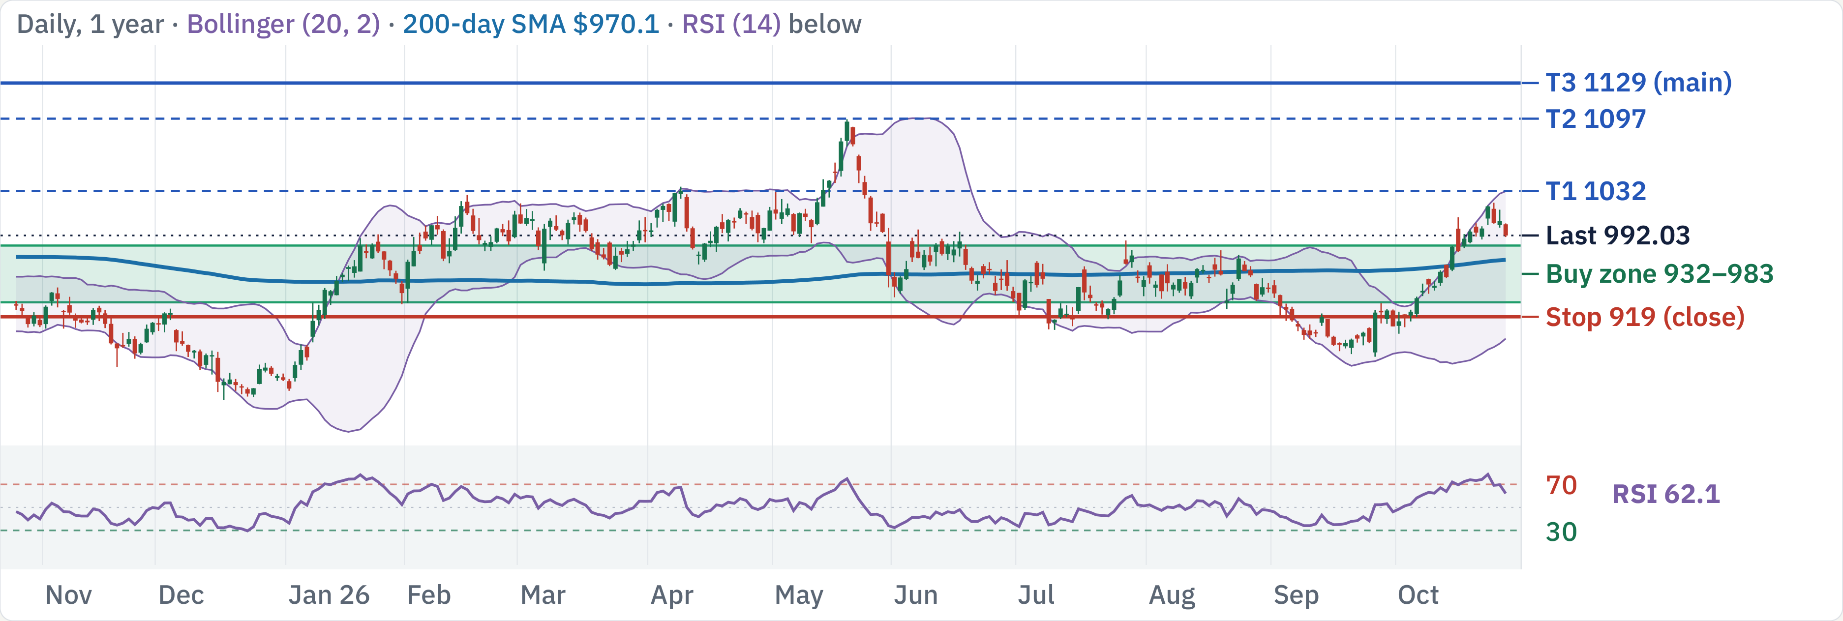
COST at $992.03: uptrend, buy the pullback
200-day SMA
RSI (14)
MACD hist
ADX (14)
ATR
$970.1 · Bullish
62 · Strong
+3.08 · Bullish
40.7 · Trending
1.6% · Low vol
Uptrend; buying now is 1.9:1 to $1129. Wait for $932–983.
Est. win rate to $1129 (3–6 mo)
80–90% · clears your 60% goal
COST technical review · Daily, 1 year · Source: Yahoo Finance, TradingView, Oct 27, 2026 close · 1 / 5

Slide 37
Factors: elite retailer at a premium multiple
Factor
Reading
Verdict
Momentum
1m +7.5%, 3m +1.8%, 6m −0.2%, 12m +6.4%
Tailwind
Growth
FQ4 sales +11.2%; Sept comps +11.4% (7.6% ex gas/FX)
Tailwind
Value
P/E 47.8 trailing, 43.5 forward; EV/EBITDA 30.3
Headwind
Quality
Op. margin 3.8%, ROIC 37%, FCF $9.4B (3.1% margin)
Neutral
Leverage
Net cash $11.1B (cash 21.3B, debt 10.2B); D/E 0.28
Tailwind
Beta
0.87 (5Y); realized vol 60d 18%, 20d 17%
Tailwind
Capital return
Dividend 0.59% + small buyback 0.09%
Neutral
Crowding
Short interest 1.66% of float, 3.1 days to cover
Neutral
Analysts
26 analysts: 73% Buy; avg target $1,093 (range 781–1,315)
Tailwind
Size
$440B market cap; ~2.0M shares (~$2.0B) a day
Neutral
Comps and cash are strong; 44× forward earnings and a fading fee boost cap upside.
Sources: Yahoo Finance; stockanalysis.com (Oct 27); Futu (Oct 15); Costco FQ4 and September sales releases · 2 / 5

Slide 38
Buy support in 2 tranches; stop at $919
Buy ladder: 2 × 50%, limit VWAP
Resistance
Note
$1129
T3: ATR projection
Tranche
Limit
Zone
Why it holds
$1097
T2: 52w high
1
$983
$975–991
3× pivot
$1032
T1: BB upper
2
$932
$924–939
50d SMA · 4× pivot
$1017
2× pivot
Exit and risk
Support
Note
Level
Price
Role
R:R, 1 → 2 fills
$992
3× pivot
Stop
$919
Daily close below support
Risk $64 → 38.5
$971
200d SMA · 3× pivot
T1
$1032
Partial · BB upper
0.8 → 1.9
$945
50d SMA · swing pivot
T2
$1097
Stretch · 52w high
1.8 → 3.6
$932
50d SMA · 4× pivot
T3
$1129
Main · ATR projection
2.3 → 4.5
$919
Stop level
Average cost: $983 with 1 fill, $957.5 with all 2. R:R is measured to the $919 stop.
COST technical review · Levels from daily chart, Oct 27, 2026 close · 3 / 5

Slide 39
Next 3 months: macro and company catalysts
Macro
Company-specific
FOMC: Oct 28 hold, Dec 9 hike priced
FQ4 reported Sep 29
Rate 3.75–4.00%; ~90% hold Oct, ~80% Dec hike odds
Sales $93.9B (+11.2%); EPS $6.75 incl. $0.15 refund
Data: CPI and jobs
September monthly sales
CPI Nov 10, Dec 10 · Jobs Nov 6, Dec 4 · PCE Nov 25
$30.0B (+13%); comps +11.4%, +7.6% ex gas/FX
US midterm elections
Membership fees
Nov 3 · Nov up in 21 of 24 midterm years (one source)
FQ4 fee income $1.85B (+7.3%); 84.1M paid members
US–China trade truce
Fee-hike tailwind fading
Runs to Jan 10, 2027; chip export curbs unchanged
Sep 2024 fee rise nearly fully in results (Motley Fool)
Q3 earnings season
Next earnings
S&P 500 Q3 EPS growth ~+26% est. (FactSet)
Dec 10 after close (per stockanalysis.com)
Monthly sales reports
Early each month; next covers October
Sources: Fed calendar; fedratecalc.com; CNBC; Costco releases; Motley Fool · 4 / 5

Slide 40
Execution risks and how to trade around them
Macro and the Fed
Earnings gap
Premium valuation
Fed funds 3.75–4.00%; a Dec 9 hike is
Next print Dec 10 (per stockanalysis.com).
44× forward P/E leaves little room for a
largely priced. CPI 3.7%, jobs +29k.
FQ4 sales rose 11.2%.
comp slowdown.
Do: Stage fills around Nov 3 and Dec 9; no
Do: No new tranche within 3 days of the
Do: Buy the ladder limits only; no chasing
all-in entry.
print.
at highs.
Thin margins
Fee tailwind ending
Ladder rules
3.8% operating margin; gasoline and tariff
The 2024 fee-hike boost is nearly done; fee
2 × 50%, limit VWAP capped at 983 / 932
swings move comps.
income growth slowed to +7.3%.
Next tranche only after the last one fills
Do: Read comps ex gas and FX.
Do: Watch renewal rate and fee income.
and holds
Exit all on a daily close below $919
Partial at 1032, main exit 1129, runner
to 1129
Sources: Bloomberg; CNBC; company filings; stockanalysis.com, Oct 27, 2026 · 5 / 5

Slide 41
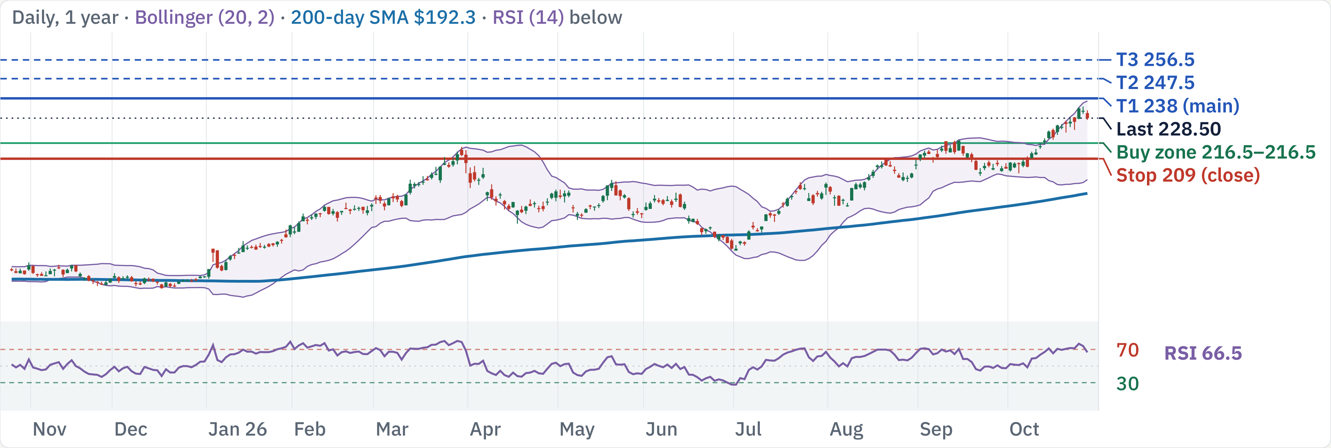
CVX at $228.5: earnings Oct 30 first, then buy dips
200-day SMA
RSI (14)
MACD hist
ADX (14)
ATR
$192.3 · Bullish
66 · Strong
+1.19 · Bullish
31.6 · Trending
2.1% · Low vol
Uptrend; Oct 30 earnings first. Then ladder $216.5–216.5; buying now is 0.5:1 to $238.
Est. win rate to $238 (3–6 mo)
65–75% · clears your 60% goal
CVX technical review · Daily, 1 year · Source: Yahoo Finance, TradingView, Oct 27, 2026 close · 1 / 5

Slide 42
Factors: oil-levered income stock with Guyana growth
Factor
Reading
Verdict
Momentum
1m +11%, 3m +19%, 6m +21%, 12m +47%
Tailwind
Growth
Q3 EPS est. ~$4.8 (+155% YoY); Q2 output +292k b/d (Hess)
Tailwind
Value
P/E 21.9 trailing, 12.0 forward; EV/EBITDA 9.4
Neutral
Quality
Op. margin 13.0%, ROIC 8.2%, FCF $27.0B (12.9% margin)
Neutral
Leverage
Net debt $28.6B (debt 37.1B, cash 8.5B); D/E 0.19
Neutral
Beta
0.52 (5Y); realized vol 60d 23%, 20d 21%
Tailwind
Capital return
Dividend 3.1%; buyback yield −12% (net issuance)
Mixed
Crowding
Short interest 1.27% of float, 2.4 days to cover
Neutral
Analysts
15 analysts: 80% Buy; avg target $232 (range 208–252)
Tailwind
Size
$447B market cap; ~7.1M shares (~$1.6B) a day
Neutral
An earnings surge and a 3.1% dividend versus oil-price and Hormuz risk; earnings Oct 30.
Sources: Yahoo Finance; stockanalysis.com (Oct 27); Futu (Oct 22); Zacks/MarketBeat/Alphastreet previews · 2 / 5

Slide 43
Wait for the Oct 30 print, then ladder in; stop $209
Buy ladder: 1 × 100%, limit VWAP
Resistance
Note
$256.5
T3: ATR projection
Tranche
Limit
Zone
Why it holds
$247.5
T2: ATR projection
1
$216.5
$214.5–218
2× pivot
$238
T1: ATR projection
Exit and risk
$234
52w high · swing pivot
Level
Price
Role
R:R, 1 → 1 fills
Support
Note
Stop
$209
Daily close below support
Risk $7.5 → 7.5
$216.5
2× pivot
T1
$238
Main · ATR projection
2.9 → 2.9
$211.5
50d SMA · swing pivot
T2
$247.5
Stretch · ATR projection
4.1 → 4.1
$209
swing pivot
T3
$256.5
Stretch · ATR projection
5.3 → 5.3
$202
swing pivot
Average cost: $216.5 with 1 fill, $216.5 with all 1. R:R is measured to the $209 stop.
$209
Stop level
CVX technical review · Levels from daily chart, Oct 27, 2026 close · 3 / 5

Slide 44
Next 3 months: macro and company catalysts
Macro
Company-specific
FOMC: Oct 28 hold, Dec 9 hike priced
Q3 results Oct 30, before the open
Rate 3.75–4.00%; ~90% hold Oct, ~80% Dec hike odds
Consensus EPS ~$4.7–4.9, revenue ~$59–62B; 11am ET call
Data: CPI and jobs
Earnings streak
CPI Nov 10, Dec 10 · Jobs Nov 6, Dec 4 · PCE Nov 25
Beat consensus 7 quarters in a row (one source)
US midterm elections
Downstream strength
Nov 3 · Nov up in 21 of 24 midterm years (one source)
Zacks sees downstream earnings $5.1B vs $1.1B a year ago
US–China trade truce
Hess and Guyana
Runs to Jan 10, 2027; chip export curbs unchanged
Stabroek 30% stake; Uaru first oil expected in 2026
Oil and the Strait of Hormuz
Guyana port studies
Brent $114 in Sept; EIA sees ~$105 Q4; STEO Nov 10
Chevron dropped funding for the proposed deepwater port
Buyback and dividend
Some previews expect higher returns (not confirmed)
Sources: Fed calendar; fedratecalc.com; EIA; Zacks; MarketBeat; Bloomberg · 4 / 5

Slide 45
Execution risks and how to trade around them
Macro and the Fed
Earnings gap
Oil price reversal
Fed funds 3.75–4.00%; a Dec 9 hike is
Reports Oct 30, before the open. A gap can
Prices hinge on Hormuz flows; a ceasefire
largely priced. CPI 3.7%, jobs +29k.
jump the stop; EPS est. ~$4.8, up ~155%
could drop Brent fast (−13% in a day in
Do: Stage fills around Nov 3 and Dec 9; no
YoY.
April).
all-in entry.
Do: Wait for the print; recheck levels. No
Do: Size small; a ceasefire headline can
fills before it.
reverse oil fast.
Beat already priced?
Guyana concentration
Ladder rules
The stock fell after the last strong quarter
Growth leans on Stabroek; the company
1 × 100%, limit VWAP capped at 216.5
(one commentary); estimates are up 13.6%
gives no Guyana-only profit figure.
Wait for the Oct 30 print before any fill
in 90 days.
Do: Treat local-press profit claims as
Exit all on a daily close below $209
Do: Judge the print on production and cash
estimates.
Partial at 238, main exit 238, runner to
flow.
256.5
Sources: Bloomberg; CNBC; company filings; stockanalysis.com, Oct 27, 2026 · 5 / 5

Slide 46
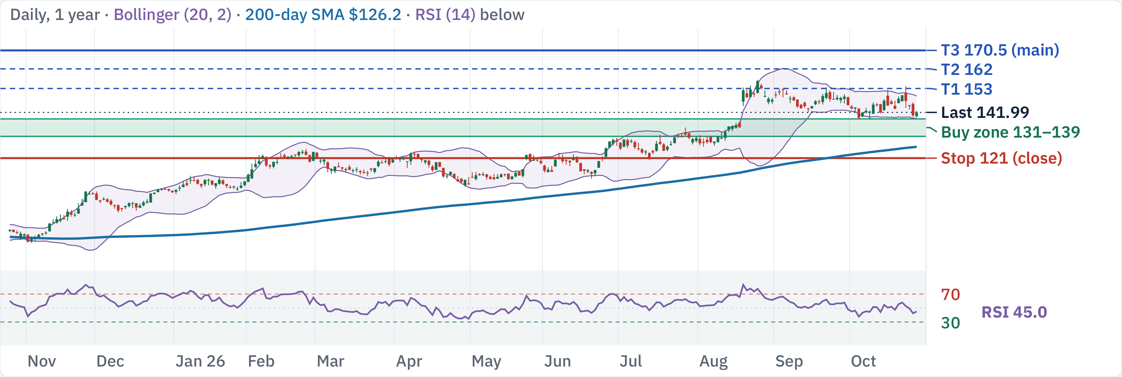
MRK at $141.99: earnings Oct 29 first, then buy dips
200-day SMA
RSI (14)
MACD hist
ADX (14)
ATR
$126.2 · Bullish
45 · Neutral
−0.37 · Bearish
15.9 · No trend
3.1% · Medium vol
Uptrend; Oct 29 earnings first. Then ladder $131–139; buying now is 1.4:1 to $170.5.
Est. win rate to $170.5 (3–6 mo)
68–78% · clears your 60% goal
MRK technical review · Daily, 1 year · Source: Yahoo Finance, TradingView, Oct 27, 2026 close · 1 / 5

Slide 47
Factors: cash machine facing the Keytruda cliff
Factor
Reading
Verdict
Momentum
1m −4.5%, 3m +8.9%, 6m +29%, 12m +62%
Tailwind
Growth
Q2 Winrevair +75%; Keytruda flat ($7.9B), LOE 2028
Mixed
Value
P/E 111.6 trailing (charges), 17.1 forward; EV/EBITDA 13.8
Neutral
Quality
Gross margin 75.9%, op. margin 35.3%, FCF $16.1B (24%)
Tailwind
Leverage
Net debt $46.8B (debt 53.9B, cash 7.1B); D/E 1.28
Headwind
Beta
0.22 (5Y); realized vol 60d 35%, 20d 32%
Tailwind
Capital return
Dividend 2.4% + buyback 1.9%
Tailwind
Crowding
Short interest 1.15% of float, 2.9 days to cover
Neutral
Analysts
19 analysts: 79% Buy; avg target $167 (range 145–180)
Tailwind
Size
$351B market cap; ~9.7M shares (~$1.4B) a day
Neutral
Margins, yield and launches versus Keytruda's 2028 patent loss and 1.3× debt/equity.
Sources: Yahoo Finance; stockanalysis.com (Oct 27); Futu (Oct 27); Zacks/24/7 Wall St. Q3 previews · 2 / 5

Slide 48
Wait for the Oct 29 print, then ladder in; stop $121
Buy ladder: 2 × 50%, limit VWAP
Resistance
Note
$157
52w high · swing pivot
Tranche
Limit
Zone
Why it holds
$153
T1: 2× pivot
1
$139
$137.5–140
BB lower · swing pivot
$146
50d SMA · swing pivot
2
$131
$130–132
2× pivot
$142.5
swing pivot
Exit and risk
Support
Note
Level
Price
Role
R:R, 1 → 2 fills
$139
BB lower · swing pivot
Stop
$121
Daily close below support
Risk $18 → 14
$135
swing pivot
T1
$153
Partial · 2× pivot
0.8 → 1.3
$131
2× pivot
T2
$162
Stretch · ATR projection
1.3 → 1.9
$126
200d SMA · swing pivot
T3
$170.5
Main · ATR projection
1.8 → 2.5
$121
Stop level
Average cost: $139 with 1 fill, $135 with all 2. R:R is measured to the $121 stop.
MRK technical review · Levels from daily chart, Oct 27, 2026 close · 3 / 5

Slide 49
Next 3 months: macro and company catalysts
Macro
Company-specific
FOMC: Oct 28 hold, Dec 9 hike priced
Q3 results Oct 29, before the open
Rate 3.75–4.00%; ~90% hold Oct, ~80% Dec hike odds
Revenue est. ~$17.3B (one preview); FY guide $66.3–67.3B
Data: CPI and jobs
Keytruda trajectory
CPI Nov 10, Dec 10 · Jobs Nov 6, Dec 4 · PCE Nov 25
Q2 $7.9B (−1%); subcutaneous QLEX $463M
US midterm elections
Winrevair
Nov 3 · Nov up in 21 of 24 midterm years (one source)
Q2 $588M (+75%); FDA added HYPERION data to the label
US–China trade truce
Year-ago comparison
Runs to Jan 10, 2027; chip export curbs unchanged
~$250M wholesaler timing benefit won't repeat
Q3 earnings season
Estimate trend
S&P 500 Q3 EPS growth ~+26% est. (FactSet)
2026 EPS est. $2.78→$2.66; 2027 $9.67→$9.27 (Zacks)
Keytruda patent expiry
2028 loss of exclusivity; biosimilars 2028–29
Sources: Fed calendar; fedratecalc.com; CNBC; Zacks; 24/7 Wall St.; Hudson Labs · 4 / 5

Slide 50
Execution risks and how to trade around them
Macro and the Fed
Earnings gap
Patent cliff
Fed funds 3.75–4.00%; a Dec 9 hike is
Reports Oct 29, before the open. A gap can
Keytruda faces biosimilars around 2028–29;
largely priced. CPI 3.7%, jobs +29k.
jump the stop; Keytruda is the swing factor.
launches must offset it.
Do: Stage fills around Nov 3 and Dec 9; no
Do: Wait for the print; recheck levels. No
Do: Buy only at support; keep size modest.
all-in entry.
fills before it.
Estimate cuts
Leverage
Ladder rules
EPS estimates for 2026 and 2027 drifted
Debt/equity is 1.28 with net debt of $46.8B.
2 × 50%, limit VWAP capped at 139 / 131
lower over 60 days (Zacks).
Do: Watch interest-cost and deal
Wait for the Oct 29 print before any fill
Do: Read guidance at the print before
headlines.
Exit all on a daily close below $121
adding.
Partial at 153, main exit 170.5, runner to
170.5
Sources: Bloomberg; CNBC; company filings; stockanalysis.com, Oct 27, 2026 · 5 / 5

Slide 51
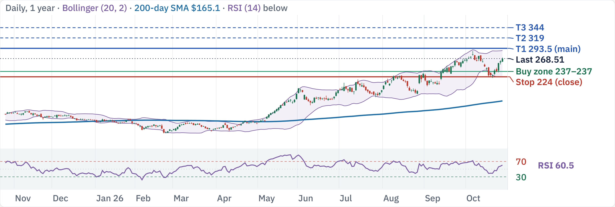
CRWD at $268.51: uptrend, buy the pullback
200-day SMA
RSI (14)
MACD hist
ADX (14)
ATR
$165.1 · Bullish
61 · Strong
−0.051 · Bearish
19.8 · No trend
4.7% · Medium vol
Uptrend; buying now is 0.6:1 to $293.5. Wait for $237–237.
Est. win rate to $293.5 (3–6 mo)
63–73% · clears your 60% goal
CRWD technical review · Daily, 1 year · Source: Yahoo Finance, TradingView, Oct 27, 2026 close · 1 / 5

Slide 52
Factors: ARR acceleration at a 50× sales multiple
Factor
Reading
Verdict
Momentum
1m +3.6%, 3m +50%, 6m +136%, 12m +104%
Tailwind
Growth
Net new ARR +51% YoY (record $333M); ARR $5.84B
Tailwind
Value
P/S 49.8; forward P/E 190; EV/EBITDA not meaningful
Headwind
Quality
Gross margin 75.2%, GAAP op. margin −2.5%, FCF $1.6B (30%)
Mixed
Leverage
Net cash $4.2B (cash 5.0B, debt 0.8B); D/E 0.16
Tailwind
Beta
1.2 (5Y); realized vol 60d 71%, 20d 58%
Neutral
Capital return
No dividend; buyback yield −3.2% (stock-comp dilution)
Headwind
Crowding
Short interest 2.59% of float, 2.3 days to cover
Neutral
Analysts
38 analysts: 87% Buy; avg target $270 ≈ price (210–425)
Neutral
Size
$275B market cap; ~8.4M shares (~$2.3B) a day
Neutral
Record net new ARR and cash versus 50× sales; the average target sits near the price.
Sources: Yahoo Finance; stockanalysis.com (Oct 27); Futu (Oct 27); CrowdStrike Q2 FY27 release (Aug 26) · 2 / 5

Slide 53
Buy support in 1 tranche; stop at $224
Buy ladder: 1 × 100%, limit VWAP
Resistance
Note
$344
T3: ATR projection
Tranche
Limit
Zone
Why it holds
$319
T2: ATR projection
1
$237
$235–238.5
50d SMA · swing pivot
$293.5
T1: ATR projection
Exit and risk
$287
52w high · swing pivot
Level
Price
Role
R:R, 1 → 1 fills
Support
Note
Stop
$224
Daily close below support
Risk $13 → 13
$237
50d SMA · swing pivot
T1
$293.5
Main · ATR projection
4.3 → 4.3
$234
swing pivot
T2
$319
Stretch · ATR projection
6.3 → 6.3
$227.5
swing pivot
T3
$344
Stretch · ATR projection
8.2 → 8.2
$221.5
BB lower · swing pivot
Average cost: $237 with 1 fill, $237 with all 1. R:R is measured to the $224 stop.
$224
Stop level
CRWD technical review · Levels from daily chart, Oct 27, 2026 close · 3 / 5

Slide 54
Next 3 months: macro and company catalysts
Macro
Company-specific
FOMC: Oct 28 hold, Dec 9 hike priced
Q3 FY27 results ~Dec 1 (est.)
Rate 3.75–4.00%; ~90% hold Oct, ~80% Dec hike odds
Guide: revenue $1.52–1.53B, ARR $6.18–6.19B
Data: CPI and jobs
Net new ARR momentum
CPI Nov 10, Dec 10 · Jobs Nov 6, Dec 4 · PCE Nov 25
Q2 record $333M, +51% YoY; FY27 NNARR growth guide 34%
US midterm elections
Falcon Flex
Nov 3 · Nov up in 21 of 24 midterm years (one source)
Flex-account ARR above $2.29B, +101% YoY
US–China trade truce
Fal.Con product news
Runs to Jan 10, 2027; chip export curbs unchanged
SafeMind AI models (NVIDIA) and Falcon IQ agents
Software and AI security demand
Profitability
Enterprise security budgets; Fal.Con AI launches
Non-GAAP op. income $372M; GAAP loss narrowed to $33M
Outage legacy
No new Falcon outage found in 2026 (2024 event only)
Sources: Fed calendar; fedratecalc.com; CNBC; CrowdStrike IR; TradingView News; TIKR · 4 / 5

Slide 55
Execution risks and how to trade around them
Macro and the Fed
Earnings gap
Valuation
Fed funds 3.75–4.00%; a Dec 9 hike is
Next print Dec 1 (per stockanalysis.com). Q2
About 50× sales: any growth slowdown de-
largely priced. CPI 3.7%, jobs +29k.
net new ARR hit a record $333M.
rates the stock quickly.
Do: Stage fills around Nov 3 and Dec 9; no
Do: No new tranche within 3 days of the
Do: Buy only the ladder limits; respect the
all-in entry.
print.
stop.
Price near targets
Trend strength
Ladder rules
The average analyst target ($270) sits at the
ADX 19.8 with RSI 60: healthy trend but not
1 × 100%, limit VWAP capped at 237
price; mid-October raises are priced in.
a strong one.
Next tranche only after the last one fills
Do: Take the partial at T1.
Do: Prefer pullbacks over breakouts.
and holds
Exit all on a daily close below $224
Partial at 293.5, main exit 293.5, runner
to 344
Sources: Bloomberg; CNBC; company filings; stockanalysis.com, Oct 27, 2026 · 5 / 5

Slide 56
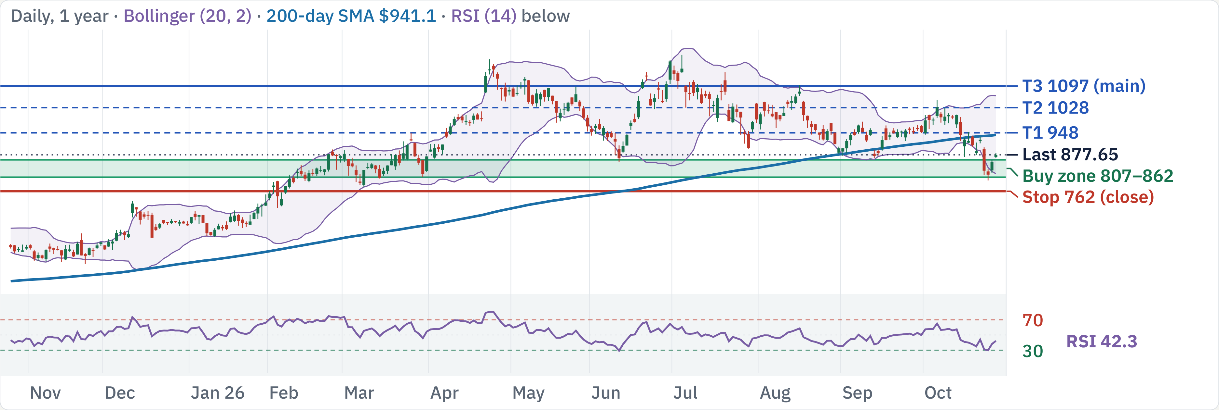
GEV at $877.65: earnings Oct 28 first, then buy dips
200-day SMA
RSI (14)
MACD hist
ADX (14)
ATR
$941.1 · Bearish
42 · Neutral
−12.36 · Bearish
20.8 · Emerging
5.1% · High vol
Mixed trend; Oct 28 earnings first. Then ladder $807–862; buying now is 1.9:1 to $1097.
Est. win rate to $1097 (3–6 mo)
55–65% · near your 60% goal
GEV technical review · Daily, 1 year · Source: Yahoo Finance, TradingView, Oct 27, 2026 close · 1 / 5

Slide 57
Factors: $176B backlog, but 42× forward earnings
Factor
Reading
Verdict
Momentum
1m −7.6%, 3m −2.5%, 6m −19%, 12m +50%
Mixed
Growth
Q2 orders +88%; backlog $176B; 2026 sales guide $45.5–46.5B
Tailwind
Value
P/E 25.1 trailing, 41.8 forward; EV/EBITDA 55.7
Headwind
Quality
Op. margin 6.6%, ROIC 41%, FCF $12.4B (30% margin)
Tailwind
Leverage
Net cash $9.0B (cash 12.7B, debt 3.7B); D/E 0.28
Tailwind
Beta
0.97 (5Y); realized vol 60d 48%, 20d 59%
Neutral
Capital return
Dividend 0.23% + buyback 2.3%
Neutral
Crowding
Short interest 2.78% of float, 3.4 days to cover
Neutral
Analysts
16 analysts: 88% Buy; avg target $1,214 (range 470–1,450)
Tailwind
Size
$234B market cap; ~2.6M shares (~$2.2B) a day
Neutral
Backlog, net cash and FCF are elite; 42× forward P/E needs a flawless print today.
Sources: Yahoo Finance; stockanalysis.com (Oct 27); Futu (Oct 24); GE Vernova Q2 release; Zacks/Yahoo previews · 2 / 5

Slide 58
Wait for the Oct 28 print, then ladder in; stop $762
Buy ladder: 2 × 50%, limit VWAP
Resistance
Note
$977
2× pivot
Tranche
Limit
Zone
Why it holds
$948
T1: 50d SMA
1
$862
$855–869
2× pivot
$922
swing pivot
2
$807
$801–813
swing pivot
$895
swing pivot
Exit and risk
Support
Note
Level
Price
Role
R:R, 1 → 2 fills
$874
swing pivot
Stop
$762
Daily close below support
Risk $100 → 72.5
$862
2× pivot
T1
$948
Partial · 50d SMA
0.9 → 1.6
$846
swing pivot
T2
$1028
Stretch · swing pivot
1.7 → 2.7
$807
swing pivot
T3
$1097
Main · 2× pivot
2.4 → 3.6
$762
Stop level
Average cost: $862 with 1 fill, $834.5 with all 2. R:R is measured to the $762 stop.
GEV technical review · Levels from daily chart, Oct 27, 2026 close · 3 / 5

Slide 59
Next 3 months: macro and company catalysts
Macro
Company-specific
FOMC: Oct 28 hold, Dec 9 hike priced
Q3 results today, Oct 28, before the open
Rate 3.75–4.00%; ~90% hold Oct, ~80% Dec hike odds
Zacks: EPS ~$4.03 (+146%), revenue ~$12.1B (+21%)
Data: CPI and jobs
Gas turbine pipeline
CPI Nov 10, Dec 10 · Jobs Nov 6, Dec 4 · PCE Nov 25
Backlog + slots 116 GW; 125+ GW targeted by year-end
US midterm elections
Guidance raised in Q2
Nov 3 · Nov up in 21 of 24 midterm years (one source)
Sales $45.5–46.5B; FCF $11.5–12.5B (from $6.5–7.5B)
US–China trade truce
Q3 outlook
Runs to Jan 10, 2027; chip export curbs unchanged
Revenue growth 17–19%; wind down low double digits
AI power demand and utility capex
Output ramp
Data-centre load growth; grid and turbine order timing
20 GW/yr in Q3; 24 GW in 2028, 30 GW in 2030
Services vs equipment
Services may not offset weaker turbine equipment
Sources: Fed calendar; fedratecalc.com; CNBC; GE Vernova Q2 release; Zacks · 4 / 5

Slide 60
Execution risks and how to trade around them
Macro and the Fed
Earnings gap
Earnings today
Fed funds 3.75–4.00%; a Dec 9 hike is
Reports Oct 28, before the open. A gap can
The Q3 print lands today at 42× forward
largely priced. CPI 3.7%, jobs +29k.
jump the stop; Q3 EPS est. ~$4.03, revenue
earnings; a miss on orders could cut the
Do: Stage fills around Nov 3 and Dec 9; no
~$12.1B.
stock fast.
all-in entry.
Do: Wait for the print; recheck levels. No
Do: Place no new orders until the print is
fills before it.
digested.
Valuation
Wind drag
Ladder rules
EV/EBITDA is 55.7; any slip in turbine orders
Wind revenue is guided down low double
2 × 50%, limit VWAP capped at 862 / 807
or slot conversion de-rates the stock.
digits on lower onshore deliveries.
Wait for the Oct 28 print before any fill
Do: Buy only the ladder limits; respect the
Do: Judge the print on gas orders and GW.
Exit all on a daily close below $762
stop.
Partial at 948, main exit 1097, runner to
1097
Sources: Bloomberg; CNBC; company filings; stockanalysis.com, Oct 27, 2026 · 5 / 5

Slide 61
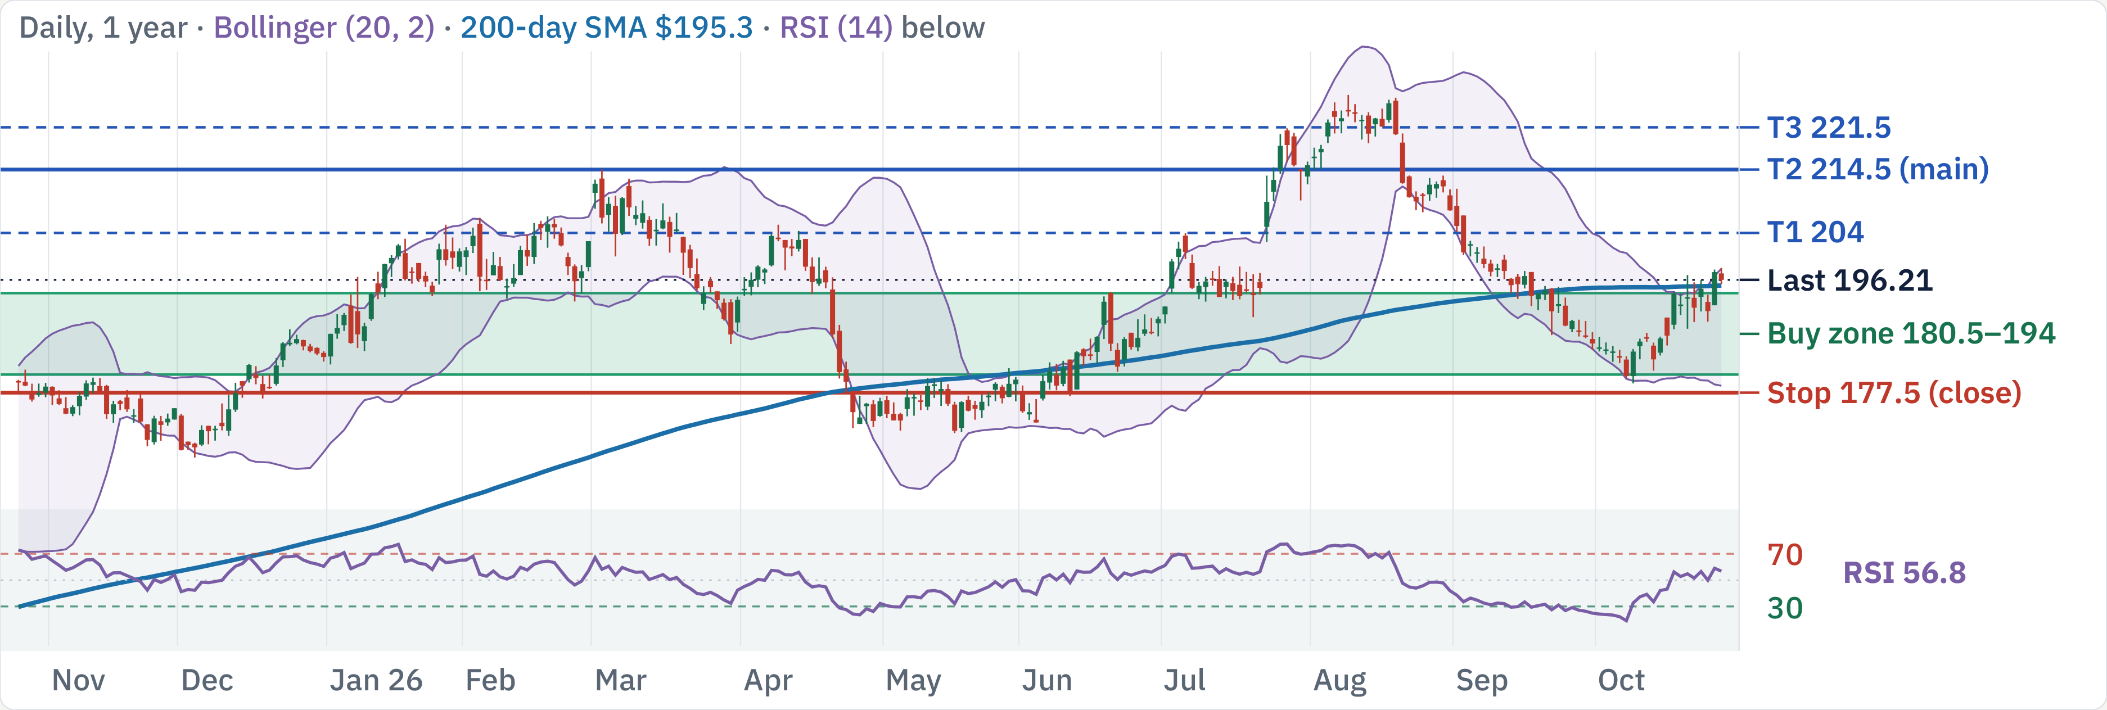
RTX at $196.21: uptrend, buy the pullback
200-day SMA
RSI (14)
MACD hist
ADX (14)
ATR
$195.3 · Bullish
57 · Neutral
+1.70 · Bullish
30.3 · Trending
2.3% · Low vol
Uptrend; buying now is 1.0:1 to $214.5. Wait for $180.5–194.
Est. win rate to $214.5 (3–6 mo)
80–90% · clears your 60% goal
RTX technical review · Daily, 1 year · Source: Yahoo Finance, TradingView, Oct 27, 2026 close · 1 / 5

Slide 62
Factors: record $340B backlog at 25× forward earnings
Factor
Reading
Verdict
Momentum
1m +4.6%, 3m −8.8%, 6m +12%, 12m +9.8%
Mixed
Growth
Q3 sales +11%; backlog $340B (+36%); EPS guide raised
Tailwind
Value
P/E 32.0 trailing, 25.3 forward; EV/EBITDA 17.5; PEG 2.1
Neutral
Quality
Op. margin 13.1%, ROIC 10.3%, FCF $9.5B (9.9% margin)
Neutral
Leverage
Net debt $29.7B (debt 38.9B, cash 9.2B); D/E 0.55
Headwind
Beta
0.31 (5Y); realized vol 60d 21%, 20d 26%
Tailwind
Capital return
Dividend 1.5%; buyback yield −0.9% (net issuance)
Neutral
Crowding
Short interest 1.09% of float, 3.4 days to cover
Neutral
Analysts
13 analysts: 69% Buy; avg target $231 (range 208–250)
Tailwind
Size
$265B market cap; ~4.9M shares (~$1.0B) a day
Neutral
Record backlog and raised guidance versus a one-off tariff refund in the beat.
Sources: Yahoo Finance; stockanalysis.com (Oct 27); Futu (Oct 26); RTX Q3 release (Oct 20) via search summaries · 2 / 5

Slide 63
Buy support in 2 tranches; stop at $177.5
Buy ladder: 2 × 50%, limit VWAP
Resistance
Note
$221.5
T3: swing pivot
Tranche
Limit
Zone
Why it holds
$214.5
T2: swing pivot
1
$194
$192.5–195.5
50d SMA · swing pivot
$206.5
2× pivot
2
$180.5
$179.5–182
BB lower · 4× pivot
$204
T1: 3× pivot
Exit and risk
Support
Note
Level
Price
Role
R:R, 1 → 2 fills
$194
50d SMA · swing pivot
Stop
$177.5
Daily close below support
Risk $16.5 → 9.75
$191.5
3× pivot
T1
$204
Partial · 3× pivot
0.6 → 1.7
$188
swing pivot
T2
$214.5
Main · swing pivot
1.2 → 2.8
$185.5
swing pivot
T3
$221.5
Stretch · swing pivot
1.7 → 3.5
$177.5
Stop level
Average cost: $194 with 1 fill, $187.25 with all 2. R:R is measured to the $177.5 stop.
RTX technical review · Levels from daily chart, Oct 27, 2026 close · 3 / 5

Slide 64
Next 3 months: macro and company catalysts
Macro
Company-specific
FOMC: Oct 28 hold, Dec 9 hike priced
Q3 reported Oct 20
Rate 3.75–4.00%; ~90% hold Oct, ~80% Dec hike odds
Adj. EPS $2.26 vs $1.78 est.; $0.25 was a one-off
Data: CPI and jobs
2026 outlook raised
CPI Nov 10, Dec 10 · Jobs Nov 6, Dec 4 · PCE Nov 25
Sales $97.0–97.5B; adj. EPS $7.65–7.75; FCF $9.0–9.2B
US midterm elections
Record backlog
Nov 3 · Nov up in 21 of 24 midterm years (one source)
$340B: $176B commercial, $164B defense (+36% YoY)
US–China trade truce
Missile awards
Runs to Jan 10, 2027; chip export curbs unchanged
~$37B multiyear Tomahawk and AMRAAM contracts in backlog
Defense budget and aerospace demand
Pratt & Whitney
US stopgap budget; airline build rates; Pentagon awards
$363M charge for a customer bankruptcy; adj. profit +29%
Next earnings
Late Jan 2027 (est.; not announced)
Sources: Fed calendar; fedratecalc.com; CNBC; RTX Q3 release; Yahoo; Investing.com · 4 / 5

Slide 65
Execution risks and how to trade around them
Macro and the Fed
Beat is partly one-off
Budget gridlock
Fed funds 3.75–4.00%; a Dec 9 hike is
$0.25 of the $0.48 EPS beat was a one-time
The US government runs on a continuing
largely priced. CPI 3.7%, jobs +29k.
IEEPA cost recovery.
resolution; new starts can slip.
Do: Stage fills around Nov 3 and Dec 9; no
Do: Value on the guide, not the headline
Do: Watch appropriations headlines before
all-in entry.
beat.
adding.
Collins margin
Limited upside
Ladder rules
The CFO flagged possible Q4 margin
Scan shows ~3.8% to the nearest resistance
2 × 50%, limit VWAP capped at 194 /
pressure at Collins after a 300bp one-off lift.
and 1.1:1 at the current price.
180.5
Do: Expect a softer Q4 margin print.
Do: Wait for the pullback ladder; no
Next tranche only after the last one fills
chasing.
and holds
Exit all on a daily close below $177.5
Partial at 204, main exit 214.5, runner to
221.5
Sources: Bloomberg; CNBC; company filings; stockanalysis.com, Oct 27, 2026 · 5 / 5

Slide 66
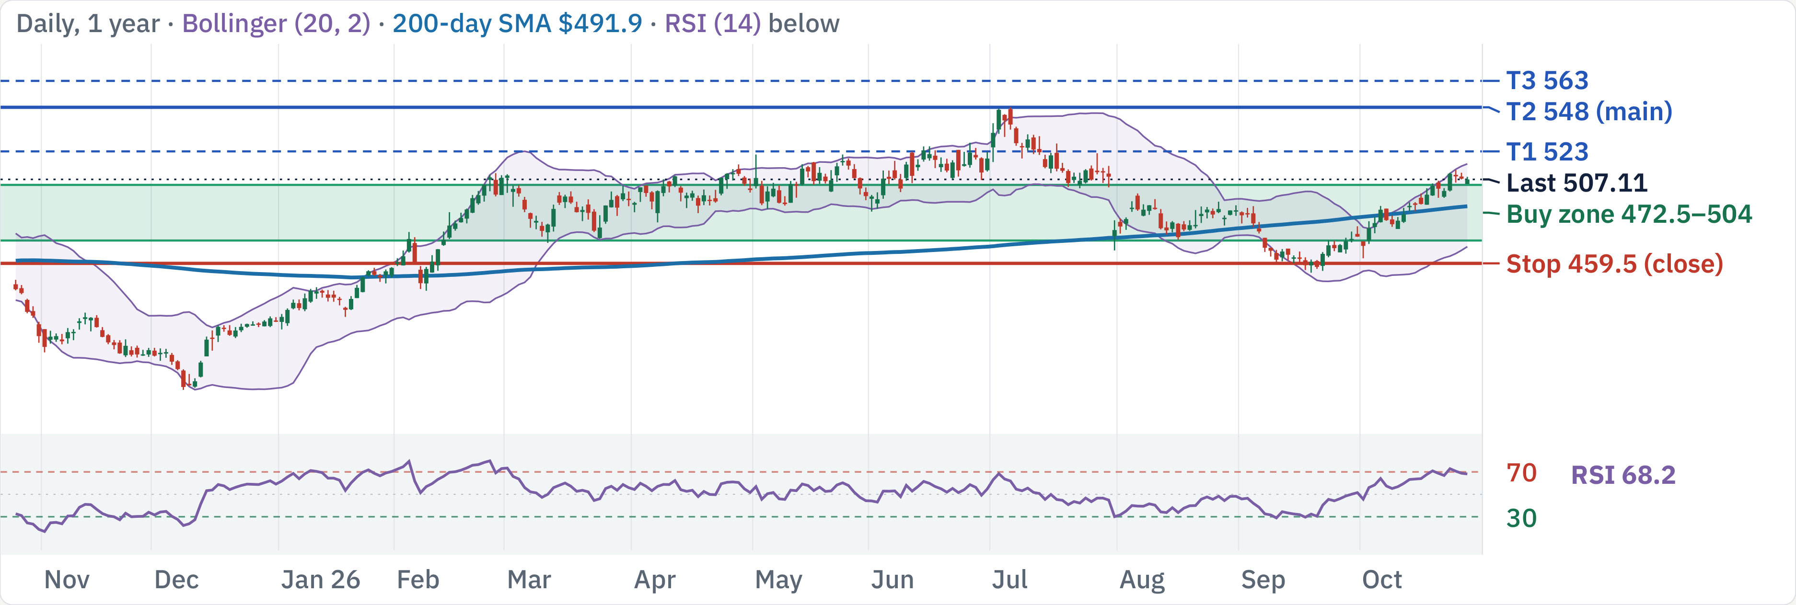
LIN at $507.11: earnings Oct 29 first, then buy dips
200-day SMA
RSI (14)
MACD hist
ADX (14)
ATR
$491.9 · Bullish
68 · Strong
+1.73 · Bullish
31.8 · Trending
1.5% · Low vol
Uptrend; Oct 29 earnings first. Then ladder $472.5–504; buying now is 0.9:1 to $548.
Est. win rate to $548 (3–6 mo)
72–82% · clears your 60% goal
LIN technical review · Daily, 1 year · Source: Yahoo Finance, TradingView, Oct 27, 2026 close · 1 / 5

Slide 67
Factors: steady compounder at a 27× forward multiple
Factor
Reading
Verdict
Momentum
1m +7.4%, 3m −0.8%, 6m −0.6%, 12m +14%
Mixed
Growth
2026 adj. EPS guide $17.70–17.90 (+8–9%); backlog $11B
Tailwind
Value
P/E 32.7 trailing, 27.1 forward; EV/EBITDA 18.6; PEG 2.9
Headwind
Quality
Op. margin 28.2%, ROIC 12.4%, FCF $5.0B (14%)
Tailwind
Leverage
Net debt $23.1B (debt 28.0B, cash 4.9B); D/E 0.69
Neutral
Beta
0.71 (5Y); realized vol 60d 15%, 20d 14%
Tailwind
Capital return
Dividend 1.3% + buyback 2.0%
Neutral
Crowding
Short interest 1.30% of float, 3.0 days to cover
Neutral
Analysts
15 analysts: 93% Buy; avg target $558 (range 530–580)
Tailwind
Size
$233B market cap; ~2.0M shares (~$1.0B) a day
Neutral
Margins and beats versus 27× forward P/E and margin pressure; earnings Oct 29.
Sources: Yahoo Finance; stockanalysis.com (Oct 27); Futu (Oct 20); Linde Q2 release; Yahoo/Hudson Labs previews · 2 / 5

Slide 68
Wait for the Oct 29 print, then ladder in; stop $459.5
Buy ladder: 3 × 33%, limit VWAP
Resistance
Note
$563
T3: ATR projection
Tranche
Limit
Zone
Why it holds
$548
T2: 52w high
1
$504
$500–508
2× pivot
$523
T1: 4× pivot
2
$486.5
$482.5–490.5
50d SMA · 3× pivot
$510
BB upper · 2× pivot
3
$472.5
$469–476.5
BB lower · 3× pivot
Exit and risk
Support
Note
$504
2× pivot
Level
Price
Role
R:R, 1 → 3 fills
$497.5
200d SMA · 2× pivot
Stop
$459.5
Daily close below support
Risk $44.5 → 28.17
$490.5
200d SMA · swing pivot
T1
$523
Partial · 4× pivot
0.4 → 1.3
$477.5
50d SMA · swing pivot
T2
$548
Main · 52w high
1.0 → 2.1
$459.5
Stop level
T3
$563
Stretch · ATR projection
1.3 → 2.7
Average cost: $504 with 1 fill, $487.67 with all 3. R:R is measured to the $459.5 stop.
LIN technical review · Levels from daily chart, Oct 27, 2026 close · 3 / 5

Slide 69
Next 3 months: macro and company catalysts
Macro
Company-specific
FOMC: Oct 28 hold, Dec 9 hike priced
Q3 results Oct 29, before the open
Rate 3.75–4.00%; ~90% hold Oct, ~80% Dec hike odds
Call 9am ET; EPS est. ~$4.52, revenue ~$9.16B
Data: CPI and jobs
Company guide
CPI Nov 10, Dec 10 · Jobs Nov 6, Dec 4 · PCE Nov 25
Q3 adj. EPS $4.45–4.55 (+6–8%); FY $17.70–17.90
US midterm elections
Beat record
Nov 3 · Nov up in 21 of 24 midterm years (one source)
Beat EPS consensus in 8 of the last 8 quarters
US–China trade truce
Project backlog
Runs to Jan 10, 2027; chip export curbs unchanged
$11B record; sale-of-gas $8.1B; capex $5.5–6.0B
Industrial activity and energy costs
Margin pressure
Industrial gas demand; helium supply; chip fabs
Q2 adj. operating margin fell 60bp to 29.5%
Helium costs
Dislocation costs dilute margin; guide unchanged
Sources: Fed calendar; fedratecalc.com; CNBC; Linde Q2 release; Yahoo; MarketBeat · 4 / 5

Slide 70
Execution risks and how to trade around them
Macro and the Fed
Earnings gap
Earnings Oct 29
Fed funds 3.75–4.00%; a Dec 9 hike is
Reports Oct 29, before the open. A gap can
The print lands tomorrow; the stock is near
largely priced. CPI 3.7%, jobs +29k.
jump the stop; Guide: Q3 adj. EPS $4.45–
its 52-week range top with a 27× multiple.
Do: Stage fills around Nov 3 and Dec 9; no
4.55.
Do: Wait for the print, then ladder in.
all-in entry.
Do: Wait for the print; recheck levels. No
fills before it.
Premium multiple
Margin pressure
Ladder rules
PEG 2.9 leaves little room for a guide cut or
Q2 margin fell 60bp on inflation; recovery in
3 × 33%, limit VWAP capped at 504 /
margin miss.
Q3 is promised, not proven.
486.5 / 472.5
Do: Buy only the ladder limits; respect the
Do: Judge the print on margin, not EPS
Wait for the Oct 29 print before any fill
stop.
alone.
Exit all on a daily close below $459.5
Partial at 523, main exit 548, runner to
563
Sources: Bloomberg; CNBC; company filings; stockanalysis.com, Oct 27, 2026 · 5 / 5

Slide 71
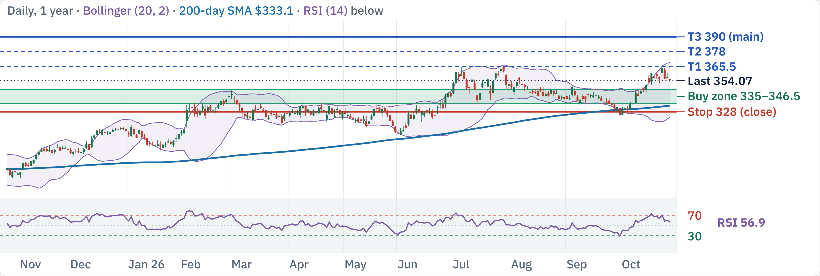
CB at $354.07: uptrend, buy the pullback
200-day SMA
RSI (14)
MACD hist
ADX (14)
ATR
$333.1 · Bullish
57 · Neutral
+0.93 · Bullish
27.7 · Trending
1.7% · Low vol
Uptrend; buying now is 1.4:1 to $390. Wait for $335–346.5.
Est. win rate to $390 (3–6 mo)
80–90% · clears your 60% goal
CB technical review · Daily, 1 year · Source: Yahoo Finance, TradingView, Oct 27, 2026 close · 1 / 5

Slide 72
Factors: top-tier insurer at 12× earnings, analysts neutral
Factor
Reading
Verdict
Momentum
1m +6.9%, 3m −2.2%, 6m +7.2%, 12m +26%
Mixed
Growth
P&C premiums +1.9%; N. America commercial −2.7%
Neutral
Value
P/E 12.4 trailing, 12.3 forward; EV/EBITDA 10.9
Tailwind
Quality
Q3 core EPS $7.66 record; P&C combined ratio 84.1%
Tailwind
Leverage
Debt $21.4B vs cash $8.3B; D/E 0.27 (insurer)
Neutral
Beta
0.37 (5Y); realized vol 60d 17%, 20d 22%
Tailwind
Capital return
Dividend 1.15% + buyback 2.8%
Neutral
Crowding
Short interest 0.91% of float, 1.9 days to cover
Tailwind
Analysts
13 analysts: only 31% Buy, 62% Hold; avg target $374
Neutral
Size
$136B market cap; ~1.5M shares (~$0.5B) a day
Neutral
Record income and a 12× P/E versus softer commercial pricing and a Hold consensus.
Sources: Yahoo Finance; stockanalysis.com (Oct 27); Futu (Oct 27); Chubb Q3 release via Investing.com/The Insurer · 2 / 5

Slide 73
Buy support in 2 tranches; stop at $328
Buy ladder: 2 × 50%, limit VWAP
Resistance
Note
$390
T3: ATR projection
Tranche
Limit
Zone
Why it holds
$378
T2: ATR projection
1
$346.5
$343.5–349
3× pivot
$365.5
T1: 52w high
2
$335
$332–337.5
200d SMA · 6× pivot
Exit and risk
Support
Note
$346.5
3× pivot
Level
Price
Role
R:R, 1 → 2 fills
$342
50d SMA · swing pivot
Stop
$328
Daily close below support
Risk $18.5 → 12.75
$335
200d SMA · 6× pivot
T1
$365.5
Partial · 52w high
1.0 → 1.9
$325
BB lower · swing pivot
T2
$378
Stretch · ATR projection
1.7 → 2.9
$328
Stop level
T3
$390
Main · ATR projection
2.4 → 3.9
Average cost: $346.5 with 1 fill, $340.75 with all 2. R:R is measured to the $328 stop.
CB technical review · Levels from daily chart, Oct 27, 2026 close · 3 / 5

Slide 74
Next 3 months: macro and company catalysts
Macro
Company-specific
FOMC: Oct 28 hold, Dec 9 hike priced
Q3 reported Oct 20
Rate 3.75–4.00%; ~90% hold Oct, ~80% Dec hike odds
Core EPS $7.66 vs $6.79 est.; core income $2.98B
Data: CPI and jobs
Combined ratio
CPI Nov 10, Dec 10 · Jobs Nov 6, Dec 4 · PCE Nov 25
P&C 84.1% vs 81.8% a year ago; cat losses $705M
US midterm elections
Investment income
Nov 3 · Nov up in 21 of 24 midterm years (one source)
Record adjusted net investment income $1.89B
US–China trade truce
Pricing softening
Runs to Jan 10, 2027; chip export curbs unchanged
Commercial P&C more competitive in US and London
Rates, catastrophes and P&C pricing
Reserve releases
Yields lift investment income; hurricane and reinsurance
Favorable prior-period development $511M (vs $361M)
Next earnings
Late Jan 2027 (est.; not announced)
Sources: Fed calendar; fedratecalc.com; CNBC; Chubb Q3 release; Investing.com; Motley Fool · 4 / 5

Slide 75
Execution risks and how to trade around them
Macro and the Fed
Softening market
Catastrophe volatility
Fed funds 3.75–4.00%; a Dec 9 hike is
Chubb itself says commercial P&C pricing is
Q3 cat losses were $705M vs $285M; Q4
largely priced. CPI 3.7%, jobs +29k.
getting more competitive.
weather can swing earnings.
Do: Stage fills around Nov 3 and Dec 9; no
Do: Expect slower premium growth; size
Do: Ladder in; avoid one big fill.
all-in entry.
modestly.
Hold consensus
Rate sensitivity
Ladder rules
Only 4 of 13 analysts rate it Buy; the average
Chubb booked $4.5B of mark-to-market
2 × 50%, limit VWAP capped at 346.5 /
target is ~6% above the price.
losses as yields rose.
335
Do: Needs a pullback entry for 3:1.
Do: Watch the 10-year yield around CPI
Next tranche only after the last one fills
and Fed.
and holds
Exit all on a daily close below $328
Partial at 365.5, main exit 390, runner to
390
Sources: Bloomberg; CNBC; company filings; stockanalysis.com, Oct 27, 2026 · 5 / 5

Slide 76
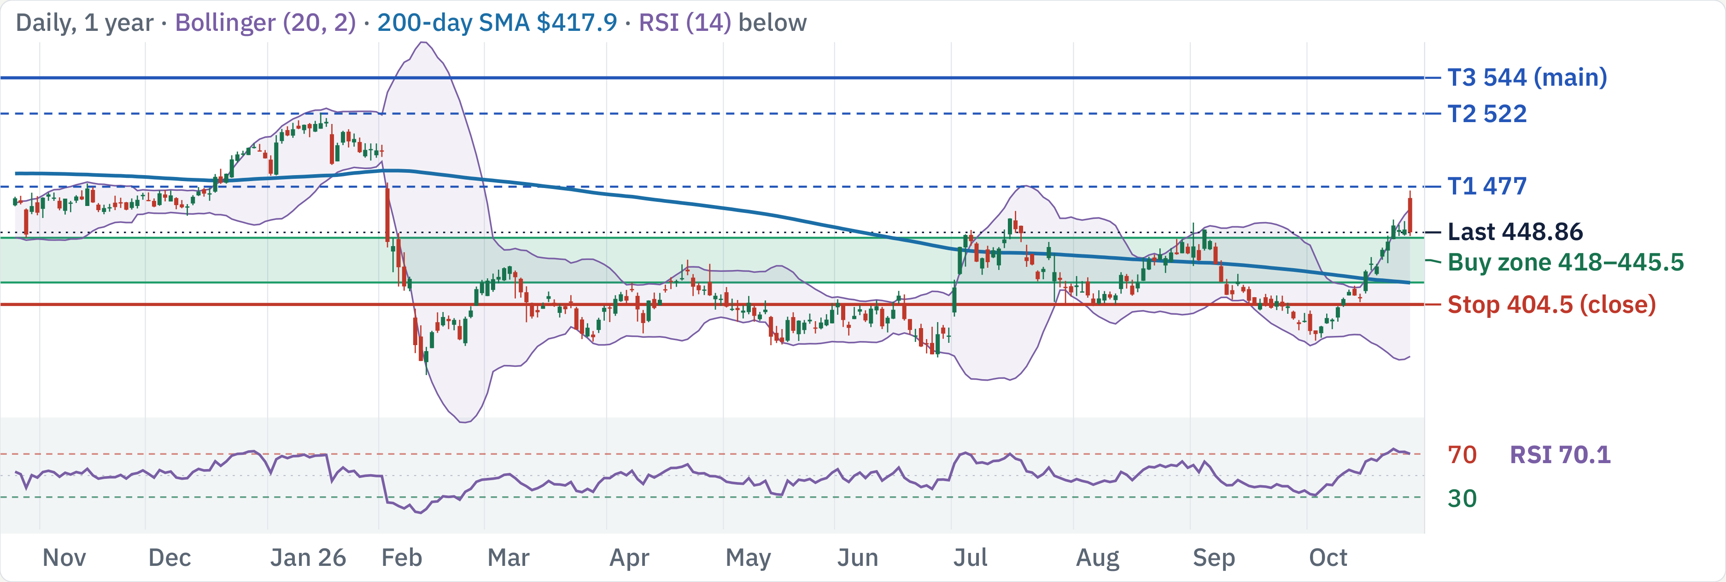
SPGI at $448.86: mixed trend, buy only at support
200-day SMA
RSI (14)
MACD hist
ADX (14)
ATR
$417.9 · Bullish
70 · Overbought
+4.81 · Bullish
30.2 · Trending
2.4% · Low vol
Mixed trend; buying now is 2.1:1 to $544. Clears your bar.
Est. win rate to $544 (3–6 mo)
49–59% · below your 60% goal
SPGI technical review · Daily, 1 year · Source: Yahoo Finance, TradingView, Oct 27, 2026 close · 1 / 5

Slide 77
Factors: high-margin franchise, down 8% on the year
Factor
Reading
Verdict
Momentum
1m +13%, 3m +7.0%, 6m +9.5%, 12m −3.1%
Mixed
Growth
Q3 revenue +7%; adj. EPS $4.58 (+9%); 2026 guide raised
Tailwind
Value
P/E 26.6 trailing, 23.0 forward; EV/EBITDA 16.7
Neutral
Quality
Op. margin 44.6%, ROIC 13.2%, FCF $5.7B (35%)
Tailwind
Leverage
Net debt $11.0B (debt 13.5B, cash 2.4B); D/E 0.53
Neutral
Beta
1.1 (5Y); realized vol 60d 24%, 20d 21%
Neutral
Capital return
Dividend 0.87% + buyback 3.3%
Tailwind
Crowding
Short interest 2.23% of float, 3.3 days to cover
Neutral
Analysts
17 analysts: 100% Buy; avg target $520 (range 477–553)
Tailwind
Size
$130B market cap; ~1.9M shares (~$0.9B) a day
Neutral
45% margin and a guide raise versus slowing Ratings growth; data review is a wildcard.
Sources: Yahoo Finance; stockanalysis.com (Oct 27); Futu (Oct 14); S&P Global Q3 release (Oct 27) via Investing.com/MarketBeat · 2 / 5

Slide 78
Buy support in 3 tranches; stop at $404.5
Buy ladder: 3 × 33%, limit VWAP
Resistance
Note
$487
2× pivot
Tranche
Limit
Zone
Why it holds
$477
T1: 2× pivot
1
$445.5
$442–449
swing pivot
$459.5
BB upper · 2× pivot
2
$430
$426.5–433.5
2× pivot
$452.5
2× pivot
3
$418
$415–421.5
50d SMA · swing pivot
Exit and risk
Support
Note
$445.5
swing pivot
Level
Price
Role
R:R, 1 → 3 fills
$430
2× pivot
Stop
$404.5
Daily close below support
Risk $41 → 26.67
$418
50d SMA · swing pivot
T1
$477
Partial · 2× pivot
0.8 → 1.7
$410.5
2× pivot
T2
$522
Stretch · 52w high
1.9 → 3.4
$404.5
Stop level
T3
$544
Main · ATR projection
2.4 → 4.2
Average cost: $445.5 with 1 fill, $431.17 with all 3. R:R is measured to the $404.5 stop.
SPGI technical review · Levels from daily chart, Oct 27, 2026 close · 3 / 5

Slide 79
Next 3 months: macro and company catalysts
Macro
Company-specific
FOMC: Oct 28 hold, Dec 9 hike priced
Q3 reported Oct 27
Rate 3.75–4.00%; ~90% hold Oct, ~80% Dec hike odds
Revenue $3.678B (+7%); adj. EPS $4.58 vs ~$4.43 est.
Data: CPI and jobs
Guidance raised
CPI Nov 10, Dec 10 · Jobs Nov 6, Dec 4 · PCE Nov 25
FY adj. EPS $17.70–17.95; organic growth 7.5–8.5%
US midterm elections
Ratings slowing
Nov 3 · Nov up in 21 of 24 midterm years (one source)
Ratings growth ~2%; slight Q4 dip in transaction revenue
US–China trade truce
Strategic review
Runs to Jan 10, 2027; chip export curbs unchanged
Capital IQ and related data businesses under review
Debt issuance and market activity
Stock reaction
Credit-market issuance, index fund flows, rates path
Up ~1–5% on the day (sources differ); mid-day ~$453
Next earnings
Late Jan/Feb 2027 (est.; not announced)
Sources: Fed calendar; fedratecalc.com; CNBC; S&P Global Q3 release; MarketBeat · 4 / 5

Slide 80
Execution risks and how to trade around them
Macro and the Fed
Ratings cycle
Priced in?
Fed funds 3.75–4.00%; a Dec 9 hike is
Ratings growth slowed to ~2% against tough
Commentary says the beat and guide raise
largely priced. CPI 3.7%, jobs +29k.
comparisons; Q4 transaction revenue dips
may already be in the price.
Do: Stage fills around Nov 3 and Dec 9; no
slightly.
Do: Wait for a pullback; no chasing the gap.
all-in entry.
Do: Expect a softer Q4; ladder in.
Review outcome
Data conflict
Ladder rules
The Capital IQ strategic review has no
Sources differ on net income and the size of
3 × 33%, limit VWAP capped at 445.5 /
timetable; the result is uncertain.
the stock move.
430 / 418
Do: Treat any deal headline as a risk event.
Do: Check the 8-K before acting on figures.
Next tranche only after the last one fills
and holds
Exit all on a daily close below $404.5
Partial at 477, main exit 544, runner to
544
Sources: Bloomberg; CNBC; company filings; stockanalysis.com, Oct 27, 2026 · 5 / 5

