Slide 1
Department of Communication Engineering
Subject Study Report
Subject：Self-Ordering System and Analytics
Adviser： Chien-Peng Ho, Ph.D.
Member：Ren-Kui Chen
Bor-Shen Chen
Notes:
I am on behalf of all the faculties in OIT to greet you here
There is a Chinese old saying , “All men are brothers” In other words we are all relatuves.

Slide 2
Outline
Preface
Motivation
Introduction
Process
Technique
On table
Waiter
Kitchen
Management
Firebase
Conclusion

Slide 3
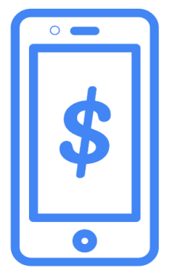
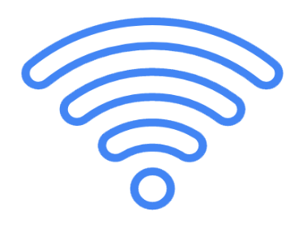






Motivation
Mobile Phone + Third-party payment platform.
Reduce costs for businesses
➔ mobile phone to replace people.

Slide 4


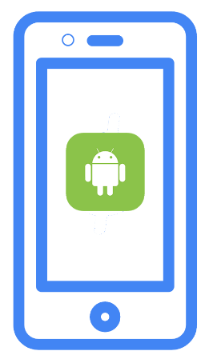

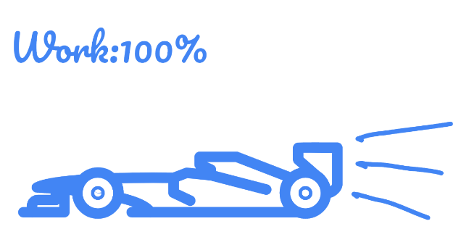

Motivation
Our project
A workflow to minimize the number of waiters or workload for restaurants.
Android-based High-tech restaurant without cashier.

Slide 5
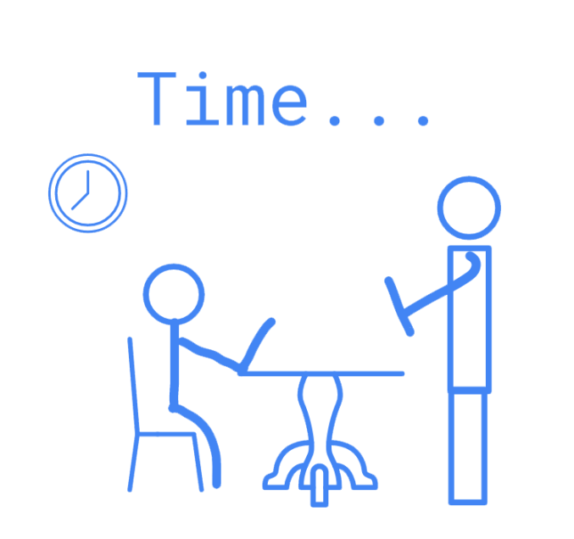
Introduction
Example in life：
There is a restaurant business model is:
taking of orders
preparing of food
serving and billing.
This is very waste time!

Slide 6
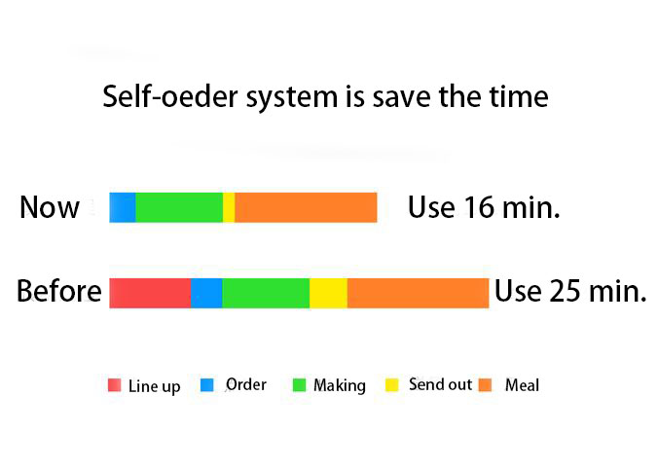
Example in life
Introduction
Source: https://kknews.cc/zh-mo/news/xj2zx8.html

Slide 7

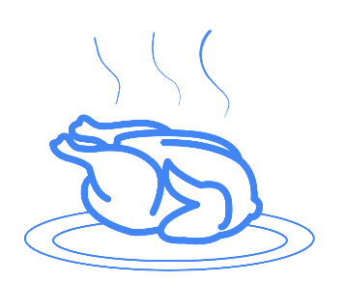





Proposed System
Our system is aim to:
the waiter’s work can let down and avoid the mistakes.
Indirectly reduce manpower arrangements

Slide 8
Proposed System

Slide 9



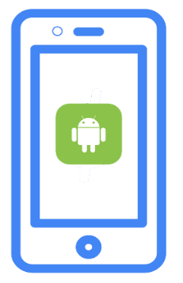
Problem & Point
We sort out five questions.
Automation
Human resources management
Logistics materials management
Revenue
Payment
Firebase

Slide 10
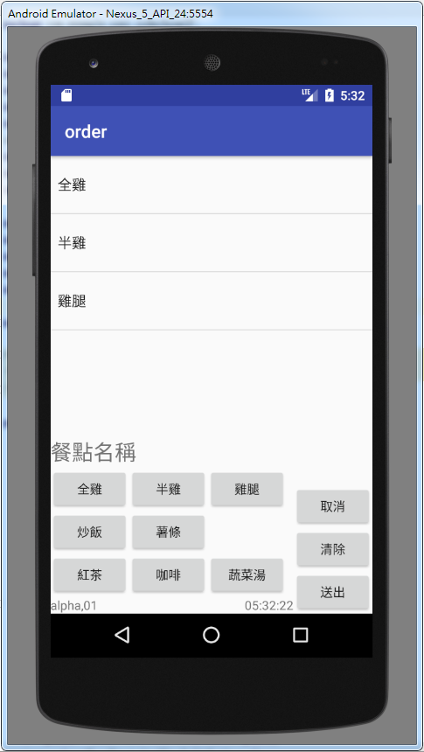
Process
Question 1: How to save manpower to getting order by customer?
Answer 1: the customer need order by themselves. We install our system on desk, includes meal introduction.

Slide 11
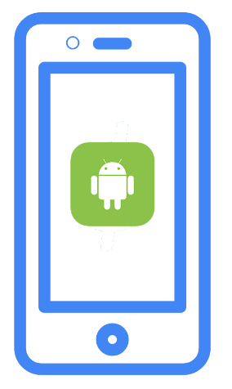


Process
When it is done. Meal list will send to kitchen.
After take a place, waiter can do something else. Do not have to wait for your order.

Slide 12


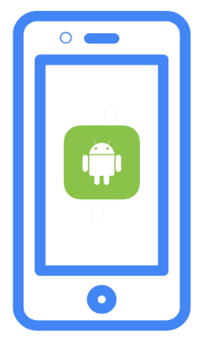

Process
Question 2 : how to avoid the mistakes by waiter or chef ?
Answer 2 : use automatic system to send meals information to kitchen.

Slide 13
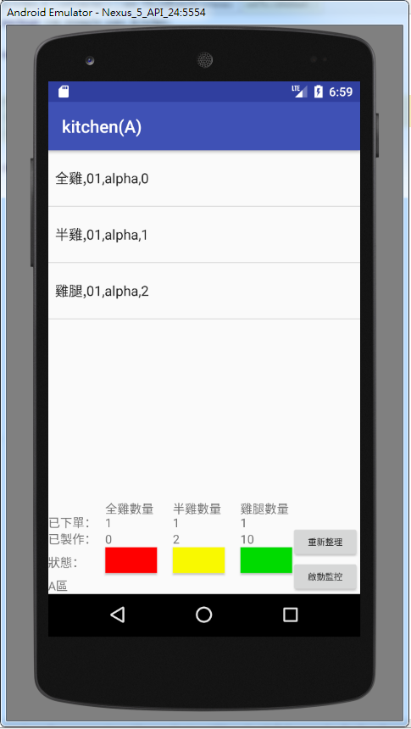



Process
The chef just watch screen, do the meal. And finish it to waiter take it for customer.

Slide 14

Process
Question 3: can we predict that there will be fewer meals?
Answer 3: we use historical statistics to predict future trends.

Slide 15
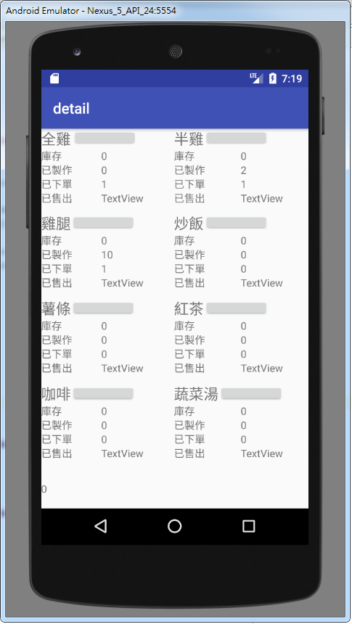
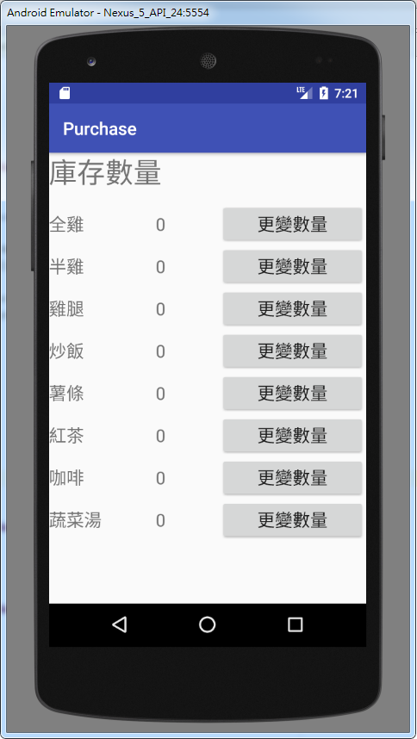
Process
At the same time analyze sales to inventory management.

Slide 16
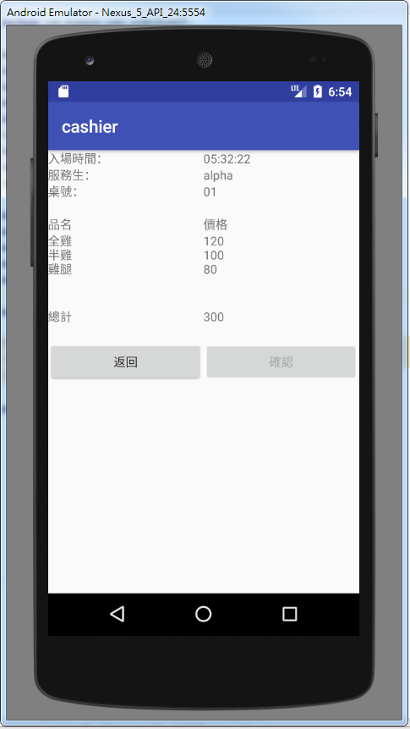
Process
Question 4: can we use third party payment?
Answer 4: It need Credit Card Center and Bank license to support this function.

Slide 17
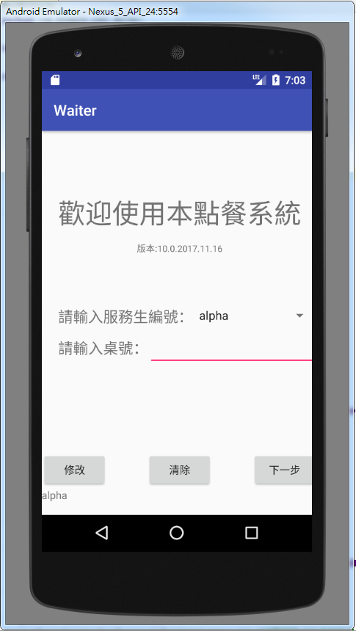
Process
Question 5: if customer wants to change meal. How can change it?
Answer 5: they need talks to
waiter. The waiter will use his
App to change data.

Slide 18
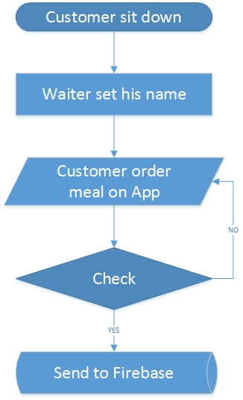
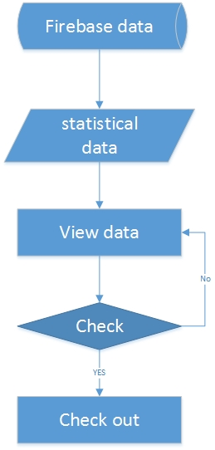
On table

Slide 19
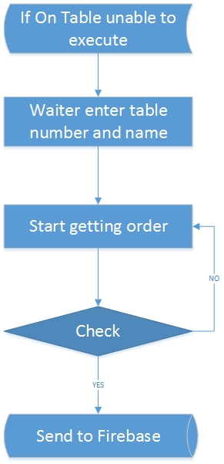
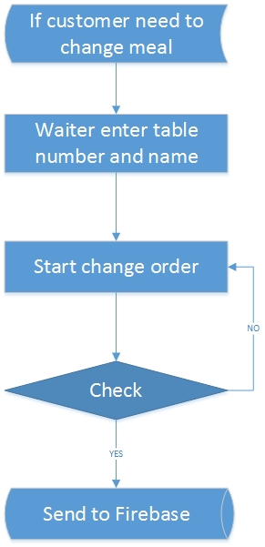
Waiter

Slide 20
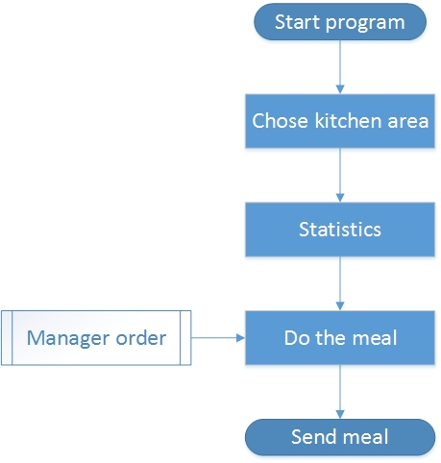
Kitchen

Slide 21
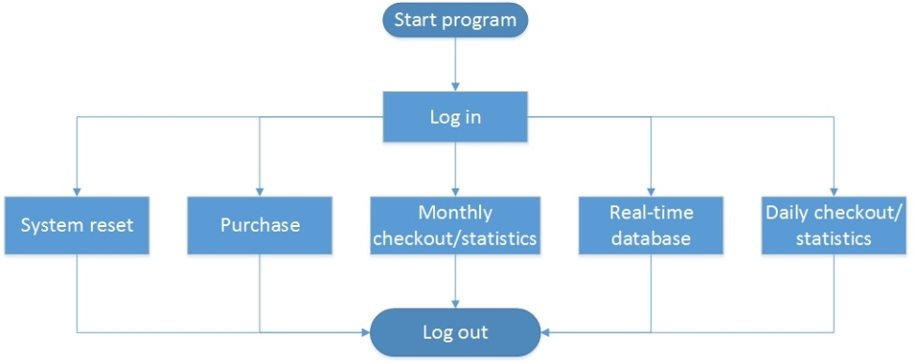
Management

Slide 22
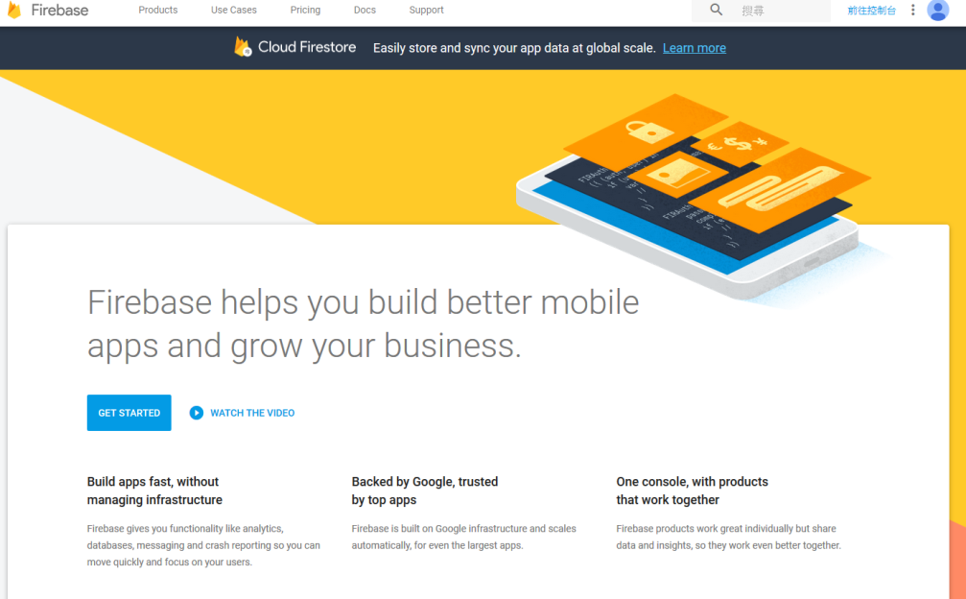
Firebase
What is Firebase?
Firebase is a mobile and web application development platform developed by Firebase, Inc. in 2011, then acquired by Google in 2014.

Slide 23
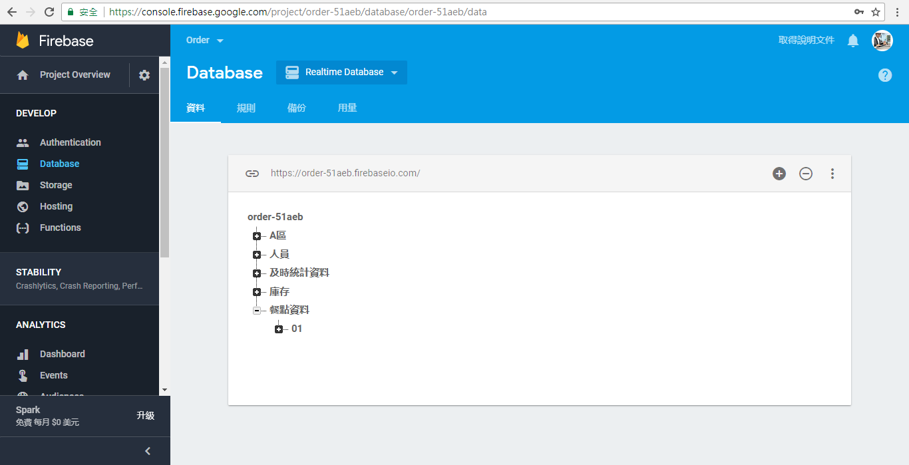
Firebase
We use features of Real time database.

Slide 24
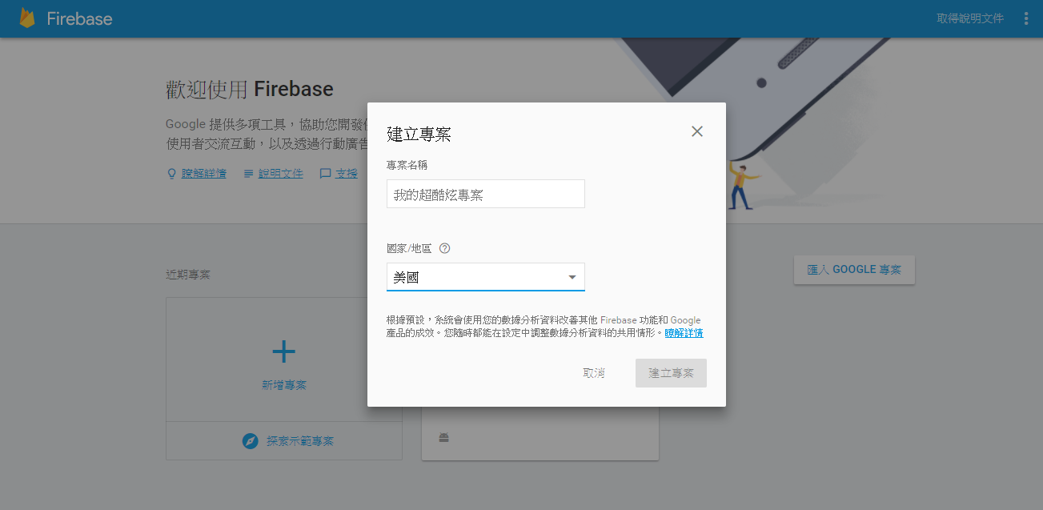
Firebase
Go to Firebase web: https://firebase.google.com/ and Sign in your Google account number.
Created new project and select country.

Slide 25
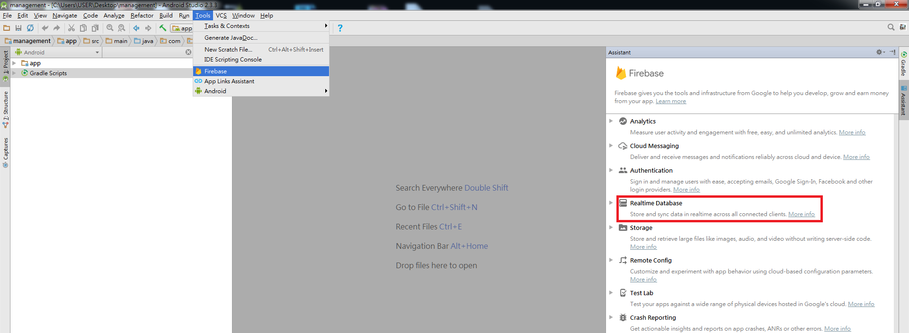
Firebase
Open Android Studio →Tool →Firebase →Real-time data base.

Slide 26
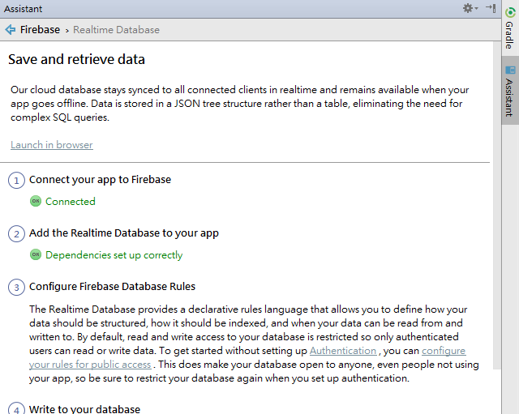
Firebase
Complete step one and two(link firebase and add code).
Start use it.

Slide 27
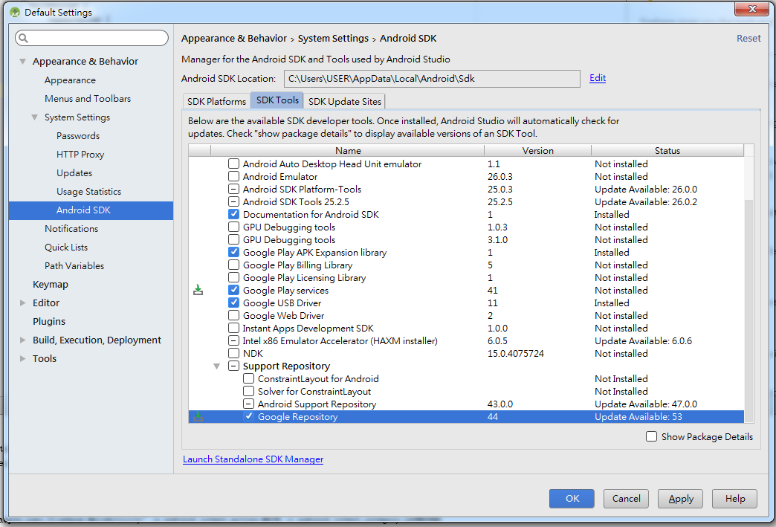
Firebase
SDK : Google play services, Google Repository, Android Support Repository.

Slide 28
Firebase
Add data:
Delete data:
Replace data:
On the same node, it will automatically replace data.

Slide 29
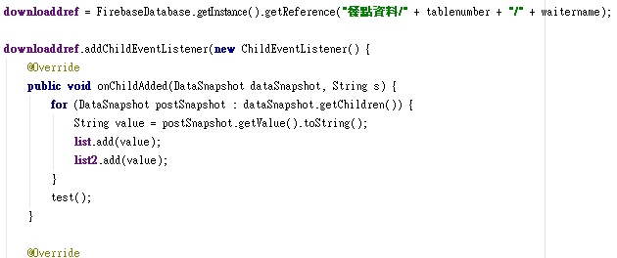
Firebase
Read data:

Slide 30
Experimental Results
Test | Take place | Order | Send meal | Cashier | Difference
A | 1.5 | 5 | 5 | 1.5 | 7
B | 1 | 4 | 4 | 2 | 4
C | 1.6 | 6 | 6 | 1 | 8.6
Test | Take place | Order | Send meal | Cashier | Difference
A | 1 | 2 | 2 | 1 | 7
B | 1 | 3 | 2 | 1 | 4
C | 1 | 2 | 2 | 1 | 8.6
Unit : min.

Slide 31
Conclusion
Reduce the work content of the waiter(order、cashier). Focus on take the meal. Indirectly reduce the number of daily commuters .
Information delivery automation, avoid human error .
Statistics for prediction and management.
Third-party payment cooperation.

