Slide 1
A Virtual Time System for Container-based Emulation of Software-defined Networking
Jiaqi Yan
Illinois Institute of Technology

Slide 2
Project Achievements
Research paper published at the Symposium on SDN Research 2015 (SOSR2015)
  Accept rate = 19.7%
Research paper published at the 2015 ACM SIGSIM Principles of Advanced Discrete Simulation
  One of 3 candidates of best paper
Poster appeared on the 2015 ACM SIGSIM PADS PhD Colloquium and Poster Session
Implementation and Experiments are Open Sourced at https://github.com/littlepretty/VirtualTimeForMininet

Slide 3
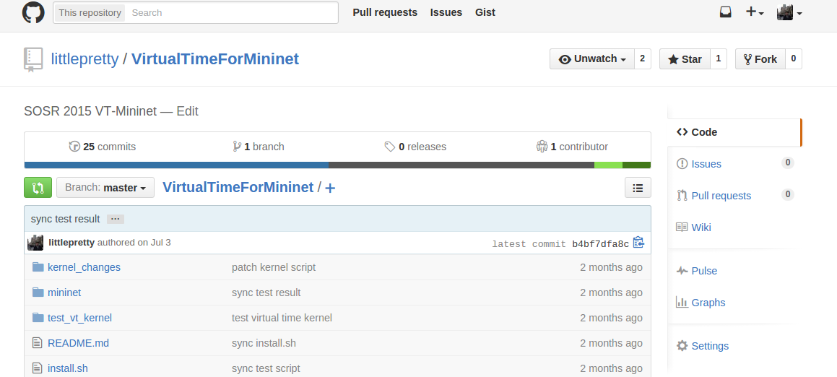
Project Achievements
Project on Github https://github.com/littlepretty/VirtualTimeForMininet

Slide 4
Outline
Background: Testing Systems for Computer Networked System
Motivating Problem: Temporal Fidelity for Scalable Emulation of SDN
Proposed Solution: Virtual Time
Related Works
System Design & Implementation
Experimental Evaluation & Case Study
Conclusion & Future Works

Slide 5
Background: Testing System
Computer networked system is large and complex
Critical to evaluate network applications and protocols prior to deployment
Categories
  Physical Testbeds
  Simulators
  Emulators

Slide 6


Physical Testbed
Highest fidelity: testing on an exact or almost exact copy of the original system
Limitation: scalability, generality, technically challenging and economically infeasible

Slide 7





Simulator
Scalable: only modelling the real system mathematically
Limitation: fidelity of modelled system is often in question due to abstraction and simplification

Slide 8
Emulator
To preserve fidelity: execute unmodifed network applications/software
To enhance scalability:
  use lightweight virtualization technique to run virtual machines inside controlled networking environment
  integrate with simulators

Slide 9



Motivating Problem
Container-based Software-defined Networking emulator
Applications
QoS
Access Control
VPN
Control Plane
OpenFlow Controller
OpenFlow Protocol
Data Plane
Net 3
Net 6
Net 1
Net 2
Net 4
OpenFlow Switches
Net 5

Slide 10


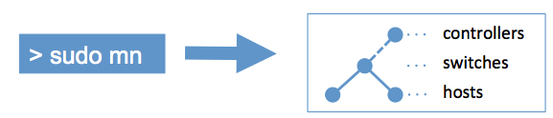

Mininet: SDN Emulator
Most popular container-based SDN simulator
  912 stars and 462 forks on Github
OS-level virtualization, e.g. Linux namespace/container
  Scalability: support hundreds of nodes on a single PC/laptop because container is more lightweight than para/full-virtualization(Xen, QEMU etc)
  Fidelity: share network stack code and execute real software
Typical workflow

Slide 11
Motivation: Temporal Fidelity for Scalable SDN Emulation
Unreliable emulation results under large topology with high traffic load
Performance[Handigol et. Al 2012]: “target experiment's aggregate resource must fit within a single multi-core server, for example:
  2.98 GHz of CPU, 4 GB RAM, 3 Gbps of internal packet bandwidth
  In the best case, user can build a toplogy of nearly 30 nodes with 100 MHz CPU, 100 MB RAM each, connected by 100 Mbps links
Temporal fidelity: execution of multiple Vms is serialized, rather than in parallel like physical testbed
Unreliable emulation results under large topology with high traffic load
Performance[Handigol et. Al 2012]: “target experiment's aggregate resource must fit within a single multi-core server, for example:
  2.98 GHz of CPU, 4 GB RAM, 3 Gbps of internal packet bandwidth
  In the best case, user can build a toplogy of nearly 30 nodes with 100 MHz CPU, 100 MB RAM each, connected by 100 Mbps links
Temporal fidelity: execution of multiple Vms is serialized, rather than in parallel like physical testbed
Unreliable emulation results under large topology with high traffic load
Performance[Handigol et. Al 2012]: “target experiment's aggregate resource must fit within a single multi-core server, for example:
  2.98 GHz of CPU, 4 GB RAM, 3 Gbps of internal packet bandwidth
  In the best case, user can build a toplogy of nearly 30 nodes with 100 MHz CPU, 100 MB RAM each, connected by 100 Mbps links
Temporal fidelity: execution of multiple Vms is serialized, rather than in parallel like physical testbed
Unreliable emulation results under large topology with high traffic load
Performance[Handigol et. Al 2012]: “target experiment's aggregate resource must fit within a single multi-core server, for example:
  2.98 GHz of CPU, 4 GB RAM, 3 Gbps of internal packet bandwidth
  In the best case, user can build a toplogy of nearly 30 nodes with 100 MHz CPU, 100 MB RAM each, connected by 100 Mbps links
Temporal fidelity: execution of multiple Vms is serialized, rather than in parallel like physical testbed
N. Handigol, B. Heller, et al. “Reproduce network experiments using container-based emulation”. In Proc of the 8th International Conference on Emerging Networking Experiments and Technologies, pp 253-264, 2012

Slide 12
Proposed Approach: Virtual Time
Time dilation
  Time dilation factor (TDF) by [Gupta et al, 2011]
  Time passing rate in physical world
  Time passing rate in VM's perception of time
TDF = 10: for every ten seconds of real time, applications running in a time-dilated emulated host perceive the time advancement as one second
  A 100 Mbps link is scaled to a 1 Gpbs link from the emulated host's viewpoint.
D. Gupta, K. V. Vishwanath, et al. “Diecast:Testing distributed systems with an accurate scale model”. ACM Transactions on Computer Systems,29(2):1–48, 2011

Slide 13
Related Works
ToInfinity&Beyond , 2005 by D. Gupta, K. V. Vishwanath, M. McNett et al
SVEET, 2009 & VENICE, 2010 by M.A. Erazo, Yue Li and Jason Liu
Time Jails, 2008 & NETbalance, 2011 by A. Grau, S. Maier, K. Herrmann and K. Rothermel
SliceTime, 2011 by E. Weing, F. Schmidt, H. Lehn, Hendrik et al
TimeKeeper, 2014 by J. Lamps, D. M. Nicol, and M. Caesar

Slide 14
Related Works
 | Virtual Machine Platform | Virtual Time Implementation
ToInfinity&Beyond | Xen | Time dilation & modify hypervisor
SVEET | Xen | Time dilation
NETbalance | Xen & OpenVZ | Time dilation
SliceTime | Xen | Modify hypervisor
S3FNet | OpenVZ | Modify hypervisor
TimeKeeper | Linux container | Time dilation & modify hypervisor

Slide 15
Virtual Time for Linux Container
Design Goals
  Lightweight
  Scalable
  Transparent to network applications (require zero modification)
  Target: Mininet, the most popular SDN emulator

Slide 16
Architecture

Slide 17
Implementation
Extend Linux Kernel
  Timekeeping
  Container/Namespace create
  Network traffic schedule
  Virtual dynamic shared object
Modify Mininet
  Virtual time API for network hosts
  Adaptive TDF Scheduling
Open Source at Github https://github.com/littlepretty/VirtualTimeForMininet

Slide 18
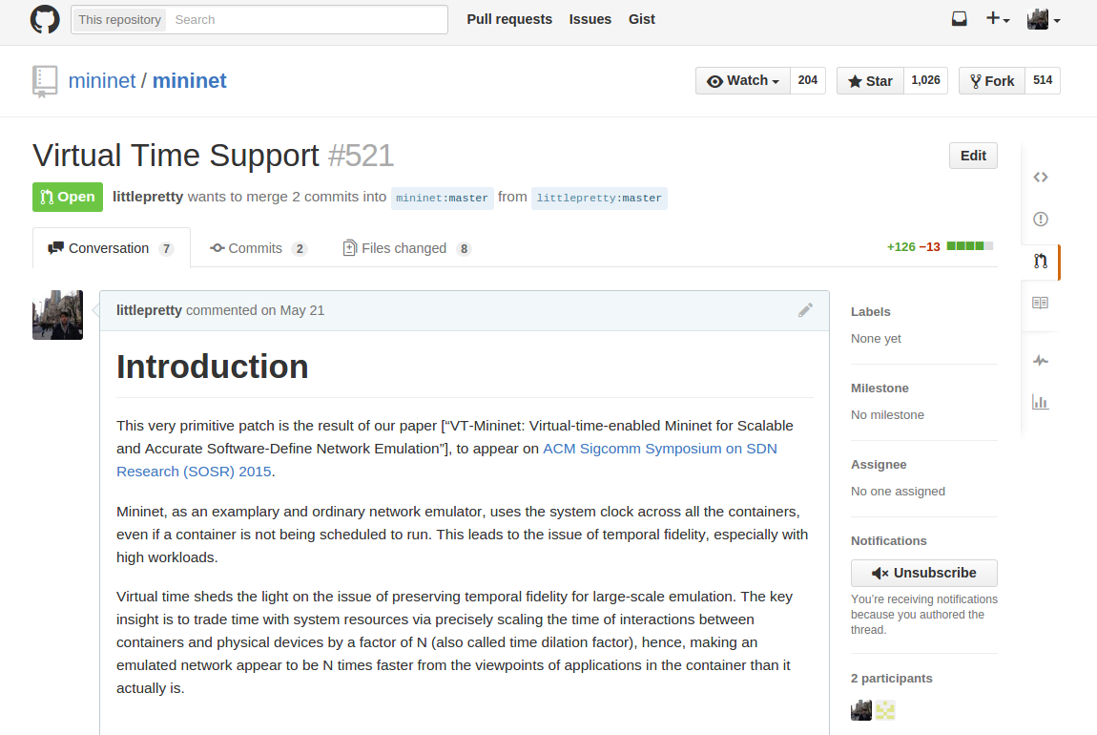
Implementation
Pull Request of virtual time patch at Mininet's project site

Slide 19
Extend Linux Kernel
Timekeeping
  virtual_start_nsec: when a process starts advancing its virtual time
  physical_past_nsec && virtual_past_nsec: how much physical/virtual time has passed since the last time a process request time
  dilation: a process's TDF
  Explicitly invoking do_dilatetimeofday: helper function in timekeeping system that maintain physical_past_nsec && virtual_past_nsec

Slide 20
Extend Linux Kernel
Container/Namespace creation
  init_virtual_time: do initializing works when process is about to enter virtual time
  virtual_time_unshare: similar to unshare system call but with additional TDF argument
  set_time_dialation_factor: userspace interface for changing a container's time dilation, e.g. all the processes inside a particular container

Slide 21
Extend Linux Kernel
Virtual Dynamic Shared Object (vDSO)
gettimeofday is one of the most frequently invoked system calls
  [http://lwn.net/articles/446528]: to optimize the overhead of context switching, kernel allows the page containing the current time to be mapped read-only into userspace; that page also contains a fast gettimeofday() implementation
  Disable vDSO to make virtual time transparent to network software & applications

Slide 22
Extend Linux Kernel
Network related: traffic control suite tc [Almesberger, 1999] in network QoS
  qdisk(queueing discipline) + filter(classify packets by header) + classes(nested qdisc)
  Dilate rate of qdisc
  No matter what type of queueing discipline is used to schedule packets (typically Hierarchy Token Bucket or Token Bucket Filter) --- thanks to well-designed interface/architecture of Linux
W. Almesberger. “Linux traffic control: implementation overview”. In Proceedings of 5th Annual Linux Expo, pages 153–164, April 1999.

Slide 23
Modify Mininet
Virtual Time API
  Create network hosts(associated with container) with virtual clock
    Invoke virtual_time_unshare() when create hosts
  Change the speed of virtual clock belonging to certain container
    Invoke set_time_dilation_factor() with new TDF
    Traverse all processes inside that container

Slide 24
Modify Mininet
Call Graph

Slide 25
Modify Mininet
Adaptive TDF Scheduling
  Emulation Monitor: monitor CPU usage of all the processes regarding to emulation
  Dilation Adaptor:
    Increase by 2 units when emulation load exceed panic threshold
    Decrease by 1 unit when emulation load fall behind under utilized threahold

Slide 26
What resource is sharing underlying?
OS's scheduler messed sender/receiver threads up?
  Manually set CPU affinity so that each thread is placed in one core
  Intervening at application level is diminished, but cannot guarantee anything when packet goes into kernel code
  No dramatical difference
software interrupt, raised by netif_schedule()? Not likely: loopback dev won't even raise interrupts at all when sending or receiving packets; ksoftirqd, who should run NET_TX_SOFTIRQ and cause net_tx_action() to be called, did not took CPU in experiment
qdisc? Not likely: we add tc for every virtual Ethernet interface attached to host
skb_buff pool? Not likely: if no available skb_buff left in pool, new one is allocated

Slide 27
What resource is sharing underlying?
TCP accept queue?
  So TCP connections are queued into backlog. Linux's implementation uses 2 queues: a SYN queue(incomplete connection) and a accept queue(complete connection)
  When accept queue is full but a connection need to be moved from SYN Q to accept Q, it either lost or get reset
  No packets dropped by kernel according to report from tcpdump, either with or without TDF
A lot of TCP retransmission, from iperf3's result log

Slide 28
Reason for retransmission?
Capture packets outside Mininet with tcpdump on loopback interface:
  size about 20MB
  Retransmitted packets' type: of_packet_in && of_packet_out
Capture packets inside hosts with tcpdump:
  3.7GB packets for 60 seconds, 1.1 GB packets for 40 seconds
  TCP analysis:
    out_of_order
    dup_ack
    previous segment not captured
    ACKed unseen segment
    retransmission by RTO

Slide 29
TCP retransimission analysis
previous segment not captured: either packet wasn't on the wire or tcpdump wasn't fast enough to record it; ACKed unseen segment maybe resulting from “previous segment not captured”
out_of_order: a packet that
  Contains data
  Does not advance sequence number
  Arrives within 3 ms of the highest sequence number seen
dup_ack: when sender receive 3 duplicate ACKs for the same piece of data, it can assume that the segment immediately after that segment being duplicately ACKed was lost in the network
  With dup_ack, receiver can trigger a retransmission faster than by Retransmission Timeout (RTO)
  Such retransmission may result in out_of_order packet

Slide 30
How packet is delivered in Mininet?
Hosts are essentially network namespace(ns)
They are connected through virtual Ethernet interface(veth)
veth always create in pair, for example
ip netns add myns1
ip netns add myns2
ip netns exec myns1 bash
ip link add name if_one type veth peer name if_one_peer
ip link set dev if_one_peer netns myns2
# now we can set ip addresses to if_one (myns1) and if_one_peer (myns2) and you can send traffic

Slide 31
How packet is sent on veth? (already arrived at Link Layer)
Schedule the packet to qdisc
After enqueue and dequeue and maybe qdisc_watchdog_timer() expires, netif_schedule() raises NET_TX_SOFTIRQ, making ksoftirqd cause net_tx_action()
qdisc_run/qdisc_restart() send packet with dev_hard_start_xmit(), otherwise requeued to qdisc and retry
dev_hard_start_xmit() calls veth's hard_start_xmit virtual method, e.g. veth_xmit in drivers/net/veth.c

Slide 32
How packet is received on veth?
Packet will not pass any hardware driver code, not to mention hardware interrupt
veth's virtual method veth_xmit directly tries to loopback packet to another net interface (veth's peer)
Inject a skb into receive queue of another device by dev_forward_skb(). Ususally the receiving queue is in another namespace, so we need to skb_scrub_packet() before invoke netif_rx_internal()
Choose current CPU(probably the one serving NET_TX_SOFTIRQ) and enqueue packet to its backlog
  Special case: if RPS is configured, a CPU will be chosen for this particular packet(skb)
Enqueueing process is crucial to packet delivery

Slide 33
Enqueue to per CPU's backlog
What is backlog?
  A per-cpu queue that incoming packets are placed on, sourced as struct softnet_data
  Members int softnet_data to our concern
    struct sk_buff_head process_queue // skb's process queue
    struct sk_buff_head input_pkt_queue // skb's input queue
    struct napi_struct backlog // how to deal with pkt
    struct list_head poll_list // a hook for napi's poll_list

Slide 34
Enqueue to per CPU's backlog
What is backlog?
  When schedule CPU's backlog sd, its struct napi_struct's poll_list will be added before the head of softnet_data's poll_list
  Very weird but kernel can indeed manage list that have items of different types
  Members in napi_struct to our concern
    int (*poll)(struct napi_struct *n, int quota) // virtual function, usually process sd's process_queue or input_pkt_queue when CPU poll the backlog
    unsigned long state // when incoming packet are enqueued, set it to NAPI_STATE_SCHED and then act as a lock on poll_list(only the one who set the flag can manage the poll_list
    struct list_head poll_list // when it is on sd's poll_list, the CPU needs to processing queued skbs
    int weight // initialized to 64 and act as quota as invoke poll: this is how much skb we can deliver in one poll

Slide 35
Enqueue to per CPU's backlog
The whole procedure of enqueue a packet
Get this CPU's backlog sd
If its input_pkt_queue's Q len > netdev_mac_backlog, drop this skb; the process ends with failure
Otherwise, it must be successfully enqueued to input_pkt_queue
  if input_pkt_queue's Q len is 0, we schedule NAPI for backlog device
    The sd's backlog should be transfer to NAPI_STATE_SCHED state
    if RPS is not configured or it is configured but this is the CPU that should process this packet, call ____napi_schedule()
      Add sd's backlog to sd's poll_list
      Raise NET_RX_SOFTIRQ
    Continue enqueue until success. Yes, packet will always be put into input_pkt_queue unless at first the queue is already full(len > netdev_mac_backlog)
  if input_pkt_queue's Q len > 0, just put this skb to its tail and return NET_RX_SUCCESS

Slide 36
Enqueue to per CPU's backlog
To summaries
  We drop the packet when CPU's backlog queue's length exceed netdev_mac_backlog value(1000)
    This is actually the first bottleneck our emulation will come across
  We enqueue packet to CPU's input_pkt_queue
    More importantly, first-time enqueue will raise NET_RX_SOFTIRQ.
  From then on, we are back to the normal network stack code path: queued packets are then handled by software interrupt
    So we should also see if there is any bottleneck in the way that kernel operates software interrupt

Slide 37
How software interrupt is served
The softirq mechanism is meant to handle processing that is almost — but not quite — as important as the handling of hardware interrupts.
We are interested in NET_RX_SOFTIRQ && NET_TX_SOFTIRQ
All softirqs' callback handlers(actions we should take after we see a softirq) are packed as a software interrupt vector softirq_vec, indexed by softirq's position in an anonymous enumeration
A per CPU bit-variable __softirq_pending indicates if there is any pending software interrupt
A per CPU thread ksoftirqd to serve software interrupt in some cases (separately covered in later slides)
Procedure: raise software interrupt then execute its action

Slide 38
Raise a software interrupt
Say we need to raise the nrth softirq
  First store hardware interrupt states into flags
  Then set the nrth bit of __softirq_pending of this cpu
  If we are not in an interrupt or software interrupt, we can wake up ksoftirqd and let it handles thereafter
  Otherwise, a particular softirq is raised and after restore interrupt states from flags, we are done for now

Slide 39
Wait A Minute, When Will OS Execute Softirq's Action?
First, ksoftirqd could do that on the condition of system idle
More often, kernel execute softirq when exiting hardware (the most outside, if interrupts are nested) interrupt
But network emulation(Mininet) won't raise any interrupt at all. So the last is the network subsystem who explicitly check and execute softirq

Slide 40
Code Path to Do Software Interrupt
When ksoftirq thread is awaken: run_ksoftirqd() → __do_softirq()
irq_exit() → invoke_softirq() → __do_softirq()
Network subsystem
  RX → __do_softirq() → net_rx_action()
    ____napi_schedule()
    rps_ipi_queued()
    net_rx_action()
    dev_cpu_callback()
  TX → __do_softirq() → net_tx_action()
    __netif_reschedule()
    __dev_kfree_skb_irq()

Slide 41
Code Path to Do Software Interrupt
To summarize: all 3 ways will bypass __do_softirq(), who actually invoke the softirq action according to softirq number
Let's dig into the gist of __do_softirq()
  Read local __softirq_pending into temporal bitwise variable pending
  reset CPU's __softirq_pending to 0
  For each set bit in pending, get its softirq handler in softirq_vec and execute it
  Access local __softirq_pending again
  If there are new pending softirq
    If certain conditions are met, we can repeat(goto 2nd step) handling these newly pending softirqs
    Otherwise, wake up ksoftirqd threads to let them take care of new coming softirqs and exit __do_softirq()

Slide 42
Do Software Interrupt
On what conditions can we repeating “do softirq”?
  There ARE newly pending softirqs of course
  Kernel didn't spend much than MAX_SOFTIRQ_TIME(2 milliseconds) jiffies on __do_softirq()
  Number of repetition is less than MAX_SOFTIRQ_RESTART(10 times)
  Current thread don't need to be rescheduled
Purpose: “balance latency against fairness”
  We want to handle softirqs as soon as possible
  But they should not starve others (e.g. user-space code)

Slide 43
Network TX/RX Softirq
Now we meet emulation's next bottleneck
heavily generated network softirq may not be immediately served
when the conditions on previous slides are NOT met, it is ksoftirqd who handles transmitting and receiving events
Summary
  Bottleneck 1: veth's backlog max queue length = 1000; packets are dropped when the queue is full and no softirq will be generated at all
  Bottleneck 2: even raised softirq may be delayed; the worst case is ksoftirqd got starved of CPU time

Slide 44
A word about ksoftirqd
Why ksoftirqd is invented
Condition 1: During heaving network traffic, softirqs are raised at high rates
Condition 2: Further, network's softirqs can raise itself so that it runs again
The dilemma softirq faces:
  If OS keep processing softirq as they come in and reactivated before returning, Condition 1 & 2 result in user-space applications being starved of processor time
  If OS return immediately after normally execute pending softirqs, but not execute reactivated ones, there may be a lengthy amount of time before kernel handle handles pending softirqs at the next time

Slide 45
A word about ksoftirqd
ksoftirqd is the compromise kernel make for previous dilemma
  Reactivated softirqs are not immediately processed
  When softirqs grows excessive kernel wakes up ksoftirqd to handle the load
  ksoftirqd's nice value is 19, so they do not run in lieu of anything important
  One ksoftirqd per processor, named ksoftirqd/n
  Now whenever do_softirq() detects an softirqs reactivating itself, ksoftirqd is awakened

Slide 46
After enqueue to per CPU's backlog
Understanding the ins and outs of software interrupt, let's continue the journey of skb
Previously on J.O.S: NET_RX_SOFTIRQ is raised and packet is queued on CPU's backlog and maybe continues to be queued
The registered action for NET_RX_SOFTIRQ is net_rx_action()

Slide 50
Send/Receive Variations
Linux provide several complementary techniques to improve performance for SMP
Receive Side Scaling
Receive Packet Steering
RFS: Receive Flow Steering
XPS: Transmit Packet Steering

Slide 51
Receive Side Scaling
On reception, NIC send different packets to different queues to distribute processing among CPUs
Usually filter packet by n-tuple hash to determine its receive queue
Require hardware support and its driver to configure queue-to-cpu or queue-to-memory-domain mapping
IRQ should also be spread between CPUs because each queue is actually associated with a separate IRQ

Slide 52
Receive Packet Steering
Software implementation of RSS: placing packet on desired CPU's backlog queue and waking up the CPU for processing
Invoked when a device driver send packet up the network stack with net_if()
Choose CPU by get_rps_cpu,also on the basis of hash on packet's header, and enqueue packet to its backlog
Inter-processor interrupt will be sent to the chosen CPU to let packet be processed up the network stack
Require configure at compile time CONFIG_RPS and /sys/class/net/<dev>/queues/rx-<n>/rps_cpus is explicitly configured
RPS is unnecessary and redundant when we have multi-queue system(RSS)

Slide 53
Receive Flow Steering
Further take into account of application locality by delivery packet to the CPU where the application thread consuming the packet is running
2-level index:
  packet's hash value → index in flow lookup table
  flow loop up index → CPU where flows are being processed
Require RPS and set global flow table configuration

Slide 58
Evaluation
Configurations
  Hardware: Dell XPS 8700 with Intel Core i7-4790, 12 GB RAM
  OS: Ubuntu 14.04.1 LTS 64 bit with customized 3.16.3 Linux kernel
  Mininet 2.1.0, modified for virtual time
  iperf 3.0.5 for TCP throughput test

Slide 59
Experiment Group 1
Purpose: to evaluate Mininet's performance and scalability with/without virtual time
Scenario
  2 hosts connected by a chain of Open vSwitches
  OpenFlow default controller (Layer 2 learning switch)
  Low latency: 10 microseconds for all links
  Test TCP throughput between 2 hosts

Slide 60
Experiment Group 1
To evaluate
  Fidelity: fix the number of switches at 40, varies per link bandwidth in [4, 8, 10] Gbps
  Scalability: fix link bandwidth = 4Gbps, increase the number of switches

Slide 61
Evaluate Fidelity
Precondition: link's low delay and switch's processing dealy will not cut down TCP throughput dramatically
With fixed number of switches, TCP throughput should approximate link bandwidth
Physical testbed for comparison
  2 hosts connected by a 10 Gbps link using Intel 82599-based network interface card
  Use tc to vary the bandwidth & latency of the physical NIC

Slide 62
Experiment Result

Slide 63
Evaluate Scalability
Precondition: link's low delay and switch's processing dealy will not cut down TCP throughput dramatically
Varying the number of switches, TCP throughput should approximate link bandwidth when round trip time is in control

Slide 64
Experiment Result

Slide 65
Experiment Group 2

