Slide 1

Shell script for Apache web server log file analysis
A Presentation by Luke Zhang(zhsongdl@cn.ibm.com)
March 1, 2012

Slide 2


Part 1: CLI - pipes and redirects

Slide 3
To redirect output to a file using > & >>
$ cat readme.txt
$ cat readme.txt > exp
'>' redirects output from 'cat readme.txt' to a file.
$ echo 'append content' >> exp
'>' -- If file 'exp' does exist, the existing contents are usually lost without any warning.
'>>' -- If file does exist, the output is appended to the existing file.

Slide 4
Standard I/O Stream
Linux shells use three standard I/O streams, each of which is associated with a well-known file descriptor:
0-stdin is the standard input stream
1-stdout is the standard output stream
2-stderr is the standard error stream
$ ls /dev/123 > deviceList
$ ls /dev/123 2> deviceList
Above 2 command redirect standard output and standard error into a file deviceList.

Slide 5
Standard I/O stream
You may want to redirect both standard output and standard error into a file with just one command:
$ ls /dev/123 &> deviceList
Use &> or &>> to redirect both standard output and standard error to the same place.

Slide 6
Ignoring output using /dev/null
$ ls /usr/bin
$ ls /usr/bin > /dev/null
Sometimes you may want to ignore either standard output or standard error entirely. To do this, redirect the appropriate stream to the empty file, /dev/null.
The command above shows how to ingore output from the ls command.
$command &>/dev/null ingore all output

Slide 7
Pipes
You use the | (pipe) operator between two commands to direct the stdout of the first to the stdin of the second. You construct longer pipelines by adding more commands and more pipe operators.
$ ls /dev/* | more
The command above shows how to piping output through 2 commands.

Slide 8
Pipes
But the results of commands below may out of our expectation:
$ cat 1.txt | some command > 1.txt
After run the command above,1.txt was cleared. Because of a special feature of pipes on Linux and UNIX systems is that, there is no intermediate file involved with a pipe. The stdout of the first command is not written to a file and then read by the second command. For this reason,Do not using the same file name as the source file and target file!

Slide 9
Part 2: CLI - Text processing

Slide 10
Text Stream Tools
grep -- a command-line text-search utility.
awk/sed -- text processing.
sort -- sort lines of text files.
uniq -- report or omit repeated lines.
tailf -- follow the growth of a log file.

Slide 11
grep - print lines matching a pattern
Global search key strings in the specified path such as 'Featured offering':
$ grep 'Featured offering' /var/www/html/pttstage2/App/track -r -n
The command above shows all matchs with filename and line number.

Slide 12
awk/sed - text processing
Synopsis:
awk [ -F re] [parameter...] ['prog'] [-f progfile]
sed [options] 'command' file(s)
Example：To process a TELECOM log file,the file has a lot of logs as the text shown below.
|100046|15335645538|0|0|0|99010528224|Sword|1
|100047|18995128160|0|0|0|99052402348|Stunning|1
|100047|10000000012|0|0|0|99052402348|Luke|1
… ...

Slide 13
awk/sed - text processing
|100047|18995128160|0|0|0|99052402348|Stunning|1
|100047|10000000012|0|0|0|99052402348|Luke|1
Step 1.Filter Invalid mobile phone number.
egrep '^13[0-9]{1}[0-9]{8}$|15[0-9]{1}[0-9]{8}$|18[0-9]{9}'

Slide 14
awk/sed - text processing
|100047|18995128160|0|0|0|99052402348|Stunning|1
1
2
3
8
separator
Step 2.Displays the 3rd and 8th fields of each record, separated by character '|'
awk -F '|' '{print $3" "$8}'

Slide 15
awk/sed - text processing
18995128160 Stunning
18910911231 Michael
...
Step 2.Displays the 3rd and 8th fields of each record, separated by character '|'
awk -F '|' '{print $3" "$8}'

Slide 16
awk/sed - text processing
18995128160 Stunning
18910911231 Michael
Step 3.Append SMS content to end of each line.
sed 's/\s.*$/\tHi&, I love you!/g'

Slide 17
awk/sed - text processing
18995128160 Stunning
18910911231 Michael
Match
sed 's/\s.*$/\tHi&, I love you!/g'

Slide 18
awk/sed - text processing
18995128160 Stunning
18910911231 Michael
Replace here
sed 's/\s.*$/\tHi&, I love you!/g'

Slide 19
awk/sed - text processing
18995128160 Hi Stunning,I love you!
18910911231 Hi Michael,I love you!
sed 's/\s.*$/\tHi&, I love you!/g'

Slide 20
sort - sort lines of text files
Sort and print all lines based on one or more sort keys extracted from each line of input.
$ ls -s | sort -n
Sort the current directory by file size.
$ du /bin/* | sort -n
Sort by number using -n option.

Slide 21
uniq - report or omit repeated lines
Filter adjacent matching lines from INPUT,writing to OUTPUT.
$ uniq number_list -d
$ uniq number_list -u
$ uniq number_list -c
-d only print duplicate lines.
-u only print unique lines.
-c prefix lines by number of occurrences.

Slide 22
tailf - follow the growth of a log file
Tailf will print out the last 10 lines of a file and then wait for the file to growing.
$ tailf /var/log/httpd/access_log
The command above shows how to monitoring Apache access log files.

Slide 23
Part 3: Process Apache log files

Slide 24
How to make a web hit counter
based on Apache logs?

Slide 25
Standard Apache Access Log
9.115.144.199 - - [22/Feb/2012:10:54:02 +0000]
"GET /track/getuserrolehistory.php HTTP/1.1" 200 591 "-"
"Mozilla/5.0 (Windows NT 5.1; rv:8.0.1) Gecko/20100101 Firefox/8.0.1"
Remote host
Request finish time
Size
Method,Request source and Protocol
Status
The User-Agent HTTP request header.
The "Referer"

Slide 26
Standard Apache Access Log
9.115.144.199 - - [22/Feb/2012:10:54:02 +0000]
"GET /track/getuserrolehistory.php HTTP/1.1" 200 591 "-"
"Mozilla/5.0 (Windows NT 5.1; rv:8.0.1) Gecko/20100101 Firefox/8.0.1"
Request source
Status
Filter by request URI and status codes

Slide 27
Standard Apache Access Log
logs path
Iterate over the files of a logs directory
access_log.1
access_log.2
access_log.3
access_log.4
Process each file
. . .
access_log.26
Counts the number of each request

Slide 28
Standard Apache Access Log
Sort and unique lines in the file
Sum the total number
Counts the number of each request

Slide 29
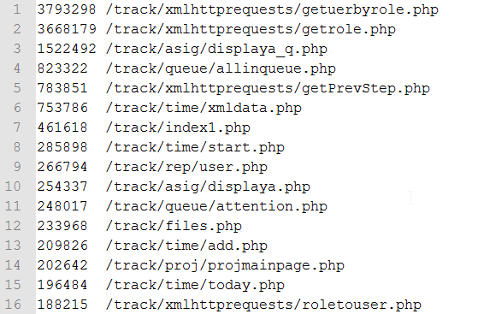
Standard Apache Access Log

Slide 30
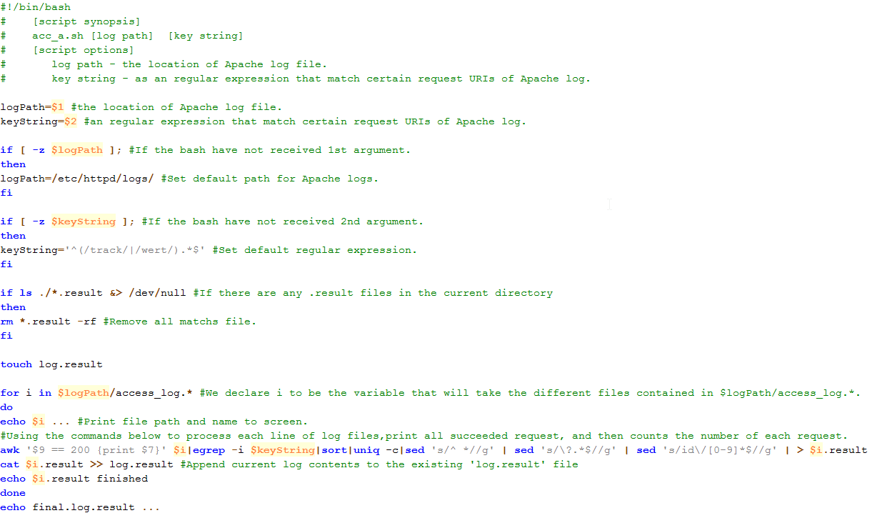
Standard Apache Access Log
Source location: Slide_code_source/slide_page_30/acc_a.sh

Slide 31
Part 4: References

Slide 32




FREE Books! You Can Get It All !!!
Books 24 × 7
https://bluepages.ibm.com/password/vendor/auth/login.wss?code=ibmlearning_books24x7

Slide 33


SHELL references

Slide 34
where There is a shell,
There is a way.

Slide 35
o

