Slide 1

Urban Pulse
Presenting Today: KPI Definition Document

Slide 2

What is a KPI? Definition & Purpose
Core Definition
The Five Properties of a Valid KPI
A Key Performance Indicator (KPI) is a quantifiable metric used to evaluate the success of an organization, project, or activity against defined objectives. KPIs translate complex operational realities into measurable, actionable signals — not passive reporting artifacts, but decision-making instruments.
In Urban Pulse, every KPI includes its business question, formula, source data columns, and explicit assumptions — ensuring full transparency over the Delhi dataset inventoried on Day 2.
Specific
Measurable
Tied to a clearly defined business question or outcome — not a generic metric.
Calculated from a documented formula using traceable source data columns.
Actionable
Time-bound
Drives decisions — not just reporting. Every KPI maps to an operational lever.
Evaluated over a defined period or threshold — scoped to available data windows.
Contextual
Interpreted alongside assumptions, data limitations, and benchmarks — never in isolation.

Slide 3
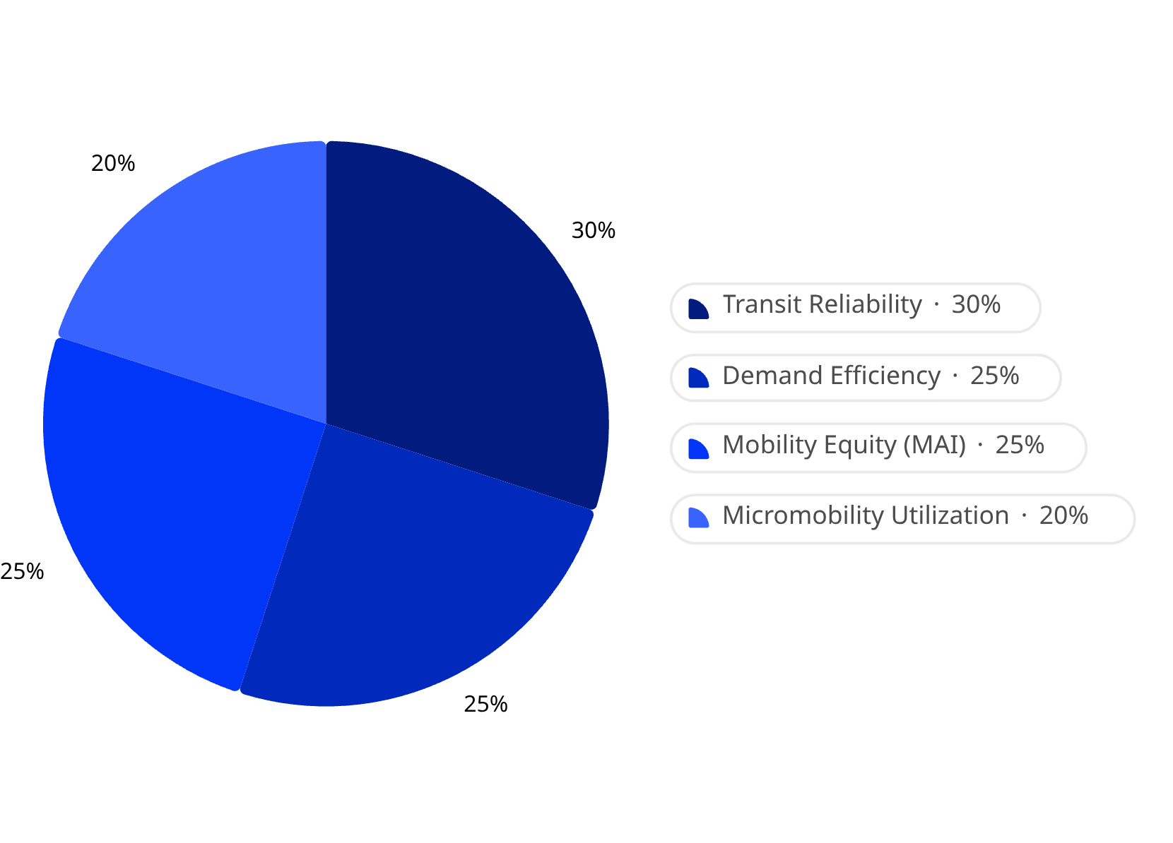

Urban Pulse KPI Framework Overview
Framework Architecture
Module Weight in City Mobility Health Score
4 KPI Modules
1 Executive Composite
Transit Reliability · Demand Intelligence · Micromobility · Mobility Equity
City Mobility Health Score — normalized 0–100 scale for the executive dashboard
Data Sources
Dataset
Module
Delhi GTFS Feed (DIMTS + DTC)
Transit Reliability
delhi_traffic_features.csv
Demand Intelligence
Bike-Sharing.zip (day.csv, hour.csv)
Micromobility
Delhi_Demographics.xlsx
Mobility Equity (MAI)
Key constraint: Several datasets are proxies or partial — all limitations are explicitly documented per KPI, not hidden.
Transit Reliability carries the highest weight at 30%, reflecting the primacy of scheduled public transit in Delhi's mobility ecosystem. Demand Efficiency and MAI are equally weighted at 25% each, while Micromobility contributes 20% as an emerging mode.

Slide 4


Transit Reliability KPIs
MODULE 1 OF 4
WEIGHT: 30% OF CITY MOBILITY HEALTH SCORE
Source: Delhi GTFS feed (DIMTS + DTC) — routes.txt, trips.txt, stops.txt, stop_times.txt, calendar.txt.
KPI
Formula
Source Columns
Schedule Adherence %
COUNT(trips within ±tolerance) ÷ COUNT(all trips) × 100
stop_times.txt, trips.txt
Headway Variance
STDEV(gap between consecutive scheduled arrivals) at same stop_id per route
stop_times.txt, stop_id, route_id
Route Coverage
COUNT(DISTINCT stop_id served) ÷ 10,560 total city stops
stops.txt, stop_id
Avg Trip Frequency (load proxy)
COUNT(trips) ÷ COUNT(DISTINCT service days) per route_id
trips.txt, calendar.txt, route_id
The GTFS feed is a STATIC schedule — no real-time or actual arrival data exists. Schedule Adherence and Headway Variance are modeled using simulated variance around the static schedule. These are clearly labeled as estimation techniques, not measured real-world delays.

Slide 5

Demand Intelligence KPIs (Ride-Hailing Proxy)
MODULE 2 OF 4
WEIGHT: 25% OF CITY MOBILITY HEALTH SCORE
Source: delhi_traffic_features.csv joined to delhi_traffic_target.csv on Trip_ID — 4,000 Delhi trips across 25 named areas.
KPI
Formula
Grouping / Source Columns
Avg Travel Time (by area pair)
AVERAGE(travel_time_minutes)
start_area, end_area
Demand by Zone
COUNT(trips)
start_area
Speed Efficiency
AVERAGE(average_speed_kmph)
road_type, traffic_density_level
Weather Sensitivity
AVERAGE(travel_time_minutes)
weather_condition
Peak vs Off-Peak Demand
COUNT(trips)
time_of_day (Morning / Afternoon / Evening / Night)
Dataset Scope
Critical Data Gap
This Delhi trip-level dataset covers origin/destination area, distance, average speed, and travel time across 4,000 trips spanning 25 named Delhi areas. It serves as the ride-hailing and demand proxy in the absence of a proprietary ride-hailing dataset.
No fare or price column exists in the dataset. Any fare-elasticity KPI requires an assumed fare model layered on top of distance and time — this assumption must be explicitly declared in all reporting.

Slide 6

Micromobility KPIs (Bike-Share Proxy)
MODULE 3 OF 4
WEIGHT: 20% OF CITY MOBILITY HEALTH SCORE
Source: Bike-Sharing.zip (day.csv, hour.csv) — structurally the public Capital Bikeshare (Washington D.C.) dataset, used as a Delhi structural stand-in.
KPI
Formula
Source Columns
What It Measures
Utilization Rate
AVERAGE(cnt)
season, weathersit, hr
Seasonal/weather/hourly ride volume patterns
Casual vs Registered Ratio
SUM(casual) ÷ SUM(registered)
workingday, casual, registered
Commuter vs. leisure demand split
Weather Impact on Rides
AVERAGE(cnt)
weathersit (1–4 scale)
Sensitivity of ridership to weather conditions
Peak Usage Hour
MAX(AVERAGE(cnt))
hr (0–23)
Hour of day with highest average ridership
This dataset contains NO station IDs or GPS coordinates — it is aggregate ride counts only. KPIs measure utilization patterns (seasonal, weather, hour-of-day behavior), not real Delhi station-level rebalancing. All charts derived from this module must be labeled as illustrative/proxy in the final report.

Slide 7

Mobility Equity KPI — Mobility Access Index (MAI)
MODULE 4 OF 4
WEIGHT: 25% OF CITY MOBILITY HEALTH SCORE
MAI Formula
Data Quality Issues — Action Required
MAI = (Transit Stop Density × 0.4) + (Inverse Avg Travel Time to Key Hubs × 0.4) – (Population Density Penalty × 0.2)
Missing Income Data
Delhi_Demographics.xlsx contains no income field. MAI is therefore scoped as a transit accessibility index only — full socioeconomic equity scoring is out of scope for this sprint.
A weighted composite score (0–100) per district measuring transit accessibility. Scoped as a Transit Accessibility Index — not a full socioeconomic equity index — due to the absence of income data in Delhi_Demographics.xlsx.
Component Breakdown
Duplicated Population Figures
Component
Weight
Formula
Population columns are currently duplicated identically across every district row — flagged as a data-quality issue on Day 2. Must be corrected during Day 9 cleansing before MAI is calculated.
Transit Stop Density
40%
COUNT(stops in district via lat/lon bucketing) ÷ Area_sq_km
Inverse Avg Travel Time to Key Hubs
40%
AVERAGE(travel_time_minutes) from district areas to hubs (CP, AIIMS, etc.)
Geo-Bucketing Required
Stop density calculation requires lat/lon bucketing of GTFS stop coordinates to district boundaries — a spatial join step to be executed in the data pipeline.
Population Density Penalty
20%
Normalized Population_Density_per_sq_km (corrected post Day 9 cleansing)
Demographics population figures are duplicated per district — MAI cannot be calculated until Day 9 data cleansing is complete.

Slide 8
Executive KPI: City Mobility Health Score & Key Assumptions
Composite Score Formula
Critical Assumptions & Limitations
City Mobility Health Score = (Transit Reliability × 30%) + (Demand Efficiency × 25%) + (MAI × 25%) + (Micromobility Utilization × 20%)
Assumption Area
Limitation
Risk Level
Schedule Adherence
Simulated — no real-time GTFS feed available
High
A single composite score (0–100) for the executive dashboard combining all four module scores. Each sub-score must be normalized to a 0–100 scale before weighting so that no single module dominates due to differing raw ranges.
Ride-Hailing KPIs
General Delhi trip dataset as proxy — no fare data for elasticity metrics
Medium
30%
Bike-Share KPIs
Washington D.C. Capital Bikeshare data as structural stand-in for Delhi
High
Transit Reliability
Highest weight — core public transit system
Weather KPIs
Weather data covers Jan–Jun 2025 only — scoped to this window
Medium
25%
Demographics / MAI
Income data absent — MAI reflects transit accessibility only, not full equity
High
Demand Efficiency
Ride-hailing proxy dataset
25%
MAI Score
Mobility Equity / Accessibility
20%
Micromobility
Bike-share proxy dataset

Slide 9
Summary — Day 3 Deliverable
KPI DEFINITION COMPLETE
DAY 3 OF PROJECT SPRINT
What Was Defined Today
1
KPI Definition Framework
2
4 KPI Modules Documented
A KPI is a quantifiable, formula-driven metric tied to a specific business question — not just a number, but a decision-making tool. Every Urban Pulse KPI includes its formula, source columns, and explicit assumptions.
Transit Reliability, Demand Intelligence, Micromobility, and Mobility Equity (MAI) — each with fully documented formulas and source data columns traceable to the Day 2 dataset inventory.
3
Executive Composite Score
4
Data Transparency Protocol
City Mobility Health Score (0–100): Transit Reliability 30% + Demand Efficiency 25% + MAI 25% + Micromobility 20%. All sub-scores normalized before weighting.
All proxy datasets and data limitations are explicitly flagged at the KPI level — no metric hides its assumptions. Proxy-based charts will be labeled illustrative in the final report.

Slide 10
Sources
30b4af51-b2c2-4e07-8248-814506bf7453.pdf

